Slide 1
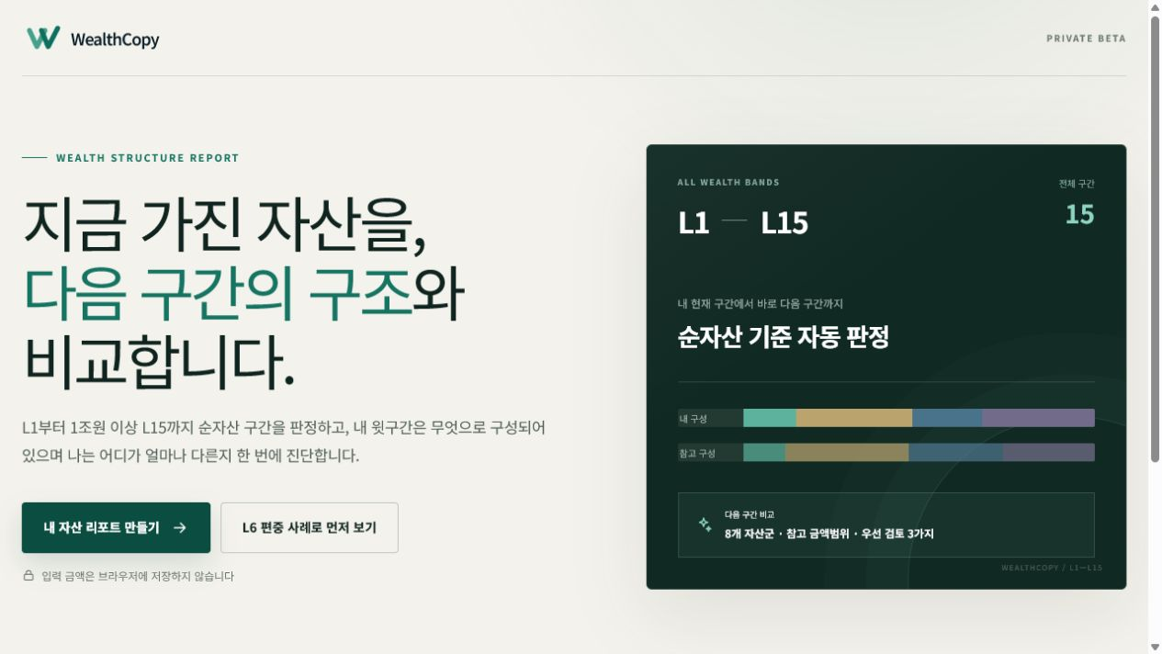
W
WealthCopy
OPENAI BUILD WEEK 2026
See the next wealth band. Know the structural gap.
A privacy-first wealth structure report across L1–L15.
Built with GPT‑5.6
Live on Google Cloud Run
LIVE PRODUCT
L1 → L15 · next-band comparison
wealth-copy-470320899177.asia-northeast3.run.app
WEALTHCOPY · OPENAI BUILD WEEK 2026
01 / 06

Slide 2
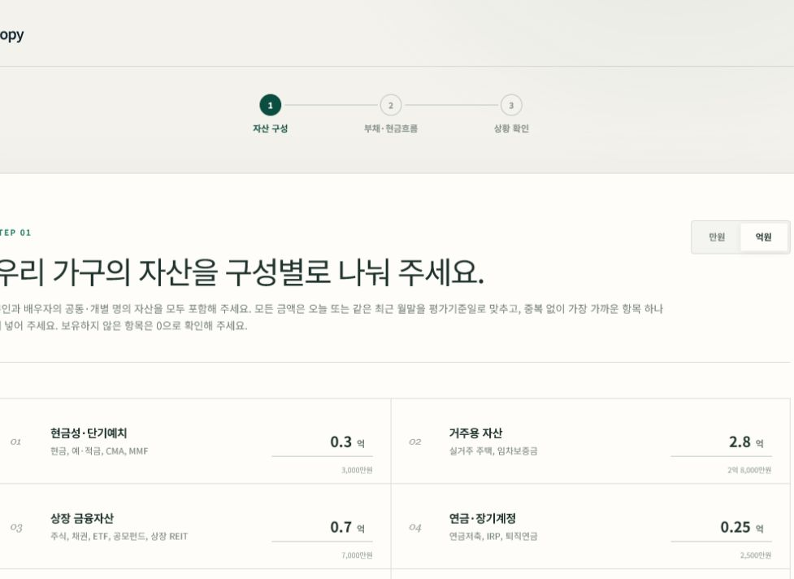
01 / PROBLEM → PRODUCT
Most wealth tools return a balance. WealthCopy returns a next-band report.
01
Locate
8-GROUP INPUT
Automatic L1–L15 band from household net worth
02
Compare
Eight asset groups against the next-band reference
03
Prioritize
Safety → three adjustments → a 12-month route
No product picks. No progress theater. One connected report.
WEALTHCOPY · OPENAI BUILD WEEK 2026
02 / 06

Slide 3
02 / ARCHITECTURE
Deterministic financial truth. GPT‑5.6 explanation orchestration.
The model never owns amounts, levels, safety rules, or free-form financial advice.
01
02
03
04
HOUSEHOLD INPUT
DETERMINISTIC ENGINE
GPT‑5.6 ORCHESTRATOR
SERVER-MAPPED REPORT
8 asset groups Debt · income · expenses 90-day event
→
→
→
L1–L15 classification Cash-flow & risk gates Composition gap
Chooses 4 allowlisted IDs Lead · order · connection · frame Categorical signals only
Approved Korean copy 3 priorities 12-month route
FAIL CLOSED
Invalid, missing, or context-unsafe model output returns the deterministic report.
WEALTHCOPY · OPENAI BUILD WEEK 2026
03 / 06

Slide 4
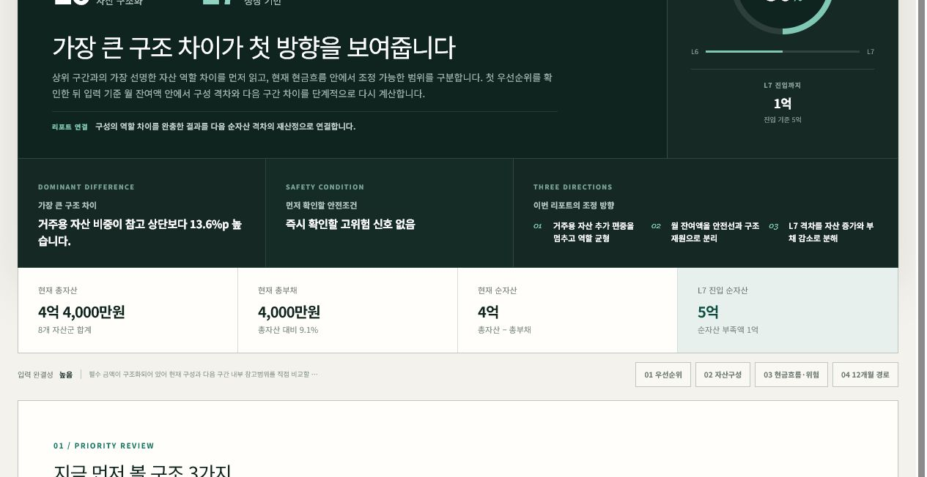
03 / ACTUAL SAMPLE
A KRW 400M household sees more than a KRW 100M gap.
L6 → L7
50%
through the current band
KRW 100M
remaining to L7
+13.6pp
primary residence vs. the next-band reference ceiling
Sample input: KRW 440M assets − KRW 40M debt = KRW 400M net worth. Internal diagnostic ranges, not market forecasts.
WEALTHCOPY · OPENAI BUILD WEEK 2026
04 / 06

Slide 5
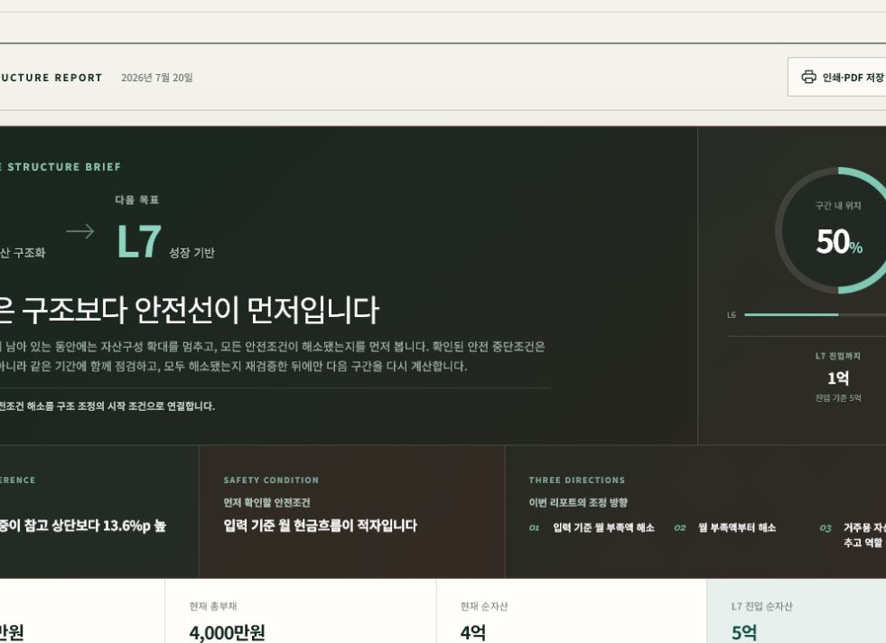
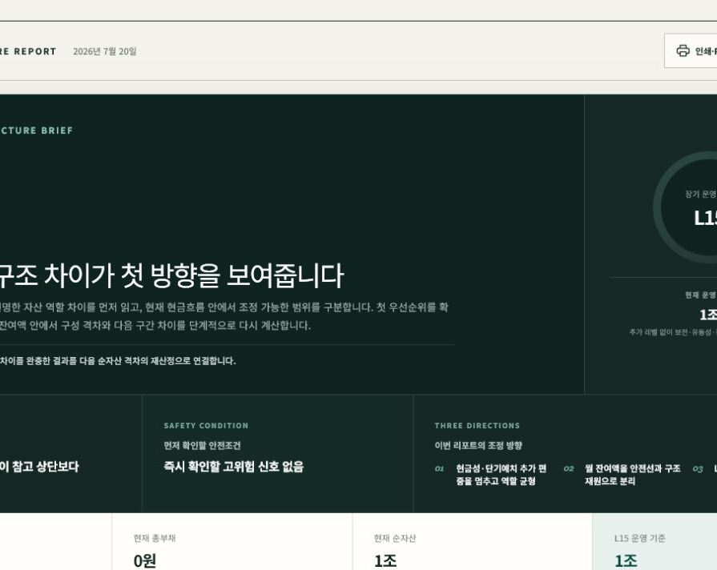
04 / SAFETY & EVIDENCE
Financial claims stay bounded, private, and testable.
SAFETY FIRST
PRIVACY BOUNDARY
A monthly deficit changes the route.
Exact amounts, ratios, levels, and notes never reach GPT‑5.6.
Liquidity and debt conditions come first.
• No financial input in localStorage • Session-only before/after comparison • Invalid model output → deterministic fallback
VERIFIED
L15 IS TERMINAL
54
15
8
No fictional L16. The report shifts to governance.
tests passing
wealth bands
asset groups
Strict wealth-report-v2 · live Cloud Run smoke verified
WEALTHCOPY · OPENAI BUILD WEEK 2026
05 / 06

Slide 6
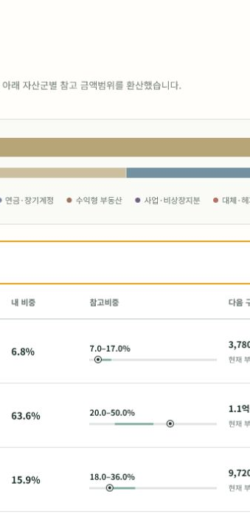
L1 → L15
W
WealthCopy
LIVE SESSION
Make the next wealth structure clear.
Open the product, run the L6 sample, then edit one variable to watch the report reconnect.
LIVE PRODUCT
wealth-copy-470320899177.asia-northeast3.run.app
Built with GPT‑5.6 · Deployed on Google Cloud Run · 54 tests passing
WEALTHCOPY · OPENAI BUILD WEEK 2026
06 / 06

