Slide 1
MouseTrack
An animal colony management system
Notes:
Today, I am going to talk to you about a project that I am working on which will enable biomedical researchers to maintain and track their animal records.
Biology labs working with mice maintain hundereds to thousands of mice.

Slide 2




Why MouseTrack?
Strain A
Strain B
BC-1
BC-2
BC-3
BC-4
1
2
3
4
5
6
7
8
Wean
Wean
Wean
Wean
9
10
11
13
14
15
16
17
18
19
20
21
22
BC-5
BC-6 - 19 X 20
14
18
Wean & breed
BC-5 - 14 X 18
BC-6
Wean
Strain A
BC-2 - 3 X 4
Strain B
BC-3 - 5 X 6
19
20
21
22
23
Notes:
Just to give you a feel for how colony management works, I will show you a simplified cartoon. Lets say a lab has two types of mice (Strain A and B) . Some of the mice are breeders and the pups weaned from these breeders are used for experiments. The research would want to keep track of which pup came from which breeder and he may want to get reminders for specific tasks.
Currently the way most people maintain their records is by entering all the information in a spreadsheet.
While a spreadsheet is usually enough to store data, it is not easy to track history of a given animal or to get email reminders.

Slide 3
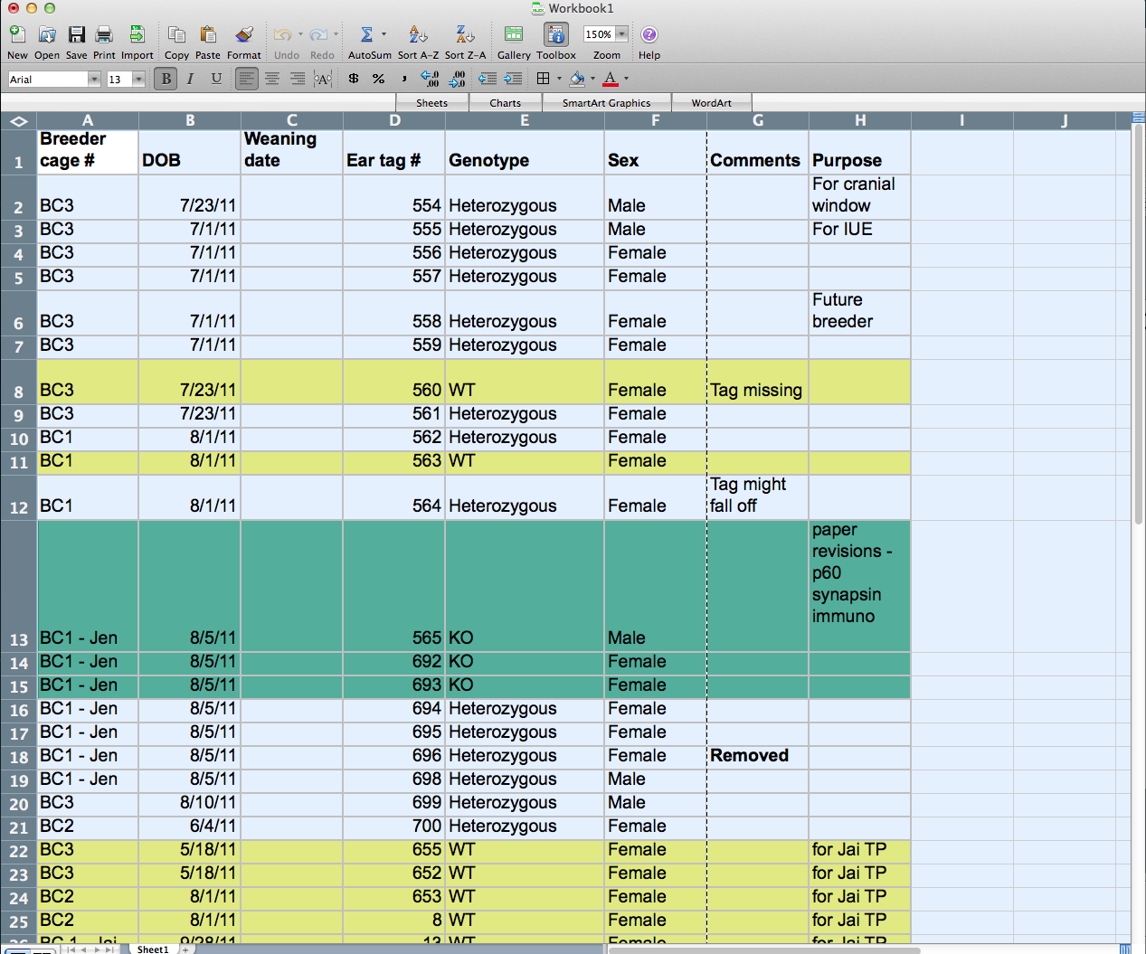
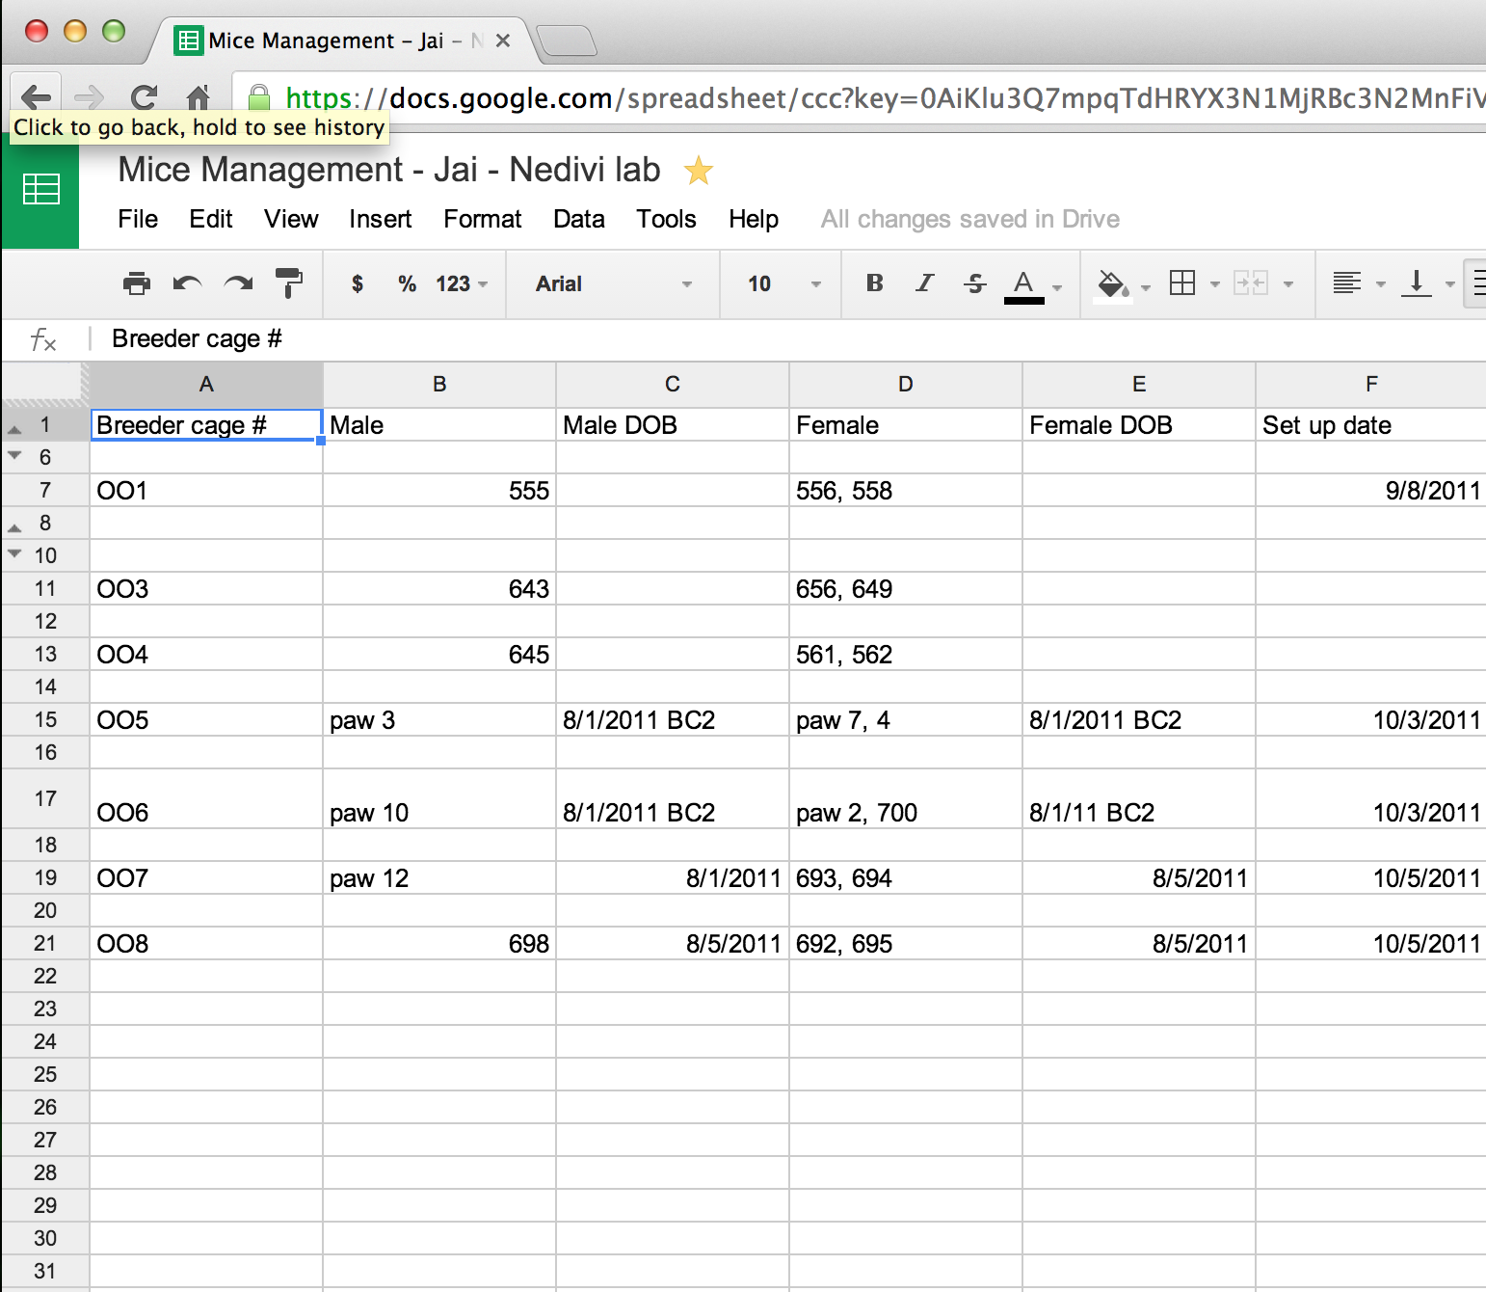
Current solution
Notes:
This is a sample of how a researcher might store his data. Notice he needs to color code them in order to distinguish/track. He needs multiple spreadsheets for breeders and experimental animals. My project is about creating a better solution for an otherwise cumbersome process.

Slide 4
A better solution
Create Database
Input to database
Search database
Edit database
Email reminder
Linking databases to allow tracking
Notes:
This would require..

Slide 5
Create database
To store/retreive data, a database is needed. I used SQLalchemy and here is how I setup a database.
flask.ext.sqlalchemy import SQLAlchemy
app = Flask(__name__) app.config['SQLALCHEMY_DATABASE_URI'] = 'sqlite:////tmp/test.db' db = SQLAlchemy(app)
class Breeding(db.Model):
__tablename__ = 'Breeding'
Breeding_Cage_Id = db.Column(db.String(100),primary_key=True)
Male_Tag = db.Column(db.String(100))
..
def __init__(self,Breeding_Cage_Id,Male_Tag..) :
self.Breeding_Cage_Id = Breeding_Cage_Id
self.Male_Tag = Male_Tag
..
def __repr__(self):
return "<Breeding(%s, %s, …>" % (self.Breeding_Cage_Id, self.Male_Tag,..)
To create the initial db, ran this : db.create_all()

Slide 6
Input to database
→ Creating the Flask view, with a get and a post method, to be able to get the inputs from user and then commit to database.
class add_breeding_info(flask.views.MethodView):
@utils.login_required
def get(self):
return flask.render_template('add_breeding_info.html')
@utils.login_required
def post(self):
input1 = Breeding(flask.request.form['bc'],
flask.request.form['maletag'],
..)
db.session.add(input1)
db.session.commit()
flask.flash("The Breeding info has been successfully added")
return flask.redirect(flask.url_for('add_pups_info'))
Based on birth of pups, the program would calculate their corresponding weaning date like this :
datetime.date(*map(int, pups_born_date.split('-'))) + datetime.timedelta(days=21)
This value calculated will be inserted into the field weaning_date of that table for that particular breeding cage. This would be handy when we need to figure out the email reminder aspect of the project.

Slide 7
Search database
→ Search of the data entered is critical. The query from db was done by using ‘filter_by’ primary key. In addition to retrieval some formatting was also needed to display in readable format.
class search_breeding_info(flask.views.MethodView):
__table__ = Breeding
@utils.login_required
def get(self):
return flask.render_template('search_breeding_info.html')
@utils.login_required
def post(self):
search_dict = {}
search_list = []
item = flask.request.form['bc']
__table__ = Breeding
search = __table__.query.filter_by(Breeding_Cage_Id = item).all()
if len(search) == 0:
flask.abort(404)
else:
for result in search:
search_dict = dict((col,getattr(result,col)) for col in result.__table__.columns.keys())
search_list.append(search_dict)
return flask.render_template('search_breeding_info.html', search_list=search_list, search_dict=search_dict)
→ I also added a Delete option incase of wrong entries, but I plan to modify that to an Edit instead.

Slide 8
Email reminder
1. Setup the Flask-Mail
2. In the program, query the database and retrieve all the rows (that were added by user earlier) that match the criteria
First_Date_of_weaning=date.today().
However, this function will only be called based on a time-based job scheduler called CRON, that is set to run at a specific time during the
day, every day.
def weaning_reminder():
….
first_output = __table__.query.with_entities(__table__.Pups_Breeding_Cage_Id).filter_by(First_Date_of_weaning=date.today()).all()
….
first_msg = Message('First weaning reminder!',
sender='itraa.narayan@gmail.com.com',
recipients=['itraa.narayan@gmail.com'])
first_msg.body = 'This is the first reminder for weaning pups from the breeding cage(s): %s' % first_email_list
mail.send(first_msg)
3. So, if say at 5am everyday, the cron scheduler calls the weaning_reminder function and if a row is returned, the list will get populated and
then the email will get sent with information about the cage id.
sched = Scheduler()
sched.start()
job = sched.add_cron_job(weaning_reminder, hour=5)

Slide 9
Updates and Modifications:
Included strain database
Created a Mice list in order to track lineage
These made Breeding/pups database simpler and easier
Drop downs populated on the forms in order to make it more user friendly
Mice id, Cage id’s etc also populated through internal queries for the same user friendly reason
Pending:
More linking between databases to track lineage
Styling the forms
Search output to be in editable format
Edit/Update instead of Delete
Notes:
What I have shown you so far is useful to a certain extent for colony management system, but given the complexity it is clearly not enough. So to expand the usefulness of this application, I have been making many changes such as:
1. The ability to relate databases.
5. In the earlier version, the user has to type in the required information every single time. With the updates I am working on, the user can choose from a his/her previous inputs.

Slide 10
THANK YOU!
Notes:
I would like to thank the mentors: Dean, Miguel and Chris for all their help. I also want to thank Mengtan and BSS for organizing the course. Finally I would also like to thank my cohort for their support.

