Slide 1

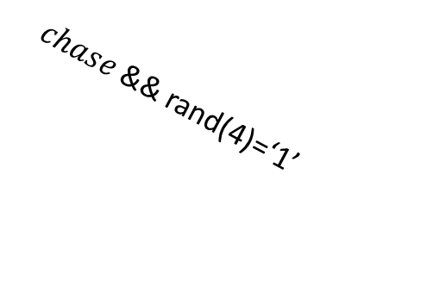
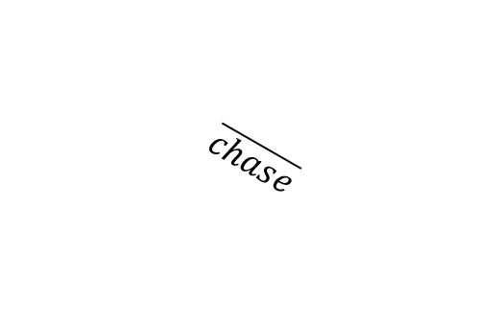






Start
EN=1
$$allowedToMove$$
Rand speeds
EN=1
$$\overline{chase}$$
Move
EN=1
$$chase$$
$$\overline{allowedToMove}$$
$$\overline{chase}$$
$chase$&& rand(4)=‘1’
$$\overline{chase}$$
Chase Mario
EN=1
$chase$&& rand(4)=‘0’
Idle
EN=1
Chase Luigi
EN=1
$$\overline{IENABLE}$$
DEAD
EN=0

Slide 2
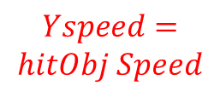





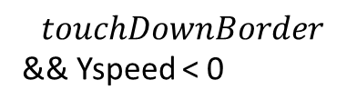




$$Yspeed=$$
$$Yspeed−gravity$$
hitObj
$$Yspeed<0$$
$$\&\& hitObj$$
On object
$$upKeyPressed$$
(Ypeed=JumpSpeed )
jump
On object
Idle
$$Yspeed=$$
$$hitObj Speed$$
$$touchDownBorder$$
&& Yspeed < 0
$$Yspeed=0$$
$$\overline{hitObj}$$
$$upKeyPressed$$
(Ypeed=JumpSpeed )
$$Yspeed>0$$
$$\&\& hitObj$$
$$\overline{hitObj}$$
Bump from object
hitObj
$$Yspeed=$$
$$Yspeed−gravity$$

Slide 3

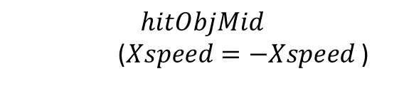
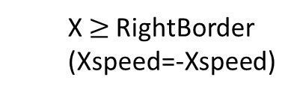
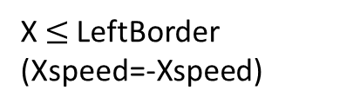
right
$$Xspeed=min⁡( Xspeed+1,XmaxSpeed)$$
Normal, Xspeed>0
left
right
hitObjMid
Normal, Xspeed=0
$$hitObjMid$$
($Xspeed=−Xspeed$)
X $≤$LeftBorder
(Xspeed=-Xspeed)
BumpFromObject
X $≥$RightBorder
(Xspeed=-Xspeed)
left
right
$$\overline{hitObjMid}$$
left
Normal, Xspeed<0
Transition according to X speed
$$Xspeed=max⁡( Xspeed−1,−XmaxSpeed)$$

