Slide 1


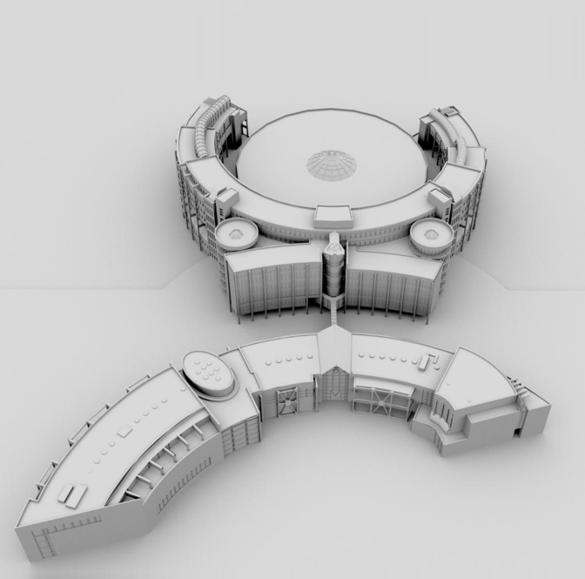

GPE Project
GPE 2025 Presentation
Lecturer: Valentin Eingartner
Felix von Amelunxen
Group 1:
No. | Full Name | Email
1 | Trần Thiên Nga | 20725017@student.vgu.edu.vn
2 | Lê Thị Vân Anh | 20725024@student.vgu.edu.vn
3 | Phạm Hoài Thương | 20725016@student.vgu.edu.vn
4 | Lê Văn Đông | 20725002@student.vgu.edu.vn
5 | Võ Sỹ Hùng | 20725018@student.vgu.edu.vn
6 | Ngô Hoàng Quân | 20725003@student.vgu.edu.vn
7 | Trần Việt Tùng | 20724041@student.vgu.edu.vn

Slide 2

Whisk3S — First Concept
A modular open-source handheld kitchen mixer and milk frother
FIRST DRAFT IDEA
Short product description
Compact handheld kitchen device
Designed for mixing food and foaming milk
Uses interchangeable attachments
Rechargeable and easy to use
3S principle
Simple · Sustainable · Serviceable
One device · multiple kitchen tasks · less equipment
Concept stage: final design, materials and technical specifications are not fixed yet.
GPE Project 2026/27 — Open Source Hardware for a Circular Economy
VGU
1

Slide 3
Why Whisk3S Fits the Project
Project fit without fixing the final technical design
Why suitable for Open Circular Design?
Circular
Modular
Repairable concept
Replaceable parts
Longer product life
One device platform
Interchangeable tools
Future upgrades
Open Source
Reproducible
CAD files
BOM
Assembly instructions
Food-Grade PP molded parts
Standard parts & simple assembly
visual direction only — final design not fixed
Current design status: Handheld platform designed for thin-wall Food-Grade Polypropylene (PP, Code #5) injection molding, saving 45% resin to eliminate brittleness and guarantee food-contact hygiene (EU 10/2011 & FDA).
This slide intentionally avoids detailed internal breakdown because Whisk3S is still a first concept.
GPE Project 2026/27 — Open Source Hardware for a Circular Economy
VGU
2

Slide 4

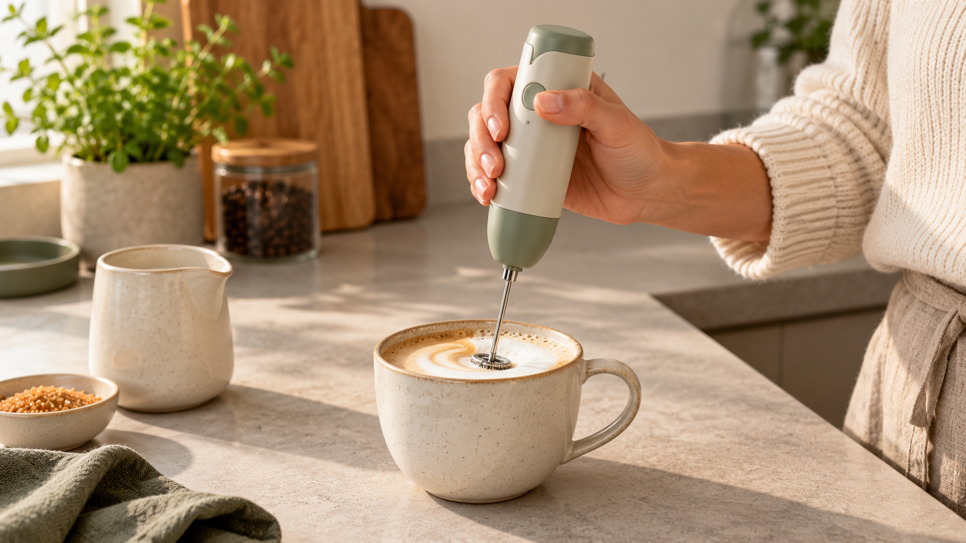
Functionality Analysis
Main functions, sub-functions and optional functions
Main functions
Mix food
Foam milk
Sub-functions
Supply
power
Generate
rotation
Control
speed
Transmit torque to attachment
Hold/change
attachment
Act on
food or milk
Must-have
Optional
mixing · foaming · speed control
safe attachment · rechargeable power
additional attachments · charging dock
battery indicator
Applications such as beating eggs or frothing coffee are use cases; sub-functions describe what the device must technically do.
GPE Project 2026/27 — Open Source Hardware for a Circular Economy
VGU
3

Slide 5
Preliminary Requirement List
Initial requirements for the first concept
Area
Preliminary requirement
Should
Function
Mixing + milk foaming
compact · one-hand use
non-brittle Food-Grade PP · standard fasteners · replaceable wear parts
Modularity
Interchangeable tools
Control
Adjustable speed
Power
Rechargeable operation
Safety
Secure rotating parts
Could
Cleaning
Food-contact parts: Dishwasher-safe Food-Grade PP & 304 stainless
charging dock · extra tools
alternative materials · community add-ons
Repair
Easy to disassemble
Open Source
CAD + BOM + instructions
Manufacturing
Thin-wall injection mold (Food-Grade PP, 45% resin saving)
Requirements are preliminary and will be refined after feasibility review and testing.
Cost
Below €200
The requirement list avoids fixed technical choices at this early stage.
GPE Project 2026/27 — Open Source Hardware for a Circular Economy
VGU
4

Slide 6
GPE Project 2026/27 — Open Source Hardware for a Circular Economy
Circular Economy: The R-Strategies Framework
Operationalizing Open Circular Design: How OpenWhisk 3S applies R0 to R8 to eliminate small kitchen appliance waste
R0 · REFUSE
Từ chối lãng phí
R2 · REDUCE
Tiết giảm vật liệu
R3 · REUSE
Tái sử dụng
R4 · REPAIR
Dễ dàng sửa chữa
R8 · RECYCLE
Tái chế tuần hoàn
• Refuse single-use AAA batteries (eliminating toxic chemical disposal).
• Refuse permanent ultrasonic welding & toxic glues.
• Refuse non-replaceable soldered batteries.
• Resin Saving via thin-wall mold (modling R&D)
• Minimalist part count: custom parts (saving of components ratio).
• Prototype BOM cost only around 21.30 - 25 €.
• Standard 18650 Li-ion cell (allows reusing cells from old laptops/e-bikes).
• Standard Mabuchi FF-180SH micro-motor (readily swappable across devices).
• Modular desktop dock doubles as desk organizer.
• 10-Second Battery Swap: twist-off cap + solderless nickel spring contacts.
• Single-Tool Teardown in <3 mins using only 1 standard PH1 screwdriver.
• Sacrificial drive collet reprints in 20 mins for 0.15 €.
• 100% Mono-Material: Food-Grade Polypropylene (PP, Code #5 ♷).
• Embossed >PP< mark for single-stream mechanical recycling.
• Zero composite plastics; clean separation of metal, lithium, and plastic.
CIRCULAR TAKEAWAY (TÁC ĐỘNG TUẦN HOÀN CỐT LÕI):
Conventional kitchen frothers end up in landfills due to ultrasonically welded casings and dead batteries. OpenWhisk 3S tackles the EU WEEE electronic waste stream by isolating wear parts, enabling non-destructive repair with 1 tool, and closing the material loop with 100% recyclable Food-Grade Polypropylene.
GPE Project 2026/27 — Open Source Hardware for a Circular Economy
VGU
3

Slide 7
OpenWhisk 3S: 1-Month Project Plan
October 04 – November 08, 2026 · Phase 1 sprint to M3 design freeze & repository swap
Work package
W1
Oct 04–11
W2
Oct 12–18
W3
Oct 19–25
W4
Oct 26–Nov 01
W5
Nov 02–08
1. Project management + platform (Vân Anh)
2. Sourcing & BOM Costing (Thiên Nga)
3. Mechanical CAD & DfIM (Tùng & Quân & Đông & Hùng)
4. Mold Dev. & Test (Hùng & Tùng & Quân & Đông)
5. Docs & Assembly Manual (Thương & Vân Anh)
6. Compliance QA (Thiên Nga & Thương)
★ M2 Review (Vân Anh & Nga)
★ M3 Repo Swap Handover (Whole Team)
Key milestones
M1 — 04.10
M2 — 25.10
M3 — 08.11
Plan & Req. locked (Passed)
Feasibility, DfIM & CAD
Design Freeze & Repo Swap
CERN-OHL-S-2.0 open hardware · Food-Grade Polypropylene (PP, Code #5, EU 10/2011) mold design saving 45% resin.
GPE Project 2026/27 — Open Source Hardware for a Circular Economy
VGU
5

Slide 8
GPE 2026/27 · OPEN SOURCE HARDWARE FOR A CIRCULAR ECONOMY · GROUP 1
OpenWhisk 3S: Executive 1-Month Gantt Chart (Simplified)
Phase 1 Sprint (Oct 04 – Nov 08, 2026) · Grouped Overall Work Packages, Tailored Leads & Material Milestones
# | Overall Work Package | Lead Owner | W1 04–11 Oct | W2 12–18 Oct | W3 19–25 Oct | W4 26 Oct–01 Nov | W5 02–08 Nov | Key Deliverable
1 | Product Strategy & VDI 2221 Requirements, platform (3S Principle, Feasibility Pitch & Vision) | Lê Thị Vân Anh Lê Văn Đông | ACTIVE |  |  |  |  | Requirements List, Vision Doc & Platform, Pitch
2 | Component Sourcing & BOM Costing (Motor 180, 18650 Cell & QA Compliance) | Trần Thiên Nga (QA Lead) | VE | ACTIVE |  |  |  | BOM & QA Certificate
3 | Mechanical 3D CAD & DfIM Interfaces (Ergonomic Shells, Dock & Quick Collet) | Trần Việt Tùng Ngô Hoàng Quân | ACTIVE ACTIVE |  |  |  |  | Free CAD Assembly, Files & Renders
4 | Mold Development & Testing (Food-Grade PP, Thin-Wall & Load Tests) | Võ Sỹ Hùng (Testing Lead) | ACTIVE |  |  |  |  | Mold flow Simulation & Benchtop Logs
5 | Technical Docs & Assembly Manual (Public GitHub Architecture & Guides) | Phạm Hoài Thương (Docs Lead) | ACTIVE |  |  |  |  | Illustrated Assembly Guide & Public Repo
6 | Milestone Delivery & Peer Handover (Reviews & Partner Swap Handover) | Whole Team | ★ M1 |  | ★ M2 |  | ★ M3 | M2 Review Pitch & SWAP_HANDOVER.md
MATERIAL SELECTION: Food-Grade Polypropylene (PP, Code #5 / EU 10/2011 & FDA compliant) — Non-brittle & dishwasher-safe.
KEY MILESTONES: ★ M1 (04.10) Plan locked | ★ M2 (25.10) Feasibility & DfIM Review | ★ M3 (08.11) Design Freeze & Swap Handover

