Slide 1
Python LAB
ConDITIONALS
Women Who Code DC

Slide 2
We are Women Who Code!
Women Who Code (WWCode) is global non-profit dedicated to inspiring women to excel in technology careers. We work to support this generation in being and becoming leaders and role models in the tech industry.
We are the DC Chapter!
Volunteer / Donate
Visit our Meetup site
Python Beginners: 1st Wednesday of the Month; Python Lab Night: 3rd Wednesday of the month

Slide 3
After this You will KNOW
Review of Variables and the print command (if needed)
How Conditionals work (if and else statements)
How to cut down your code with the while loop

Slide 4
Variables & Data Types
Variables are containers for information
X = ‘information’
Notice you name your variable something then use the operator = to tell it to store the information that comes after
You can store
Text in the form of a string (data type)
Numbers in the form of an integer (data type) or float (data type)
bread = 2
bread_string = ‘Two slices’
Notice the second bread variable is a string variable type because of the quotation ‘ ‘ marks
3

Slide 5
Print command
Use the print command to show some information to the screen
bread = 2
bread_string = ‘Two slices’
Python 2.7 print bread
Python 3 print(bread)
Python 2.7 print type(bread)
Python 3 print(type(bread))
Now do the same for bread_string
4

Slide 6
Print command CONT…
Lets try to convert the first bread variable to string
bread_st = str(bread)
What happens if we try to convert the second bread variable back to an integer?
bread_int = int(bread_string)
Or
bread_int = int(bread_st)
Do you see a difference between bread_st and bread_int? Try printing them out and their data types.
Use print type(variablename) for 2.7
Use print(type(variablename)) for Python 3
Remember in Python 3 you have to put the print statements in a parentheses
5

Slide 7
CONDITIONALS
They are IF AND ELSE statements that are used to diagnose True or False.
You use the following operators:
== equal eg: bread == 2
>= greater than or equal to
<= less than or equal to
!= does not equal
6

Slide 8
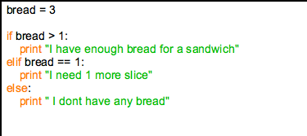
CONDITIONALS CONT
Needs 3 things:
Colon
Indents
Comparison (can use operators)
Optional:
ELIF statements
Else statements
6

Slide 9
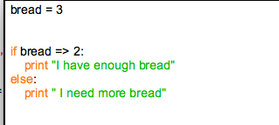
CONDITIONALS
IF AND ELSE statements are used to compare things. True or False?
What is the expected output?
6

Slide 10
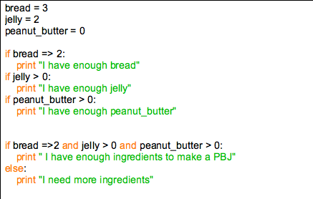
CONDITIONALS
Python reads line by line. What if we had several things to check?
What would be the more efficient code?
6

Slide 11
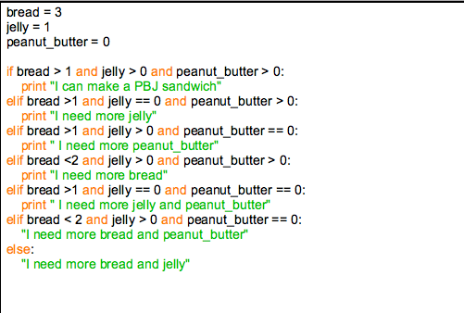
Now Let’s Create a PBJ
How can we write which ingredient we are missing?
Doesn't’t this seem cumbersome and inefficient?
Notes:
Creating and saving variables

Slide 12
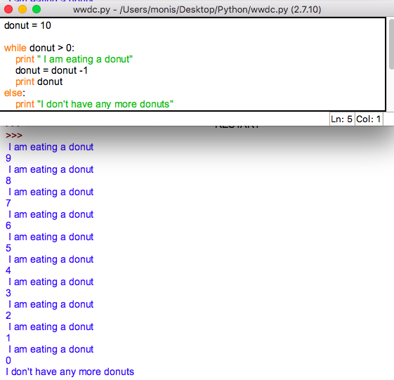
Introducing the while loop
Notes:
Creating and saving variables

Slide 13
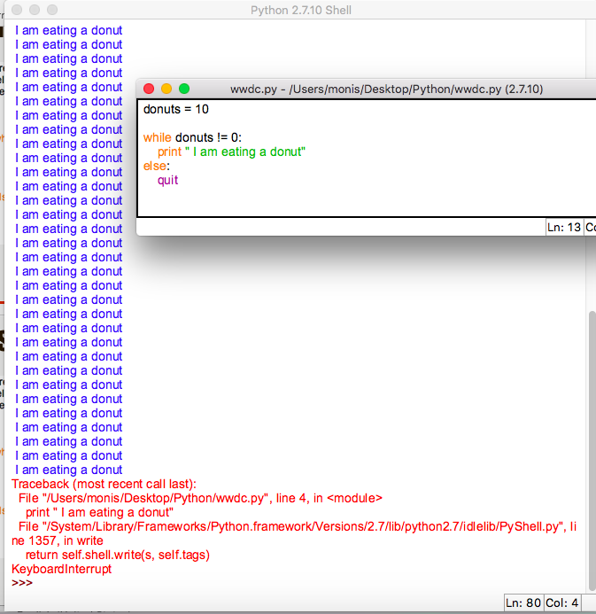
Tip use CTRL + C to kill a program
https://media.giphy.com/media/3u1bKI2ve3G3S/giphy.gif
Notes:
Creating and saving variables

Slide 14
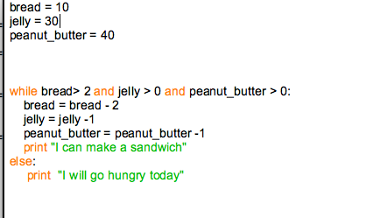
Using The WHILE LOOP for PBJ
Notes:
Creating and saving variables

Slide 15
Even More Advanced
This is for you to read at home. Using while loops with a min function and a format method
https://medium.com/@itrypython/how-i-made-a-pbj-sandwich-with-python-99cb3b0a4923
Notes:
Creating and saving variables

Slide 16
THANK YOU
Notes:
Creating and saving variables

Slide 17
Python Training Resources
In Person:
WWCDC
Hear Me Code
ONLINE
Coursera
HackerRank
StackOverflow
Slack
CodeCombat
GitHub
Kaggle
EDX by microsoft
How to Think Like a Computer Scientist - PDF
Learn Python the Hard Way
Data Camp

Slide 18
Lynda.com via DC library
http://www.dclibrary.org/lynda
Who can get a library card for free?
Maryland
Montgomery, Prince George's
Virginia
Fairfax, Loudoun, Arlington, Prince William, Falls Church, Alexandria, Frederick
Non-residents - $20 a year
19 Python courses and 600+ video tutorials complete with data files to do lessons.

