Slide 1

S
Monica Puerto
WWCD Python Lab

Slide 2
Women Who Code (WWCode) is global non-profit
Dedicated to inspiring women to excel in technology careers.
We work to support this generation in being and becoming leaders and role models in the tech industry.
We are the DC Chapter!
Volunteer / Donate
Visit our Meetup site
Python Beginners: 1st Wednesday of the Month; Python Lab Night: 3rd Wednesday of the month

Slide 3
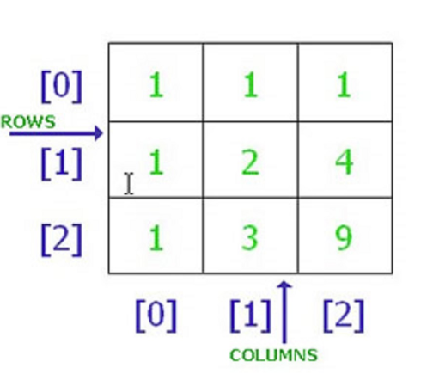
Is this a 2D matrix or a dataframe?
Matrix - are 2D arrays together of same data types
DataFrame - 2D, potentially heterogeneous tabular data structure with labeled axes (rows and columns).
Now what if Column 1 was string versus integers?

Slide 4
Pandas vs NUMPY
Pandas is built on top of Numpy, but Pandas is more sophisticated in terms of data manipulation
numpy consumes (roughtly 1/3) less memory compared to pandas
numpy generally performs better than pandas for 50K rows or less
pandas generally performs better than numpy for 100K rows or more
Notes:
https://github.com/lukaszkm/machinelearningexp/blob/master/DataScience_Performance_Python_Pandas_Numpy.ipynb

Slide 5
Why don’t you use SQL?
pandas is used to take weak relations between various data sources and then strengthens those relations by fitting the clean data into a SQL like data schema. - from a reddit comment
You can use statistics with Pandas
You can write and export out to CSV in Pandas.
*Most people use both because Pandas is limited by Ram size whereas SQL databases are built for housing large amounts of data. I normally query from a relational database and use Pandas to further manipulate/clean the data for machine learning in jupyter notebooks.

Slide 6
http://bit.ly/2wU850i
pip install -r requirements.txt for Python 2
If you have Anaconda you don’t have to do anything you will already have these packages
If you have Python 3 -
pip3 install -r requirements.txt
Notes:
http://bit.ly/2wU850i

Slide 7
PYTHON RESOURCES
ONLINE:
●Coursera
●HackerRank
●StackOverflow
●Slack
●CodeCombat
●GitHub
●Kaggle
●EDX by microsoft
●How to Think Like a Computer Scientist - PDF
●Learn Python the Hard Way
●Data Camp
In Person:
WWCDC (1st & 3rd wed)
Hear Me Code (Once a Month on Saturdays)

