Slide 1
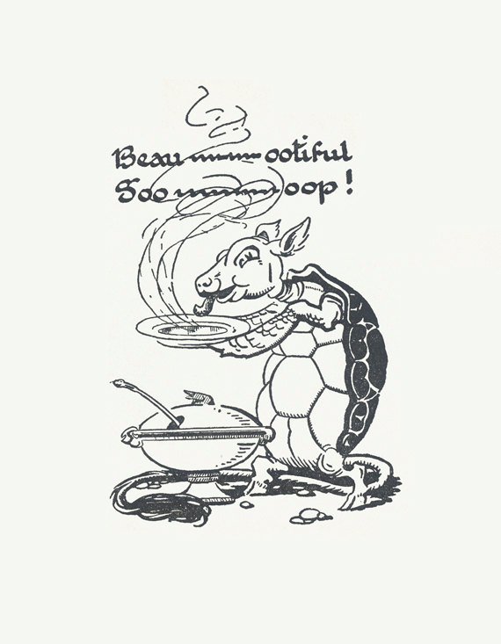
Beautiful Soup

Slide 2
Web Scraping
Extracting information from a website (usually HTML) and parsing it in a readable format (this is called getting soup).
We will be using a package in the Python Library called Beautiful Soup which parses HTML and XML.
Some Best Practices:
Check the Robots.txt to make sure you can web scrape the website. Look for User Agent: *
Scraping too many pages at once quickly can get your IP blocked
Use a browser developer tool to determine the classes of objects (in Chrome you select Inspect)
Use an LXML parser which is faster than HTML parser

Slide 3
Packages Python 3: pip3 install beautifulsoup4
Python 2.7: pip install beautifulsoup4
conda install -c anaconda beautifulsoup4
Dependencies
Install pip only if you don’t have anaconda
Install lxml
Install requests

Slide 4
http://bit.ly/2TbrX8Y

Slide 5
Our Web Scraping Exercise
Check the Robots.txt of IMDB
Save your Python File and import the packages that you need (Beautiful Soup & Requests)
Parse the HTML of 1 url of IMDB of a movie: Monty Python Holy Grail’s IMDB.
Let’s web scrape the Title, Content Rating, Description of this movie
Let’s create a function where we pass through an ID of an IMDB movie to add the previous information we web scraped in the form of a dictionary.

Slide 6
@monipip3 on twitter, medium, github

