Slide 1

Customer Shopping Behavior Analysis
Uncovering insights from 3,900 transactions across product categories to guide strategic business decisions.

Slide 2

Dataset at a Glance
Key Features
Demographics: Age, Gender, Location, Subscription
Purchases: Item, Category, Amount, Season
Behavior: Discount, Frequency, Review Rating
3,900
37
Rows · 18 columns
Missing review ratings

Slide 3
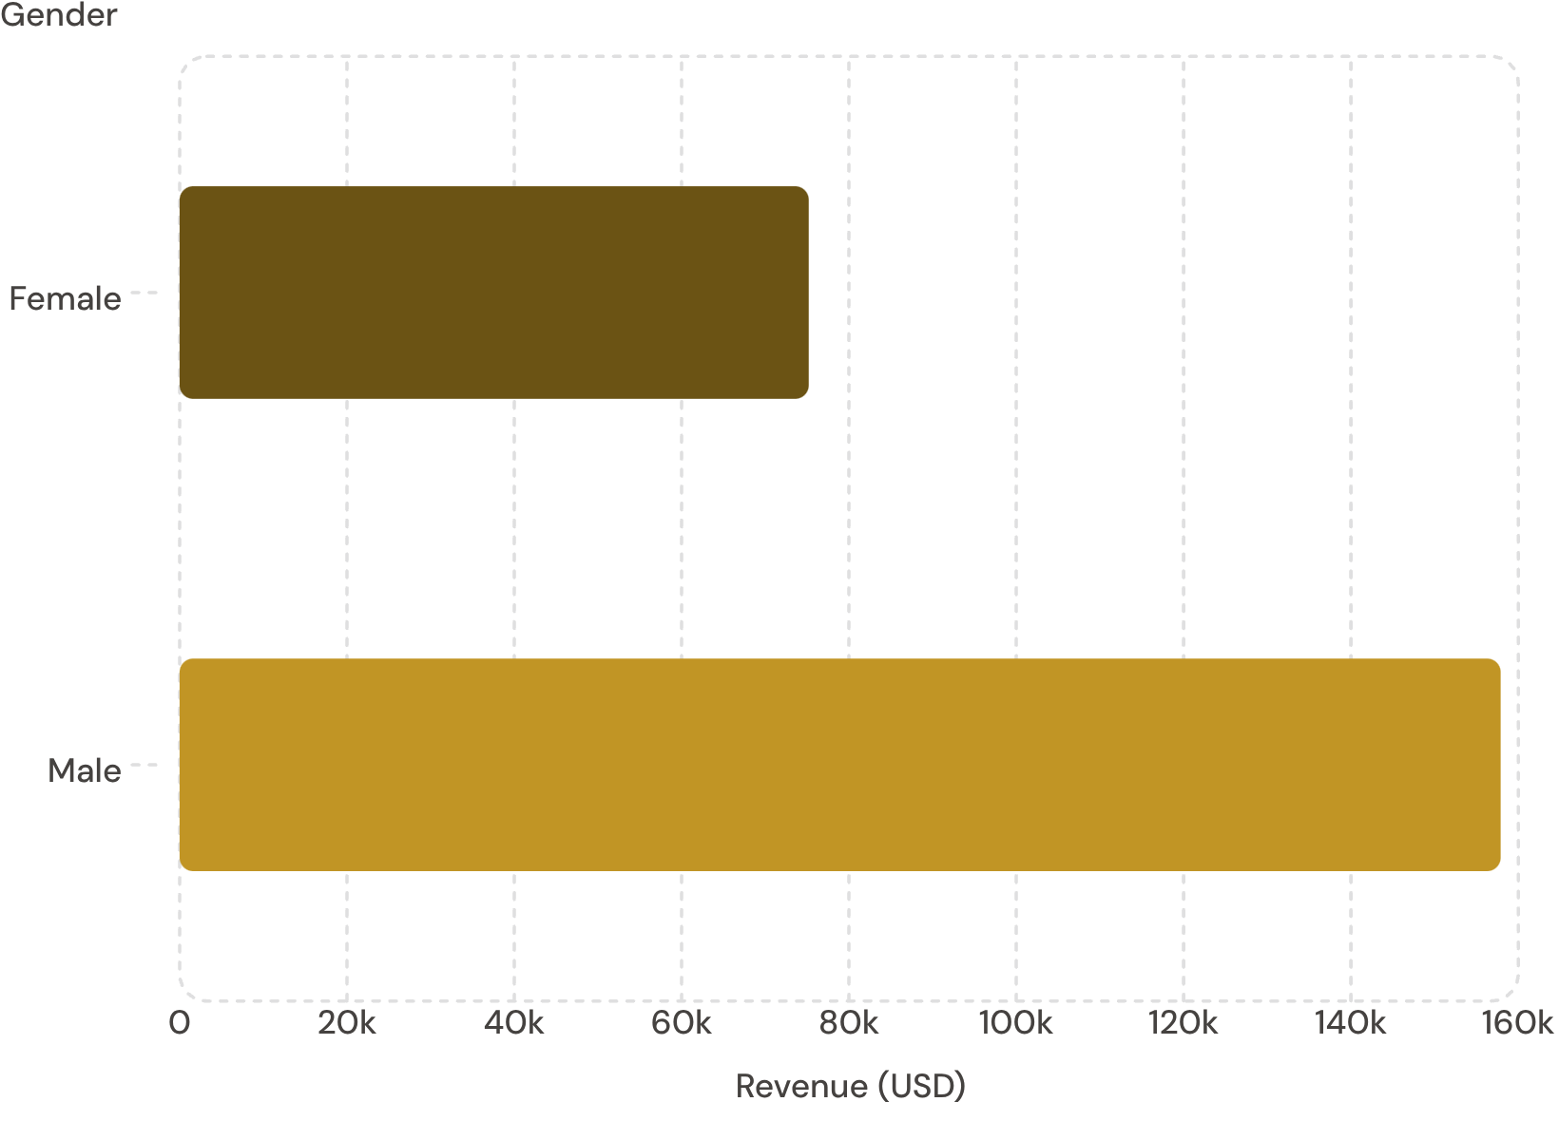

Revenue by Gender
Key Insight
Male customers generated 2.1x more revenue than female customers across the dataset.
Male: $157,890 · Female: $75,191

Slide 4
Top Products & Discount Patterns
Top 5 by Review Rating
Most Discounted Products
Item
Avg Rating
Item
Discount Rate
Gloves
3.86
Hat
50.00%
Sandals
3.84
Sneakers
49.66%
Boots
3.82
Coat
49.07%
Hat
3.80
Sweater
48.17%
Skirt
3.78
Pants
47.37%

Slide 5
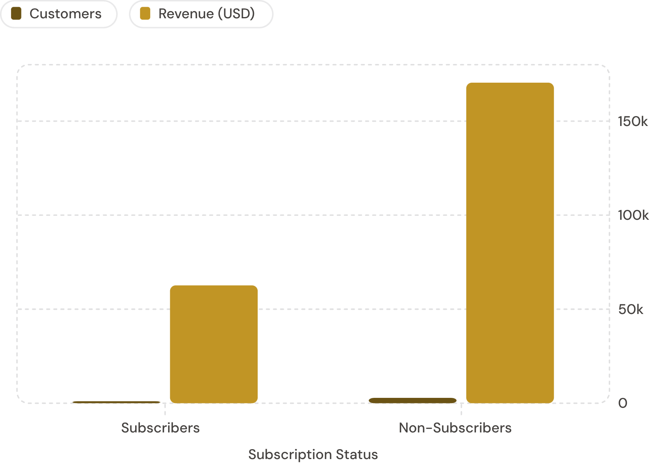
Subscribers vs. Non-Subscribers
Average Spend
Subscribers: $59.49 · Non-Subscribers: $59.87
Repeat Buyers
Of customers with >5 purchases: 958 subscribed vs. 2,518 did not.

Slide 6
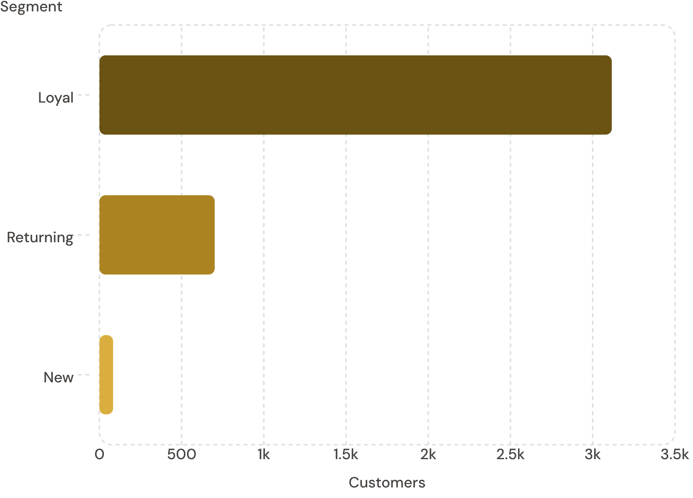
Customer Segmentation
Segment Breakdown
Loyal — 3,116 customers (80%)
Returning — 701 customers (18%)
New — 83 customers (2%)
Segmentation based on purchase history frequency.

Slide 7
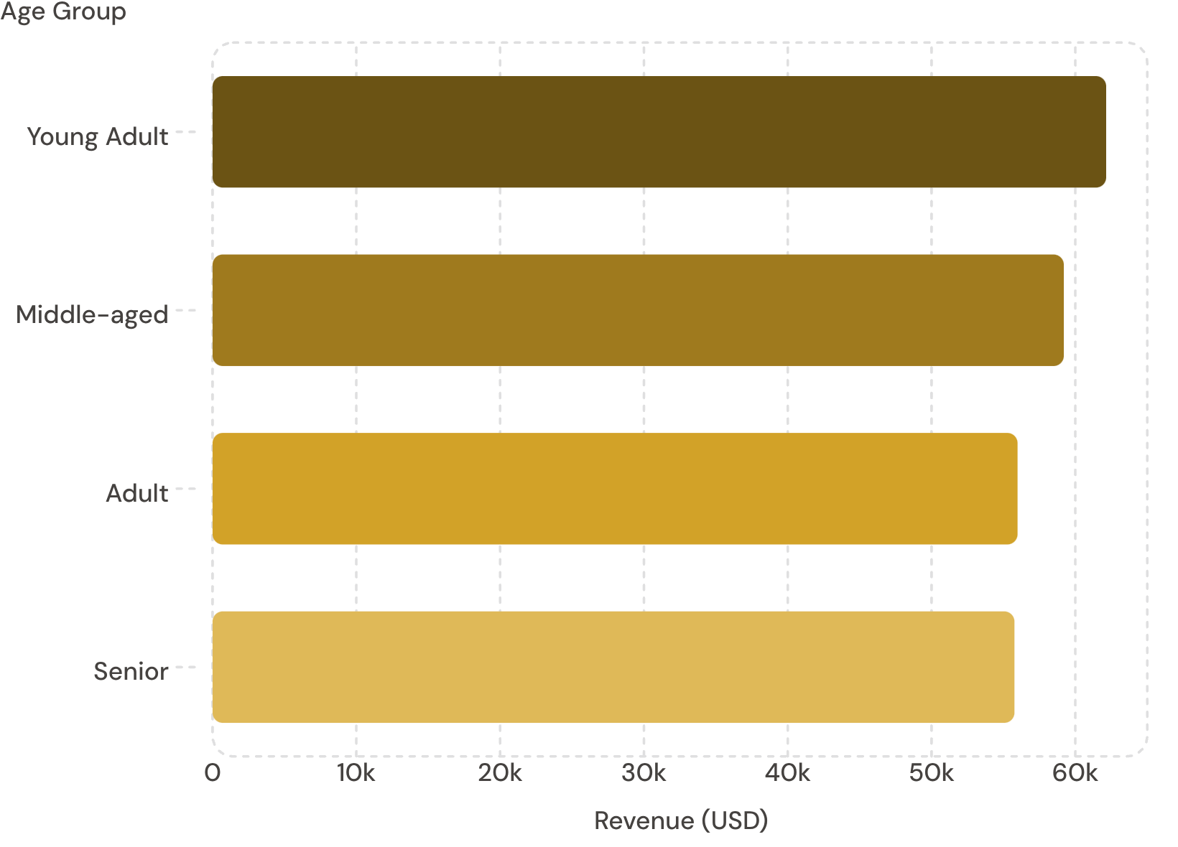
Revenue by Age Group
Shipping Spend Comparison
Express: $60.48 avg · Standard: $58.46 avg
Top Products per Category
Clothing: Blouse, Pants, Shirt
Footwear: Sandals, Shoes, Sneakers
Outerwear: Jacket, Coat
Accessories: Jewelry, Sunglasses, Belt

Slide 8

Power BI Dashboard
3.9K
Customers
$59.76
Avg Purchase
3.75
Avg Rating
27%
Subscribers

Slide 9





Business Recommendations
Boost Subscriptions
Loyalty Programs
Review Discount Policy
Promote exclusive subscriber benefits
Reward repeat buyers toward "Loyal" segment
Balance sales boosts with margin control
Targeted Marketing
Product Positioning
Focus on high-revenue age groups & express-shipping users
Highlight top-rated & best-selling products in campaigns

