Slide 1
C

Slide 2
Bit Manipulation
Non Negative Int. can Store in n bits –
2^n -1
For Signed Int in n bits :- x=n-1
-(2^x ) to (2^x-1)

Slide 3
Bit Manipulation
For signed Integers
MSB- Most significant
0 – positive
1 -- negative
LSB (Least)
Bits Used for Store Magnitude (n-1)
If MSB is 0 then compiler normally convert binary into Decimal.
If MSB is 1 then compiler goes to 2’s Compliment method then convert.
Note :- if we initially assign the negative value then compiler goes to 2’s compliment then stores (MSB becomes 1) but …
If we store a number out of range [>2(^n-1) -1] then MSB must have to 1 then compiler treat that binary as of a –ive number

Slide 4
eg
short int of 2 bytes 16 bits n=16
For signed 1 bit is MSB hence no. of bits to store magnitude is n-1=15
Range -(2^15)to (2^15 -1) ➔ -32768 to 32767
if we store 32768 then its binary is 1000000000000000
If we print this then as MSB is 1
Compiler take 2’s compliment
And print –(no. obtained)
That is -32768

Slide 5
2’s Compliment
Step 1st (1’s Compliment):- Interchnage all bits (0 to 1 & 1 to 0)
eg :- 0011011 --1’s--> 1100100
Step 2nd :- add 1
1100100 –2’s--> 1100101
Another Method :- start from LSB to MSB goes untill 1 is found as 1 found
invert all value at left
eg 0011011 –2’s --> 1100101

Slide 6
X=Any binary
XOR | X ^ 0s | X
XOR | X ^ 1s | ~X
XOR | X ^ X | 0
AND | X & 0s | 0
AND | X & 1s | X
AND | X & X | X
OR | X | 0s | X
OR | X | 1s | 1s
OR | X | X | X

Slide 7
Float literal
IEEE 745 method
+2.5 ---> 0…010.100….
…
128 64 32 16 8 4 2 1 0.5 0.25 0.125 . . .
MSB
Exponent bits
Fractional bits
Data_type | size | Sign | Exponent bit | Fractional bits
Float (4 bytes) | 32 bits | 1 | 8 | 23
Double (8 bytes) | 64 bits | 1 | 11 | 52
long double (16 bytes) | 128 bits | 1 | 15 | 112

Slide 8
Lexical in c
Lexical :-
Grammar ~ syntax (the way to write a code)
Paragraph ~ Function(set of instructions)
Chapter ~ file(set of funciton)
Book ~ project(set of files)

Slide 9
Lexical Element
Characters Set :- A set of all the valid characters that can we use in source program.
It contains alphabets (A-Z & a-z), number(0-9) and symbols
For encoding use ASCII (7 & 8) …
American Standard Code for Information Interchange
C can support 256 characters

Slide 10
Tokens
Set of Character Set
Keyword :- 32 in c … int, main if else etc …
Identifier :- var_name , fun_name , user define DS
Punchuation Character :- Symbol used in syntax eg ; ( )
White spaces :- space and enter and tabs
Literals :- int in syntax e.g. return 0
int hello(){
printf(“Hi”);
return 0;
}

Slide 11
Lexical in c
Alphabets
words
Sentences
Paragraph
Chapter
Book
Character Set
Token
Statement/ Set of Token
Function
File
Project

Slide 12
Arrays

Slide 13
Properties of Array
1. Fixed Size
The array in C is of fixed-size. The size of the array must be known at the compile time and it cannot be changed once it is declared.
2. Homogeneous Collection
We can only store one type of element in an array. There is no restriction on the number of elements but the type must same.
3. Indexing in Array
4. Dimensions of an Array
It is the number of directions in which you can grow the array size.
5. Contiguous Storage
All the elements in the array are stored continuously one after another in the memory. It is one of the defining properties of the array in C which is also the reason why random access is possible in the array.
6. Random Access
The array in C provides random access to its element i.e we can get to a random element at any index of the array in constant time complexity just by using its index number.
7. No Index Out of Bounds Checking
, the following program compiles fine but may produce unexpected output when run.

Slide 14
Array size calculator
Size of
Using loop
Using pointer

Slide 15
puts vs printf
printf() | puts
printf allows us to print formatted strings using format specifiers. | puts do not support formatting.
printf does not add new line characters automatically. | puts automatically adds a new line character.
It returns the number of characters successfully written to the console. -ive for an error | It returns a non-negative value on success and EOF (end-of-file) on failure.
printf can handle multiple strings at one time which helps in concatenating the strings in the output. | puts can print a single string at one time.
printf can print data of different data types. | puts can print only strings.

Slide 16
Entry function
scanf() gets() getch() fgets()fchar() fscanf()

Slide 17
Storage Class
Storage Classes in C describe the features of a variable/function. These features basically include the scope, visibility, and lifetime which help us to trace the existence of a particular variable during the runtime of a program.

Slide 18
Function

Slide 19
Parameters
Formal Parameter: A variable and its type as they appear in the prototype of the function or method.
Actual Parameter: The variable or expression corresponding to a formal parameter that appears in the function or method call in the calling environment.
Modes:
  IN: Passes info from caller to the callee.
  OUT: Callee writes values in the caller.
  IN/OUT: The caller tells the callee the value of the variable, which may be updated by the callee.

Slide 20
The C function prototype is a statement that tells the compiler about the function’s name, its return type, numbers and data types of its parameters.

Slide 21
Variadic function
Variadic functions are functions that can take a variable number of arguments.
The variadic function consists of at least one fixed variable and then an ellipsis(…) as the last parameter.
int fun(int x,…); // syntax
A liberary Is used to access to the variable
#include <stdarg.h> // header file

Slide 23
Pointers
. A pointer can be used to store the memory address of other variables, functions, or even other pointers. The use of pointers allows low-level memory access, dynamic memory allocation, and many other functionality in C.
As the pointers store the memory addresses, their size is independent of the type of data they are pointing to.

Slide 24
Types
Integer Pointer :- Point to Integer
Array Pointer:-
Structure Pointer :-
Function Pointer :-
Double Pointer :-
NULL Pointer :-
Void Pointer :-
Wild Pointer :-
Constant Pointer
Pointer to Constant :-

Slide 25
Function pointer
Function pointers point to the functions. They are different from the rest of the pointers in the sense that instead of pointing to the data, they point to the code. Let’s consider a function prototype – int func (int, char), the function pointer for this function will be
Syntax
int (*ptr)(int, char);

Slide 26
Void
The Void pointers in C are the pointers of type void. It means that they do not have any associated data type. They are also called generic pointers as they can point to any type and can be typecasted to any type.
Syntax
  void * pointer_name;
One of the main properties of void pointers is that they cannot be dereferenced.

Slide 27
Constant pointer
In constant pointers, the memory address stored inside the pointer is constant and cannot be modified once it is defined. It will always point to the same memory address.
Syntax
data_type * const pointer_name;

Slide 28
Pointer to constant
The pointers pointing to a variable which contain constant value that cannot be modified are called pointers to a constant. Here we can only access the data pointed by the pointer, but cannot modify it. Although, we can change the address stored in the pointer to constant.
Syntax
const data_type * pointer_name;

Slide 29
Size of Pointers in C
The size of the pointers in C is equal for every pointer type. The size of the pointer does not depend on the type it is pointing to. It only depends on the operating system and CPU architecture. The size of pointers in C is
8 bytes for a 64-bit System
4 bytes for a 32-bit System

Slide 30
Files

Slide 31
Structures
It is User-defines datatypes
The below syntax is also called a structure template or structure prototype and no memory is allocated to the structure in the declaration.
Tag or structure tag
struct student {
char name[30];
int id;
int age;
}
Members or
Fields of structure

Slide 32
To use structure in our program, we have to define its instance. We can do that by creating variables of the structure type.
There are 2 methods
Structure Variable Declaration with Structure Template
      struct structure_name {
      data_type member_name1;
      data_type member_name1;
      .... .... }variable1, varaible2, ...;
2. Structure Variable Declaration after Structure Template
// structure declared beforehand struct structure_name variable1, variable2, .......;

Slide 33
Acess member by dot operator
1. Initialization using Assignment Operator
struct structure_name str; str.member1 = value1; str.member2 = value2; str.member3 = value3;
2. Initialization using Initializer List
struct structure_name str = { value1, value2, value3 };
3. Initialization using Designated Initializer List
Designated Initialization allows structure members to be initialized in any order. This feature has been added in the C99 standard.
struct structure_name str = { .member1 = value1, .member2 = value2, .member3 = value3 };

Slide 34
Structures
struct student {
char name[30];
int id;
int age;
}
int main(){
struct student boy;
struct student girl;
}
student
boy
girl

Slide 35
typedef

Slide 36
Pointer Struct
We can access the members of the structure pointed by the structure pointer using the ( -> ) arrow operator.
Self-Referential Structures
The self-referential structures in C are those structures that contain references to the same type as themselves i.e. they contain a member of the type pointer pointing to the same structure type.

Slide 37
Technically, the size of the structure in C should be the sum of the sizes of its members. But it may not be true for most cases. The reason for this is Structure Padding.
Structure padding is the concept of adding multiple empty bytes in the structure to naturally align the data members in the memory. It is done to minimize the CPU read cycles to retrieve different data members in the structure.

Slide 38
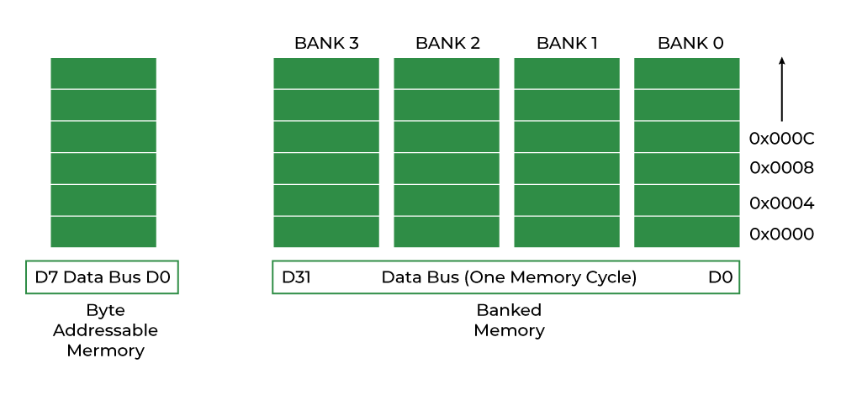
Structure Padding
In one memory cycle we can fetch block which are at same level only….

Slide 39
Rules
1). Every datatype will take the memory address which is multiple of sizeof(datatype)
2). The size of Total structure will be multiple of longest sizeof(data_type)

Slide 41
Bit Fields
Bit Fields are used to specify the length of the structure members in bits. When we know the maximum length of the member, we can use bit fields to specify the size and reduce memory consumption.
Pointer cannot pointer a bit field members
Array of bit field not allowed

Slide 42
Structure Adv. Dis Adv.

Slide 43
Union
The Union is a user-defined d_type just like structure. But unlike structures, all the members in the C union are stored in the same memory location. Due to this, only one member can store data at the given instance.
We can only store data in a single member at the same time.

Slide 44
All syntax same as structures
The size of the union = size of the largest member of Union. All the less-sized elements can store the data in the same space without any overflow.
Structure | Union
The size of the structure is equal to or greater than the total size of all of its members. | The size of the union is the size of its largest member.
The structure can contain data in multiple members at the same time. | Only one member can contain data at the same time.
It is declared using the struct keyword. | It is declared using the union keyword.

Slide 45
Enum

Slide 46
Storage Classes
C Storage Classes are used to describe the features of a variable/function. These features basically include the scope, visibility, and lifetime which help us to trace the existence of a particular variable during the runtime of a program.

Slide 47
Auto :- only with local variable
  Store in RAM
  Default value =garbage
  Life upto end of block
Static :- local and global (all variable)
  Default value =0 , null for char
  For local variable – no linkage
  For global variable – internal linkage (in file)
  Used is function recursion and want to restore previous value

Slide 48
Extern :-
  Work with global variable only
  Used in multifile projects
  extern int a; --- only declaration not definition.
Register :-
  Store in cpu register block
  Take less time and fast execution
  It is used when we 100% sure that variable will create in register of cpu
  If cpu register is full then var goes to memory like auto

Slide 49
Memory Management

Slide 50
File Handling
Files of 2 Type
  1. Text Files
    A text file contains data in the form of ASCII characters and is generally used to store a stream of characters.
    Each line in a text file ends with a new line character (‘\n’).
    It can be read or written by any text editor.
    They are generally stored with .txt file extension.
    Text files can also be used to store the source code.
2. Binary Files
  A binary file contains data in binary form (i.e. 0’s and 1’s) instead of ASCII characters. They contain data that is stored in a similar manner to how it is stored in the main memory.
  The binary files can be created only from within a program and their contents can only be read by a program.
  More secure as they are not easily readable.
  They are generally stored with .bin file extension.

Slide 51
C File Operations
  Creating a new file – fopen() with attributes as “a” or “a+” or “w” or “w+”
  Opening an existing file – fopen()
  Reading from file – fscanf() or fgets()
  Writing to a file – fprintf() or fputs()
  Moving to a specific location in a file – fseek(), rewind()
  Closing a file – fclose()

