Slide 1

Bank Telemarketing Analytics
BUSINESS ANALYTICS CASE STUDY
Customer segmentation and subscription prediction
I explored which customer groups subscribed more often and how prediction models could support campaign planning.
github.com/its-adesh/bank-telemarketing-analytics

Slide 2



The campaign planning question
How could the bank use customer data to prioritise outreach?
45,211
I used customer groups to explore patterns, then compared models to predict subscriptions.
records in the analysis
11.7%
I held out 20% of the data for testing and excluded call duration from the inputs.
subscribed to a term deposit

Slide 3


Cluster 0 had the highest subscription rate
The largest customer group had the lowest rate.
A group worth testing
I would explore Cluster 0 in a small outreach test before expanding the campaign.
The groups overlap. A silhouette score of 0.17 supports treating them as broad profiles.
Notes:
Full cluster table: Cluster 0 - 13.9% of customers, 22.7% subscription rate; Cluster 1 - 45.1%, 8.8%; Cluster 2 - 29.6%, 9.6%; Cluster 3 - 2.4%, 15.1%; Cluster 4 - 9.0%, 15.3%. Silhouette score 0.17.

Slide 4
Accuracy alone missed the main problem
Predicting “no” for everyone would achieve about 88.3% accuracy.
88.3%
accuracy from predicting “no” for everyone
Weighted LightGBM
Best F1 score: 0.42
Recall 61%
Precision 32%
I compared subscriber precision and recall to understand the cost of missed subscribers and incorrect predictions.
Notes:
Full results (Accuracy / Precision / Recall / F1): Logistic Regression 89.4% / 68% / 18% / 0.28; Random Forest 88.3% / 50% / 21% / 0.29; Decision Tree 82.4% / 28% / 32% / 0.30; XGBoost 89.0% / 57% / 23% / 0.33; LightGBM 89.4% / 64% / 21% / 0.31; Weighted LightGBM 80.4% / 32% / 61% / 0.42.

Slide 5
More subscribers found, more false positives
Class weighting changed the balance of LightGBM predictions.
Recall
21% → 61%
Precision
64% → 32%
I would choose the threshold around calling capacity and contact costs, then test its value in a campaign.

Slide 6
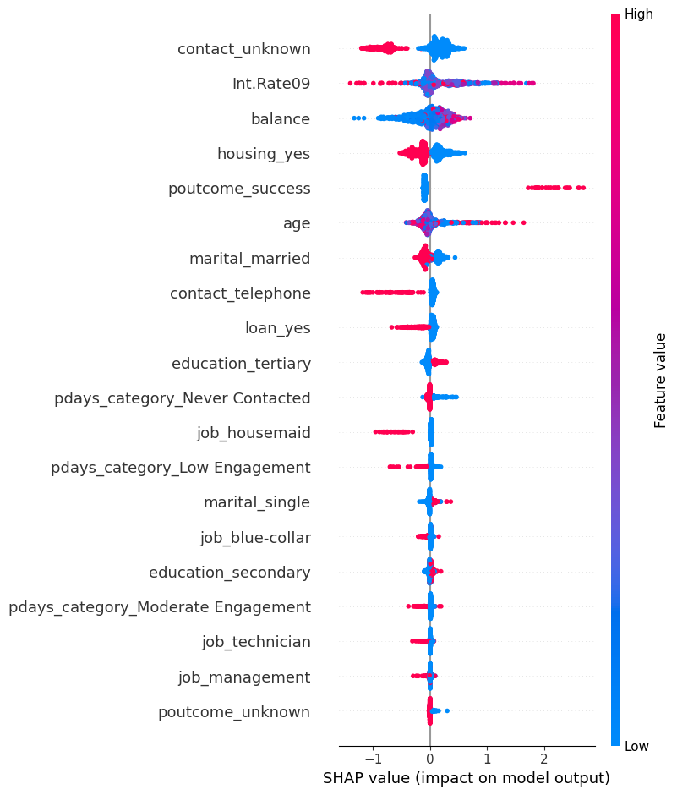




What influenced the predictions
SHAP helps explain the weighted LightGBM model.
How to read the chart
Each dot represents a customer record.
Right: pushes the prediction towards subscription.
Left: pushes it away.
These patterns explain the model. They do not establish cause and effect.

Slide 7
A small campaign test is the next step
I recommend comparing targeted outreach with the usual approach.
01
02
03
04
Set the comparison
Run the test
Measure results
Decide whether to expand
Use comparable customer pools and equal contact budgets.
Compare model-based targeting with the usual approach.
Track subscriptions gained and cost per subscription.
Expand only if the results meet the agreed business target.

Slide 8


My recommendation
The analysis supports a focused pilot before wider use.
Customer targeting
Model selection
Business impact
Explore the group with the highest historical subscription rate.
Match the threshold to calling capacity and validate on newer data.
Use the campaign test to measure value before claiming savings.

Slide 9
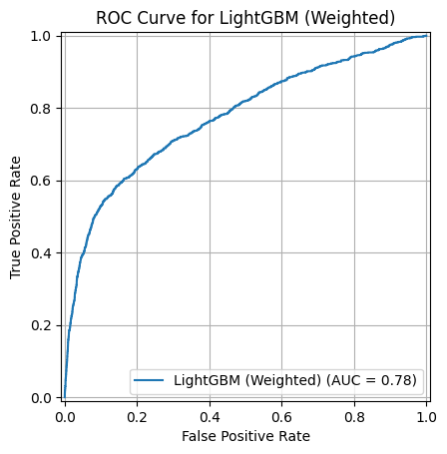

Supporting result: ROC curve
Weighted LightGBM achieved a ROC-AUC score of 0.7752.
0.7752
ROC-AUC, weighted LightGBM
A measure of ranking quality
The curve shows the balance between identifying subscribers and incorrectly flagging non-subscribers across thresholds.
The business decision still depends on contact costs and capacity.

