Slide 1
Bank Telemarketing
Analytics
Customer segmentation and subscription prediction
I explored which customer groups subscribed more often and how prediction models could support campaign planning.
Business analytics case study
github.com/its-adesh/bank-telemarketing-analytics
01
Notes:
Portfolio case study based on my customer segmentation and subscription prediction notebooks. This analysis uses historical data. I have not run a live campaign. AI tools supported code development, debugging and documentation, as disclosed in the notebooks.

Slide 2
The campaign planning question
How could the bank use customer data to prioritise outreach?
45,211
11.7%
records in the analysis
subscribed to a term deposit
I used customer groups to explore patterns, then compared models to predict subscriptions.
I held out 20% of the data for testing and excluded call duration from the inputs.
02
Notes:
Source: Classification.ipynb, train/test split and classification reports. 36,168 training records plus 9,043 test records = 45,211. Subscribers: 4,231 training plus 1,058 test = 5,289, approximately 11.7%. These are records, not a verified count of distinct people. Call duration was excluded. The workbook includes additional rate fields whose provenance needs separate checking before deployment.

Slide 3
Cluster 0 had the highest subscription rate
The largest customer group had the lowest rate.
Group | Customer share | Subscription rate
Cluster 0 | 13.9% | 22.7%
Cluster 1 | 45.1% | 8.8%
Cluster 2 | 29.6% | 9.6%
Cluster 3 | 2.4% | 15.1%
Cluster 4 | 9.0% | 15.3%
A group worth testing
I would explore Cluster 0 in a small outreach test before expanding the campaign.
The groups overlap. A silhouette score of 0.17 supports treating them as broad profiles.
03
Notes:
Source: CLUSTERING.ipynb, Cluster_5 summary. Rates: 0.226637, 0.087885, 0.095940, 0.150735, 0.153224. Shares: 0.139170, 0.450753, 0.295791, 0.024065, 0.090221. Five clusters had the highest silhouette score among k=2 through 10, approximately 0.17. Outcome y was excluded from clustering. The group differences describe historical associations, not campaign lift.

Slide 4
Accuracy alone missed the main problem
Predicting “no” for everyone would achieve about 88.3% accuracy.
Model | Accuracy | Precision | Recall | F1
Logistic Regression | 89.4% | 68% | 18% | 0.28
Random Forest | 88.3% | 50% | 21% | 0.29
Decision Tree | 82.4% | 28% | 32% | 0.30
XGBoost | 89.0% | 57% | 23% | 0.33
LightGBM | 89.4% | 64% | 21% | 0.31
Weighted LightGBM | 80.4% | 32% | 61% | 0.42
I compared subscriber precision and recall to understand the cost of missed subscribers and incorrect predictions.
04
Notes:
Source: Classification.ipynb, saved test outputs. Table shows the five initial models plus weighted LightGBM, not every weighted variant. Precision, recall and F1 refer to subscriber class. Figures rounded from notebook. Test support: 7,985 non-subscribers and 1,058 subscribers. No claim that weighted LightGBM is universally best.

Slide 5
More subscribers found, more false positives
Class weighting changed the balance of LightGBM predictions.
Test-set result | Standard | Weighted
Subscribers found | 220 | 641
Subscribers missed | 838 | 417
Non-subscribers flagged | 124 | 1,355
Recall: 21% to 61%
Precision: 64% to 32%
I would choose the threshold around calling capacity and contact costs, then test its value in a campaign.
05
Notes:
Source: Classification.ipynb confusion matrices on the same 9,043-record test set. Standard LightGBM TN=7,861 FP=124 FN=838 TP=220. Weighted TN=6,630 FP=1,355 FN=417 TP=641. Exact subscriber recall: 20.79% and 60.59%; precision 63.95% and 32.11%. These are predictions, not outcomes from a new campaign. Model thresholds and contact economics require testing.

Slide 6
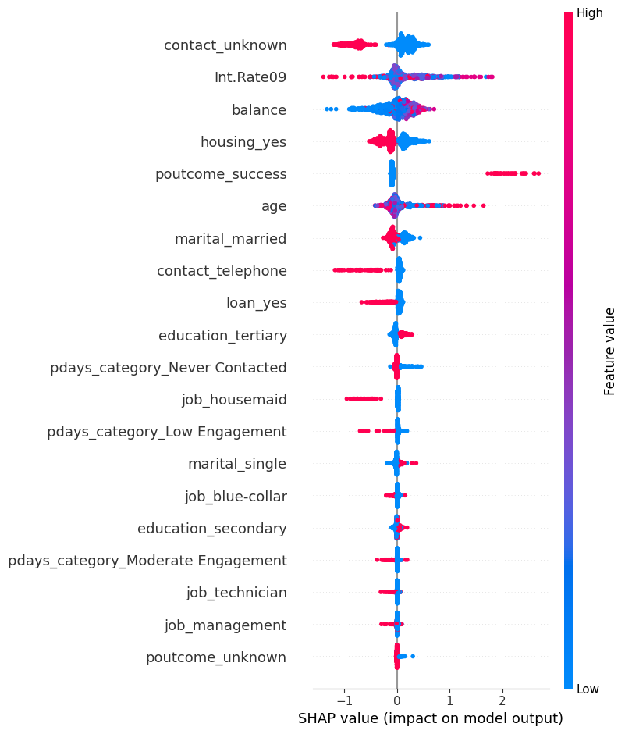
What influenced the predictions
SHAP helps explain the weighted LightGBM model.
How to read the chart
Each dot represents a customer record.
Right: pushes the prediction towards subscription.
Left: pushes it away.
These patterns explain the model. They do not establish cause and effect.
06
Notes:
Source: Classification.ipynb, SHAP summary on a sample of up to 1,000 test records, random_state=42. Image extracted from saved notebook. Rightward SHAP values push the model towards subscription; leftward values push it away. These reflect model associations, not causal effects. Int.Rate09 is the workbook field name. Its source and time alignment require confirmation before operational use.

Slide 7
A small campaign test is the next step
I recommend comparing targeted outreach with the usual approach.
01 Set the comparison
02 Run the test
Use comparable customer pools and equal contact budgets.
Compare model-based targeting with the usual approach.
03 Measure results
04 Decide whether to expand
Track subscriptions gained and cost per subscription.
Expand only if the results meet the agreed business target.
07
Notes:
Proposed future experiment, not completed work. Define a comparable eligible population and randomly allocate records to targeting-policy arms. Keep contact budget, offer, timing and measurement window consistent. Compare total subscriptions under equal budgets and cost per subscription; also report conversion among contacted customers. Agree success threshold and sample size before launch. Revenue/ROI require measured subscription value and campaign cost.

Slide 8
My recommendation
The analysis supports a focused pilot before wider use.
Customer targeting
Explore the group with the highest historical subscription rate.
Model selection
Match the threshold to calling capacity and validate on newer data.
Business impact
Use the campaign test to measure value before claiming savings.
08
Notes:
Summary of findings and proposed actions. Source notebooks and documentation: https://github.com/its-adesh/bank-telemarketing-analytics . Limitations: historical random holdout, no later-period validation, modest cluster separation, no live campaign or measured financial return. Next work includes confirming added rate-field definitions/time alignment and verifying full reproducibility with the original workbook. This is a portfolio case study, not a deployed banking product.

Slide 9
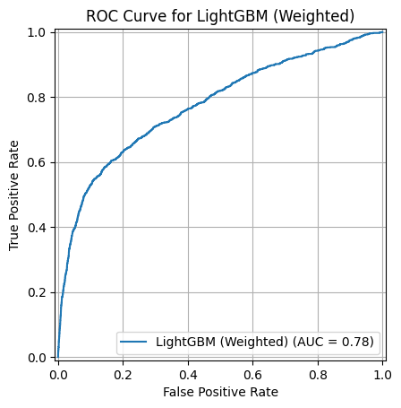
Supporting result: ROC curve
Weighted LightGBM achieved a ROC-AUC score of 0.7752.
A measure of ranking quality
The curve shows the balance between identifying subscribers and incorrectly flagging non-subscribers across thresholds.
The business decision still depends on contact costs and capacity.
09
Notes:
Source: Classification.ipynb weighted LightGBM ROC-AUC output 0.7752. Notebook chart rounds to 0.78. Evaluated on the 9,043-record holdout test set. AUC is a ranking measure across thresholds; it does not show campaign profit or prescribe a contact threshold.

