Slide 1

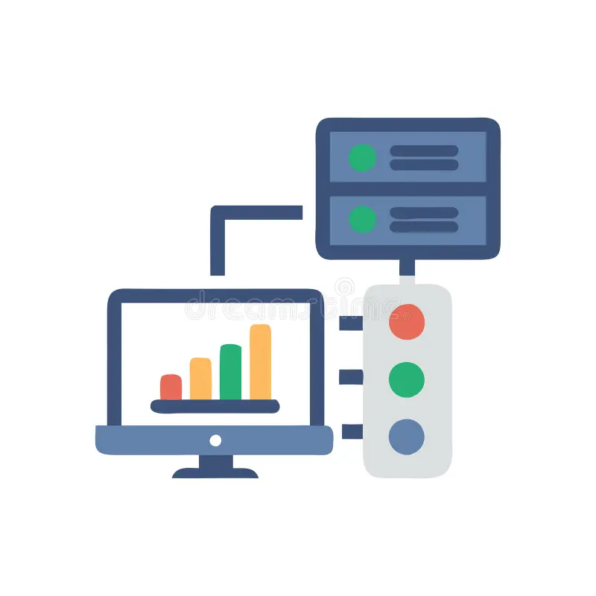
Wireshark: a network traffic analysis tool

Slide 2
What is wireshark
Wireshark is a network packet/protocol analyzer
Open source
Multi-platform
Deep inspection of packets
Live captures and offline analysis
Powerful display filters

Slide 3
Intended purpose
Network administrators use it to troubleshoot network problems
Examine the security problem
Debug protocol implementation
Learn network protocol
Wireshark will not manipulate the things on the network; it will only measure

Slide 4
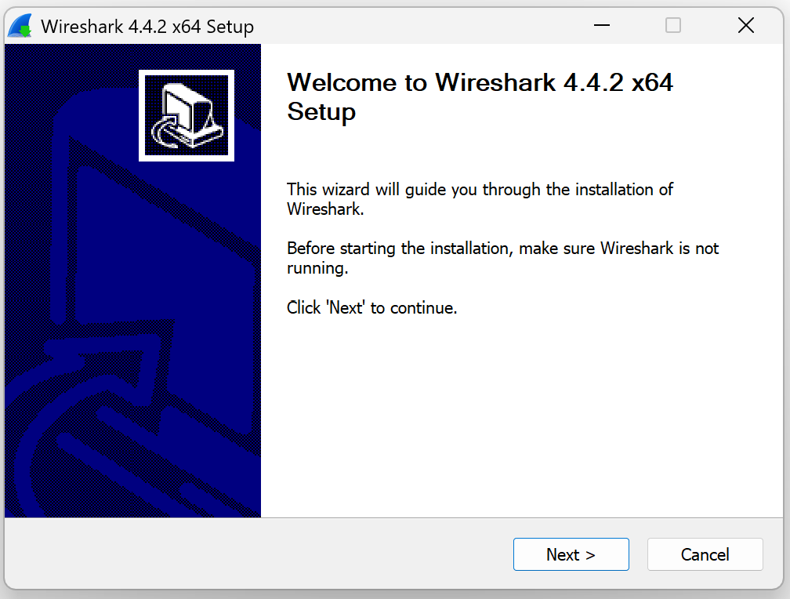
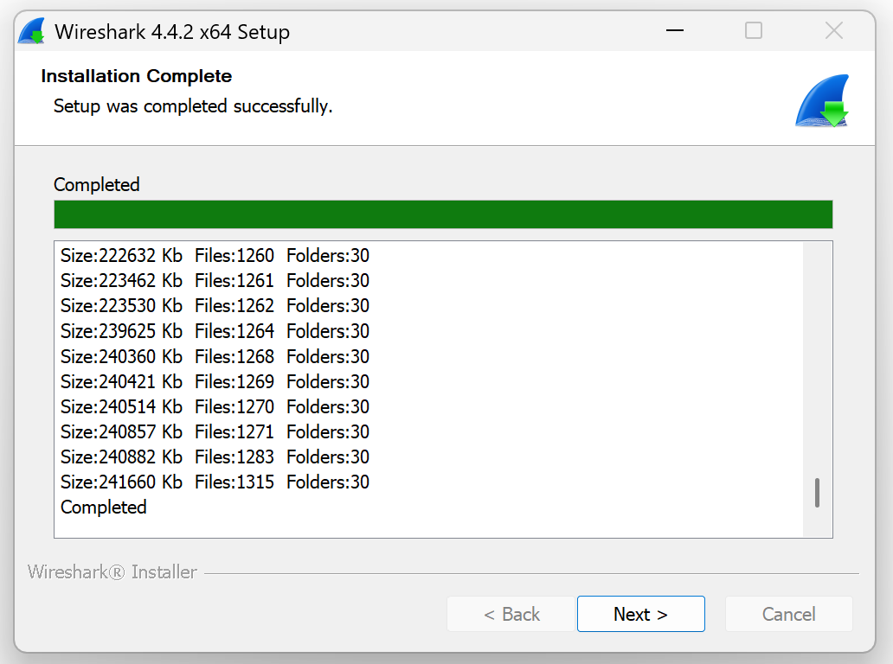
Download and installation
Use the link below to download Wireshark:
https://www.wireshark.org/download.html

Slide 5
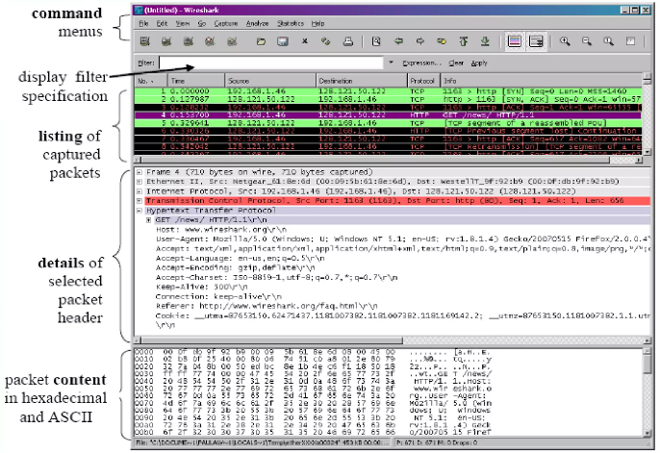
Wireshark interface

Slide 6
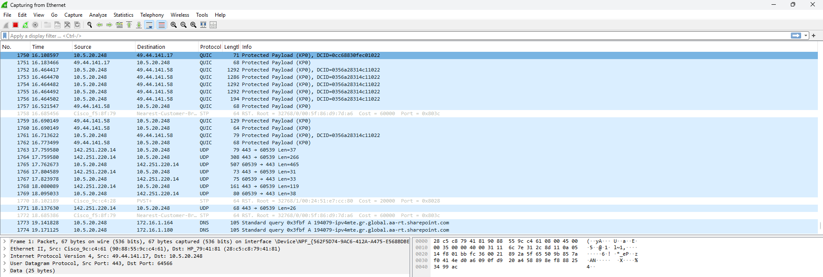
Wireshark interface
Header fields

Slide 7
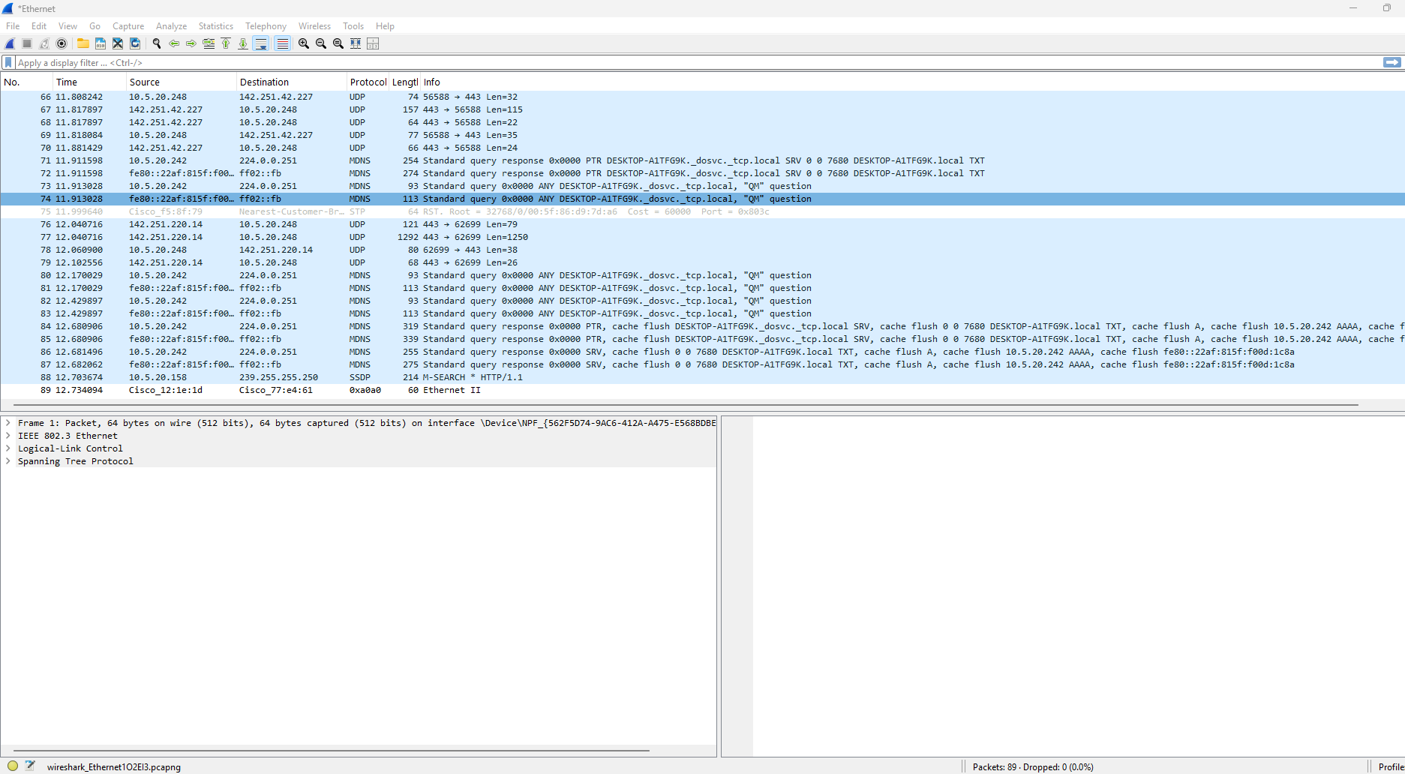
Packet statistics
Number of packets captured

Slide 8
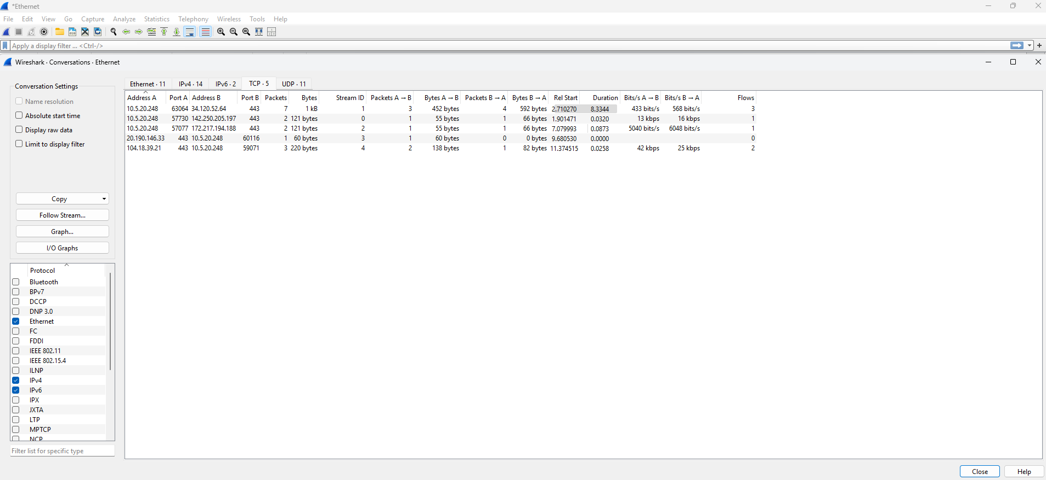
Packet conversations
Go to statistics in the command menus
Under statistics, go to conversations

Slide 9
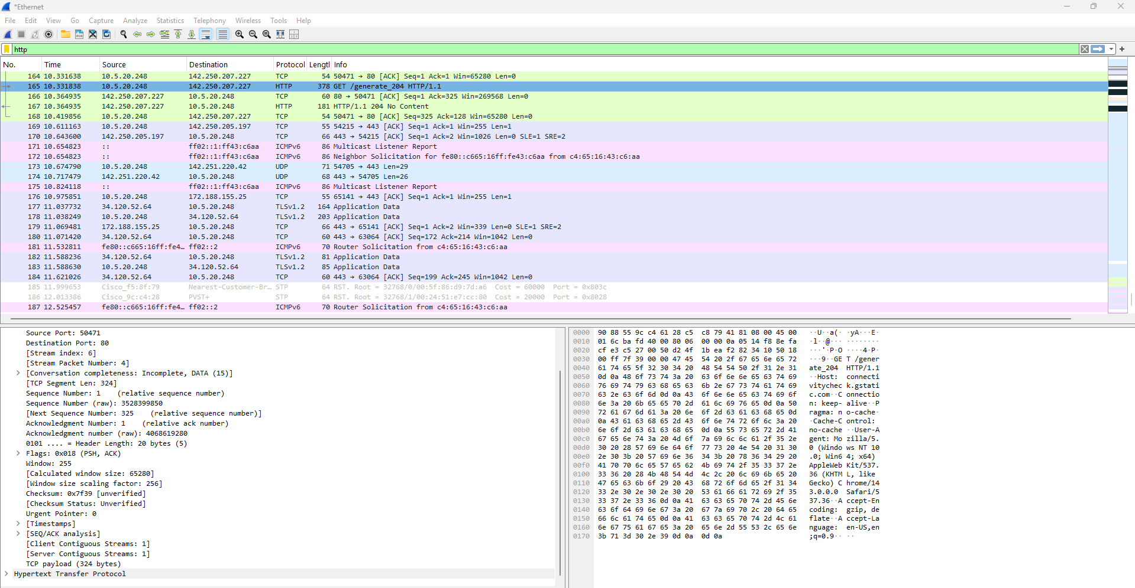
Packet filtering
Type ‘HTTP’ in the display filter and enter
Display filter

Slide 10
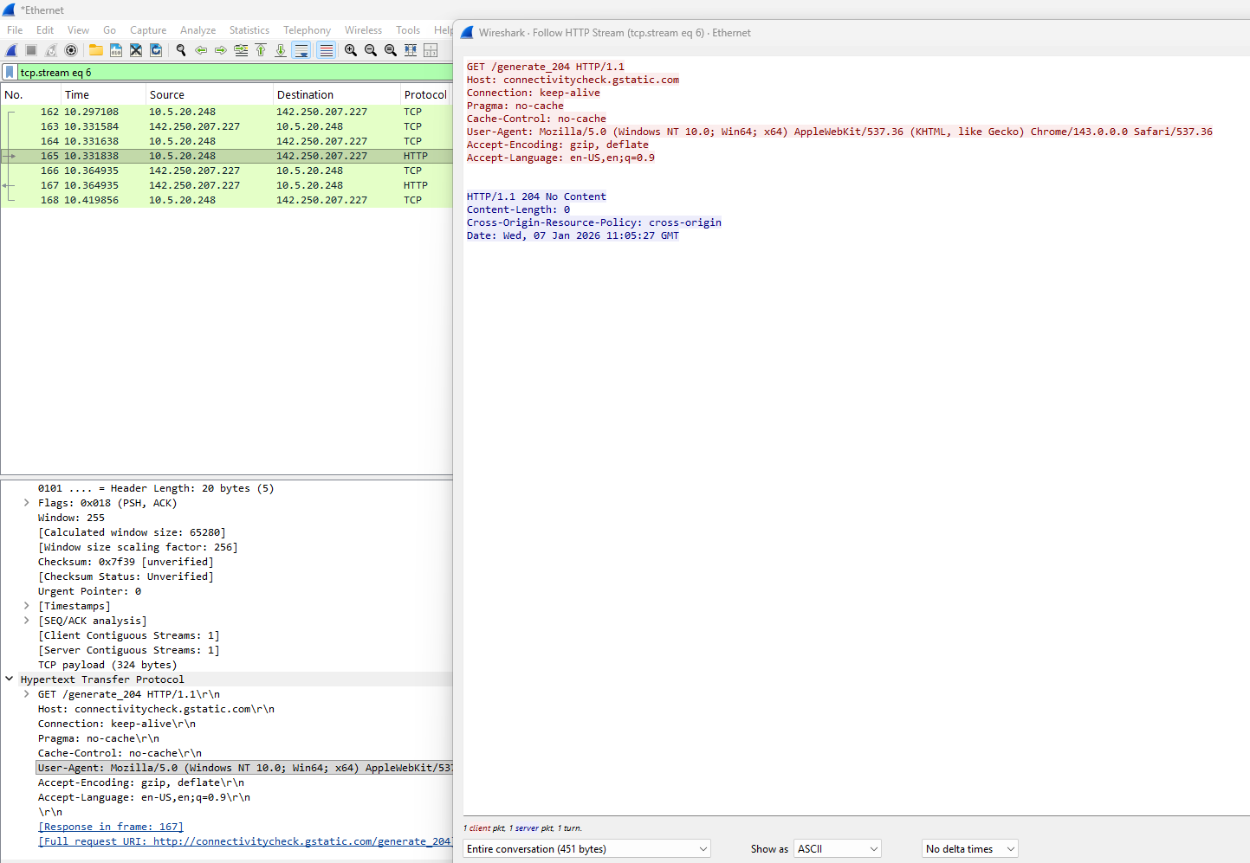
Packet filtering
Select the HTTP packet and right-click
Go to the ‘Follow’ option and then click on HTTP stream

Slide 11
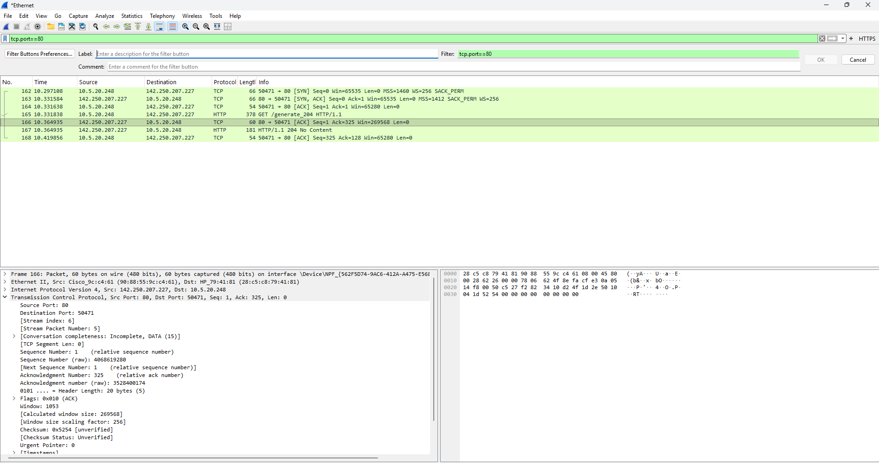
How to create filter button
Click on sign on the right-hand side of the display filter

Slide 12
Display filter example
ip.src==10.5.20.248
ip.addr==10.5.20.248 && ip.addr==172.16.1.164
Tcp.port==80
Tcp.port==80 || tcp.port ==3389
(ip.addr==10.5.20.248 && ip.addr==172.16.1.164) &&(tcp.port==445||tcp.port==139)
(ip.addr==10.5.20.248 && ip.addr==172.16.1.164) &&(udp.port==67||udp.port==68)

Slide 13
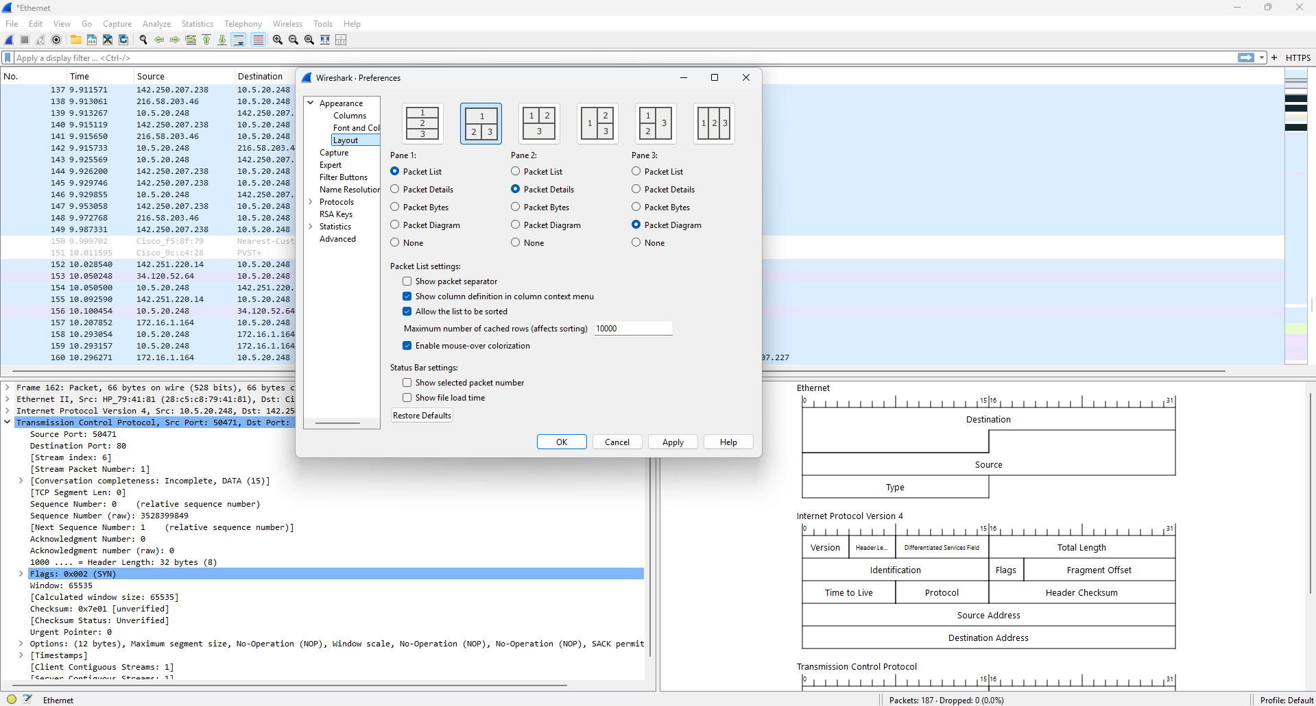
Layout change
Go to the ‘Edit’ in the command menus
Under ‘Edit’, click on Preferences
Click on the layout

Slide 14
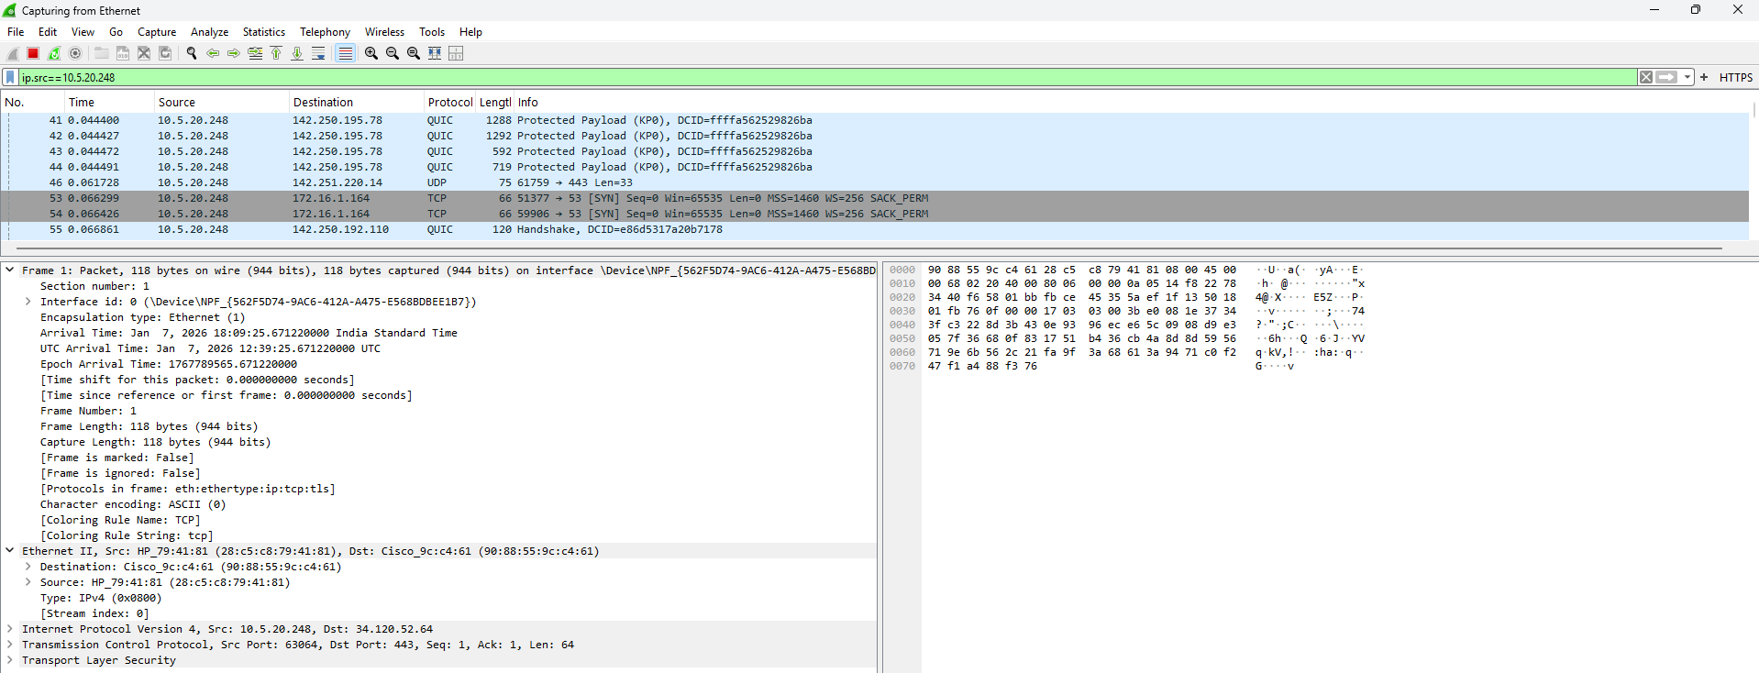
Analyzing packets-Ethernet frame example

Slide 15
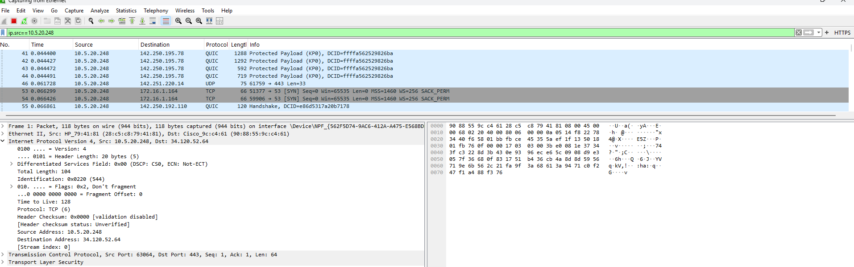
Analyzing packets-IP header

Slide 16
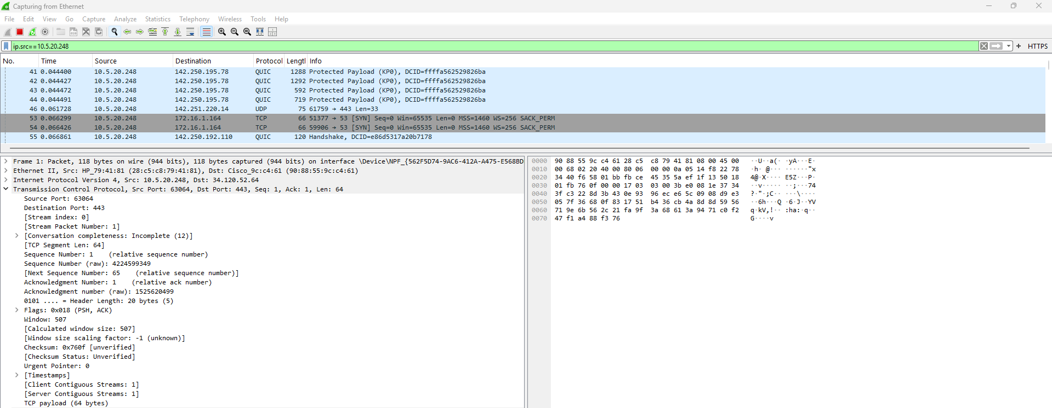
Analyzing TCP header

Slide 17
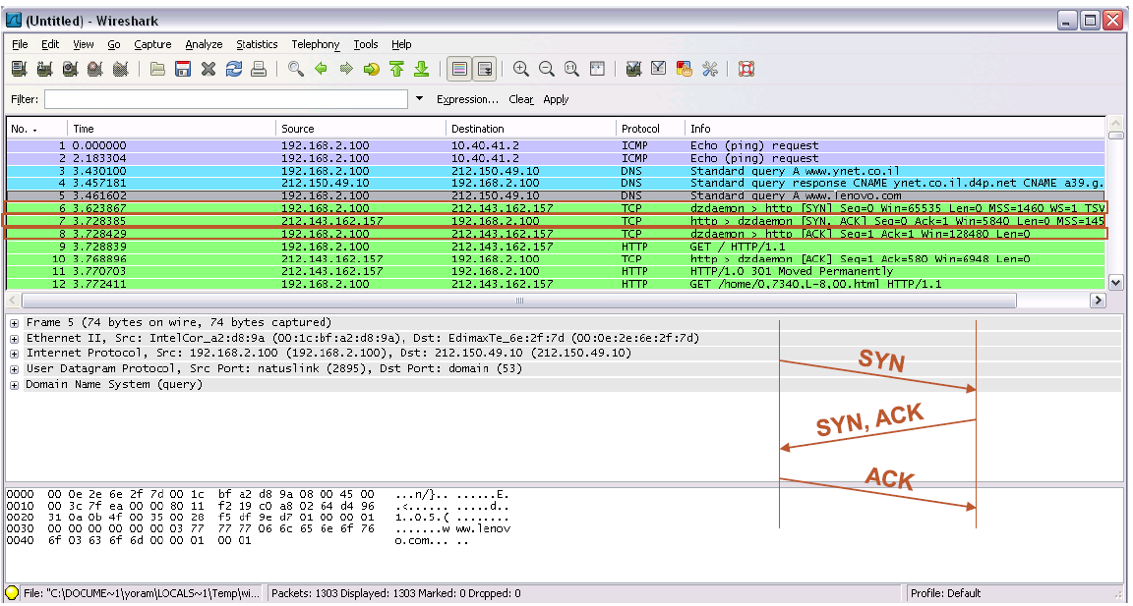
Analyzing TCP handshaking

Slide 18
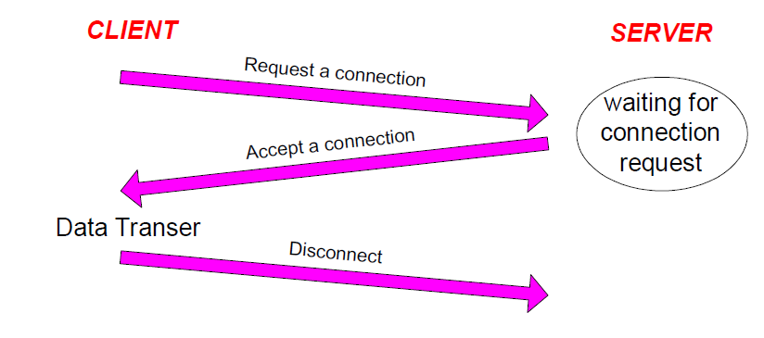
Connection-oriented service
Before any data transfer, TCP establish a connection
One TCP entity is waiting for a connection (“Server”)
The other TCP entity (“Client”) contacts the server

Slide 20
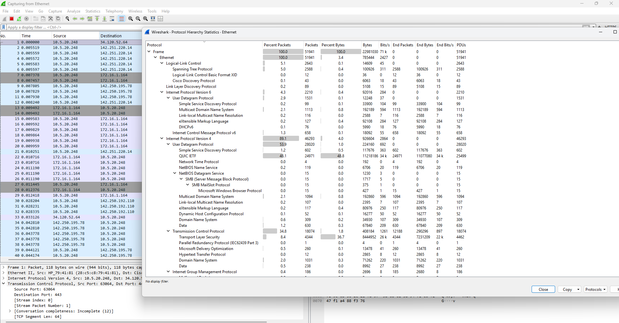
Protocol Hierarchy

Slide 21
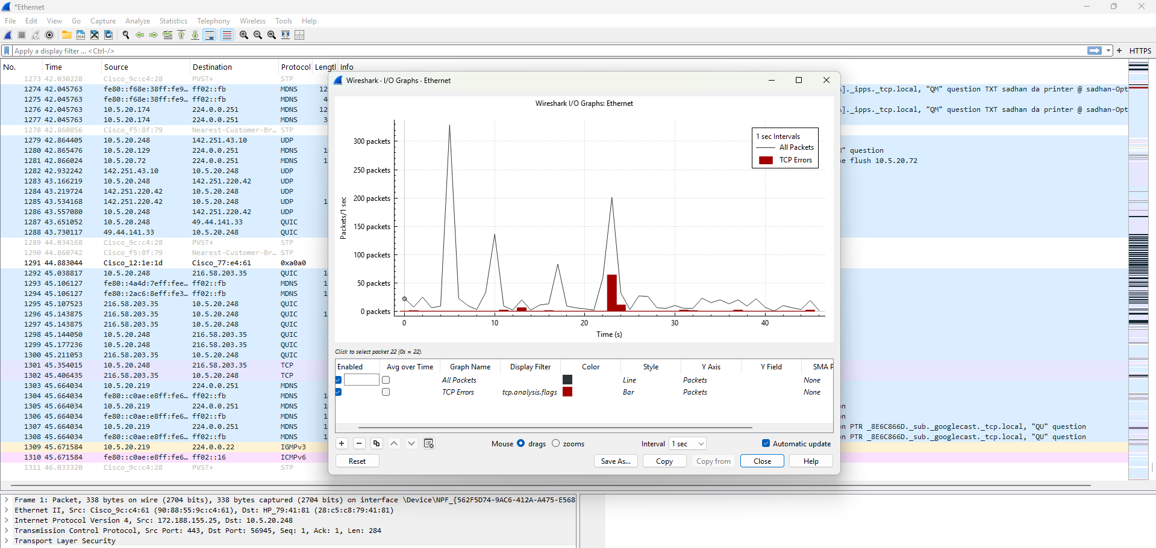
Packet Statistics
Go to statistics and then select I/O Graphs
Graphical visualization tool

