Slide 1

Experiment 3.C.
Design a digital clock using common-cathode 7-segment display modules and a mode switch. The clock normally displays the time in hh-mm-ss format. It updates time automatically using the timer interrupt of the microcontroller. On pressing the mode switch, the display changes to stopwatch mode in hh-mm-ss format. In stopwatch mode there are two more buttons – start and stop. The start button starts the stopwatch resetting it to zero, stop button stops the stopwatch. It should be noted that in the stopwatch mode, both normal clock and stopwatch clock get updated with timer interrupt. This ensures that the normal time also gets updated during the run of stopwatch. On pressing the mode button once more, the display returns to show clocktime.

Slide 2
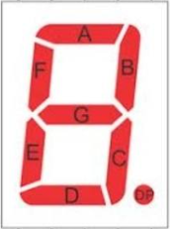
Connection (Multiplexing with buffers)
B0
7
B1 – B7
74245
A-G
A0
CC
CC
CC
CC
CC
CC
mode
A1 – A7
7
Port-A (0 -7)
J3
Port-B (0-5)
6
Port-C (0-2)
6
B2- B7
3
B0, B1
74245
Stop
start
A0
A1
A2 – A7

Slide 3
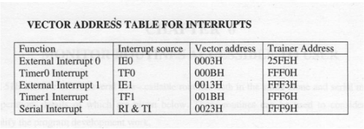
INTERRUPTS:
ORG 25FE H ;IE0 address
LJMP OUR_ISR
…
ORG 8100 H
MAIN_LOOP:
…
SJMP MAIN_LOOP
OUR_ISR: …
RETI ;return from interrupt
TIMER_ISR: …
RETI ;return from interrupt
…
ORG FFF0 H ;timer 0 address
LJMP TIMER_ISR
**External Interrupts can be configuring as level triggered as well as edge triggered.
SETB IT0 // IE0 configured as edge triggered
CLR IT0 // IE0 configured as level triggered

Slide 4


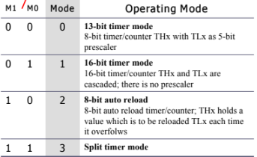
TIMER REGISTERS
TMOD REGISTOR
TCON REGISTER
GATE: To instruct 8051 if starting and stopping timer by software or hardware control. Gate = 0/1 for software/hardware configuration
C/T: When C/T = 1, the timer is used as a counter and gets its pulses from outside the 8051.
MODE:
IT0 TCON.0 Set/cleared -> falling edge/low-level triggered for external interrupt 0.
IE0 TCON.1 External interrupt 0 edge flag.
IT1 TCON.2 Set/cleared->falling edge/low-level triggered for external interrupt 1.
IE1 TCON.3 External interrupt 1 edge flag.
TR0 TCON.0 Timer 0 run control bit. 1/0 -> on/off.
TF0 TCON.1 Timer 0 overflow flag.
TR1 TCON.2 Timer 1 run control bit. 1/0 -> on/off.
TF1 TCON.3 Timer 1 overflow flag.

Slide 5
INTERRUPT ENABLE REGISTER (IE):
D7
D0
EA | - | ET2 | ES | ET1 | EX1 | ET0 | EX0
(a) CLR IE.7 ;DISABLE INTERRUPTS
EX0 IE.0 Enables or disables external interrupt 0
ET0 IE.1 Enables or disables timer 0 overflow interrupt
EX1 IE.2 Enables or disables external interrupt 1
ET1 IE.3 Enables or disables timer 1 overflow interrupt
ES IE.4 Enables or disables the serial port interrupt
ET2 IE.5 Enables or disables timer 2 overflow or capture interrupt (8952)
-- IE.6 Not implemented, reserved for future use
EA IE.7 Disables all interrupts
(b) SETB IE.7 ;ENABLE INTERRUPTS
SETB IE.0 ;ENABLE INTERRUPT 0
SETB IE.2 ;ENABLE INTERRUPT 1
(c) MOV IE, #82 ;ENABLE TIMER 0

Slide 6
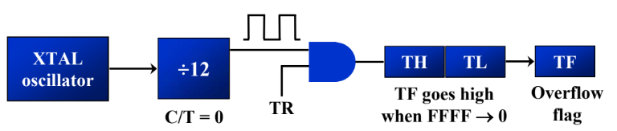
TIMER INTERRUPTS
1 Machine cycle = 12 / 11.0592 MHz
= 1.085 µs
Max time construct time timer interrupt
= 65536 * 1.085 * 10^-6
= 71.1 ms
Therefore, we construct 50ms and run it 20 times to get 1 Sec
i.e. 50 ms/ 1.085 µs = 46080
65536 – 46080 = 19456 -> 4C00 H (TH0 = 4C H and TL0 = 00 H)
TH0 and TL0: The High and Low bytes where we load our starting number.

Slide 7
TIPS:
START WITH 3 MEMORY LOCATIONS TO SAVE THE VALUE AND INITIALIZE THEM:
HOURS
MINUTES
SECONDS
INTRODUCE ANOTHER RIGISTER/ MEMORY SEGMENT FOR COUNTER AND RUN IT 20 TIMES (TIMER INTERRUPT TF0 HIGH COUNT).
ENTER REGISTER VALUES:
IE
TCON
TOMD
START TIMER i.e. TRO -> 1
COUNT TF0
DEFINE CLOCK AND STOPWATCH ISR
TF0 (20 -> 0) UPDATE SECONDS REG
SECONDS (0 -> 60) UPDATE MINUTES
MINUTES (0 -> 60) UPDATE HOURS
KEEP CHECKING MODE INPUT IN CLOCK MODE
MODE -> LOW GO TO STOPWATCH ISR
KEEP CHECKING START AND STOP INPUT
KEEP THE CLOCK RUNNING ALWAYS
AFTER GETTING THE INTERRUPT, 8051 LEAVES ALL ITS WORK AND DIRECTLY GO TO INTERRUPT SERVICE ROUTINE.
PUSH DPH, DPL, ACC, PSW (IMMEDIATELY AFTER ENTERING ISR)
POP DPH, DPL, ACC,PSW (BEFORE RETI FROM ISR)

