Slide 1
Experiment 1. C
Check whether a NULL terminated string stored from location 9000H is a substring of another NULL terminated string stored from location 9200H or not. If a substring is detected, store the start index (not address) at memory location 9500H, else store -1 at 9500H.

Slide 2
OBJECTIVE
 | 0 | 1 | 2 | 3 | 4 | 5 | 6 | 7 | 8 | 9 | A | B | C | D | E | F
9000 | 57 | 4F | 52 | 4C | 44 | 00 | 00 | 00 | 00 | 00 | 00 | 00 | 00 | 00 | 00 | 00 | WORLD
9010 | 00 | 00 | 00 | 00 | 00 | 00 | 00 | 00 | 00 | 00 | 00 | 00 | 00 | 00 | 00 | 00
⁞ ⁞ ⁞ ⁞ | ⁞ | ⁞ | ⁞ | ⁞ | ⁞ | ⁞ | ⁞ | ⁞ | ⁞ | ⁞ | ⁞ | ⁞ | ⁞ | ⁞ | ⁞ | ⁞
9200 | 48 | 45 | 4C | 4C | 4F | 20 | 57 | 4F | 52 | 4C | 44 | 21 | 00 | 00 | 00 | 00 | HELLO WORLD!
⁞ ⁞ ⁞ ⁞ | ⁞ | ⁞ | ⁞ | ⁞ | ⁞ | ⁞ | ⁞ | ⁞ | ⁞ | ⁞ | ⁞ | ⁞ | ⁞ | ⁞ | ⁞ | ⁞
9500 | 06 | 00 | 00 | 00 | 00 | 00 | 00 | 00 | 00 | 00 | 00 | 00 | 00 | 00 | 00 | 00

Slide 3
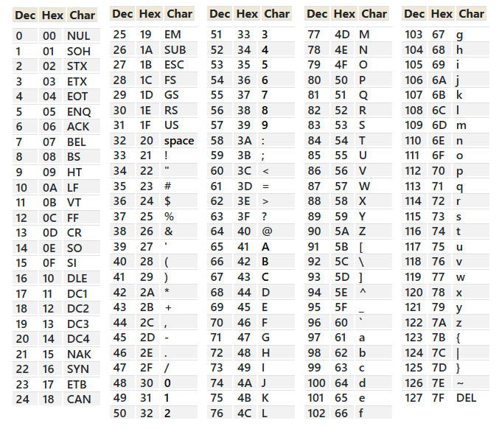
Character values in HEX

