Slide 1
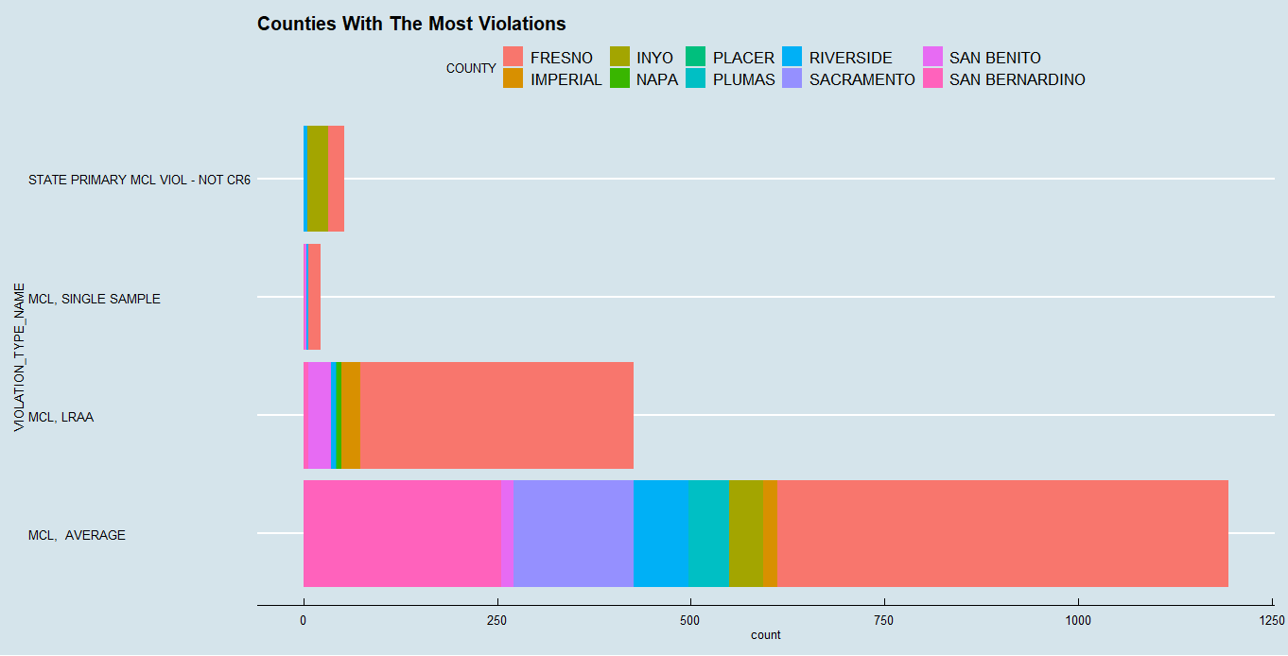
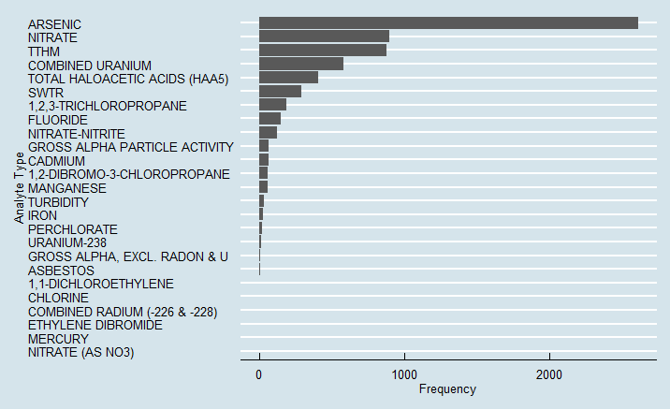
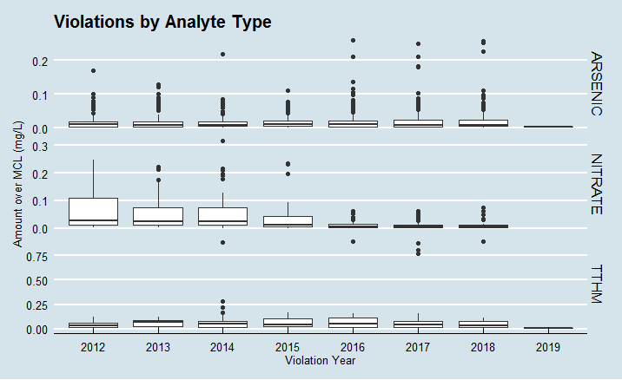
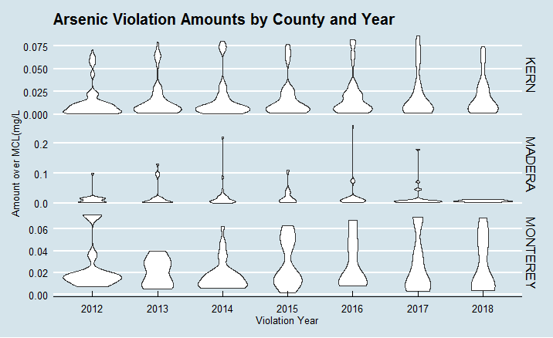

Slide 2
Predictive Models
Random Forest
Naïve Bayes Classification
Inputs: Zip Code, Classification, Population, Service Connections, Regulating Agency, Analyte Name
Inputs: County, Classification, MCL, Regulating Agency, Analyte Name
Performance Metrics | #
Accuracy | 0.8889
Misclass Error | 0.1111
F1 Score | 0.9184
No Information Rate | 0.65
Performance Metrics | #
Accuracy | 0.8829
Misclass Error | 0.1171
F1 Score | 0.9058
No Information Rate | 0.64
Areas for Improvement: Impute missing values, parameter tuning (random forest), joining datasets, normalize MCL and Result data, binning of select categorical variables, methodical feature selection, cross validation and/or bootstrapping.

Slide 3
