Slide 1


Introduction to Guesstimating
Guesstimating is the art of making educated estimates when precise data is unavailable. This presentation will explore the top-down and bottom-up approaches, the role of constraints, and how to solve a guesstimate question using the example of estimating Rapido customer numbers.

Slide 2
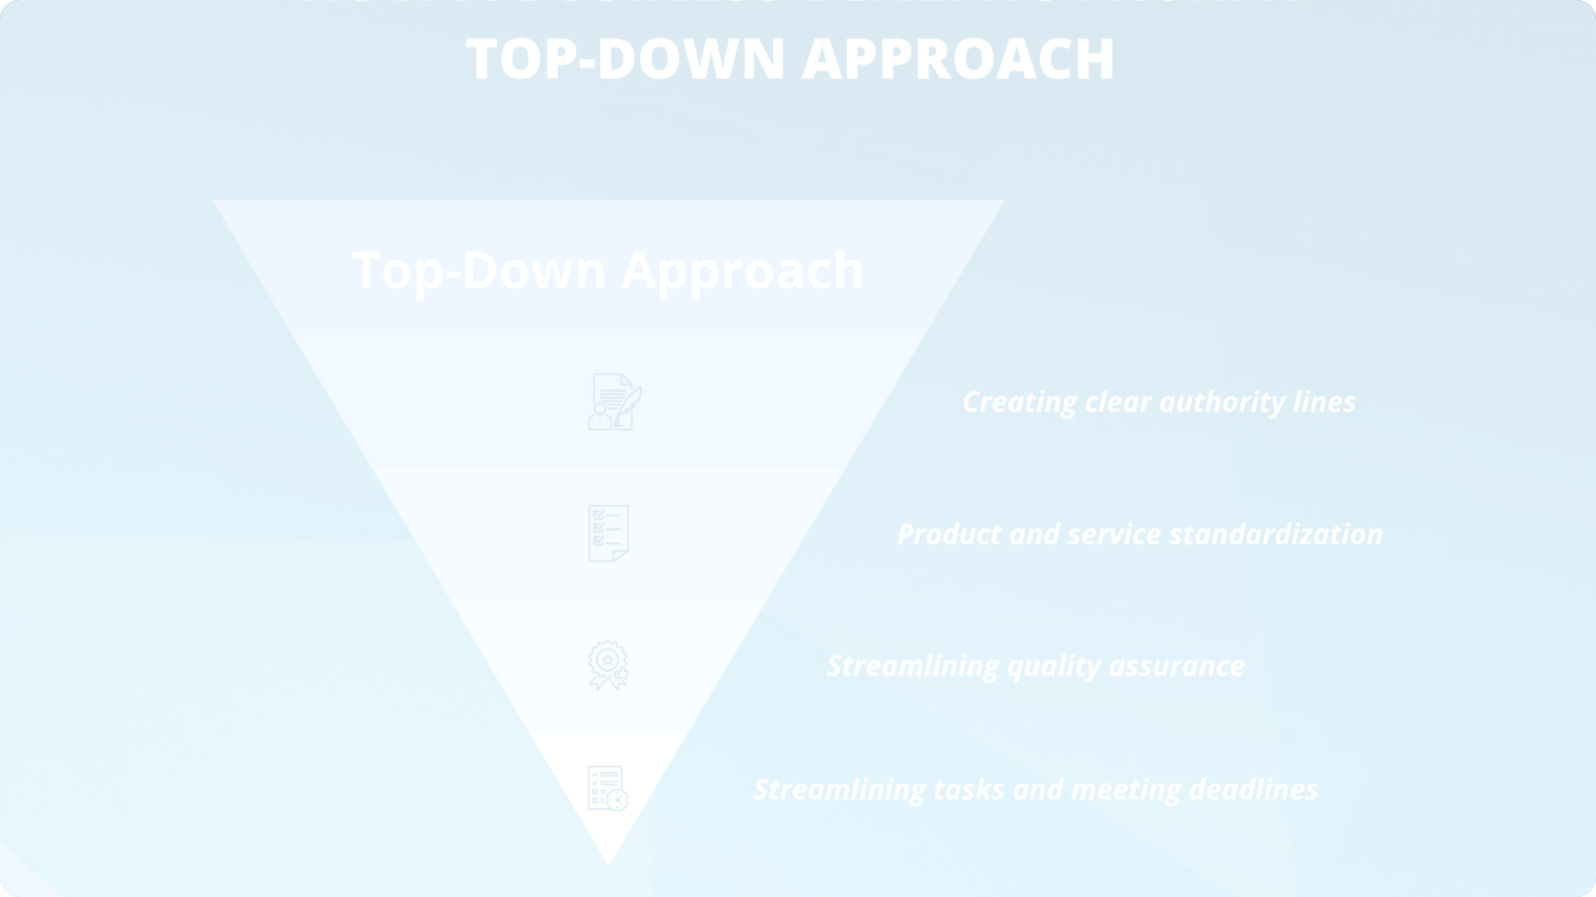
Top-Down Approach
Identify Drivers
Aggregate
Pinpoint the key factors that influence the overall estimate.
Combine the individual estimates to arrive at the final number.
1
2
3
Break Down
Divide the big picture into smaller, more manageable components.

Slide 3
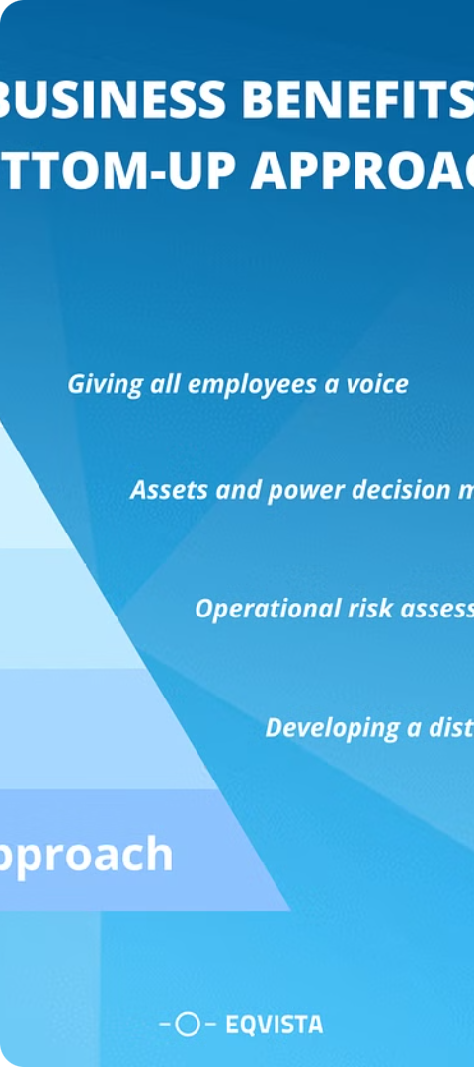
Bottom-Up Approach
1
Identify Components
Determine the individual elements that contribute to the overall estimate.
2
Estimate Individually
Calculate the value of each component using available data and assumptions.
3
Sum Up
Add up the individual estimates to arrive at the final number.

Slide 4
Constraints Lead
Time
Resources
Stakeholder Needs
The available time frame to make the estimate can significantly impact the approach and level of detail.
The data, tools, and personnel resources at hand will determine the depth and accuracy of the guesstimate.
Understanding the specific requirements and expectations of the stakeholders is crucial for a relevant guesstimate.

Slide 5




Solving a Guesstimate Question
Understand the Problem
Identify Relevant Factors
Apply Appropriate Approach
Validate and Refine
Cross-check the estimate, make adjustments, and ensure it aligns with the stakeholder's needs.
Clearly define the question and the goal of the guesstimate.
Determine the key drivers and components that influence the estimate.
Choose between top-down, bottom-up, or a combination of methods based on the available data and constraints.

Slide 6
Estimating the Number of Rapido Customers per Day
Top-Down Approach
Bottom-Up Approach
Constraints-Led Approach
Estimate the total daily active users of the Rapido app, then calculate the percentage who request rides on a given day.
Determine the average number of rides per day for each Rapido driver, then multiply by the total number of drivers to get the daily customer estimate.
Consider factors like app usage patterns, driver availability, and customer demand during different times of the day and week.

Slide 7
Top-Down Approach
Start with Total Population: Suppose we know the total population of the area where Rapido operates. Let's assume it's a city with a population of 1 million people.
Estimate the Market Share: Assume that 5% of the population uses Rapido regularly.
Calculate Total Customers:
=Total customers=Population×Market share
Total customers=1,000,000×0.05=50,000 customers

Slide 8
Break Down by Segments: Break down the potential customer base into segments (e.g., students, office-goers, tourists).
Estimate Each Segment: Estimate how many customers from each segment might use Rapido in a day
Sum Up: Add up all the estimated numbers from each segment to get the total.
For example:
Students: 10,000
Office-goers: 20,000
Tourists: 5,000
Total customers=10,000+20,000+5,000=35,000 customers
Bottom-up Approach

Slide 9
Conclusion
1
Key Takeaways
2
Practical Application
3
Continuous Improvement
Guesstimating is a valuable skill for making informed decisions with limited data. The top-down, bottom-up, and constraints-led approaches offer different perspectives.
By applying these techniques to the Rapido customer estimation problem, you can develop a more accurate and reliable guesstimate.
Refine your guesstimating skills through practice, feedback, and a willingness to adapt your approach to the specific challenges at hand.

