Slide 1

WalletPlatform
Digital Wallet & Payment Platform
Capgemini Industrial Training Report
Bachelor of Technology (Information Technology)
Lovely Professional University
December 2025 – May 2026
Anuska Palit
CONFIDENTIAL | INDUSTRIAL TRAINING REPORT | 2025–2026

Slide 2
Training Overview
Category | Details
Organization | Capgemini
Duration | 5 Months (18 Dec 2025 – 20 May 2026)
Domain | .NET Full Stack Development
Project | WalletPlatform – Digital Wallet & Payment Platform
Technologies | .NET 10 · Angular · SQL Server · RabbitMQ
Training Focus: ASP.NET Core · Angular · Microservices Architecture · RabbitMQ · JWT Authentication · SQL Server

Slide 3
Training Structure
Phase 1
Phase 2
Phase 3
Phase 4
Phase 5
Foundations
ASP.NET Core
APIs & Security
Microservices
Project
C# Fundamentals
OOP Concepts
Collections
LINQ
Async Programming
MVC
Dependency Injection
Middleware
Entity Framework Core
REST APIs
JWT Auth
Refresh Tokens
Swagger
RabbitMQ
Ocelot Gateway
Angular
RxJS
WalletPlatform
Full Integration
Production Build

Slide 4
Technical Skills Acquired
C# & .NET 10
ASP.NET Core
Microservices
Core Competencies
OOP Principles
LINQ
Async Programming
Web APIs
JWT Authentication
Swagger Docs
Service Decomposition
RabbitMQ Messaging
Ocelot API Gateway
.NET 10
Angular
Microservices
JWT
RabbitMQ
Ocelot
Angular
Database
EF Core
SQL Server
Components & Routing
Reactive Forms
RxJS
SQL Server
Entity Framework Core
Schema Design
REST APIs
Swagger
LINQ
Async/Await

Slide 5
System Architecture
Microservices Architecture Independent services communicate through RabbitMQ and are exposed via a centralized Ocelot API Gateway.
Ocelot API Gateway
RabbitMQ Message Bus
Service | Responsibility
Auth Service | Authentication & JWT
User Profile | KYC & User Info
Wallet Service | Wallet Management
Ledger Service | Transaction Records
Rewards Service | Loyalty Points
Catalog Service | Reward Redemption
Notification | Email Notifications
Receipts Service | Receipt Generation
Admin Service | Administrative Controls
Wallet
Ledger
Auth
Rewards
Catalog
Profile
Receipts
Admin
Notify
Angular Frontend

Slide 6
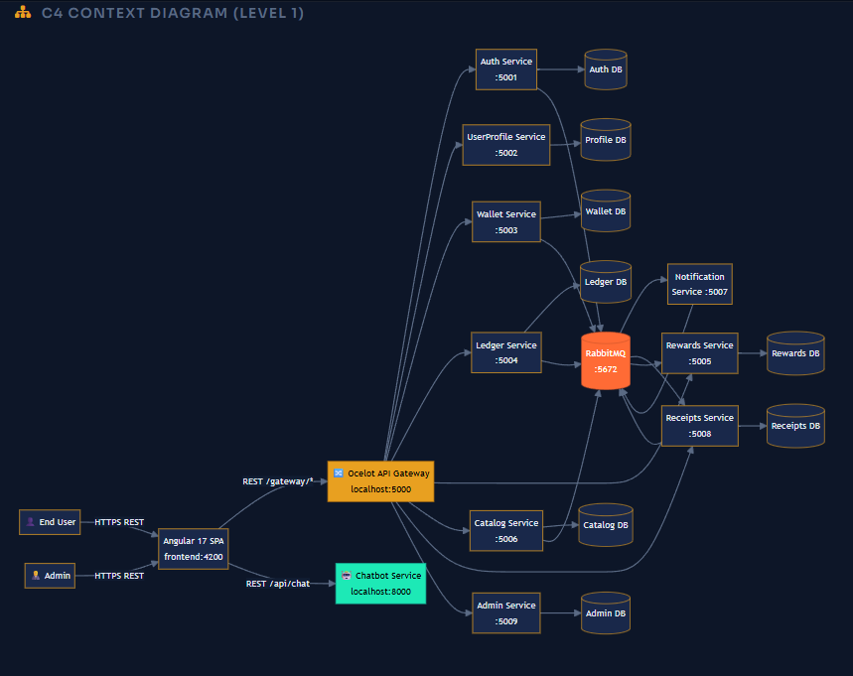
System Architecture
Ocelot API Gateway

Slide 7
Key Features
🔐
Secure Authentication
💳
Digital Wallet
🪪
KYC Verification
JWT with Refresh Tokens and Role-Based Access Control for all platform users.
Wallet creation, balance management, and secure money transactions.
Admin-reviewed document verification workflow for user onboarding.
🎁
Rewards System
📨
Event-Driven
🤖
AI Assistant
Earn loyalty points and redeem vouchers through the rewards catalog.
RabbitMQ-powered async communication between independent services.
Integrated chatbot for user support and platform guidance.

Slide 8
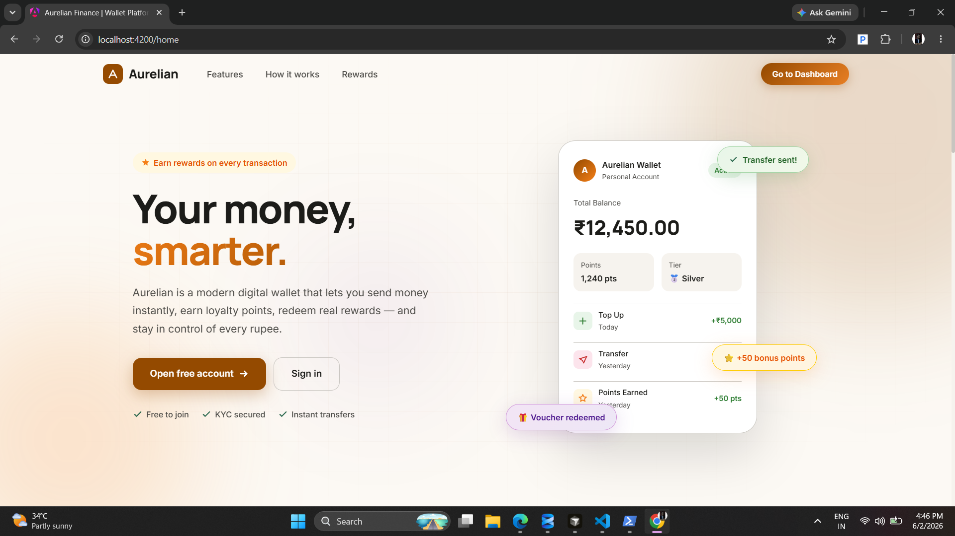
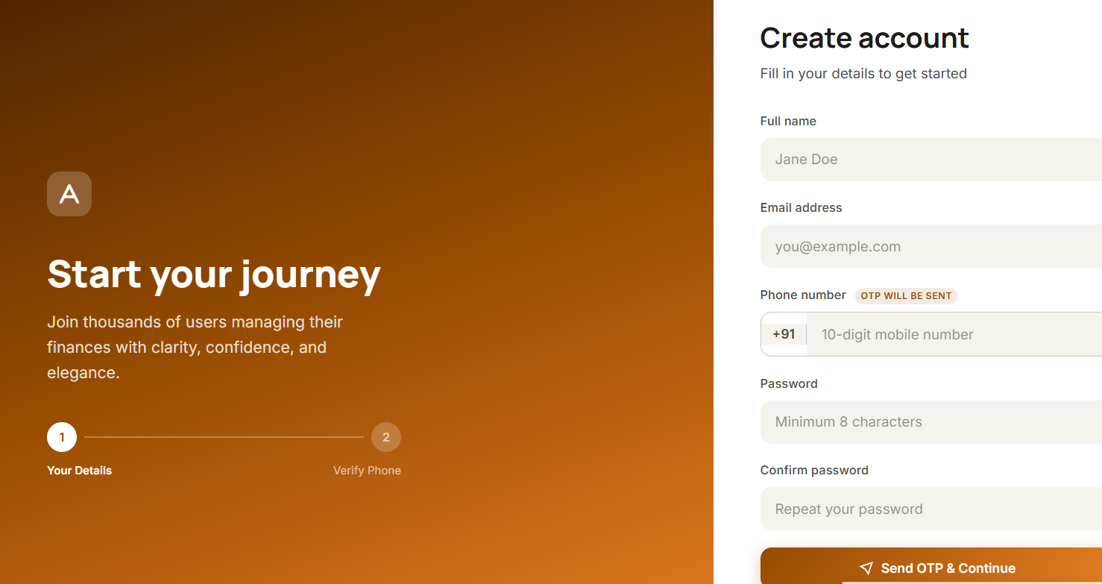
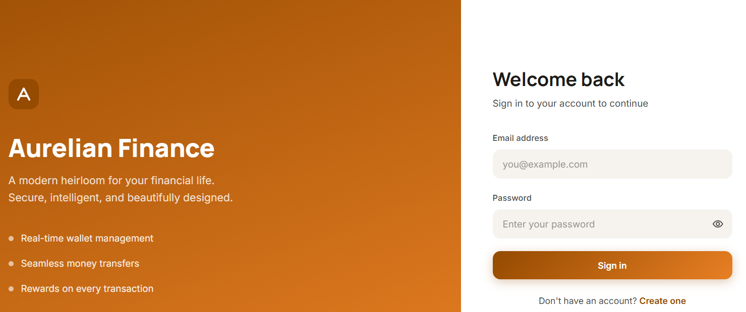
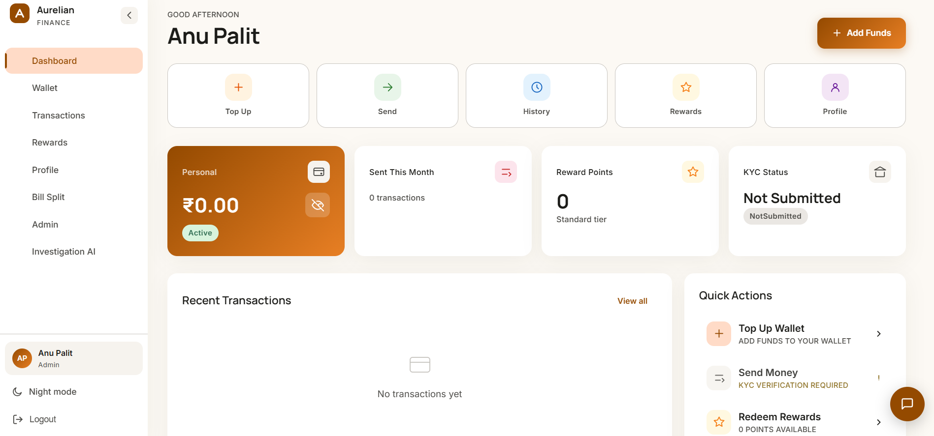
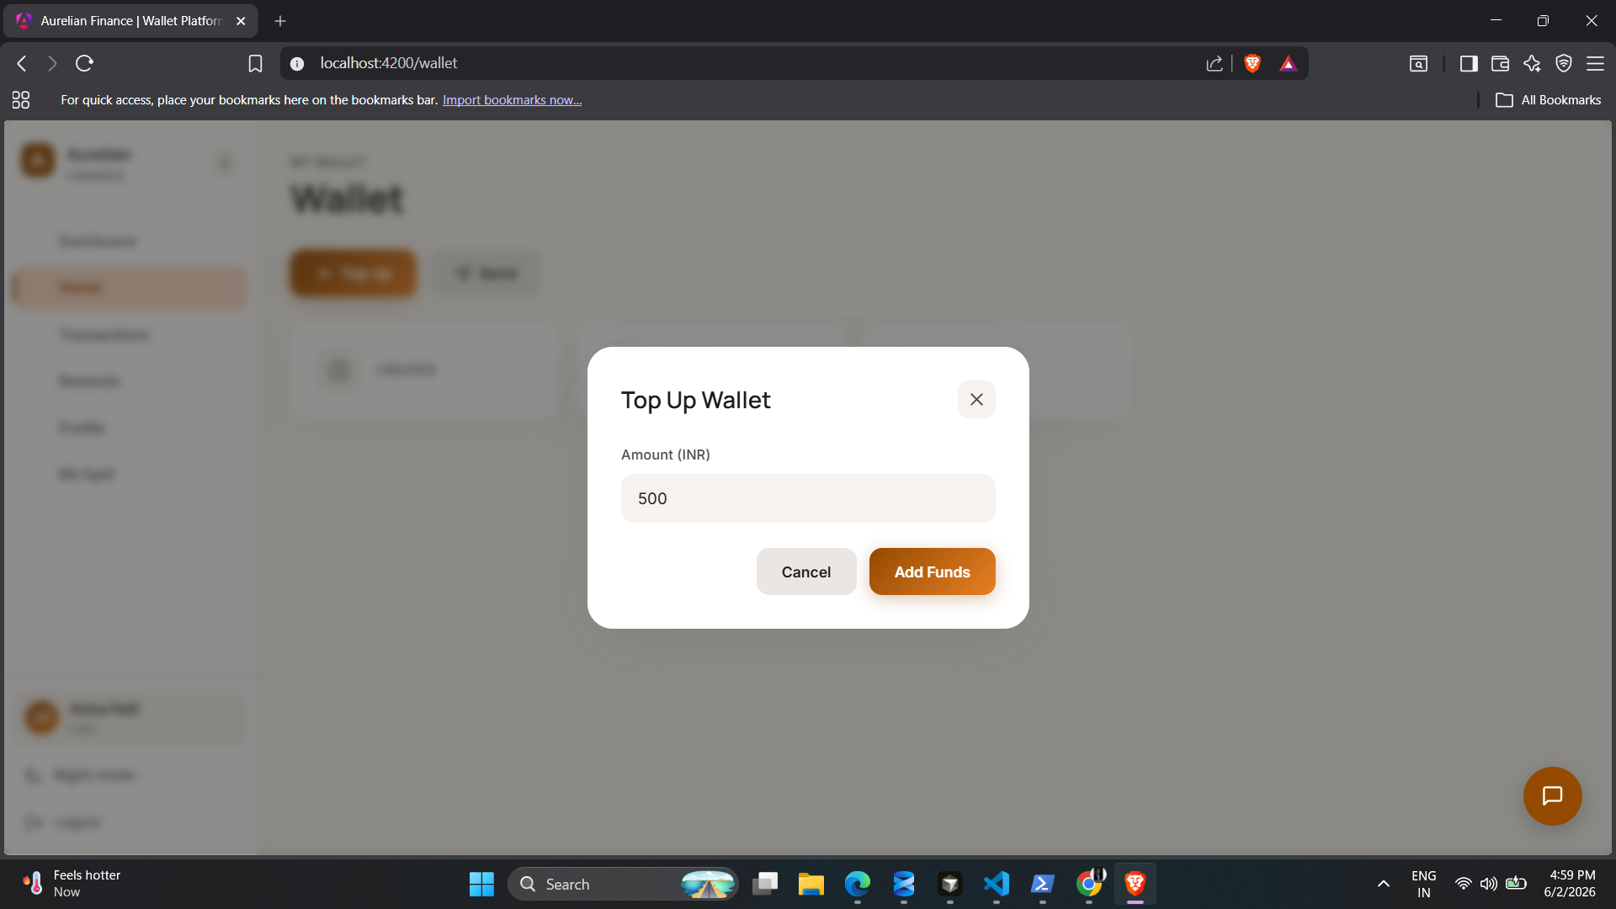
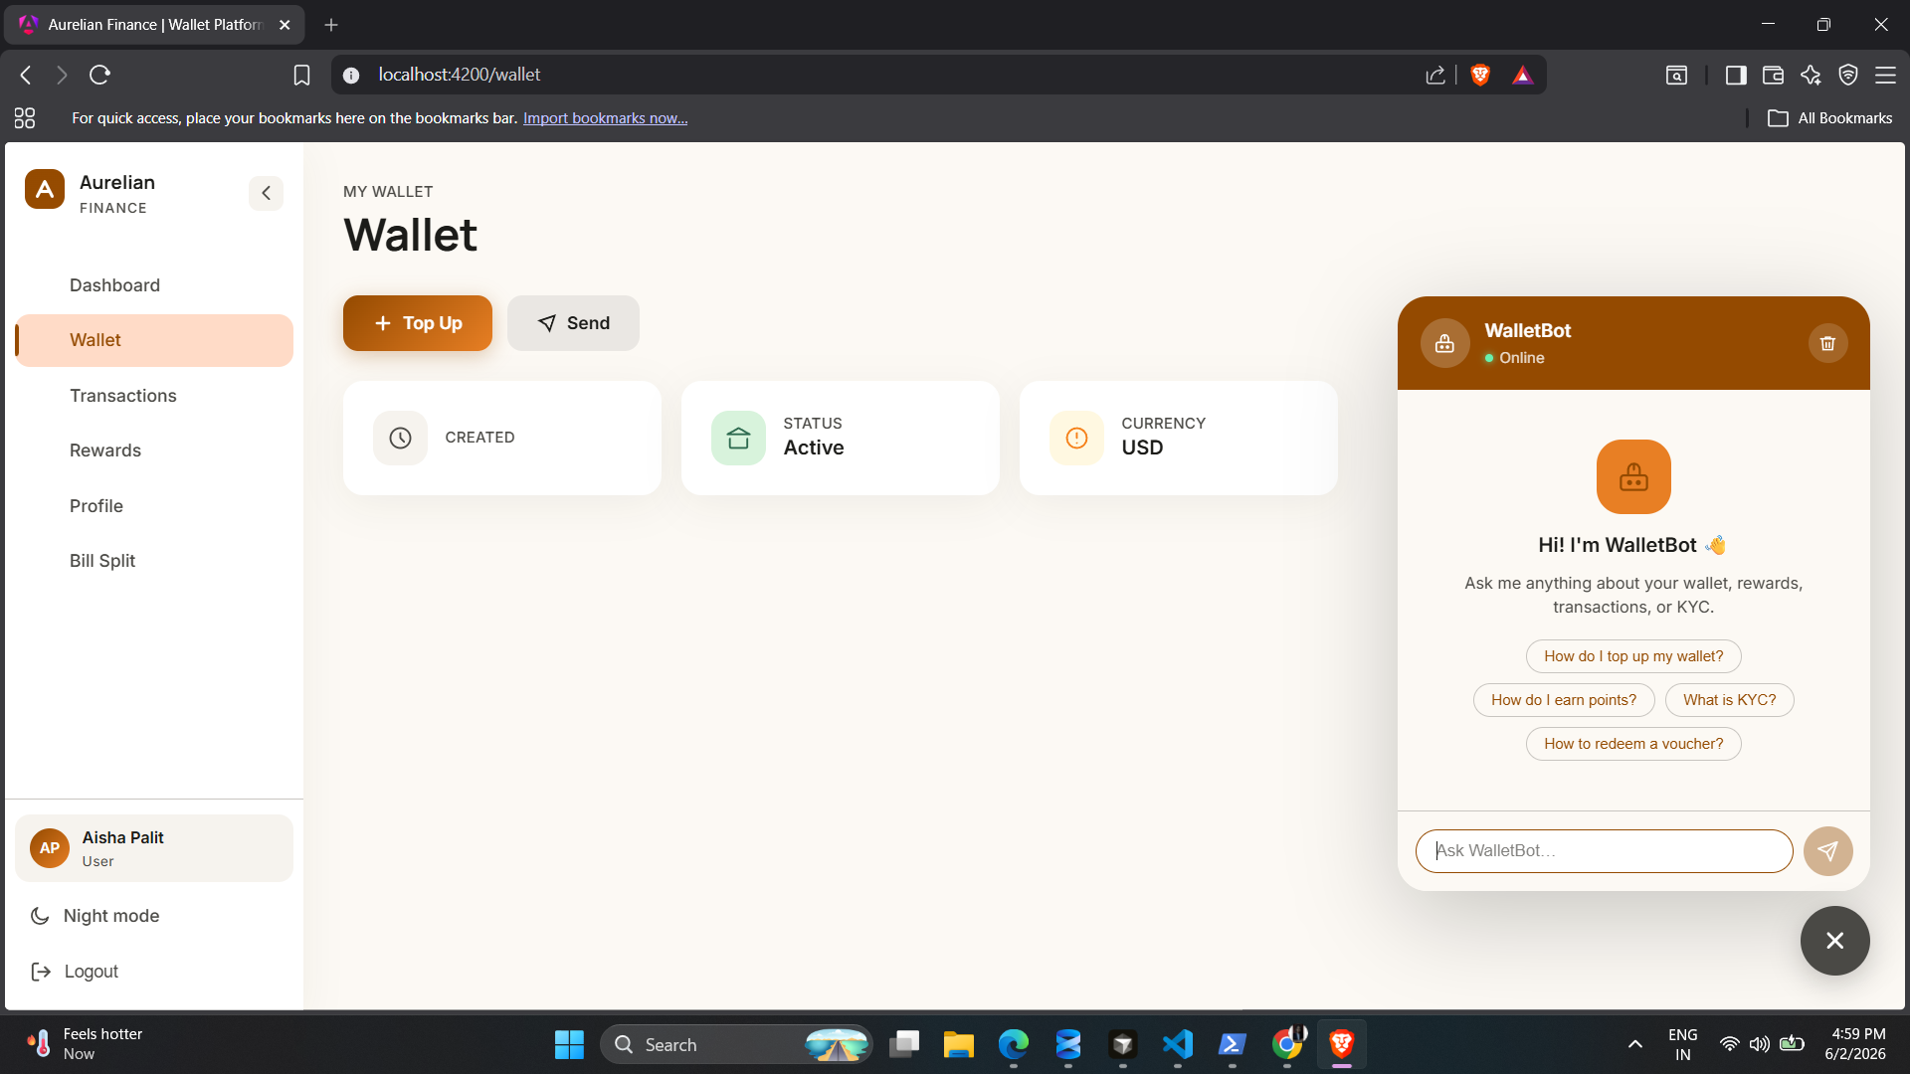
Interface Designs
Landing Page
Registration
Login Page
User Dashboard
Wallet Module
ChatBOT
📌 Replace placeholder frames with actual application screenshots.

Slide 9
Examinations & Evaluations
01
M1
02
PE1
03
PE2
04
L1
M1 Assessment
Project Eval 1
Project Eval 2
L1 Assessment
C# and .NET Fundamentals Based Coding
Technical Interview I
Technical Interview II
Final Technical Evaluation
Based MCQs
✓
✓
✓
✓
Training Outcome
Successfully completed all assessments and project evaluations while developing a production-grade fintech application.

Slide 10
Conclusion
📈
Technical Growth
Gained practical experience in .NET Full Stack Development, Microservices Architecture, Angular, SQL Server, RabbitMQ, and secure application development.
🏗️
Project Achievement
Developed WalletPlatform — a scalable digital wallet ecosystem featuring authentication, KYC verification, transactions, rewards, notifications, and admin controls.
💼
Industry Readiness
The training enhanced problem-solving abilities, software engineering skills, and readiness for enterprise-level software development roles.

Slide 11
Thank You
Anuska Palit
Bachelor of Technology (Information Technology)
Lovely Professional University
Capgemini Industrial Training · 2025–2026
WALLETPLATFORM · DIGITAL WALLET & PAYMENT PLATFORM

