Slide 1

Department of Computer Science & Engineering Internship Presentation
SPRING-BOOT APPLICATION TO EXTRACT DATA FROM PDF
Project member
ARITRA DAS 1DB19CS013
Guide
Prof.

Slide 2
Index
Introduction
Problem Definition
Objectives
Methodology
Outcome
Conclusion
References

Slide 3
INTRODUCTION
INTRODUCTION TO SPRING-BOOT
Spring Boot is a project that is built on the top of the Spring Framework.
It provides an easier and faster way to set up, configure, and run both simple and web-based applications.

Slide 4
INTRODUCTION
REST-API
Representational State Transfer (REST) is an architectural style that defines a set of constraints to be used for creating web services. REST API is a way of accessing web services in a simple and flexible way without having any processing.
REST technology is generally preferred to the more robust Simple Object Access Protocol (SOAP) technology because REST uses less bandwidth, simple and flexible making it more suitable for internet usage.
It’s used to fetch or give some information from a web service. All communication done via REST API uses only HTTP request.

Slide 5
PROBLEM STATEMENT
Build a spring-boot application which takes a pdf as input (post request) and extracts the text, metadata and pdf-signature (if signed) from it and fetches it on user request (get request)

Slide 6
OBJECTIVE
Strive to obtain an exhibition of an automated voice classification model using Machine Learning. The principle behind the working of this project is to detect the sentiments behind the tone of the speech.

Slide 7
METHODOLOGY
Creating a model in which we feed the dataset of different kinds of voice and tones.
The model is trained accordingly and after the training the model is ready.
The model is then able to detect the sentiments behind the voice or the audio that is given by the user.

Slide 8
METHODOLOGY
Creating a model in which we feed the dataset of different kinds of voice and tones.
The model is trained accordingly and after the training the model is ready.
The model is then able to detect the sentiments behind the voice or the audio that is given by the user.
The voice classification is done and then categorized on the basis of their tone such as sad, happy, disgust, neutral, fear, angry, surprised etc. and the result is given accordingly.

Slide 9
METHODOLOGY
This project uses CNN to analyse the given dataset and classify on the basis of various emotions such as angry, sad, neutral, surprised etc.
CNN stands for convolutional neural network, is a deep learning neural network sketched for processing structured arrays of data such as portrayals.
The CNN has the potential to improve speech recognition performance.

Slide 10
METHODOLOGY
The datasets used in this project are open source datasets which include:
RAVDESS
CREMA
SAVEE
TESS

Slide 11
OUTCOME
The project resulted in, the classification of the voice sentiment, and training the model to get maximum accuracy for the machine to analyse and recognize voice sentiment.
Where,
Test Accuracy : 0.8838643431663513
Test Loss: 0.4092389643192291

Slide 12
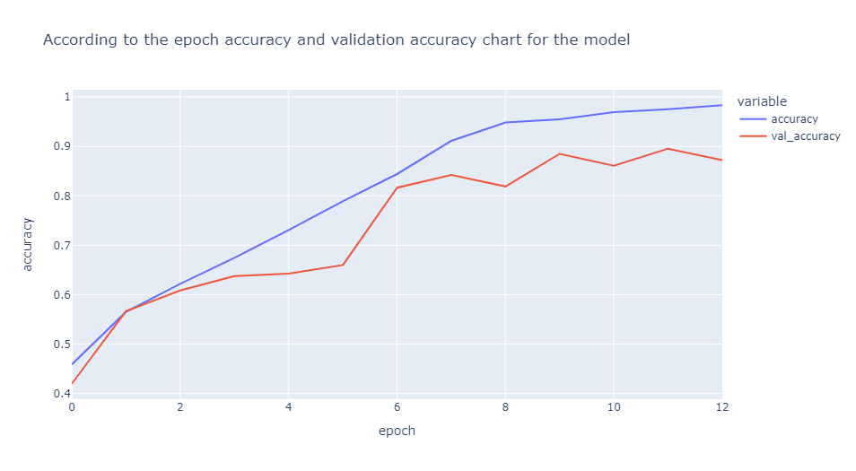
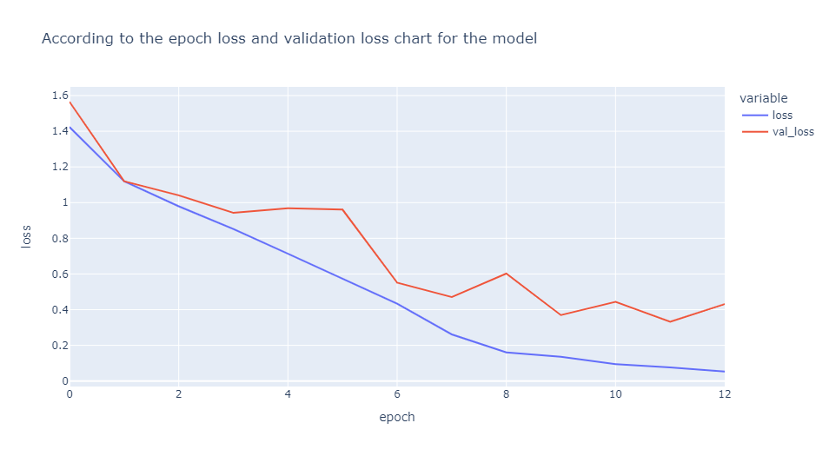
OUTCOME
Graph for epoch loss and accuracy.

Slide 13
CONCLUSION
This project Is applicable in many field and technical as well as industrial uses and decreases the workload for the trivial matters.
Being automated the machine is trained to analyse and give the result based on which the user can further work on their work.
It is easy to use and is hassle free.

Slide 14
REFERENCES
https://www.geeksforgeeks.org/what-is-sentiment-analysis/
https://www.geeksforgeeks.org/machine-learning-with-python/
https://www.kaggle.com/datasets/dmitrybabko/speech-emotion-recognition-en?select=Ravdess
https://www.kaggle.com/code/lkergalipatak/speech-emotion-recognition-with-cnn/notebook

Slide 15
THANK YOU

