Slide 1

AMASE: A Harness-Ablation Framework for Measuring Cost–Quality Trade-offs in Autonomous Software Engineering Agents
Department of Computer Science and Engineering
(Supervisor: Mr. <Supervisor Name>, Assistant Professor, CSE)
Group Members
Name of Member | Roll Number | Role
Aryan Raj Singh | <Roll No> | Backend, Agent Harness, Telemetry
<Team Member Name> | <Roll No> | Sandbox & Infrastructure
<Team Member Name> | <Roll No> | Evaluation & Benchmark Authoring
<Team Member Name> | <Roll No> | Documentation & Dashboard

Slide 2

Index
1. Introduction
2. Problem Definition
3. Objectives
4. Literature Survey
5. Research Gap
6. Proposed Methodology – System Architecture
7. Proposed Methodology – Ablation Arms
8. Feasibility Study, Need and Significance
9. Facilities Required
10. Expected Outcomes and References

Slide 3
Introduction
What is an autonomous software engineering agent?
An LLM operating a closed perception–action loop over a real development environment: it reads files, searches a repository, edits source, runs shell commands and tests, observes stdout/stderr, and revises its own work until the goal is met or a budget is exhausted.
What is the agent harness?
The software around the model — tool interface, prompting, control flow, context management, loop detection, model-selection policy and instrumentation. It involves no retraining, yet it decides what the system can actually do.
Why this matters
Harness design is worth an estimated 11–15 points of task resolution with the model held fixed.
One published result: 52.8 → 66.5 on Terminal-Bench 2.0 — harness changed, model unchanged.
That is comparable to, and often larger than, an entire model-generation upgrade.

Slide 4
Problem Definition
The gap
Practitioners choose among many harness mechanisms — context injection, pre-completion verification, loop detection, compaction, sub-agent delegation, retrieval architecture, model routing, reasoning-effort allocation — with no controlled evidence attributing an effect size or a cost to any individual mechanism.
Three consequences
Effort is spent on fashionable mechanisms rather than effective ones.
Systems ship with unquantified unit economics: +2 points at 3× tokens is invisible.
The benchmarks used to settle such questions are compromised.
Benchmark validity has collapsed
OpenAI retired SWE-bench Verified in 2026: an audit of 138 problems found 59.4% materially defective, with frontier models reproducing reference patches verbatim.

Slide 5
Objectives
Build a deliberately minimal coding-agent harness in which every mechanism is an independently switchable experimental arm rather than an architectural assumption.
Instrument every model call and tool invocation for tokens, monetary cost, latency and outcome, conforming to the OpenTelemetry GenAI semantic conventions.
Measure the marginal contribution of eight harness mechanisms to task resolution rate, token consumption, cost per task and p95 latency.
Execute each configuration a minimum of three times and report variance, since single-run agent benchmark figures are dominated by stochastic noise.
Author a decontaminated held-out task set so that findings survive scrutiny of benchmark validity.
Gate every pull request on an automated regression check so accumulated results are protected.
Publish the resulting attribution table, including negative results, as a reproducible artefact.

Slide 6
Literature Survey
Sr. | Work | Year | Contribution | Limitation
1 | ReAct (Yao et al.) | 2022 | Interleaves reasoning with actions; the control paradigm coding agents use. | Defines the loop, not what makes it reliable.
2 | Reflexion (Shinn et al.) | 2023 | Verbal self-reflection over failures without weight updates. | No component attribution or cost accounting.
3 | SWE-bench (Jimenez et al.) | 2023 | First large-scale real GitHub issue benchmark. | Saturated and contaminated; retired 2026.
4 | SWE-agent (Yang et al.) | 2024 | Purpose-built Agent-Computer Interface raises resolution sharply. | Shows interface matters; does not decompose it.
5 | OpenHands (Wang et al.) | 2024 | Open generalist software-development agent platform. | Optimises a whole product; mechanisms entangled.
6 | Lost in the Middle (Liu et al.) | 2023 | Retrieval degrades for mid-context information. | Diagnoses; does not evaluate remedies in a loop.
7 | RouteLLM (Ong et al.) | 2024 | Learned routing: ~95% quality at ~26% of cost. | Chat benchmarks, not long-horizon agentic tasks.
8 | SWE-rebench (Badertdinov et al.) | 2025 | Automated decontaminated task collection pipeline. | Clean tasks, but whole-system evaluation.
9 | SWE-Bench Pro (Scale AI) | 2025 | 1,865 long-horizon tasks, ~107 LOC over ~4.1 files. | Raises difficulty; attribution untouched.
10 | Terminal-Bench (Merrill et al.) | 2026 | 89 sandboxed CLI tasks, end-state verification, pluggable agents. | Supplies the substrate; supplies no ablations.

Slide 7
Research Gap
What the literature establishes
The harness is the dominant controllable factor in coding-agent performance.
What it does not establish
No work isolates individual harness mechanisms under controlled conditions — published results compare complete systems, so a practitioner cannot tell which of a dozen simultaneous design choices produced an observed improvement.
Cost is almost universally omitted. Benchmarks report resolution rate, not the tokens or currency spent to achieve it, although that ratio decides whether a technique is deployable.
The benchmarks conventionally used for such measurement are demonstrably invalid.
The gap AMASE occupies
A reproducible, cost-annotated, contamination-resistant framework that attributes agent performance to its individual harness components — addressing all four conditions simultaneously.

Slide 8
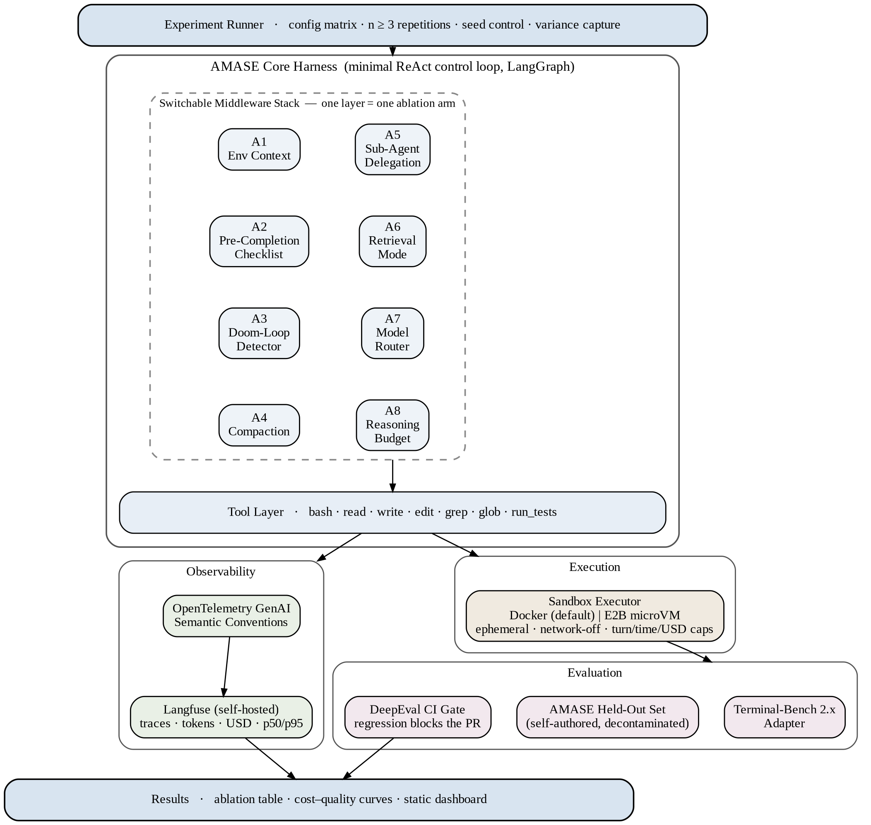
Proposed Methodology – System Architecture

Slide 9
Proposed Methodology – Harness Ablation Arms
Arm | Mechanism | Function | Hypothesis
A1 | Environment context | Directory map, tool discovery and budget stated at startup. | Small gain, low token cost
A2 | Pre-completion checklist | Blocks completion until output is verified and tests run. | Largest single effect
A3 | Doom-loop detection | Per-file edit counters trigger a forced re-plan. | Fewer catastrophic runs; better p95
A4 | Compaction strategy | Truncation vs summarisation vs external notes file. | Notes win on long-horizon tasks
A5 | Sub-agent delegation | Review in a clean context, returning a condensed summary. | Positive only past a length threshold
A6 | Retrieval mode | Agentic search vs BM25 + dense + cross-encoder rerank. | Agentic wins on exact symbols
A7 | Model routing | Frontier for plan/debug, local SLM for mechanical edits. | Large cost cut, small quality loss
A8 | Reasoning budget | Uniform effort vs high-plan / mid-build / high-verify. | Better resolution per rupee

Slide 10
Feasibility Study, Need and Significance
Technical
Every component is mature and open source — LangGraph, Docker, Langfuse, DeepEval, Ollama, Terminal-Bench. No model training, no specialised hardware, no proprietary dataset.
Economic
Full matrix runs on a cheap or local model; frontier models only for final confirmation. Hard per-rollout caps on turns, time and spend. Spend tracked in the same telemetry pipeline.
Operational and Schedule
Operated by the developers, so no adoption risk. Five phases with explicit exit criteria; the measurement infrastructure is completed before any experimental arm is attempted.
Need and Significance
Agents are deployed in production on anecdotal design evidence, while the usual means of settling such questions has been withdrawn by its own authors.
Contribution: an attribution of effect and cost per mechanism, a reusable experimental apparatus, and a decontaminated task set. Negative results carry equal weight.

Slide 11
Facilities Required
Hardware
Intel Core i5 (8th gen) / AMD Ryzen 5 or better; 16 GB RAM (32 GB recommended); 256 GB SSD with 80 GB free; NVIDIA GPU with 8 GB VRAM (optional, for the local-model routing arm).
Software
Python 3.11 with uv; LangGraph for the stateful control loop; Docker Engine and Compose for sandboxes; E2B SDK behind the same interface for microVM isolation.
OpenTelemetry SDK with a self-hosted Langfuse backend; DeepEval and pytest for the CI gate; Terminal-Bench 2.x as the task harness.
Qdrant, rank_bm25, sentence-transformers and tree-sitter for the hybrid retrieval arm; Ollama and vLLM for local model serving; pandas and matplotlib for analysis.
Data
Terminal-Bench 2.x public dataset, plus 25–40 self-authored held-out tasks in three difficulty tiers, drawn from repositories with no plausible training-corpus presence.

Slide 12
Expected Outcomes and References
Expected outcomes
An attribution table: for each of eight mechanisms, its marginal effect on resolution rate with token and monetary cost attached, reported with variance over n ≥ 3 runs.
Cost–quality curves for the routing and retrieval arms, with the operating knee identified.
A reproducible apparatus and a decontaminated task set, released with the write-up.
References
[1] S. Yao et al., “ReAct: Synergizing Reasoning and Acting in Language Models”, arXiv:2210.03629, 2022.
[2] C. E. Jimenez et al., “SWE-bench: Can Language Models Resolve Real-World GitHub Issues?”, arXiv:2310.06770, 2023.
[3] J. Yang et al., “SWE-agent: Agent-Computer Interfaces Enable Automated Software Engineering”, NeurIPS, 2024.
[4] I. Ong et al., “RouteLLM: Learning to Route LLMs with Preference Data”, arXiv:2406.18665, 2024.
[5] M. A. Merrill et al., “Terminal-Bench: Benchmarking Agents on Hard, Realistic Tasks in CLIs”, arXiv:2601.11868, 2026.
[6] OpenAI, “Why SWE-bench Verified No Longer Measures Frontier Coding Capabilities”, 2026.

Slide 13
Thank You

Slide 14
Feedback from the Panel
The panel wants the team to :

