Slide 1


POWER BI
USA
Flight Status Dashboard
its.darsh

Slide 2







Goal # 1
OVERVIEW
Goals
Goal # 2
To Analyse Airline’s
MAP’S / FLIGHTS DATA
Goal # 3
DASHBOARD

Slide 3
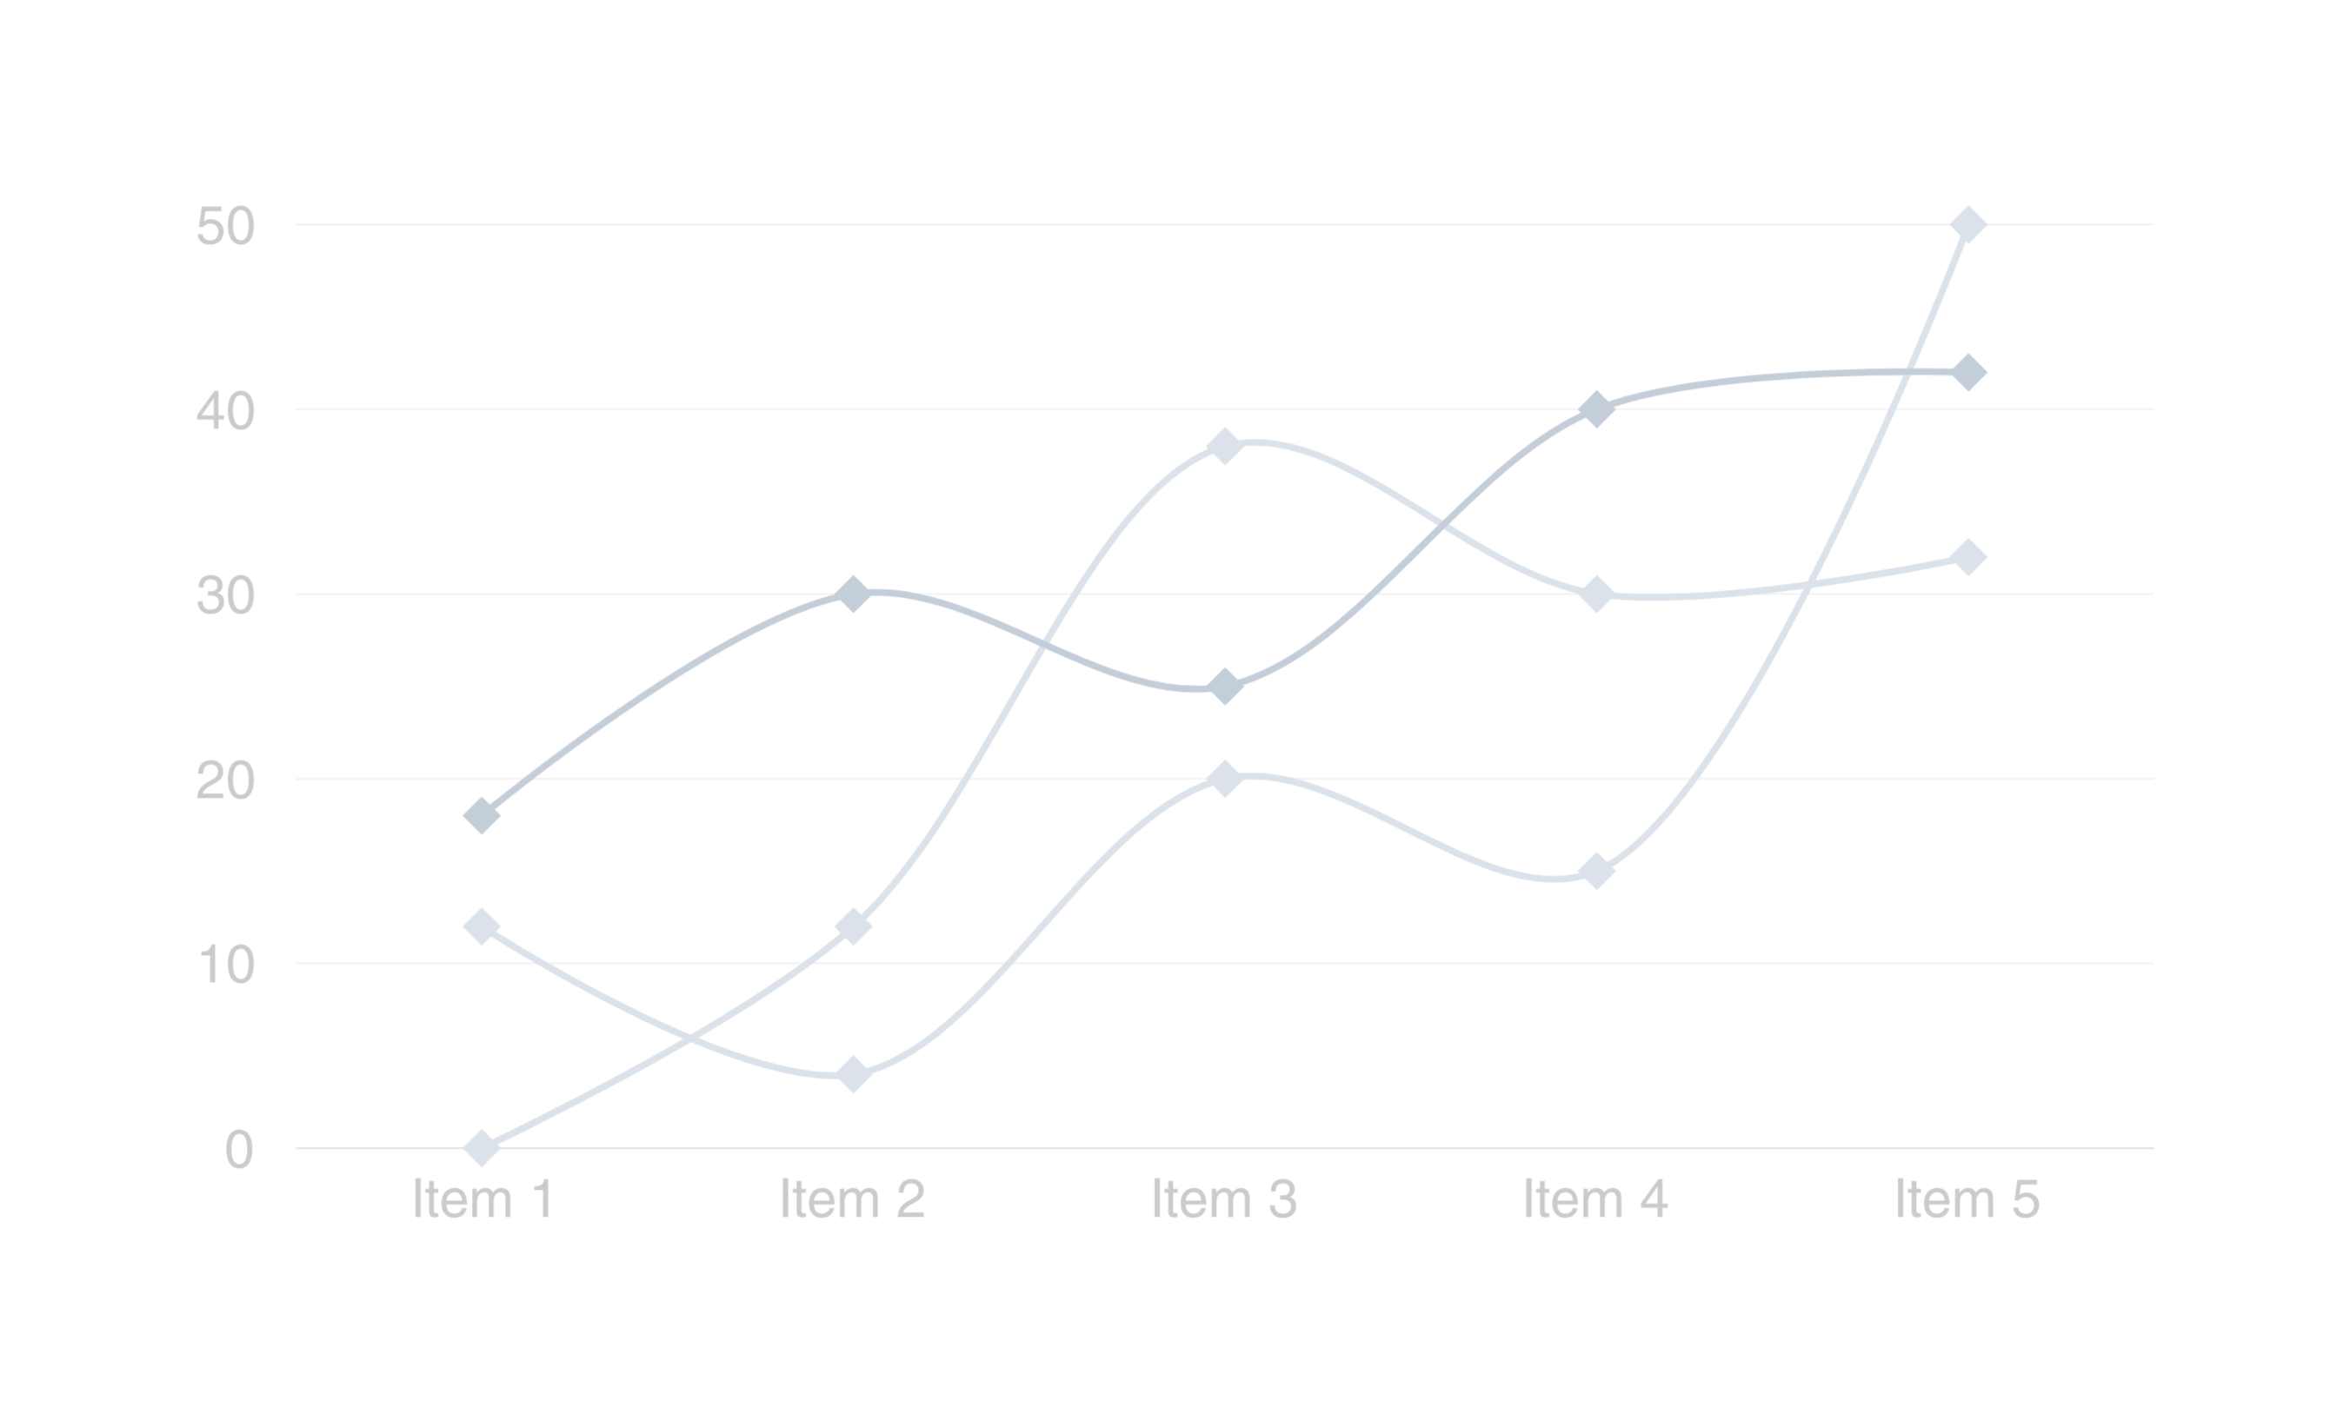

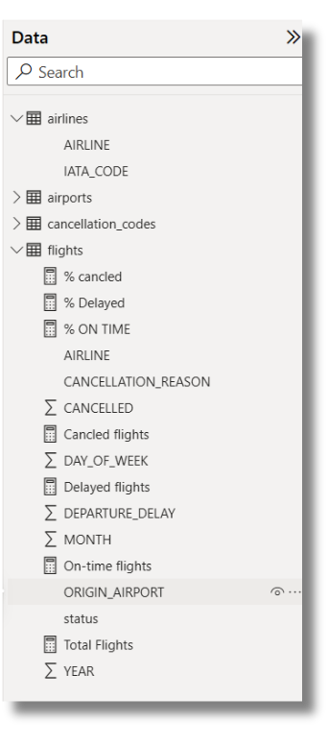
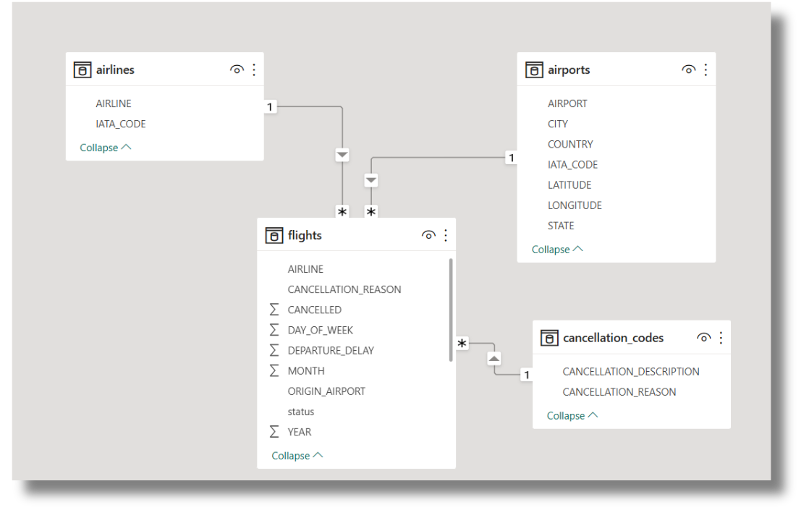
MODEL VIEW

Slide 4
Dashboard

