Slide 1

Trees
Binary Trees Binary Search Trees
Balanced Binary Search Trees

Slide 2
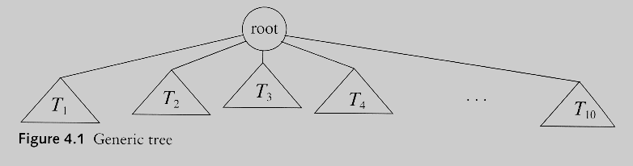
Trees
A tree is a collection of nodes
The collection can be empty
(recursive definition) If not empty, a tree consists of a distinguished node r (the root), and zero or more nonempty subtrees T₁, T₂, ...., T_{k}, each of whose roots are connected by a directed edge from r

Slide 3
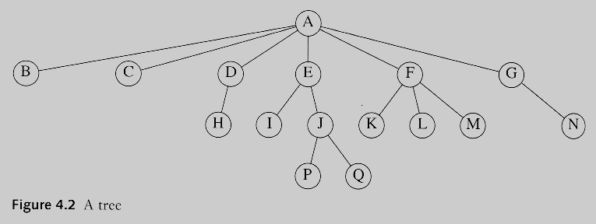
Some Terminologies
Child and parent
Every node except the root has one parent
A node can have an arbitrary number of children
Leaves
Nodes with no children
Sibling
nodes with same parent

Slide 4
Some Terminologies
Path
Length
number of edges on the path
Depth of a node
length of the unique path from the root to that node
The depth of a tree is equal to the depth of the deepest leaf
Height of a node
length of the longest path from that node to a leaf
all leaves are at height 0
The height of a tree is equal to the height of the root
Ancestor and descendant
Proper ancestor and proper descendant

Slide 5
Tree traversal
Used to print out the data in a tree
Pre-order traversal
Print the data at the node
Recursively print out all data in the subtree
Post-order traversal
Recursively print out all data in the subtree
Print the data at the node

Slide 6
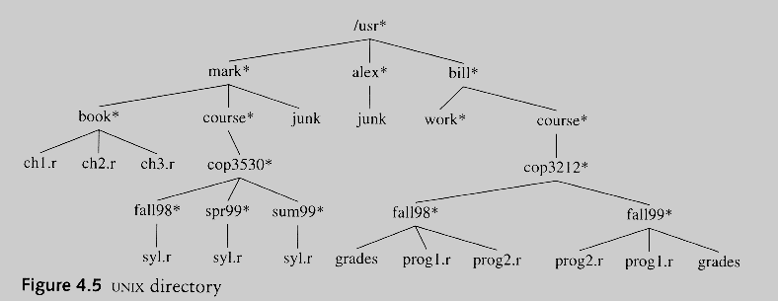
Link To: Example: UNIX Directory

Slide 7
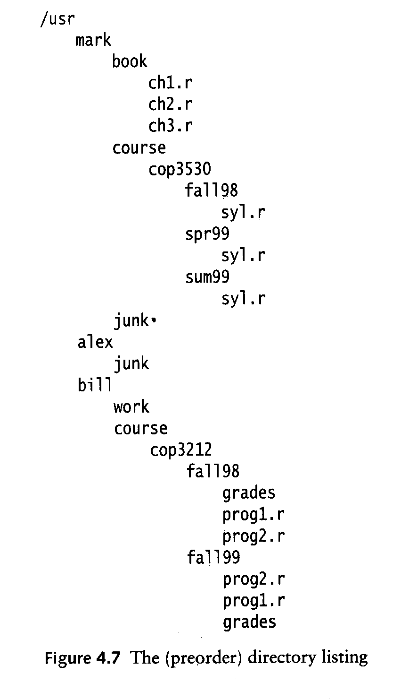
Preorder

Slide 8
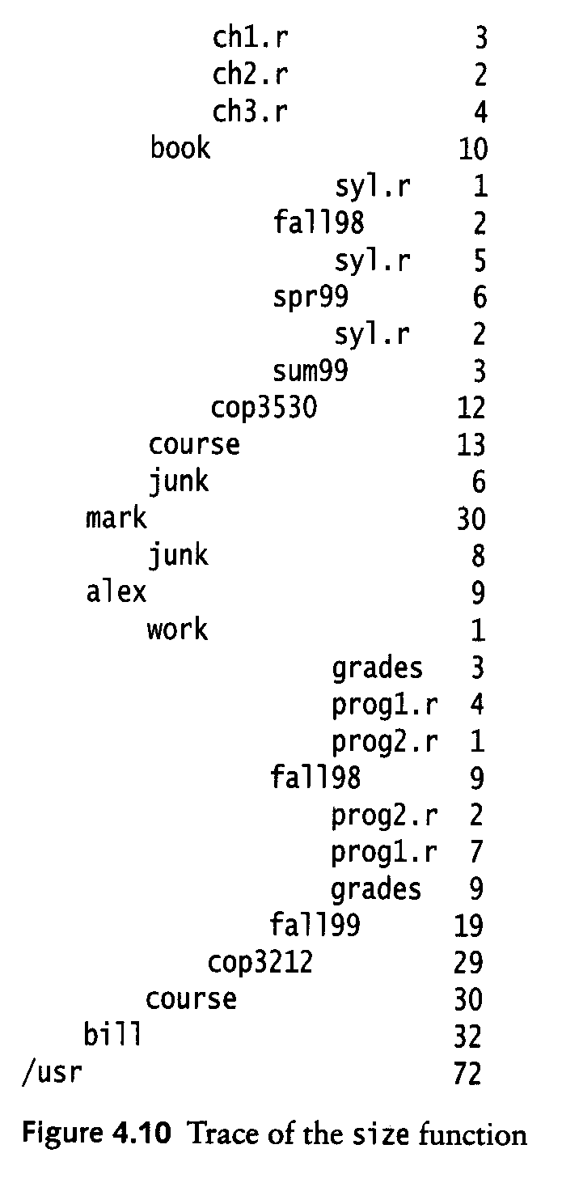
Postorder

Slide 9
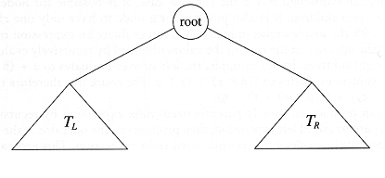
Binary Trees
A tree in which no node can have more than two children

Slide 10
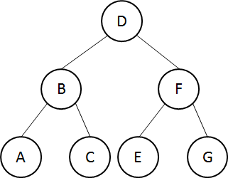
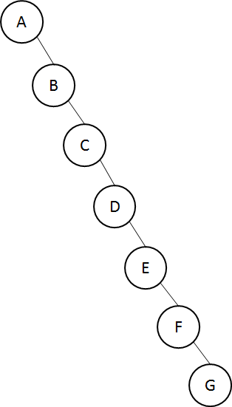
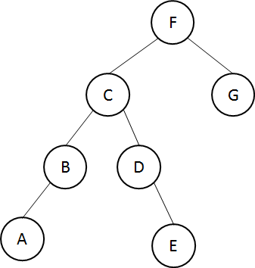
Binary Trees
The depth of an “average” binary tree is considerably smaller than N, even though in the worst case, the depth can be as large as N – 1.
best case
worst case

Slide 11
Tree traversal for binary trees
Used to print out the data in a binary tree
Pre-order traversal
Print the data at the root
Recursively print out all data in the left subtree
Recursively print out all data in the right subtree
In-order traversal
Recursively print out all data in the left subtree
Print the data at the root
Recursively print out all data in the right subtree
Post-order traversal
Recursively print out all data in the left subtree
Recursively print out all data in the right subtree
Print the data at the root

Slide 12
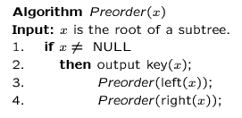
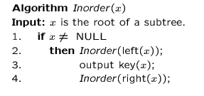
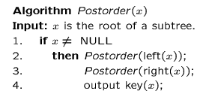
Preorder, Postorder and Inorder

Slide 13
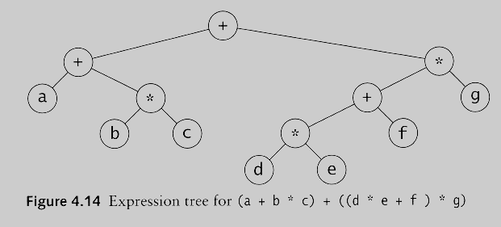
Example: Expression Trees
Leaves are operands (constants or variables)
The other nodes (internal nodes) contain operators
Will not be a binary tree if some operators are not binary

Slide 14
Preorder, Postorder and Inorder
Preorder traversal
node, left, right.
prefix expression
++a*bc*+*defg

Slide 15
Preorder, Postorder and Inorder
Inorder traversal
left, node, right.
infix expression
a+b*c+d*e+f*g

Slide 16
Preorder, Postorder and Inorder
Postorder traversal
left, right, node
postfix expression
abc*+de*f+g*+

Slide 17
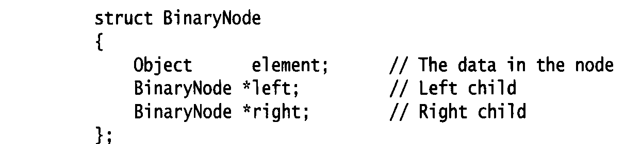
Implementation of Binary Tree
Possible operations on the Binary Tree ADT
parent
left_child, right_child
sibling
root, etc
Implementation
Because a binary tree has at most two children, we can keep direct pointers to them

Slide 18
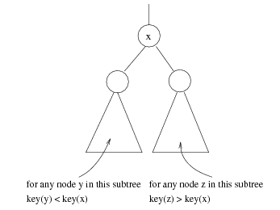
Binary Search Trees
Stores keys in the nodes in a way so that searching, insertion and deletion can be done efficiently.
Binary search tree property
For every node X, all the keys in its left subtree are smaller than the key value in X, and all the keys in its right subtree are larger than the key value in X

Slide 19
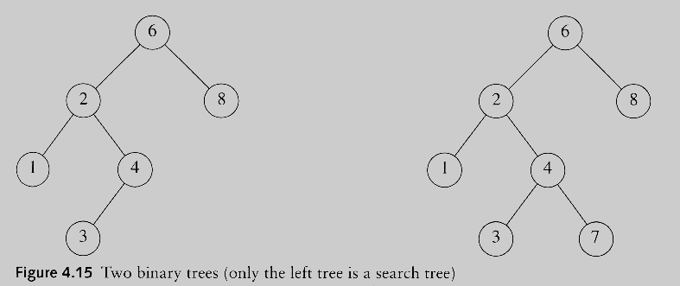
Binary Search Trees
A binary search tree
Not a binary search tree

Slide 20
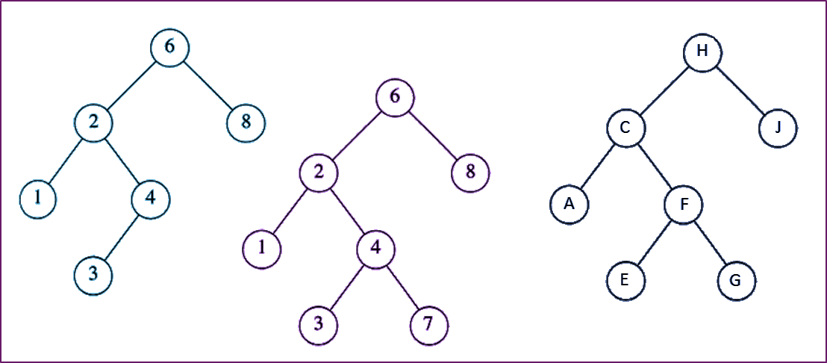
Which of these is not BST?

Slide 21
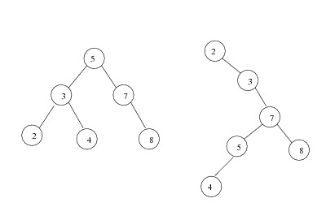
Binary search trees
Two binary search trees representing the same set:
Average depth of a node is O(log N);
Maximum depth of a node is O(N)

Slide 22
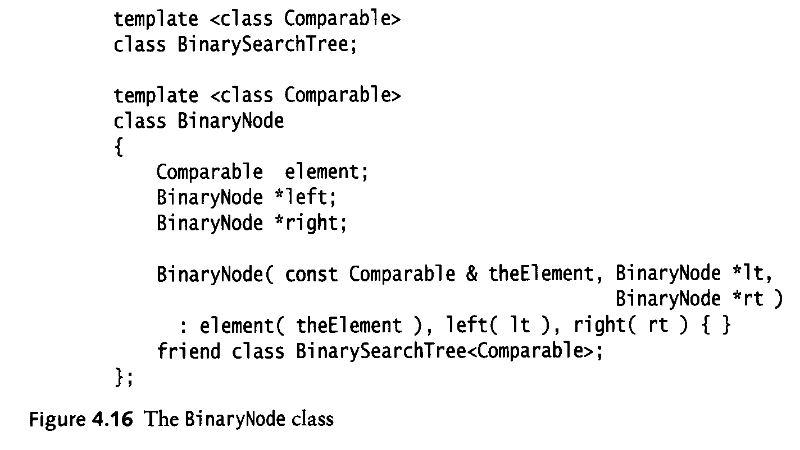
Implementation of Binary Search Tree

Slide 23
Implementation of a BST using an array
Node 1 is the root
Left child of node i is 2i
Right child of node i is 2i+1
Parent of node i is i/2
x
c
f
k
z
b
y
x | c | f | k | z | b | y

Slide 24
Implementation of BST using array for Incomplete Binary Tree
x
c
f
k
z
b
y
x | c | f | - | z | - | y

Slide 25
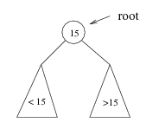
Searching BST
If we are searching for 15, then we are done.
If we are searching for a key < 15, then we should search in the left subtree.
If we are searching for a key > 15, then we should search in the right subtree.

Slide 26
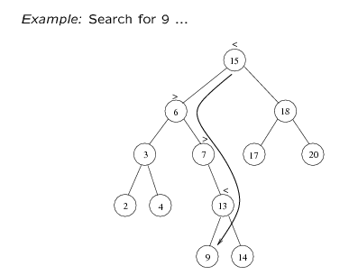
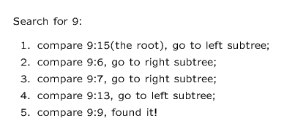

Slide 27
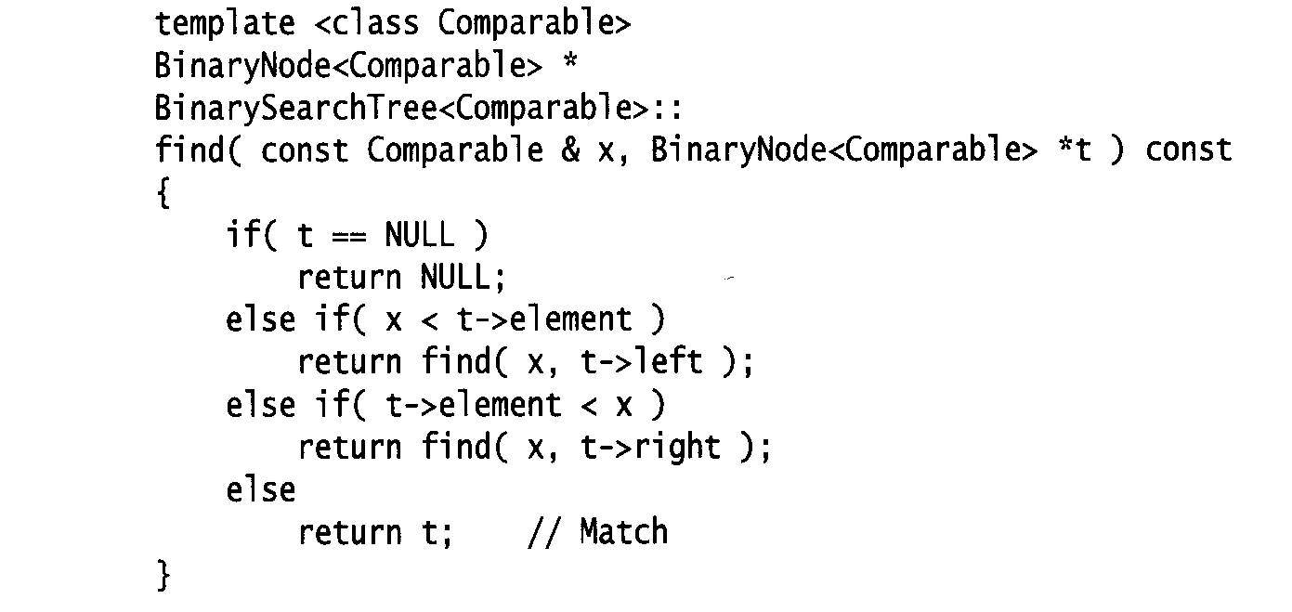
Searching (Find)
Find X: return a pointer to the node that has key X, or NULL if there is no such node
Time complexity
O(height of the tree)

Slide 28
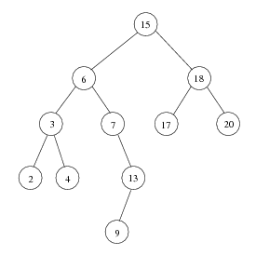
Inorder traversal of BST
Print out all the keys in sorted order
Inorder: 2, 3, 4, 6, 7, 9, 13, 15, 17, 18, 20

Slide 29
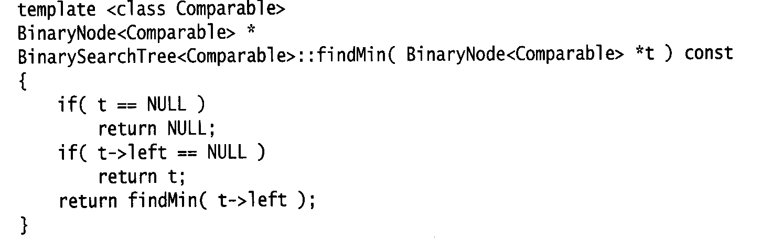
findMin/ findMax
Returns the node containing the smallest element in the tree
Start at the root and go left as long as there is a left child. The stopping point is the smallest element
Similarly for findMax
Time complexity = O(height of the tree)

Slide 30
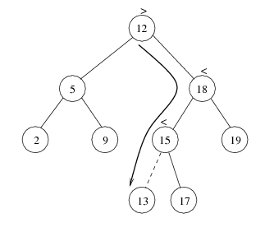
Inserting a node in BST
Proceed down the tree as you would with a find
If X is found, do nothing (or update something)
Otherwise, insert X at the last spot on the path traversed
Time complexity = O(height of the tree)

Slide 31
Deleting a node from BST
When we delete a node, we need to consider how we take care of the children of the deleted node.
This has to be done such that the property of the search tree is maintained.
Three cases:
the node is a leaf
the node has one child
the node has 2 children

Slide 32
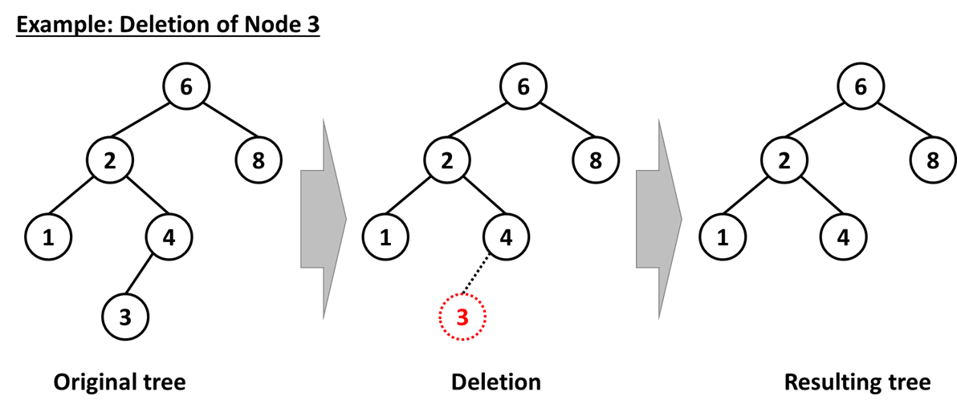
Three cases in deletion
Case 1: the node is a leaf
Delete it immediately

Slide 33
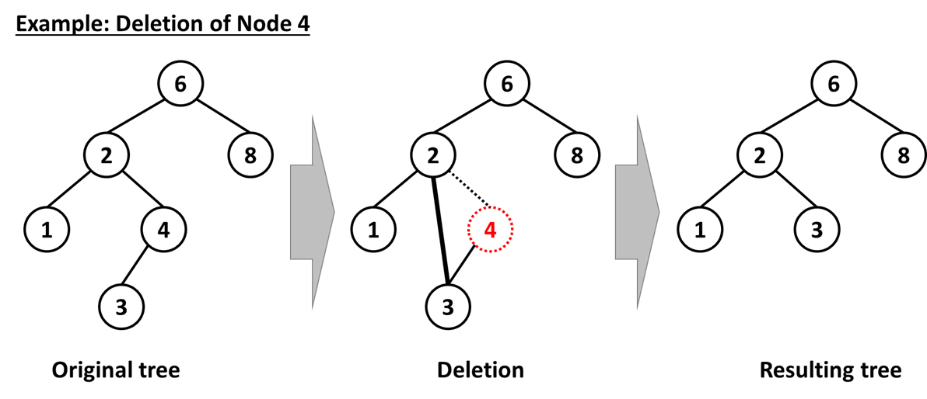
Three cases in deletion
Case 2: the node has one child
Adjust a pointer from the parent to bypass that node

Slide 34
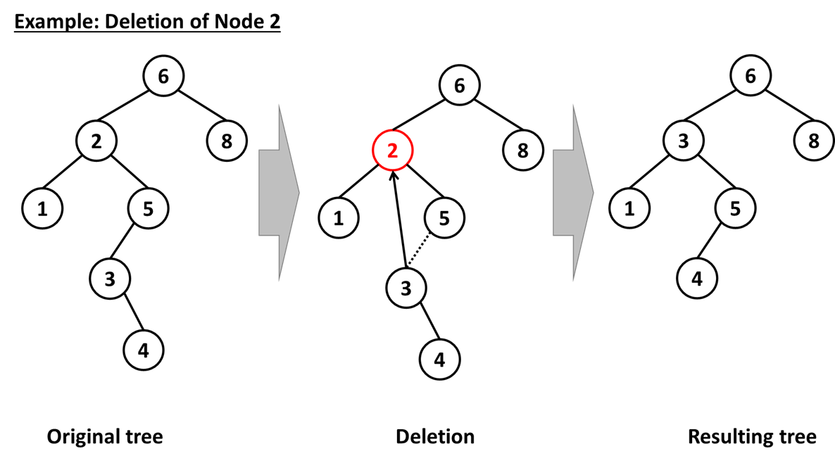
Three cases in deletion
Case 3: the node has 2 children
replace the key of that node with the minimum element at the right subtree
delete the minimum element
Has either no child or only right child because if it has a left child, that left child would be smaller and would have been chosen.
So invoke case 1 or 2.

Slide 35
Balanced binary tree
The disadvantage of a binary search tree is that its height can be as large as N-1
This means that the time needed to perform insertion and deletion and many other operations can be O(N) in the worst case
We want a tree with the least height
A binary tree with N node has height at least Θ(log N)
Thus, our goal is to keep the height of a binary search tree O(log N)
Such trees are called balanced binary search trees. Examples are AVL tree, B+ tree and red-black tree.

Slide 36
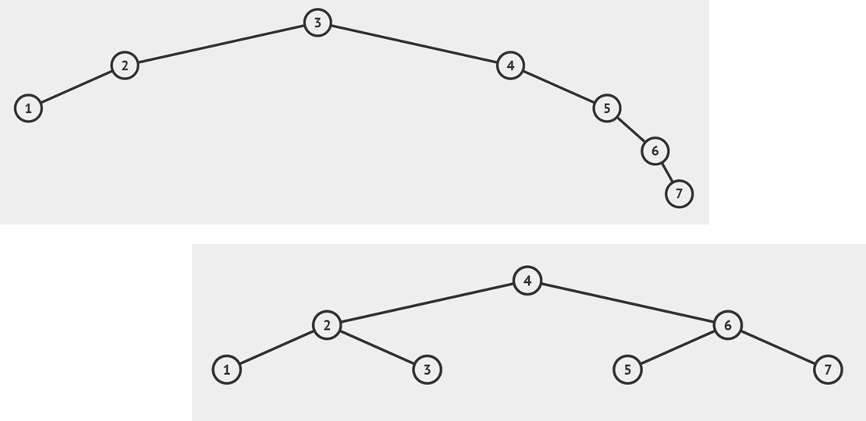
Why balanced binary search tree?

Slide 37
AVL tree
Named after Georgy Adelson-Velsky and Evgenii Landis
An AVL Tree is a BST in which every node in the tree, the height of left and right subtrees differ by at most 1
Balancing factor, d = height of left subtree - height of the right subtree
d element of {1, 0, -1}

Slide 38
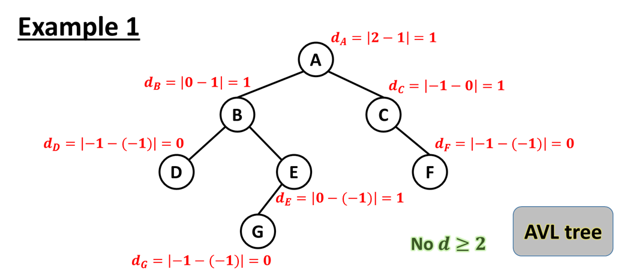
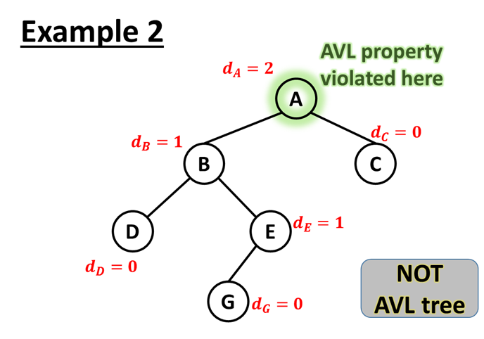
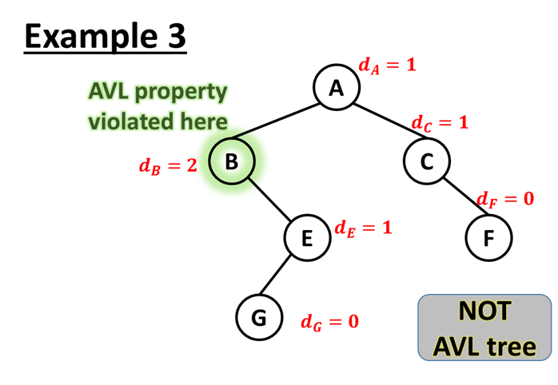
Calculating balancing factor, d

Slide 39
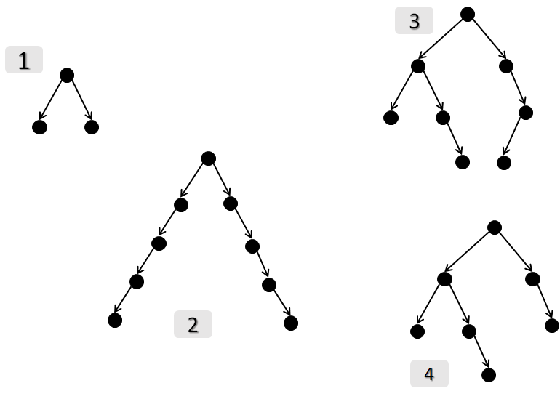
Are these AVL trees?

Slide 40
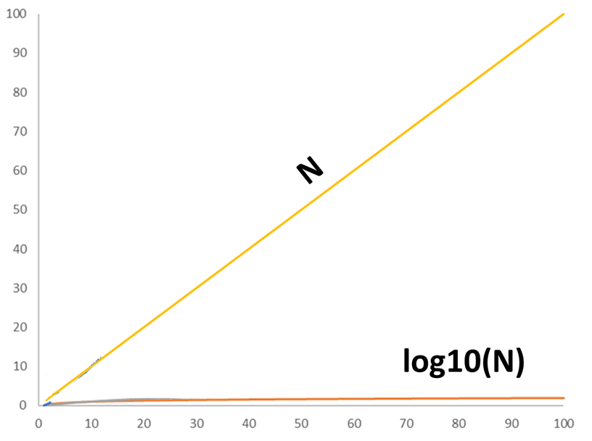
Why AVL tree?
All operations (searching, insertion, deletion) on an AVL tree will take O(log N) time.

Slide 41
Consequence of Insertion or Deletion
When the tree structure changes (e.g., insertion or deletion), we need to transform the tree to restore the AVL tree property.
This is done using single rotations or double rotations based on different cases

Slide 42
Constructing an AVL tree
Insert a Node at a time
Calculate balancing factor (d-factor) for each node in the tree
If the tree is unbalanced
do rebalancing
check the BST property,
if fails go to (a)
calculate balancing factor (d-factor) for each node in the tree
if it is not balance go to (a),
else go to (1)

Slide 43
Measure of Imbalance
Since an insertion/deletion involves adding/deleting a single node, this can only increase/decrease the height of some subtree by 1
Thus, if the AVL tree property is violated at a node x, it means that the heights of left(x) ad right(x) differ by more than 2.

Slide 44
Cases of Unbalanced AVL
Cases | Conditions | Action
Case 1 | Height of left(x) is h+2 (i.e. height of right(x) is h) Height of left(left(x)) is h+1 ⇒ single rotate with left child | single rotate with left child
Case 2 | Height of left(x) is h+2 (i.e. height of right(x) is h) Height of right(left(x)) is h+1 ⇒ double rotate with left child | double rotate with left child
Case 3 | Height of right(x) is h+2 (i.e. height of left(x) is h) Height of right(right(x)) is h+1 ⇒ single rotate with right child | single rotate with right child
Case 4 | Height of right(x) is h+2 (i.e. height of left(x) is h) Height of left(right(x)) is h+1 ⇒ double rotate with right child | double rotate with right child

Slide 45
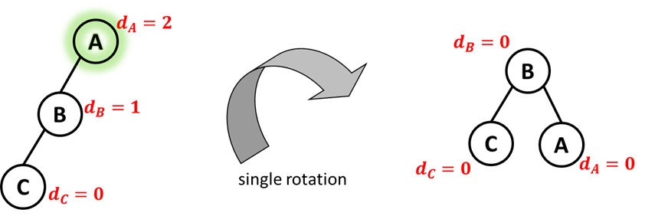
Case 1 Unbalanced AVL
Conditions | Action
Height of left(x) is h+2 (i.e. height of right(x) is h) Height of left(left(x)) is h+1 ⇒ single rotate with left child | single rotate with left child

Slide 46
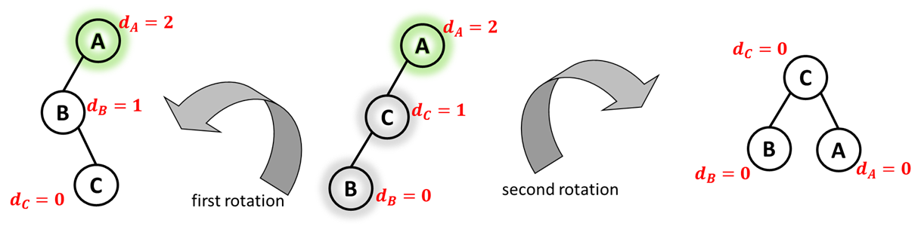
Case 2 Unbalanced AVL
Conditions | Action
Height of left(x) is h+2 (i.e. height of right(x) is h) Height of right(left(x)) is h+1 ⇒ double rotate with left child | double rotate with left child

Slide 47
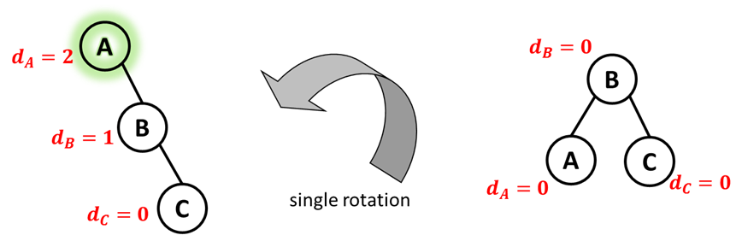
Case 3 Unbalanced AVL
Conditions | Action
Height of right(x) is h+2 (i.e. height of left(x) is h) Height of right(right(x)) is h+1 ⇒ single rotate with right child | single rotate with right child

Slide 48
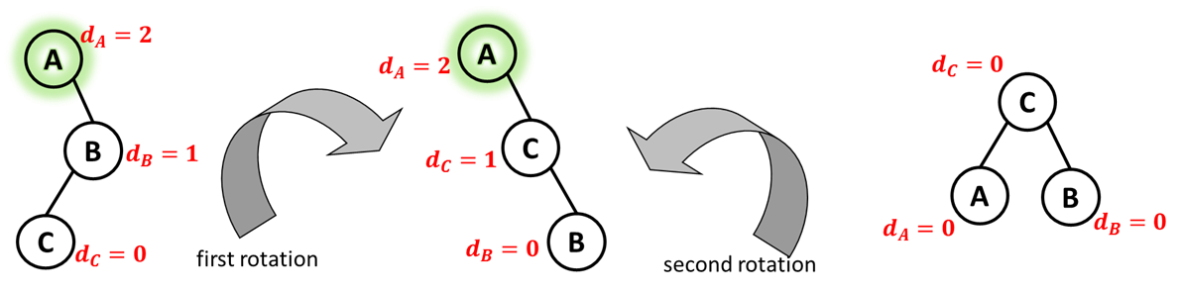
Case 4 Unbalanced AVL
Conditions | Action
Height of right(x) is h+2 (i.e. height of left(x) is h) Height of left(right(x)) is h+1 ⇒ double rotate with left child | double rotate with right child

Slide 49
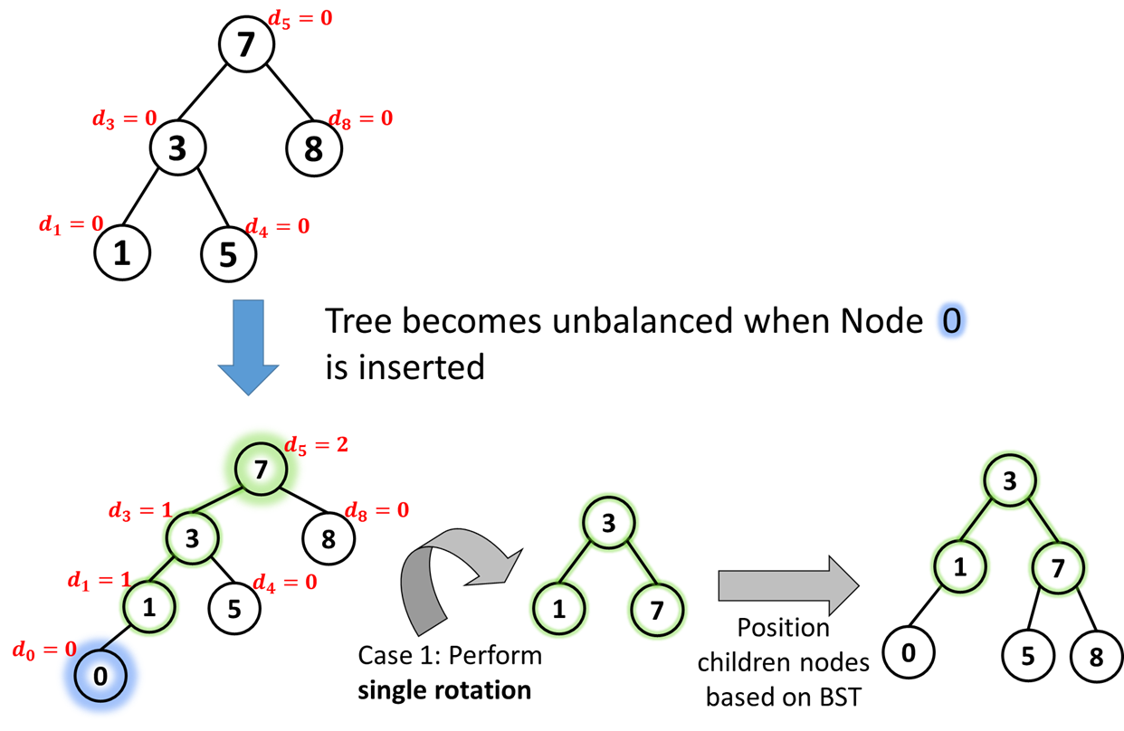
Example: Single rotation

Slide 50
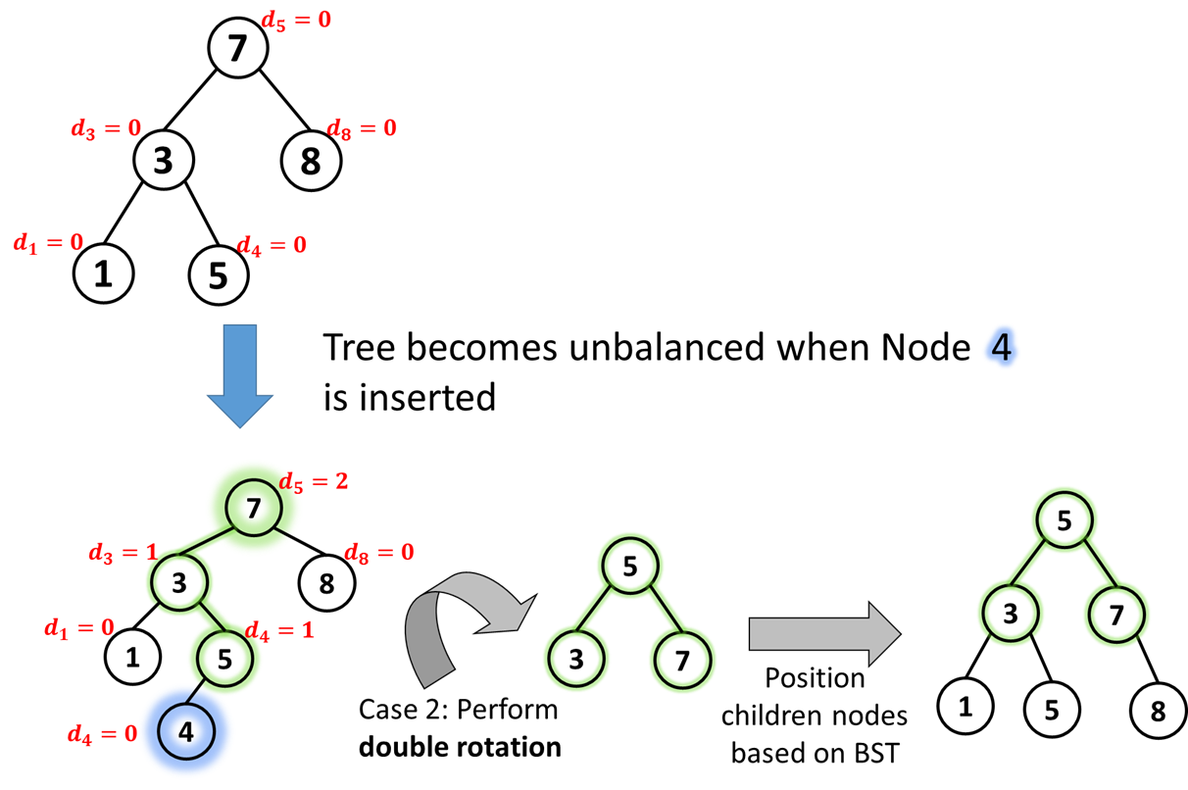
Example: Double rotation

Slide 51
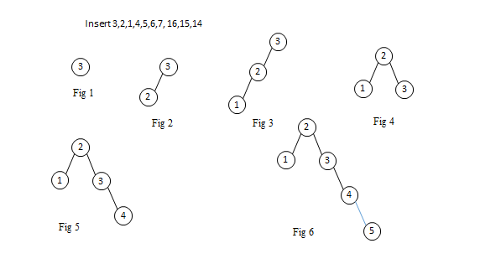
An extended example

Slide 52

Continued…. Inserting 3,2,1,4,5,6,7, 16,15,14
2
2
4
1
4
1
2
5
4
3
5
1
3
6
3
5
Fig 7
Fig 8
Fig 9
6
4
4
2
5
Single rotation
2
6
1
3
6
1
3
5
7
7
Fig 10
Fig 11

Slide 53
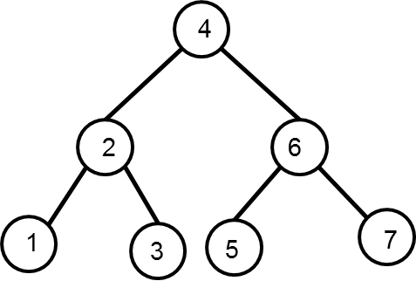
Fig 12
16
Fig 13
16
Double rotation
4
15
2
6
1
3
5
15
Fig 14
7
16

Slide 54
4
4
Double rotation
2
6
2
7
1
5
15
1
3
6
15
3
7
16
5
16
14
Fig 15
14
Fig 16

Slide 55
Consequence of Deletion
Delete a node x as in ordinary binary search tree. Note that the last node deleted is a leaf
Check the balancing factor for each node
If it is not balance, apply balancing procedure mentioned before

Slide 56
Deletion – an example on Single Rotation
Delete 12
9
5
Single rotation
5
12
3
9
3
8
11
1
4
8
11
1
4

Slide 57
Deletion – an example on Double Rotation
Delete 12
9
8
Double rotation
5
12
5
9
3
8
11
3
6
11
1
6
1

Slide 58
Deletion: An extended example
20
Delete 5
10
35
single rotation
5
15
25
40
18
30
38
45
50

Slide 59
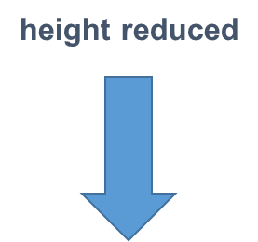
Deletion: An extended example (continued)
Continue to check balance factor at parent
20
35
15
10
18
25
40
30
38
45
50
single rotation

Slide 60
Deletion: An extended example (continued)
35
40
20
15
25
38
45
10
18
30
50
50
AVL tree!!
For deletion, after rotation, we need to continue tracing upward to see if AVL-tree property is violated at other nodes.

Slide 61
END OF SLIDES

