Slide 1

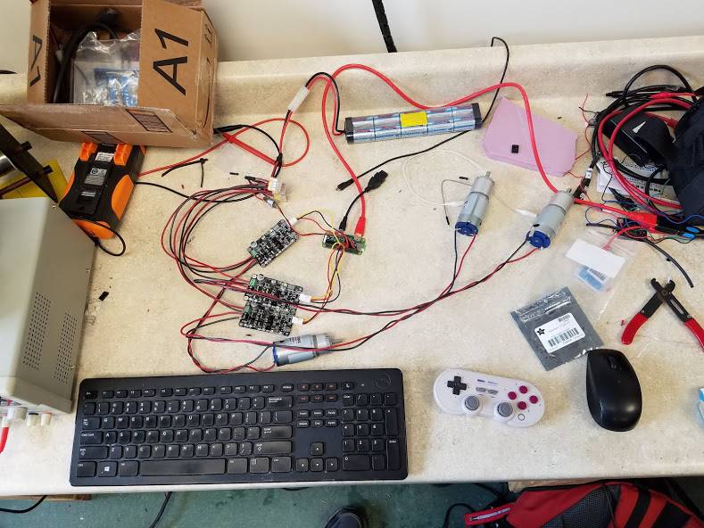
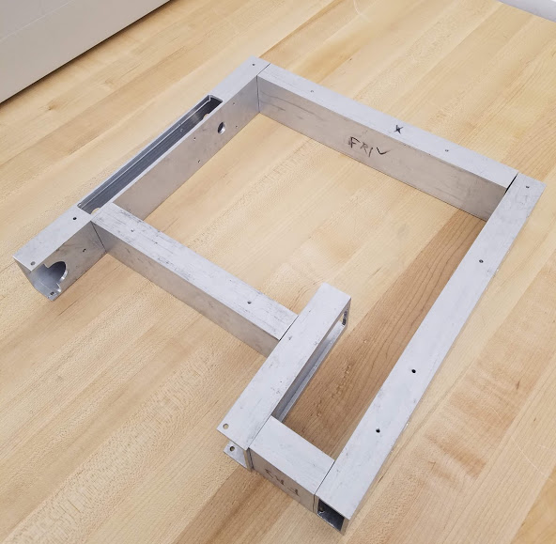
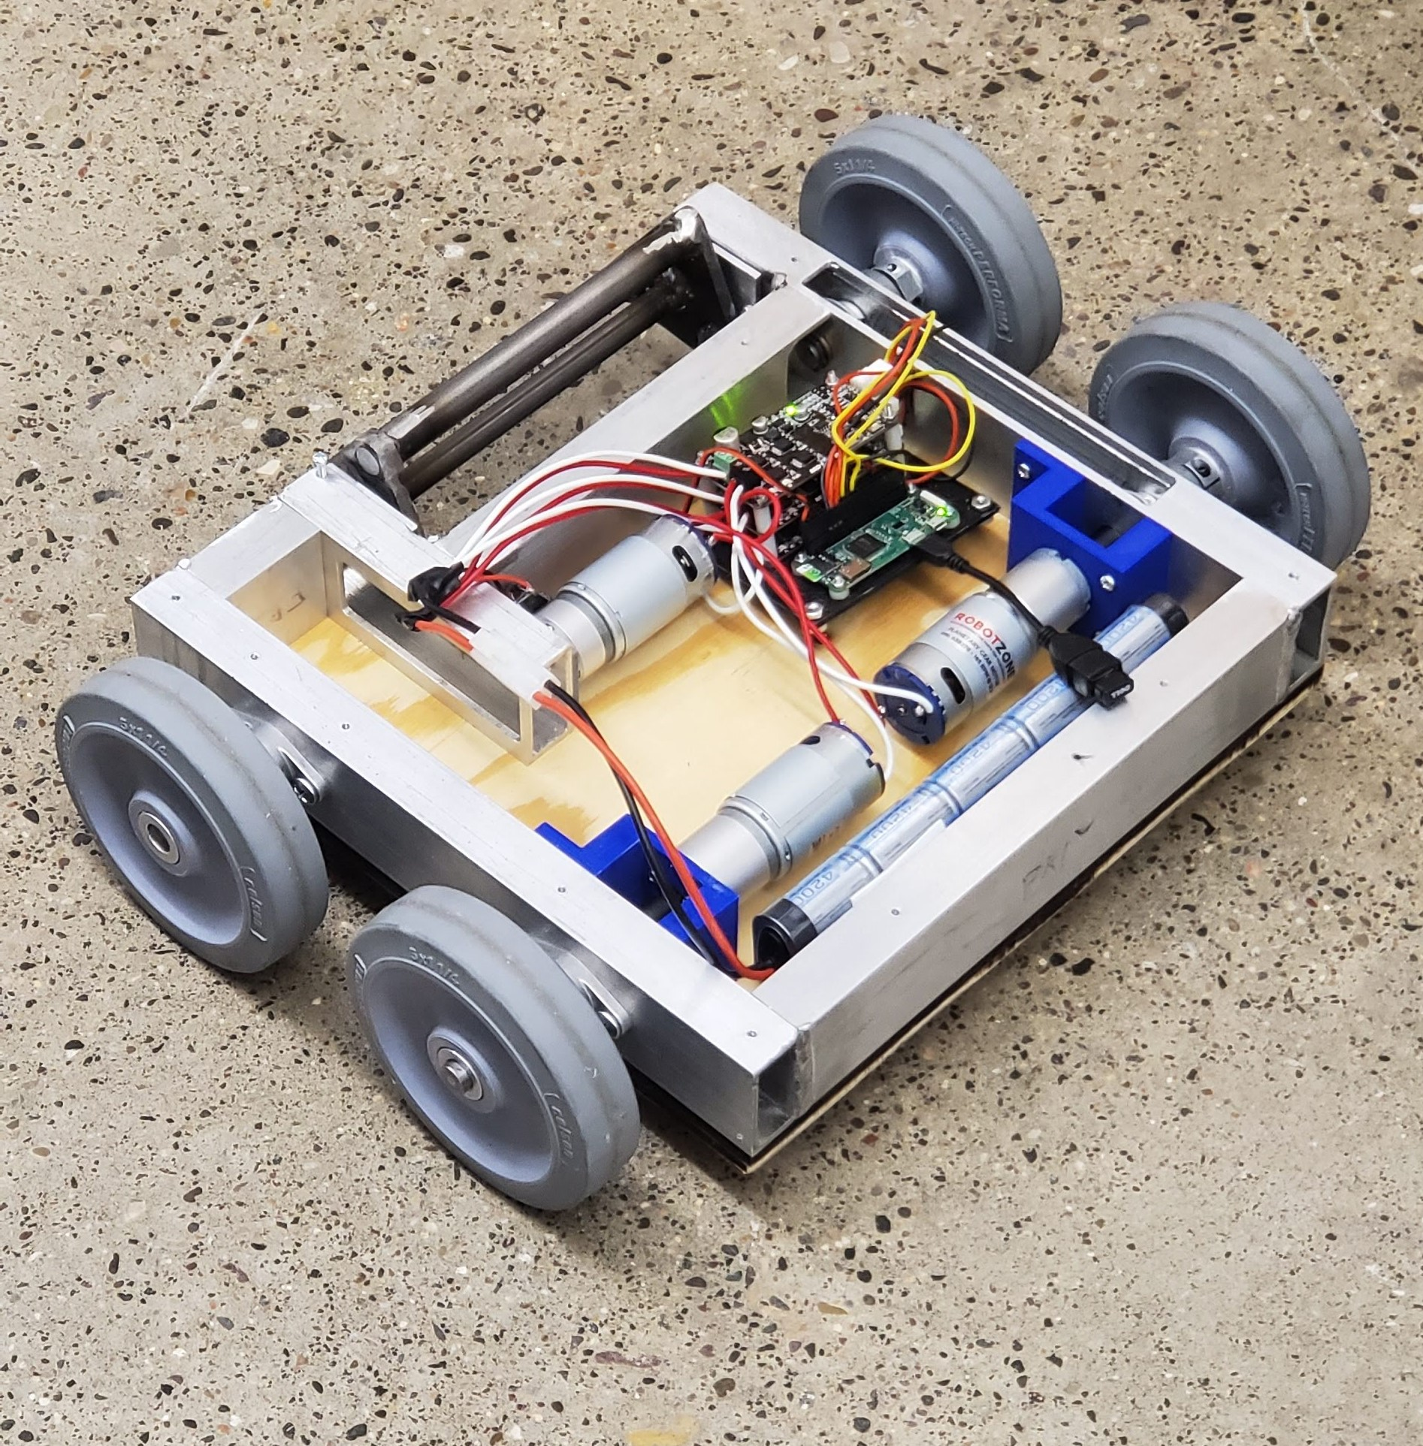
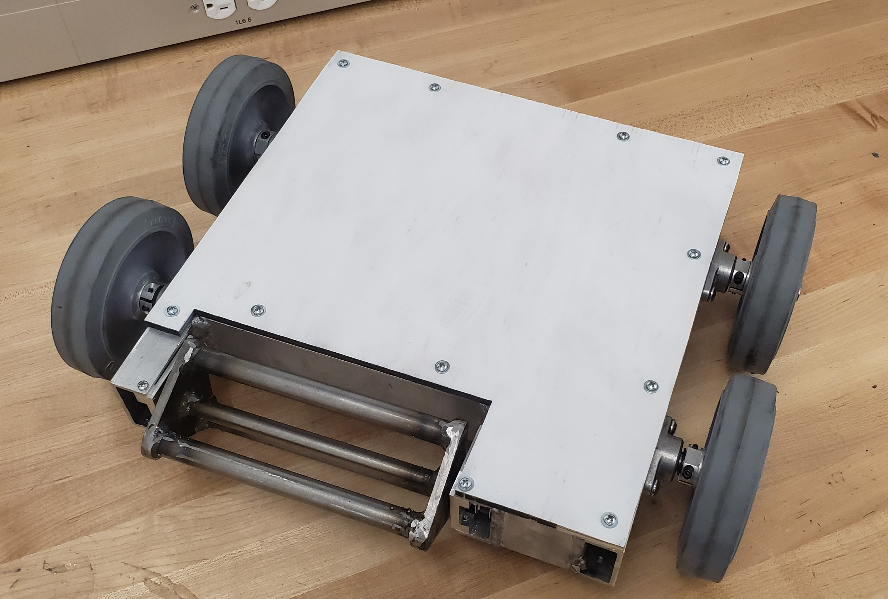
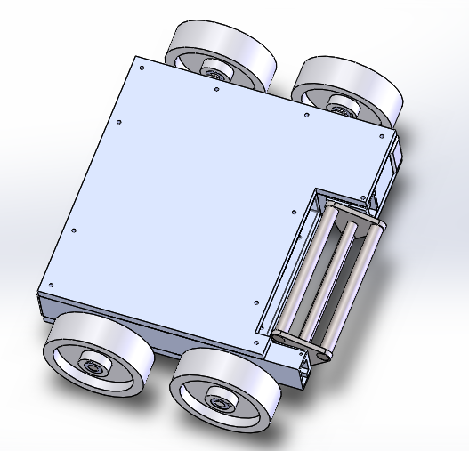
Battlebot Team 3
EMEC 499- Capstone 2
Instructors : R.Larson and C. Shankwitz
Faculty Advisor: James Black
Group members: Nishagar Raventhiran, Ivan Albert, Cole Trugman
Date : April 25th 2019
Background
Design
Testing
3 Teams will be battling it out in a three-bot free for all.
Will battle for 3 3-minute rounds and attempt to disable opponent bots without being disabled.
In addition to the opponents, several environmental hazards will also be present in the arena that can damage or destroy robots that get too close to them.
20ft x 20ft arena
Outdoor conditions
Largely manufactured in house via machining, welding, laser cutting, soldering, and other manufacturing methods.
Offensive/defensive Specifications:
The robot must be able to push with a force of 20 lb. This is to ensure it can move opponents and obstacles. This is based on the fact that rubber on asphalt has a coefficient of kinetic friction between 0.5 and 0.8. (25lb * 0.8 = 20lb)
The robot can also withstand 20 lb of pushing force from opponent, based on friction and motor stall torque.
The robot must be able to withstand at least 25 lb added weight in case another bot gets on top of it.
The robot must move under its own power at a minimum speed of 1 foot per second.
Assembly Specifications:
The battery should provide enough power to run the robot for 3 minutes continuously and be replaced or charged in under 5 minutes.
The turning radius of the robot must be at most 3 ft
Interface Specifications:
The robot must include a remote power disconnect switch
The control system must interface with driving motors as well as a remote control, which must maintain a reliable connection over a distance of at least 33.28 ft. This was calculated by finding the corner to corner span of the arena and adding 5 feet
Material Specifications:
Device (Not including peripheral equipment) must weigh between 20 and 25 lb in order to meet requirements and not be pushed around easily.
Device must stow into an 18” cube.
Device must not have sharper than 1/8” radius edge.
Device should cost between $500-$1000
Final Design Capabilities:
Left and right side controlled independently, allowing the robot to be easily controlled and turn in place
Multiple partial failure points built in the way of critical failure points
Many parts easily replaceable between rounds
Rotating cage of steel rods can reach speeds of nearly 1600 RPM.
Half inch thick wooden armor is durable, impact resistant, and easily replaceable between rounds
Both wheels on each side are connected and can all provide power
The high durability and replaceable parts used in the robot’s structure will make the bot difficult to eliminate, and its high speed rotating cage will deliver devastating hit and run attacks.
Code and electrical testing performed as electrical system was built
Drop test from 2 feet showed no damage
Armor durability test showed high armor durability
All electrical and mechanical systems functional
Control range found to be larger than the area available to test it in
Figure 4. Wiring setup and function testing
Figure 1. Frame pieces after machining and drilling
Final Product
Level one requirements
The batlebot should be
Less than 25 lbs
Fits in 18 in cube
Must be able to move under its own power
Must be able to be controlled remotely
Adheres to weapon limitations
No flames or flaming liquid
No chemical weapons
No untethered projectiles
No explosives or explosive-driven weaponry
No blades, spears, or edged weapons
Costs less than $1000
Able to run for 3 minutes on one charge
Not a pre-assembled robot or toy
No unsportsmanlike conduct
Figure 4. Final Battlebot ready for the competition
ACKNOWLEDGMENTS
Research reported in this publication was supported by the National Institute of General Medical Sciences of the National Institutes of Health under Award Number P20GM103474. The content is solely the responsibility of the authors and does not necessarily represent the official views of the National Institutes of Health.
Figure 2. SolidWorks model of the Battlebot.
Figure 3. Actual Battlebot with top armor plate removed

