Slide 1
AI-POWERED HACKATHON DISCOVERY
HackMate-AI
AI-Powered Hackathon Discovery & Matching Assistant
Find the right hackathon. Match your skills. Compete smarter.
Nisha R
Siva Priya V
B.Tech Artificial Intelligence & Data Science

Slide 2
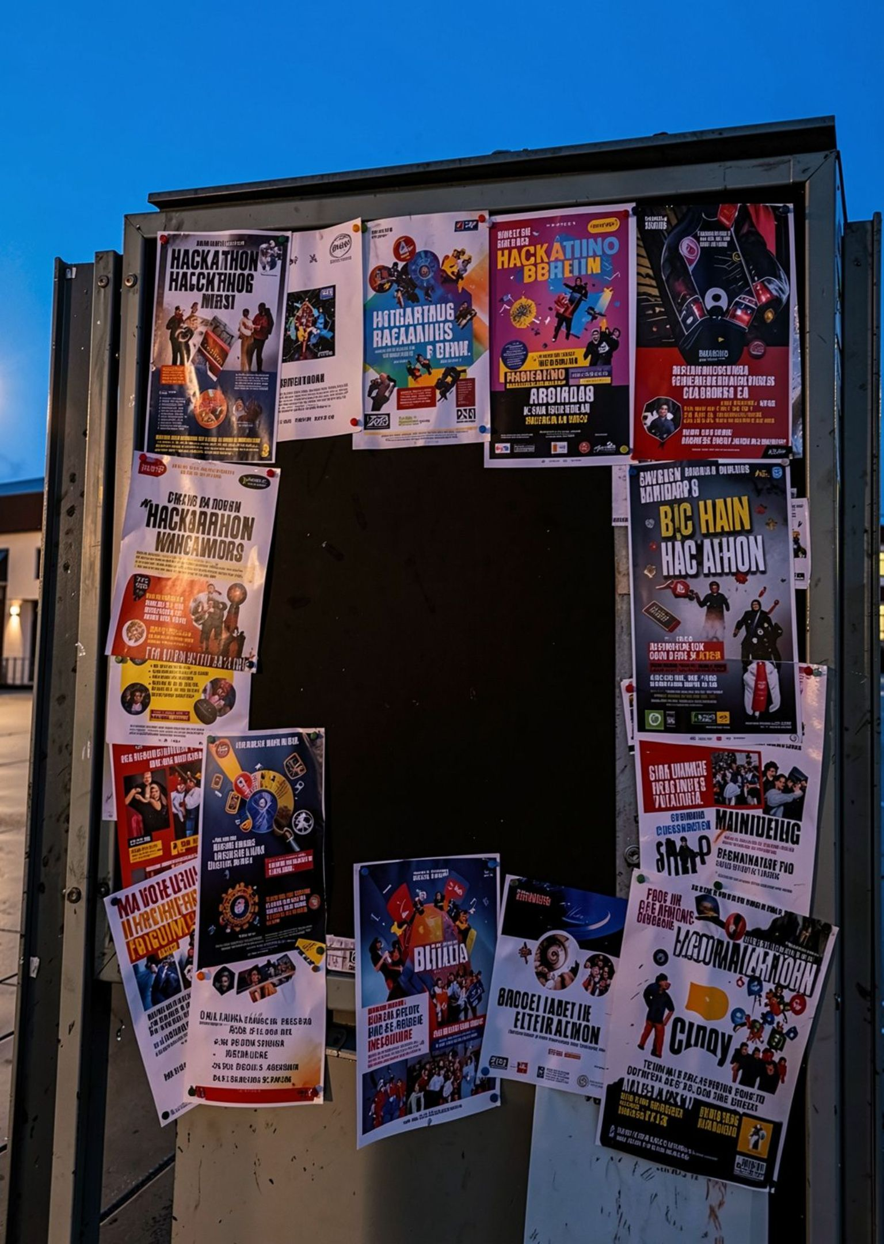



THE PROBLEM
Finding the right hackathon is the real problem
Too many listings
Hard to compare
Generic guidance
Relevant opportunities are scattered across platforms.
Skills, team-size rules, deadlines, and fees compete for attention.
Search leaves participants without personalized direction.

Slide 3
THE SHIFT
HackMate-AI turns search into decision support
A profile becomes a ranked, explainable path to registration.
01
02
03
04
Input
Match
Explain
Register
Skills, team size, preferred location, and availability.
Compare the profile against hackathon requirements.
Gemini explains the strongest fit.
Review information, approve registration, receive a ticket ID.

Slide 4
THE PIPELINE
From user profile to recommendation
01
02
03
User profile
Skill matching
Team validation
Capture preferences.
Compare required skills.
Check team-size rules.
04
05
06
Location matching
Deadline check
Match score
Check location fit.
Confirm availability.
Calculate compatibility.
07
08
09
Ranked hackathons
Gemini recommendation
Registration
Surface the best options.
Explain the strongest fit.
Approve and receive a ticket ID.

Slide 5





MATCHING ENGINE
Multi-factor matching, not random recommendations
The recommendation is grounded in structured compatibility.
Skill compatibility
Team compatibility
Location compatibility
Deadline and availability compatibility
Skill Compatibility + Team Compatibility + Location Compatibility + Deadline Compatibility = Overall Match Score

Slide 6
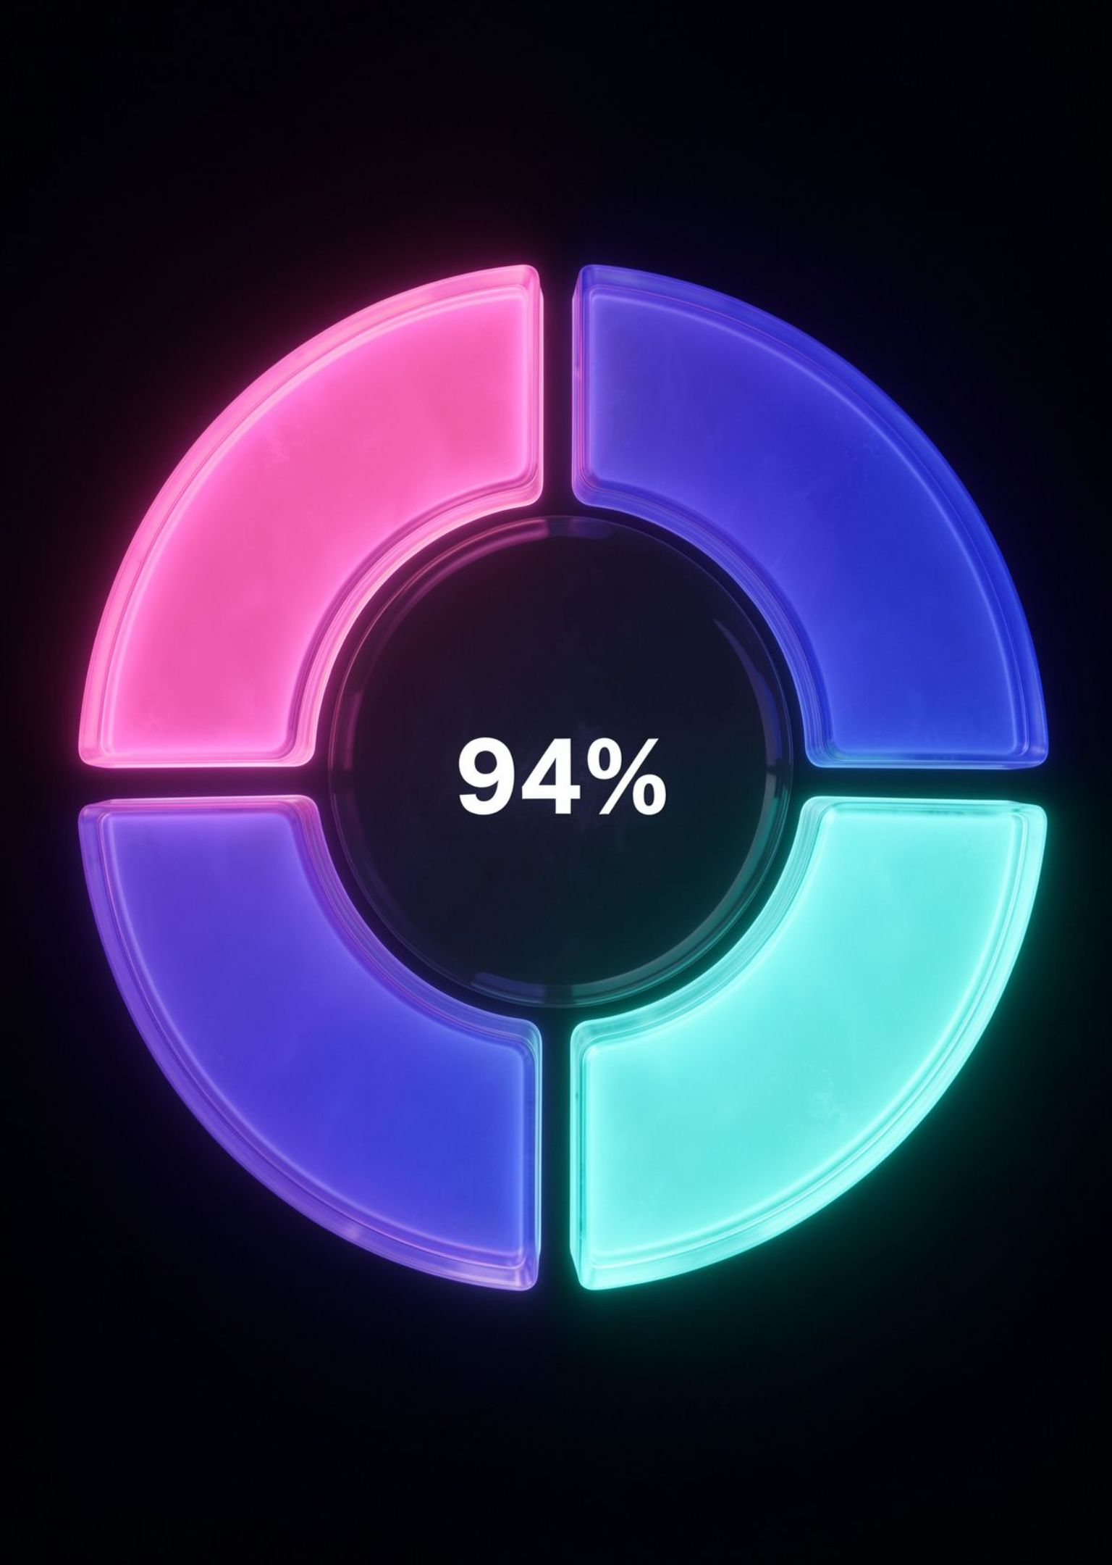

A RECOMMENDATION YOU CAN INSPECT
More than just a score
AI Innovation Challenge
Team: 2–4 members
Location: India
Deadline: 15 Nov 2026
Registration: FREE
94%
Match
Matching skills
Python · AI · Machine Learning
Match breakdown: Skills 50/50 · Team 20/20 · Location 15/15 · Availability 15/15
Skill gap: None. Users can see why the match fits.

Slide 7
EXPLANATION LAYER
Gemini explains the recommendation
Gemini is the explanation and recommendation layer, not a blind decision-maker.
01
02
03
04
Structured results
Strongest opportunity
Personalized explanation
Human decision
Matching results establish the evidence.
The user decides what to do next.
Gemini analyzes the best-ranked option.
Matching skills and skill gaps become clear.

Slide 8
HUMAN IN THE LOOP
AI recommends. The user decides.
01
02
03
04
05
Selected
Fee check
Decision branch
Approval
Ticket
Choose a hackathon.
Check the registration fee.
Known fee → review. Unknown fee → review fee information. Prototype example: ₹500.
Approve registration.
Generate ticket ID.
The system supports the decision. The user owns the approval.

Slide 9

SYSTEM VIEW
HackMate-AI architecture
Streamlit UI
Matching Engine
Score & Rank
Explain & Register
User → Streamlit interface → matching engine → ranked hackathons → Gemini AI → registration and ticket workflow

Slide 10








PROTOTYPE STACK
A lightweight stack for a focused prototype
Small, transparent components keep the prototype easy to understand and extend.
Python
Streamlit
Pandas
Google Gemini
CSV
Git & GitHub
Core programming language.
Web application interface.
Dataset processing.
Hackathon data storage.
AI-powered recommendations.
Version control and project hosting.
Environment variables handle API-key configuration.

Slide 11




TRUST BY DEFAULT
Secure and transparent by design
Protected configuration
API key is not hard-coded: GEMINI_API_KEY is handled through the environment.
Explainable recommendations
Users see why a hackathon matches.
Human-controlled registration
Approval stays with the user.
Clear prototype boundary
Current listings use a structured CSV dataset for demonstration and testing. Live hackathon APIs are not currently integrated.

Slide 12




BUILT FOR THE DEMO
What we have built
A complete path from discovery to a user-approved ticket.
Discover
Evaluate
Understand
Discovery, skill matching, team-size validation, and location matching.
Deadline compatibility, match scoring, top-match ranking, and skill-gap analysis.
Gemini recommendation layer and registration fee review.
Act
Use
Registration approval, ticket ID generation, and hackathon links.
Streamlit dashboard.

Slide 13

THE DIFFERENCE
Why HackMate-AI?
Traditional search
HackMate-AI
Manual
Fragmented
Generic
Hard to compare
Unclear compatibility
Personalized discovery
Multi-factor matching
Explainable recommendations
Skill-gap analysis
Team validation
Registration workflow
Not just a hackathon listing platform — an intelligent decision-support assistant.

Slide 14
THE PROMISE
HackMate-AI:
Compete Smarter
DISCOVER → MATCH → UNDERSTAND → DECIDE → COMPETE
HackMate-AI transforms hackathon discovery from manual searching into an intelligent, explainable, and user-controlled experience.

Slide 15
THANK YOU
Find the right hackathon.
Match your potential.
Compete smarter.
Nisha R
Siva priya V
B.Tech Artificial Intelligence & Data Science
HackMate-AI · AI-Powered Hackathon Discovery & Matching Assistant

