Slide 1

HEALTHCARE ANALYTICS FOR DOCTOR VISITS
NAME : NISHA R
AICTE STUDENT ID : STU6a6b5fa76dafc1785421735
COLLEGE NAME : RAMCO INSTITUTE OF TECHNOLOGY

Slide 2

PROBLEM STATEMENT
Doctor visits can vary based on a person's age, health condition, illness level, lifestyle limitations, and access to healthcare. However, raw healthcare data does not immediately reveal these patterns.
The objective of this project is to analyze doctor-visit data and identify meaningful relationships between patient characteristics, health conditions, healthcare access, and the number of doctor visits.

Slide 3
PROJECT DESCRIPTION
This project analyzes a healthcare dataset containing 5,190 records and 13 original variables related to doctor visits.
The analysis focuses on:
      Doctor visit patterns
      Age and gender
      Income
      Illness and reduced activity
      General health condition
      Chronic conditions
      Healthcare access and coverage
The project uses Python-based data analysis and visualization to transform raw healthcare data into meaningful insights.

Slide 4

WHO ARE THE END USERS?
Healthcare Providers
Understand patterns in healthcare utilization.
Healthcare Administrators
Identify groups with higher healthcare usage.
Healthcare Researchers
Study relationships between health conditions and doctor visits.
Policy & Planning Teams
Use analytical insights to support healthcare resource planning.
“The analysis can be useful for healthcare providers, administrators, researchers, and planning teams who need to understand healthcare utilization patterns.”

Slide 5

TECHNOLOGY USED
          Python
          Google Colab
          Pandas
          NumPy
          Matplotlib
          Seaborn
          SciPy
          Statistical Analysis
          Data Visualization

Slide 6
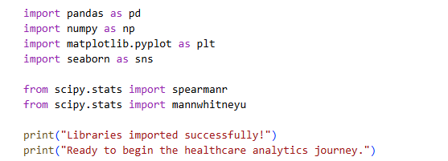
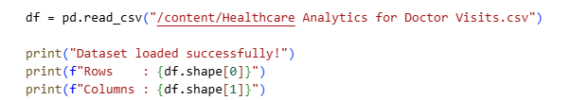
RESULTS
Import Libraries Load the Dataset

Slide 7

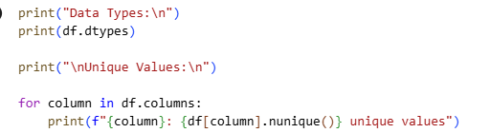

RESULTS
View the Data Understand the Variables
The dataset contains both numerical and categorical variables.
The main outcome variable is:
      **visits → number of reported doctor visits**
Other variables describe demographic characteristics,
health conditions, healthcare access, and chronic conditions.

Slide 8
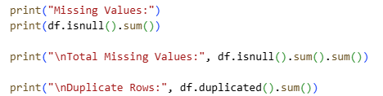

RESULTS
Data Quality Check
Can We Trust the Data?
Before analyzing the story, we perform basic data-quality checks.
We check:
  Missing values
  Duplicate records
  Data types
  Unnecessary columns
The column `Unnamed: 0` behaves like an index/record identifier, so it will not be used as an analytical variable.

Slide 9
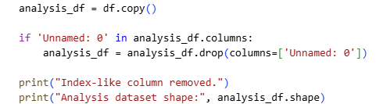
RESULTS
Remove the Index Column Statistical Summary
What Does the Data Look Like Statistically? We now examine the numerical variables using descriptive statistics. This gives us a basic understanding of the range, central tendency, and variation in the dataset.

Slide 10
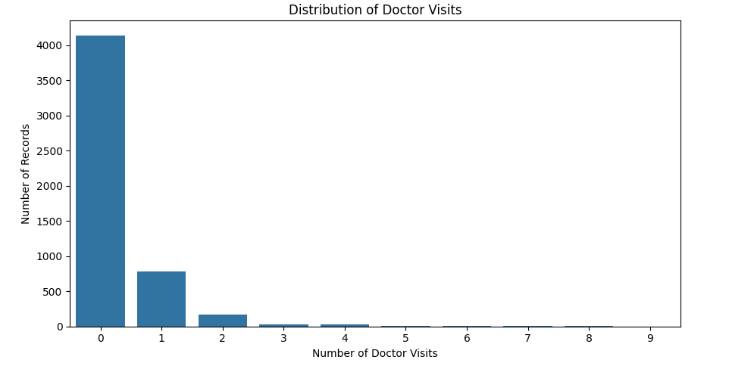
RESULTS
Our First Question: Doctor Visits
What Does Doctor-Visit Usage Look Like?
We begin with the most important variable:
How frequently are doctor visits reported?
Understanding the distribution of visits gives us the starting point for the entire analysis.
Observation:
Doctor visits are highly concentrated at the lower end of the distribution. This tells us that the dataset contains many records with zero or relatively few doctor visits. Now we need to understand what characteristics are associated with higher visit counts.
The reference code is in the uploaded google colab notebook💻

Slide 11
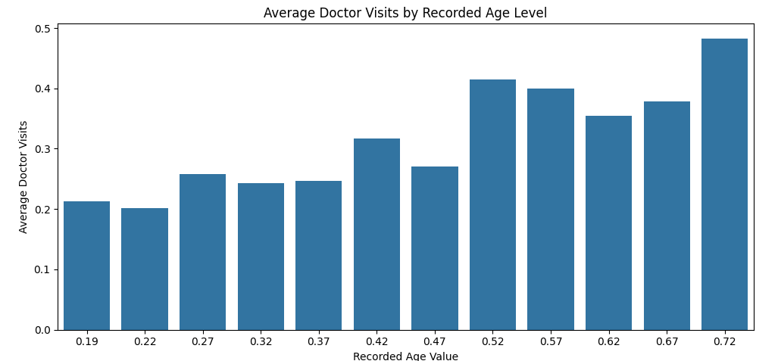
RESULTS
Question 2: Age
Does Age Relate to Doctor Visits?
The next question is about demographics.
Do different recorded age levels show different doctor-visit patterns?
We will analyze the age values exactly as they are represented in the dataset.
Observation:
The Spearman correlation between age and doctor visits is approximately **0.148**. This indicates a positive statistical association between the recorded age variable and doctor visits in this dataset. The relationship should be interpreted as an association, not as evidence that age directly causes doctor visits.
The reference code is in the uploaded google colab notebook💻

Slide 12
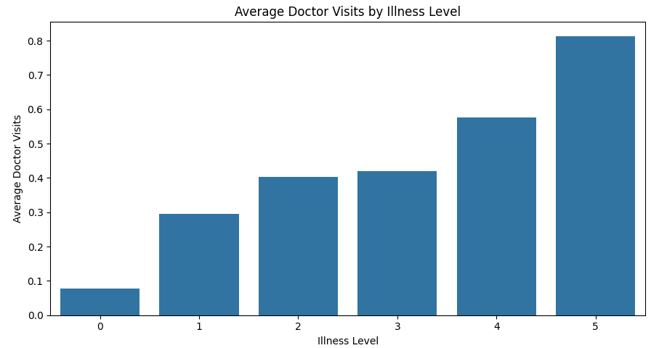
RESULTS
Question 3: Illness
Does Illness Relate to Doctor Visits?
We now move from demographics to health. The key question is:
As the reported illness level changes, how does the average number of doctor visits change?
Observation:
The Spearman correlation between illness and doctor visits is approximately **0.263**. The relationship is positive, meaning higher reported illness levels tend to be associated with higher doctor-visit counts in this dataset.
The reference code is in the uploaded google colab notebook💻

Slide 13
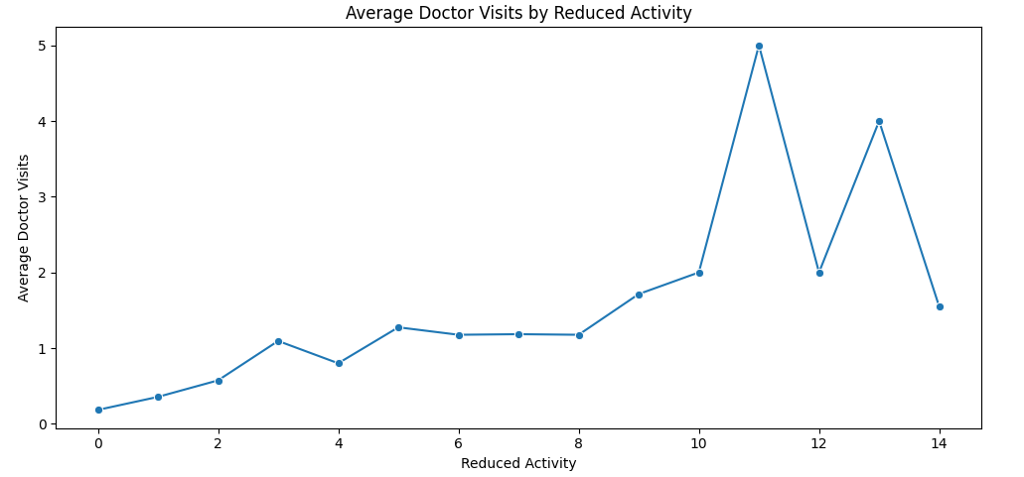
RESULTS
Question 4: Reduced Activity
Does Reduced Activity Relate to Doctor Visits?
Health conditions can also affect daily activity. So we ask:
Is reduced activity associated with doctor visits?
Observation:
Reduced activity has a Spearman correlation of approximately **0.336** with doctor visits. Among the main numerical variables analyzed, this is one of the stronger positive associations with doctor visits. This means that higher reported reduced activity tends to occur alongside higher doctor-visit counts.
The reference code is in the uploaded google colab notebook💻

Slide 14
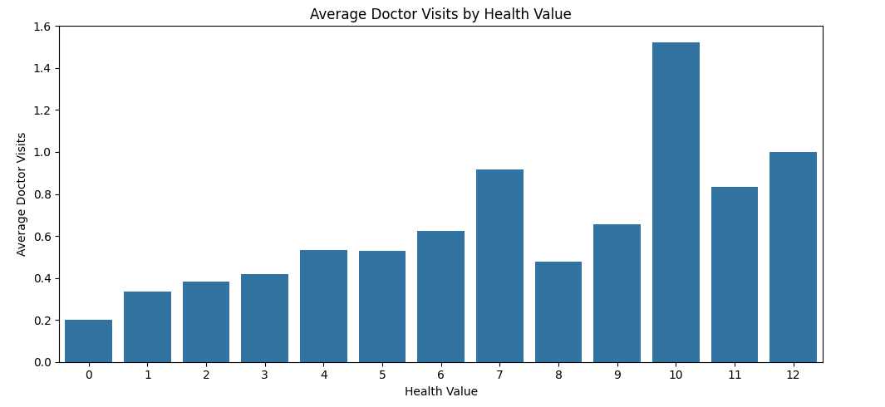
RESULTS
Question 5: Health
What About the Health Variable?
We now examine the recorded health variable.
Does the health measure show a statistical relationship with doctor visits?
Observation:
The Spearman correlation between the health variable and doctor visits is approximately **0.178**. This represents a positive statistical association, although it is weaker than the associations observed for reduced activity and illness.
The reference code is in the uploaded google colab notebook💻

Slide 15
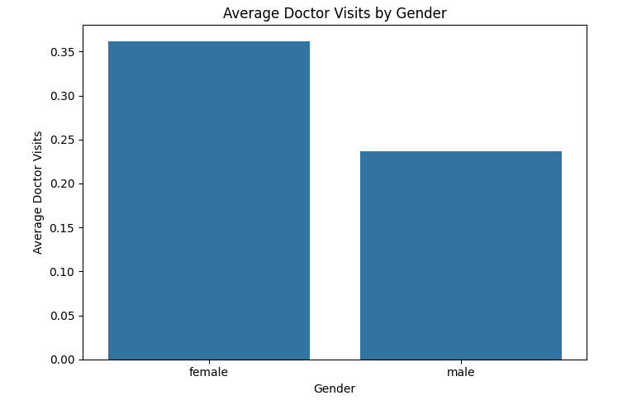
RESULTS
Question 6: Gender
Are Doctor Visits Different by Gender?
We now return to demographic characteristics.
Do the gender groups show different average doctor-visit patterns?
Observation:
The two gender groups show different distributions of doctor visits in this dataset. The statistical test provides evidence of a difference between the groups. This result describes the observed data and does not explain why the difference exists.
The reference code is in the uploaded google colab notebook💻

Slide 16
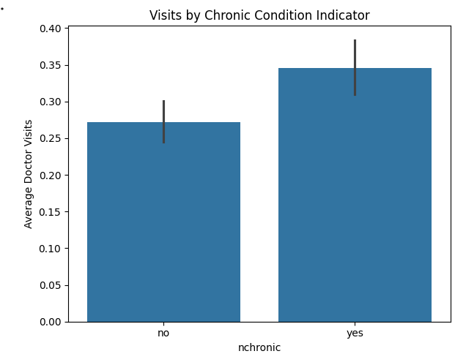
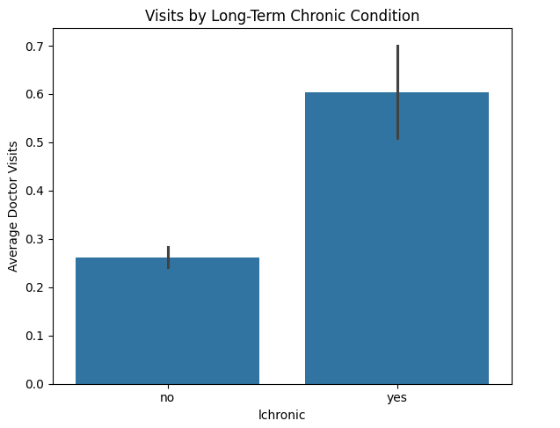
RESULTS
Question 7: Chronic Conditions
Do Chronic Conditions Relate to Visits?
The dataset contains indicators for chronic conditions. We examine:
    `nchronic`
    `lchronic`
The question is:
Do records with chronic-condition indicators show different doctor-visit patterns?
The reference code is in the uploaded google colab notebook💻

Slide 17
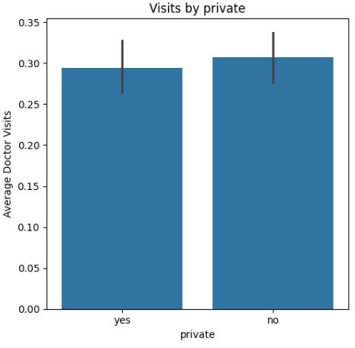
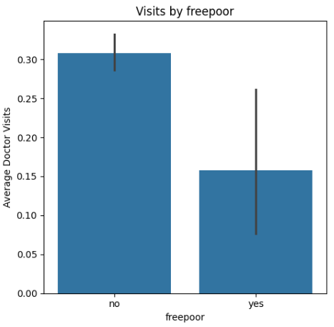
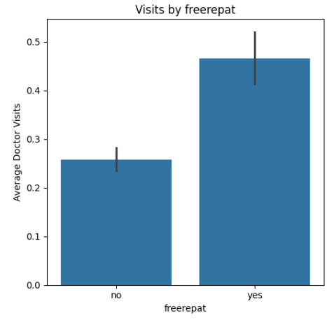
RESULTS
Healthcare Access Variables
Does Healthcare Access Show Different Patterns?
    The dataset contains three healthcare-access
indicators:
    - `private`
    - `freepoor`
    - `freerepat`
We compare average doctor visits across their categories. The goal is not to claim that access causes visits, but to identify patterns worth investigating.
The reference code is in the uploaded google colab notebook💻

Slide 18
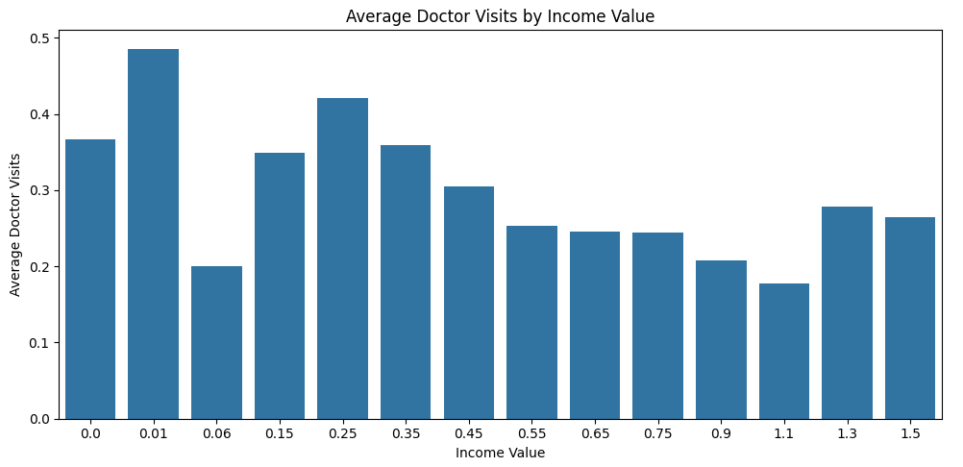
RESULTS
Income
Is Income Related to Doctor Visits?
The dataset also contains an income variable. We ask:
Does the recorded income value show an association with doctor visits?
Observation:
The Spearman correlation between income and doctor visits is approximately **−0.093**. This indicates a weak negative statistical association in this dataset. The relationship is much weaker than the positive associations observed for reduced activity and illness.
The reference code is in the uploaded google colab notebook💻

Slide 19
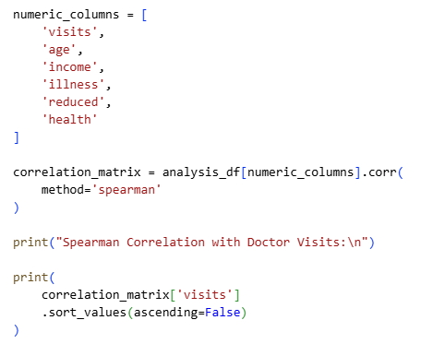
RESULTS
BIG QUESTION: Compare All Numeric Factors
⭐ Final Analytical Question
Which Numerical Factors Show the Strongest Association with Doctor Visits?
We have examined the variables individually. Now we compare them together using Spearman correlation. This helps us move from individual observations to an overall analytical picture.

Slide 20
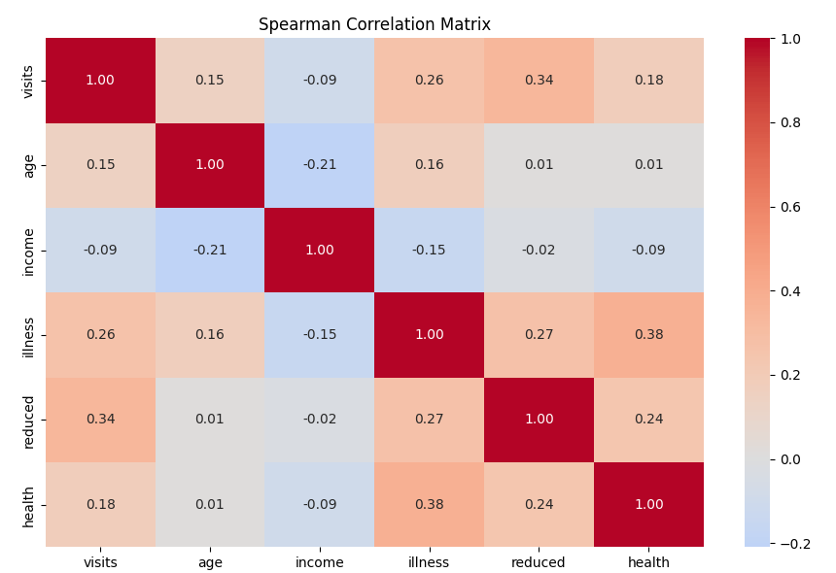
RESULTS
Correlation Heatmap
The reference code is in the uploaded google colab notebook💻

Slide 21
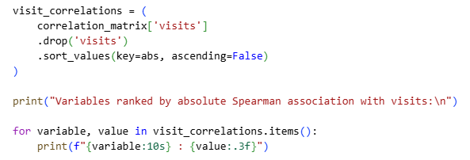
RESULTS
Automatically Find Strongest Relationships

Slide 22
RESULTS
Final Story / Key Insights
🎯 Final Chapter — What Did the Data Tell Us?
After moving through demographics, health conditions, healthcare access, and chronic-condition indicators, we can now connect the story.
Key Insights:
  Doctor visits are concentrated at low visit counts. Most records contain zero or relatively few reported visits.
  Reduced activity shows the strongest positive association among the main numerical variables analyzed.
  Illness also shows a positive association with doctor visits.
  The health variable and age show weaker positive associations.
  Income shows a weak negative association with visits.
  Differences are also observed across gender, chronic-condition indicators, and healthcare-access categories.
These findings describe statistical associations in this dataset.
They should not be interpreted as causal or individual medical conclusions.

Slide 23
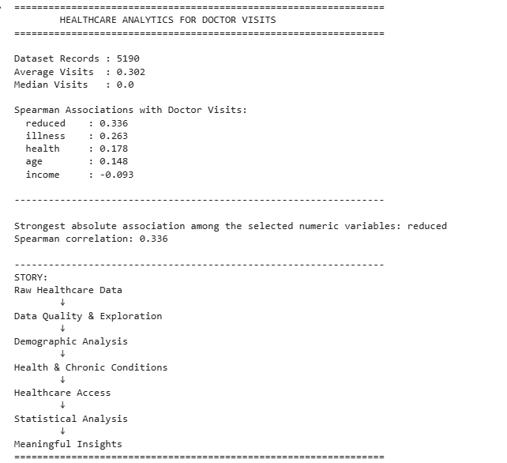
RESULTS
Generate a Professional Summary Automatically
It was the output:
The reference code is in the uploaded google colab notebook💻

Slide 24
EXPLANATION
Beginning: “I started with a simple question: Why do doctor visits differ between people?”
After cleaning: “Before finding patterns, I first made sure the dataset was suitable for analysis.”
Age: “I first investigated demographic characteristics and examined the recorded age values.”
Illness: “Then I moved from demographics to health. I wanted to know whether illness was associated with doctor visits.”
Reduced activity: “The next question was whether reduced activity showed a stronger relationship with healthcare utilization.”
Chronic conditions: “I then examined whether chronic-condition indicators were associated with different visit patterns.”
Healthcare access: “Finally, I explored whether the healthcare-access variables showed different patterns in doctor visits.”
Statistics: “After examining the variables individually, I used Spearman correlation to compare their statistical associations with doctor visits.”
Ending: “The analysis transformed the original healthcare records into a clear analytical story: raw data, questions, evidence, and insights.”
.
.

Slide 25
THANK YOU
.
.
https://github.com/its-nishar/Healthcare_Analytics_for_Doctor_Visits

