Slide 1


DATA COMMUNICATION
CSE 225/233
WEEK-1
OVERVIEW OF DATA
COMMUNICATION

Slide 2
Background
The term telecommunication means communication at a distance. The word data refers to information presented in whatever form is agreed upon by the parties creating and using the data.
Data communications are the exchange of data between two devices via some form of transmission medium such as a wire cable or wireless.
For data communications to occur, the communicating devices must be part of a communication system made up of a combination of hardware (physical equipment) and software (programs).
Data Communication Lecture Series, NRC, MAY2020
1.2

Slide 3
Characteristics of Data Communication
The effectiveness of a data communications system depends on four fundamental characteristics: delivery, accuracy, timeliness, and jitter.
Delivery: The system must deliver data to the correct destination. Data must be received by the intended device or user and only by that device or user.
Accuracy: The system must deliver the data accurately. Data that have been altered in transmission and left uncorrected are unusable.
Data Communication Lecture Series, NRC, MAY2020
1.3

Slide 4
Characteristics of Data Communication (Contd.)
Timeliness: The system must deliver data in a timely manner. Data delivered late are useless. In the case of video and audio, timely delivery means delivering data as they are produced, in the same order that they are produced, and without significant delay. This kind of delivery is called real-time transmission.
Jitter: Jitter refers to the variation in the packet arrival time. It is the uneven delay in the delivery of audio or video packets. For example, let us assume that video packets are sent every 30 ms. If some of the packets arrive with 30-ms delay and others with 40-ms delay, an uneven quality in the video is the result.
Data Communication Lecture Series, NRC, MAY2020
1.4

Slide 5
Components of Data Communication
A data communications system has five components.
Message: The message is the information (data) to be communicated. Popular forms of information include text, numbers, pictures, audio, and video.
Sender: The sender is the device that sends the data message. It can be a computer, workstation, telephone handset, video camera, and so on.
Receiver: The receiver is the device that receives the message. It can be a computer, workstation, telephone handset, television, and so on.
Data Communication Lecture Series, NRC, MAY2020
1.5

Slide 6
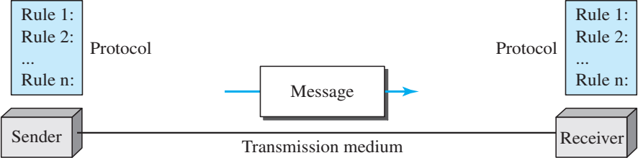
Components of Data Communication (Contd.)
Transmission medium: The transmission medium is the physical path by which a message travels from sender to receiver. Some examples of transmission media include twisted-pair wire, coaxial cable, fiber-optic cable, and radio waves.
Protocol: A protocol is a set of rules that govern data communications. It represents an agreement between the communicating devices. Without a protocol, two devices may be connected but not communicating, just as a person speaking French cannot be understood by a person who speaks only Japanese.
Data Communication Lecture Series, NRC, MAY2020
1.6

Slide 7
Data Representation
Text: bit pattern
ASCII: 128 different symbols (7 bits)
Extended ASCII: size of each pattern is 1 byte (8 bits)
Unicode: 65.536 symbols (16 bits)
ISO: 4.294.967.296 symbols (32 bits)
Numbers: decimal numbers converted directly to binary
Images: divided into a matrix of pixels
Audio: representation of sound by an analog or a digital signal
Video: represented by an analog or digital signal
Data Communication Lecture Series, NRC, MAY2020
1.7

Slide 8
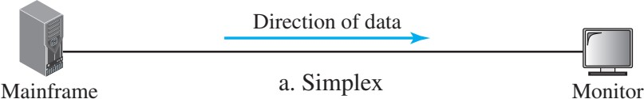
Data Flow
Communication between two devices can be simplex, half duplex, or full-duplex.
Simplex: In simplex mode, the communication is unidirectional, as on a one-way street. Only one of the two devices on a link can transmit; the other can only. Keyboards and traditional monitors are examples of simplex devices. The simplex mode can use the entire capacity of the channel to send data in one direction.
Data Communication Lecture Series, NRC, MAY2020
1.8

Slide 9
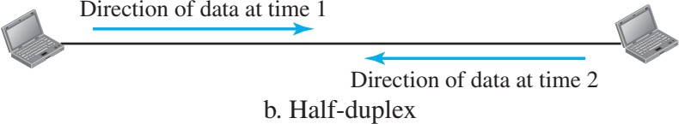
Data Flow (Contd.)
Half-duplex: In half-duplex mode, each station can both transmit and receive, but not at the same time. When one device is sending, the other can only receive, and vice versa.
Walkie-talkies and CB (citizens band) radios are both half- duplex systems. The half-duplex mode is used in cases where there is no need for communication in both directions at the same time; the entire capacity of the channel can be utilized for each direction.
Data Communication Lecture Series, NRC, MAY2020
1.9

Slide 10
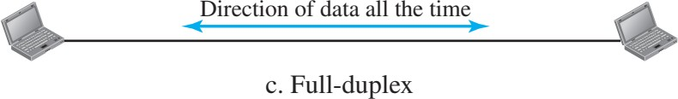
Data Flow (Contd.)
Full-duplex: In full-duplex mode (also called duplex), both stations can transmit and receive simultaneously.
One common example of full-duplex communication is the telephone network. When two people are communicating by a telephone line, both can talk and listen at the same time. The full-duplex mode is used when communication in both directions is required all the time. The capacity of the channel, however, must be divided between the two directions.

Slide 11
Network
A network is the interconnection of a set of devices capable of communication. In this definition, a device can be a host (or an end system as it is sometimes called) such as a large computer, desktop, laptop, workstation, cellular phone, or security system. A device in this definition can also be a connecting device such as a router, which connects the network to other networks, a switch, which connects devices together, a modem (modulator-demodulator), which changes the form of data, and so on.

Slide 12
Network criteria
Performance
—Can be measured in many ways
transit time: amount of time required for a message to travel from one device to another
response time: time elapsed (passed) between an inquiry
and a response
Number of users
Type of transmission medium
Hardware capabilities and software efficiency
Reliability
—A measure of frequency of failure and the time needed to recover, network robustness
Security
—Protecting of data from unauthorized users

Slide 13
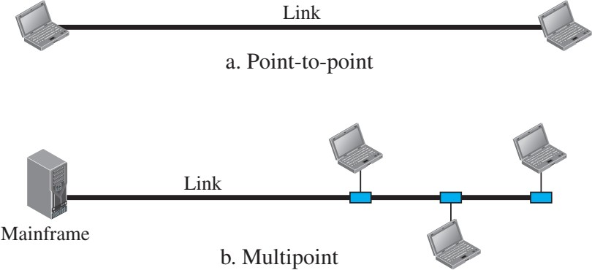
Physical Structure
Types of connections: point-to-point and multipoint

Slide 14
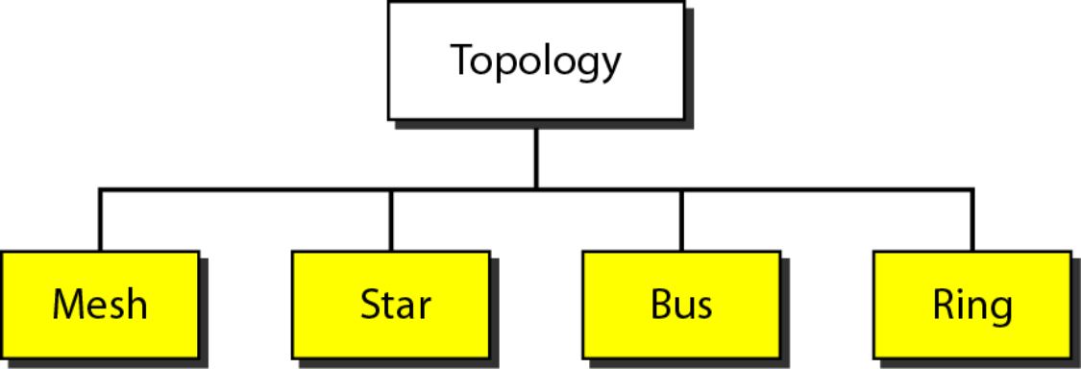
Physical Topology
The term physical topology refers to the way in which a network is laid out physically. Two or more devices connect to a link; two or more links form a topology. The topology of a network is the geometric representation of the relationship of all the links and linking devices (usually called nodes) to one another. There are four basic topologies possible: mesh, star, bus, and ring.

Slide 15
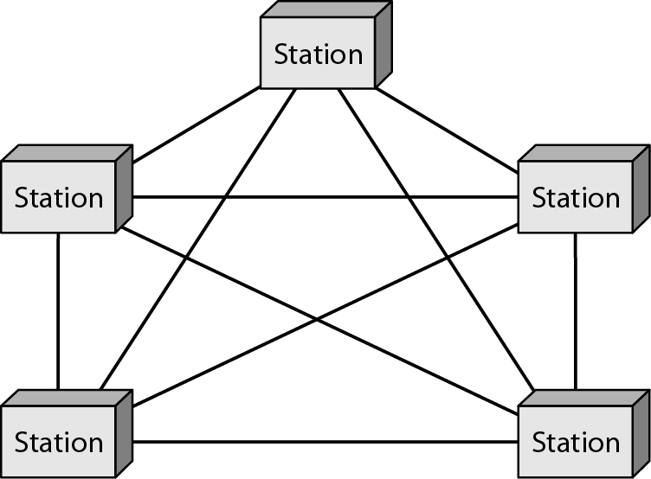
Mesh Topology
In a mesh topology, every device has a dedicated point-to point link to every other device. The term dedicated means that the link carries traffic only between the two devices it connects. To find the number of physical links in a fully connected mesh network with n nodes, we first consider that each node must be connected to every other node.

Slide 16
Mesh Topology- Advantages
The use of dedicated links guarantees that each connection can carry its own data load, thus eliminating the traffic problems that can occur when links must be shared by multiple devices.
A mesh topology is robust (Strong). If one link becomes unusable, it does not incapacitate (disable) the entire system. Third, there is the advantage of privacy or security. When every message travels along a dedicated line, only the intended recipient sees it. Physical boundaries prevent other users from gaining access to messages. Finally, point-to-point links make fault identification and fault isolation easy. Traffic can be routed to avoid links with suspected problems. This facility enables the network manager to discover the precise location of the fault and aids in finding its cause and solution.

Slide 17
Mesh Topology- Disadvantages
Disadvantage of a mesh are related to the amount of cabling because every device must be connected to every other device, installation and reconnection are difficult.
Second, the sheer bulk of the wiring can be greater than the available space (in walls, ceilings, or floors) can accommodate. Finally, the hardware required to connect each link (I/O ports and cable) can be prohibitively expensive.
For these reasons a mesh topology is usually implemented in a limited fashion, for example, as a backbone connecting the main computers of a hybrid network that can include several other topologies.

Slide 18
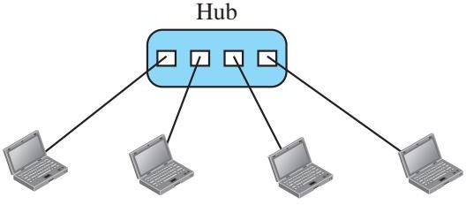
Star Topology
In a star topology, each device has a dedicated point-to-point link only to a central controller, usually called a hub. The devices are not directly linked to one another. Unlike a mesh topology, a star topology does not allow direct traffic between devices. The controller acts as an exchange: If one device wants to send data to another, it sends the data to the controller, which then relays the data to the other connected device

Slide 19
Star Topology- Advantages
Easy to manage and maintain the network because each node require separate cable.
Easy to locate problems because cable failure only affect a single user.
Easy to extend the network without disturbing to the entire network
Due to Hub/Switch device network control and management is much easier.
Fault identification and removing nodes in a network is easy.
It provides very high speed of data transfer.

Slide 20
Star Topology- Disadvantages
Entire performance of the network depends on the single device hub/switch. If the hub/switch device goes down, the entire network will be dead.
Star topology requires more wires compared to the ring and bus topology.
Extra hardware is required (hubs or switches) which adds to cost

Slide 21
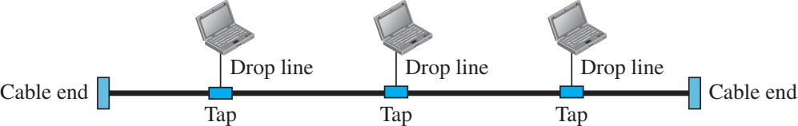
Bus Topology
The star and mesh topology describe point-to-point connections. A bus topology, on the other hand, is multipoint. One long cable acts as a backbone to link all the devices in a network. Nodes are connected to the bus cable by drop lines and taps. A drop line is a connection running between the device and the main cable. A tap is a connector that either splices into the main cable or punctures the sheathing of a cable to create a contact with the metallic core. As a signal travels along the backbone, some of its energy is transformed into heat. Therefore, it becomes weaker and weaker as it travels farther and farther. For this reason there is a limit on the number of taps a bus can support and on the distance between those taps.

Slide 22
Bus Topology- Advantages
Easy to connect or remove devices in a network without affecting any other device.
In case of any computer or device failure, there will be no effect on other devices or network.
Cable cost is less as compared to other network topology
i.e. mesh and star.
It is easy to understand topology.
Easy to expand by joining two cables together
No hubs or switches are required.

Slide 23
Bus Topology- Disadvantages
In the case of any device failure, it is difficult to find faults in a network.
If the backbone cable damages the entire system/network will fail.
If network traffic increases or devices increase, the performance of the network decreases.
Proper termination is required to prevent bouncing of signals. The use of terminators is a must.
It is slower because one computer transmits at a time.
It provides very low security because all the computers receive the sent signal from the source.
The length of cable is limited

Slide 24
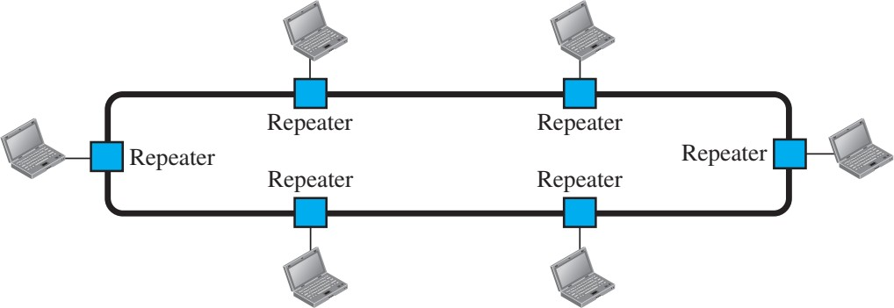
Ring Topology
In a ring topology, each device has a dedicated point-to-point connection with only the two devices on either side of it. A signal is passed along the ring in one direction, from device to device, until it reaches its destination. Each device in the ring incorporates a repeater. When a device receives a signal intended for another device, its repeater regenerates the bits and passes them along

Slide 25
Ring Topology- Advantages
All data flows in one direction, reducing the chance of packet collisions.
A network server is not needed to control network connectivity between each workstation.
Data can transfer between workstations at high speeds.
Additional workstations can be added without impacting performance of the network.

Slide 26
Ring Topology- Disadvantages
All data being transferred over the network must pass through each workstation on the network, which can make it slower than a star topology.
The entire network will be impacted if one workstation shuts down.
The hardware needed to connect each workstation to the network is more expensive than Ethernet cards and hubs/switches.

Slide 27
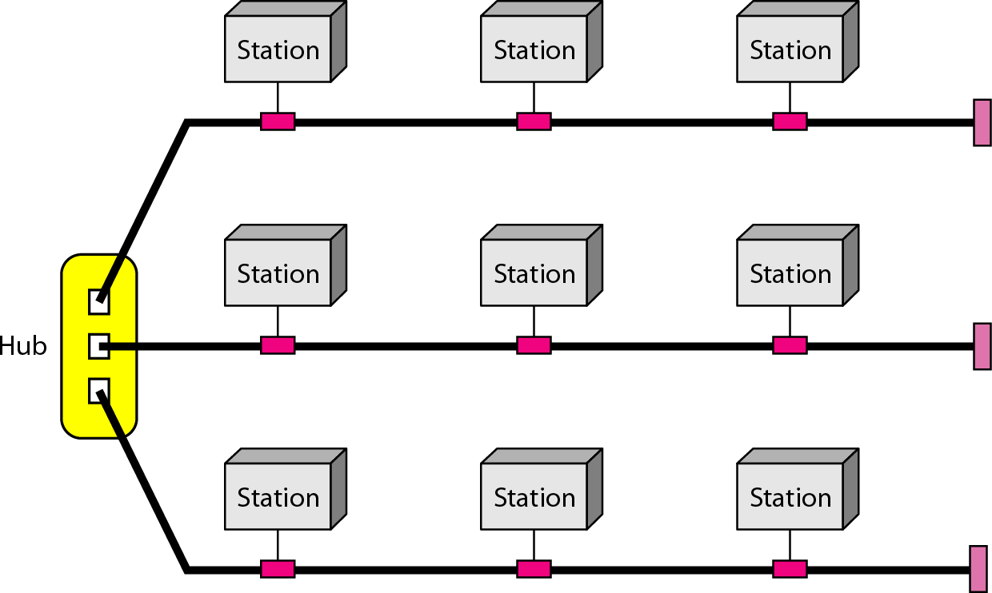
Hybrid Topology

Slide 28
The Internet
The Internet has revolutionized many aspects of our daily lives. It has affected the way we do business as well as the way we spend our leisure time. The Internet is a communication system that has brought a wealth of information to our fingertips and organized it for our use.

Slide 29
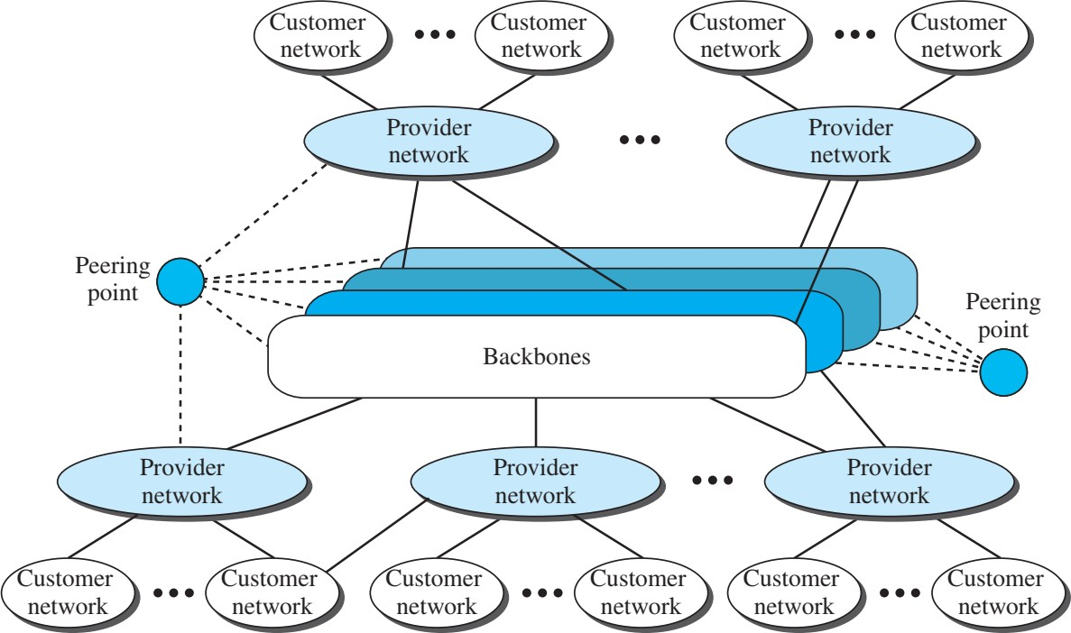
The Internet (Conceptual View)

Slide 30
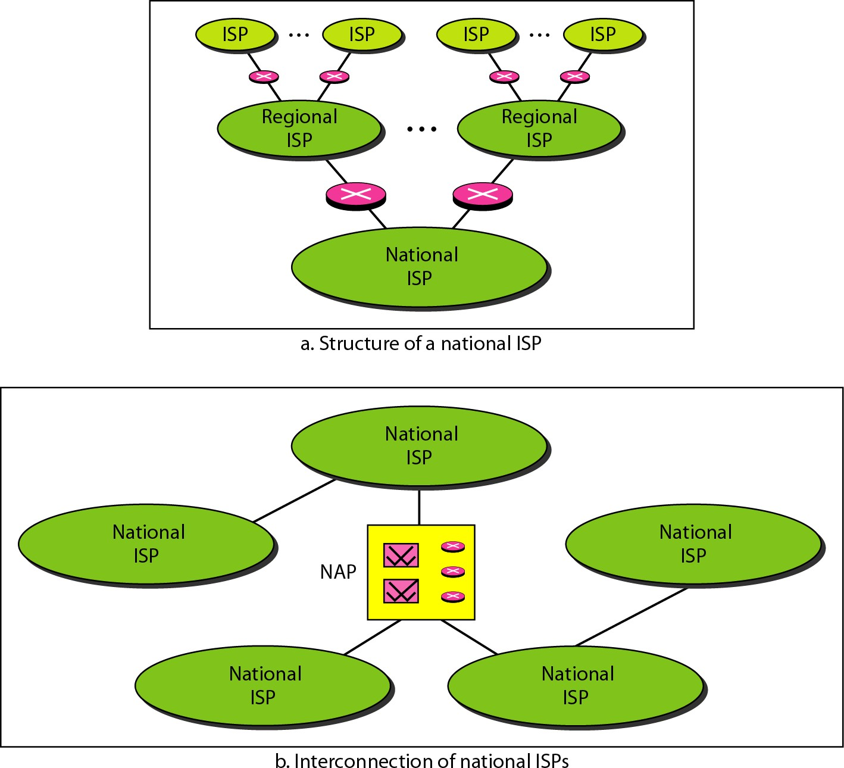
Hierarchical Organization of Internet

Slide 31
The Protocol and Standard
In this section, we define two widely used terms: protocols and standards. First, we define protocol, which is synonymous with rule. Then we discuss standards, which are agreed-upon rules.

Slide 32
The Protocol
A protocol is a set of rules that governs data communications
It defines what is communicated, how it is communicated and when it is communicated
Key elements of a protocol:
—Syntax
Structure or format of data, meaning the order in which they are presented
—Semantics
Refer to the meaning of each section of bits, how a pattern is interpreted and what action to be taken
—Timing
Refers to when data should be sent and how fast can they be sent

Slide 33
The Standard
Standards are essential in creating and maintaining an open and competitive market for equipment manufacturers
Required to guarantee national and international interoperability of data and telecommunications technology and processes
Categories of data communications standards
—De facto:
Standards that have not been approved by an organizational body but have been adopted through widespread use, eg. model TCP/IP)
—De jure:
Those that have been legislated by an official recognized body, eg. OSI model

Slide 34
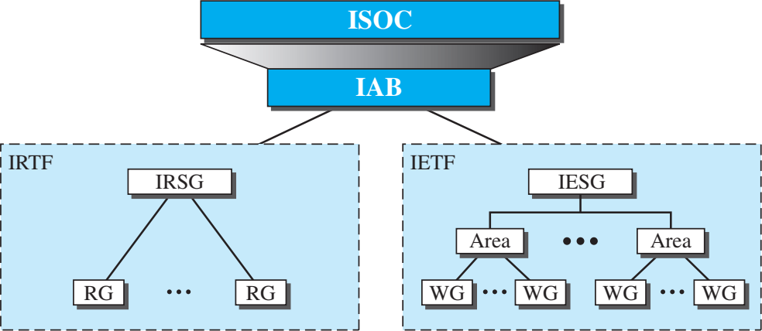
Internet Administration

Slide 35
Data Communication Lecture Series, NRC, MAY2020
1.35

