Slide 1


DATA COMMUNICATION
CSE 225/233
WEEK-3, LESSON-2
DATA AND SIGNAL

Slide 2
Transmission Impairment
Signals travel through transmission media, which are not perfect. The imperfection causes signal impairment. This means that the signal at the beginning of the medium is not the same as the signal at the end of the medium. What is sent is not what is received. Three causes of impairment are attenuation, distortion, and noise.
Data Communication Lecture Series, NRC, MAY2020
3.2

Slide 3
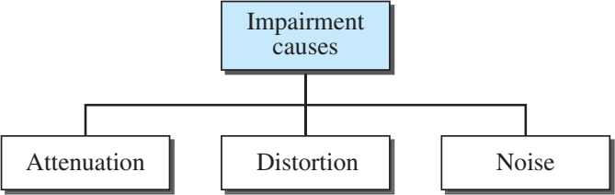
Causes of impairment
3.3

Slide 4
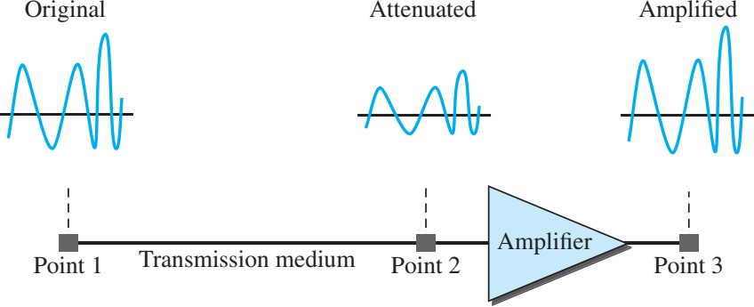
Attenuation
Attenuation means a loss of energy. When a signal, simple or composite, travels through a medium, it loses some of its energy in overcoming the resistance of the medium. That is why a wire carrying electric signals gets warm, if not hot, after a while. Some of the electrical energy in the signal is converted to heat. To compensate for this loss, amplifiers are used to amplify the signal. Following figure shows the effect of attenuation and amplification.
3.4

Slide 5

Decibel
To show that a signal has lost or gained strength, we use the concept of the decibel (dB).
The decibel measures the relative strengths of two signals or
a signal at two different points.
The decibel is negative if a signal is attenuated and positive if a signal is amplified.
where P1 and P2 are the powers of a signal at points 1 and 2, respectively
3.5

Slide 6

Example (1)
Suppose a signal travels through a transmission medium and its power is reduced to one-half. This means that P2 is (1/2)P1. In this case, the attenuation (loss of power) can be calculated as
A loss of 3 dB (–3 dB) is equivalent to losing one-half the power.
3.6

Slide 7


Example (2)
A signal travels through an amplifier, and its power is increased
10 times. This means that P2 = 10P1 . In this case, the amplification (gain of power) can be calculated as
3.7

Slide 8

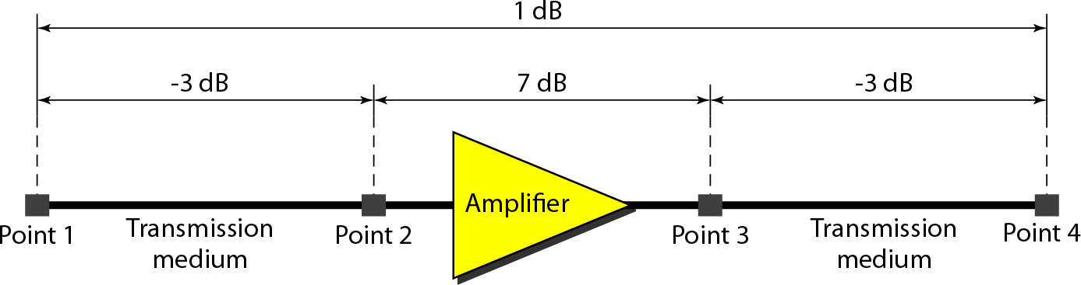
Example (3)
One reason that engineers use the decibel to measure the changes in the strength of a signal is that decibel numbers can be added (or subtracted) when we are measuring several points (cascading) instead of just two. In Figure 3.27 a signal travels from point 1 to point 4. In this case, the decibel value can be calculated as
3.8

Slide 9
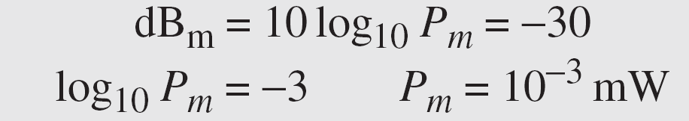
Example (4)
Sometimes the decibel is used to measure signal power in milliwatts. In this case, it is referred to as dBm and is calculated as dBm = 10 log10 Pm , where Pm is the power in milliwatts. Calculate the power of a signal with dBm = −30.
We can calculate the power in the signal as
3.9

Slide 10
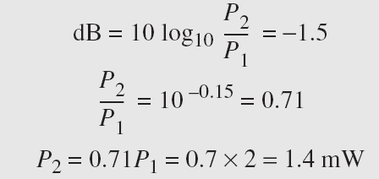
Example (5)
The loss in a cable is usually defined in decibels per kilometer (dB/km). If the signal at the beginning of a cable with −0.3 dB/km has a power of 2 mW, what is the power of the signal at 5 km?
Solution
The loss in the cable in decibels is 5 × (−0.3) = −1.5 dB. We can calculate the power as

Slide 11
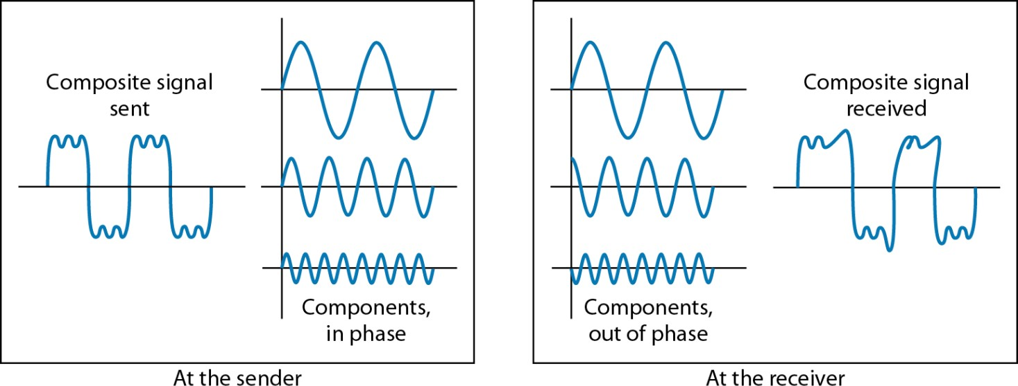
Distortion
Distortion means that the signal changes its form or shape.
Distortion occurs in a composite signal made of different frequencies.
Each signal component has its own propagation speed
through a medium and therefore its own delay in arriving at the final destination.

Slide 12
Noise
Noise is another cause of impairment. Several types of noise, such as thermal noise, induced noise, crosstalk, and impulse noise, may corrupt the signal.
Thermal noise is the random motion of electrons in a wire,
which creates an extra signal not originally sent by the transmitter.
Induced noise comes from sources such as motors and appliancses. These devices act as a sending antenna, and the
transmission medium acts as the receiving antenna.
Crosstalk is the effect of one wire on the other. One wire acts as a sending antenna and the other as the receiving antenna.
Impulse noise is a spike (a signal with high energy in a very short time) that comes from power lines, lightning, and so on.

Slide 13
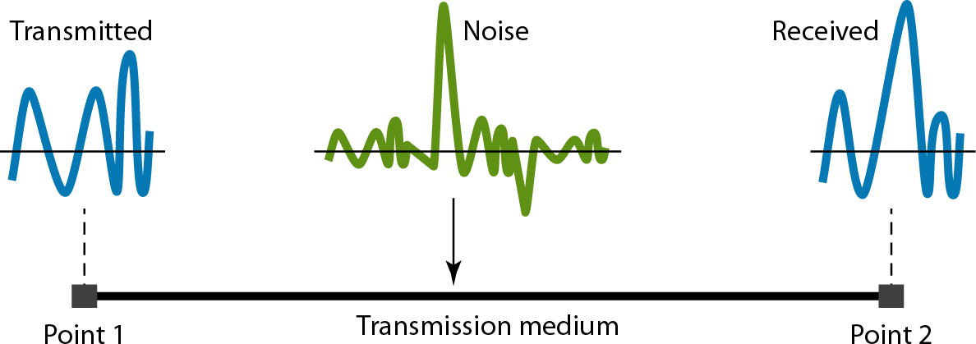
Noise
3.13

Slide 14

Signal to Noise Ratio
SNR is the statistical ratio of power of the signal to the power of the noise
In decibels it can be expressed as follows:

Slide 15
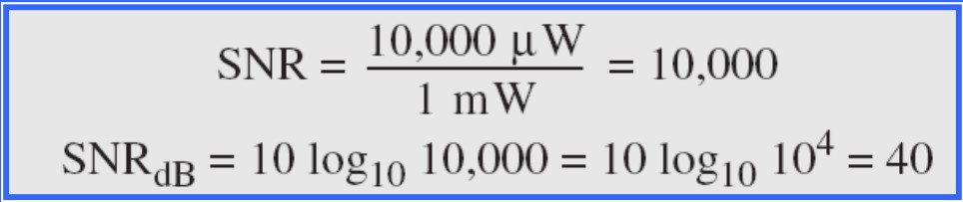
Example (1)
The power of a signal is 10 mW and the power of the noise is 1
μW; what are the values of SNR and SNRdB ?
Solution
The values of SNR and SNRdB can be calculated as follows:

Slide 16
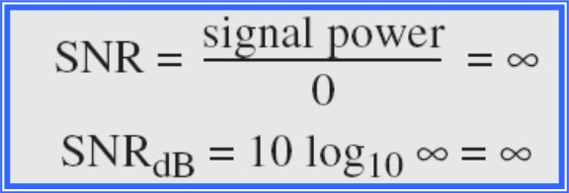
Example (2)
The values of SNR and SNRdB for a noiseless channel are
Solution:
We can never achieve this ratio in real life; it is an ideal.

Slide 17
Data Rate Limits
A very important consideration in data communications is how fast we can send data, in bits per second, over a channel. Data rate depends on three factors:
The bandwidth available
The level of the signals we use
The quality of the channel (the level of noise)
Two theoretical formulas were developed to calculate the data rate:
Nyquist for a noiseless channel
Shannon for a noisy channel

Slide 18
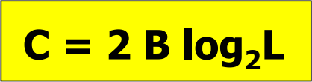
Noiseless channel: Nyquist bit rate
For a noiseless channel, the Nyquist bit rate formula defines the theoretical maximum bit rate
Where,
C is the channel capacity or bit rate in bps B is the bandwidth in Hz
L is the number of signal levels used to represent data

Slide 19

Example (1)
Consider a noiseless channel with a bandwidth of 3000 Hz transmitting a signal with two signal levels (binary signal). The maximum bit rate can be calculated as
Consider the same noiseless channel transmitting a signal with four signal levels (for each level, we send 2 bits). The maximum bit rate can be calculated as

Slide 20

Example (2)
We need to send 265 kbps over a noiseless channel with a bandwidth of 20 kHz. How many signal levels do we need?
Solution
We can use the Nyquist formula as shown:
Since this result is not a power of 2, we need to either increase the number of levels or reduce the bit rate. If we have 128 levels, the bit rate is 280 kbps. If we have 64 levels, the bit rate is 240 kbps.

Slide 21

Noisy channel: Shannon capacity
In reality, we cannot have a noiseless channel; the channel is always noisy.
In this case, the Shannon capacity formula
is used to for a noisy
determine the theoretical highest data rate channel:
Where,
C is the capacity of the channel in bps B is the bandwidth in Hz
SNR is the signal to noise ratio

Slide 22
Example (1)
Consider an extremely noisy channel in which the value of the signal-to-noise ratio is almost zero. In other words, the noise is so strong that the signal is faint. For this channel the capacity C is calculated as
This means that the capacity of this channel is zero regardless of the bandwidth. In other words, we cannot receive any data through this channel.

Slide 23
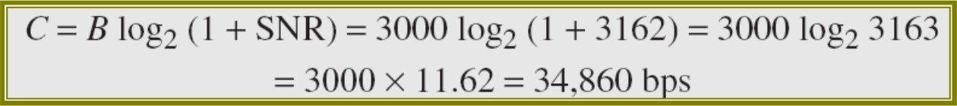
Example (2)
We can calculate the theoretical highest bit rate of a regular telephone line. A telephone line normally has a bandwidth of 3000. The signal-to-noise ratio is usually 3162. For this channel the capacity is calculated as
This means that the highest bit rate for a telephone line is 34.860 kbps. If we want to send data faster than this, we can either increase the bandwidth of the line or improve the signal-to-noise ratio.

Slide 24
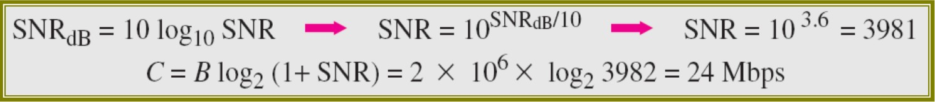
Example (3)
The signal-to-noise ratio is often given in decibels. Assume that SNRdB = 36 and the channel bandwidth is 2 MHz. The theoretical channel capacity can be calculated as

Slide 25
Example (4)
We have a channel with a 1-MHz bandwidth. The SNR for this channel is 63. What are the appropriate bit rate and signal level?
Solution
First, we use the Shannon formula to find the upper limit.
The Shannon formula gives us 6 Mbps, the upper limit. For better performance we choose something lower, 4 Mbps, for example. Then we use the Nyquist formula to find the number of signal levels.

Slide 26
Performance
One important issue in networking is the performance of the network—how good is it? In this section, we introduce the following terms to measure the performance.
Bandwidth Throughput Latency (Delay)

Slide 27
Bandwidth
In networking, we use the term bandwidth in two contexts.
The first, bandwidth in hertz, refers to the range of frequencies in a composite signal or the range of frequencies that a channel can pass.
The second, bandwidth in bits per second, refers to the speed of bit transmission in a channel or link.

Slide 28
Example
The bandwidth of a subscriber line is 4 kHz for voice or data. The bandwidth of this line for data transmission can be up to 56,000 bps using a sophisticated modem to change the digital signal to analog.
If the telephone company improves the quality of the line and increases the bandwidth to 8 kHz, we can send 112,000 bps by using the same technology.

Slide 29
Throughput
The throughput is the measurement of how fast data can pass through a network in one second.
Throughput is calculated as follows:

Slide 30

Example
A network with bandwidth of 10 Mbps can pass only an average of 12,000 frames per minute with each frame carrying an average of 10,000 bits. What is the throughput of this network?
Solution
We can calculate the throughput as
The throughput is almost one-fifth of the bandwidth in this case.

Slide 31
Latency (Delay)
The latency or delay defines how long it takes for an entire message to completely arrive at the destination from the time the first bit is sent out from the source. We can say that latency is made of four components: propagation time, transmission time, queuing time and processing delay.

Slide 32
Propagation time and transmission time
Propagation time measures the time required for a signal (or a bit) to travel from one point of the transmission medium to another.
Propagation time is calculated as follows:
Transmission time measures the time required for a signal to be transmitted from the sending device to the medium. Transmission time is calculated as follows:

Slide 33
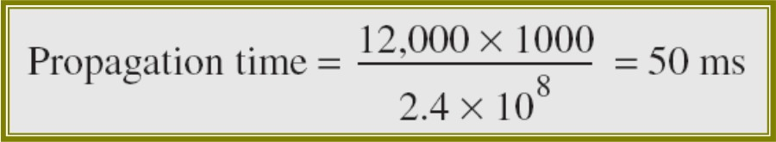
Example (1)
What is the propagation time if the distance between the two points is 12,000 km? Assume the propagation speed to be 2.4×108 m/s in cable.
Solution
We can calculate the propagation time as
The example shows that a bit can go over the Atlantic Ocean in only 50 ms if there is a direct cable between the source and the destination.

Slide 34
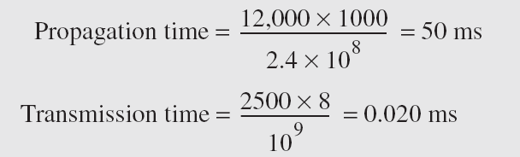
Example (2)
What are the propagation time and the transmission time for a 2.5kbyte message (an e-mail) if the bandwidth of the network is 1 Gbps? Assume that the distance between the sender and the receiver is 12,000 km and that light travels at 2.4×108 m/s
Solution
We can calculate the propagation and transmission time as follows:
Note that in this case, because the message is short and the bandwidth is high, the dominant factor is the propagation time, not the transmission time. The transmission time can be ignored.

Slide 35
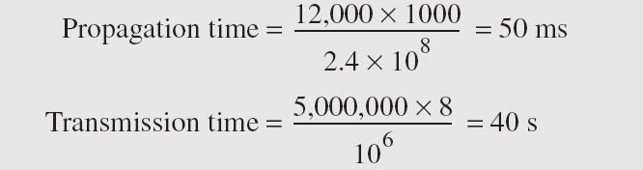
Example (3)
What are the propagation time and the transmission time for a 5- Mbyte message (an image) if the bandwidth of the network is 1 Mbps? Assume that the distance between the sender and the receiver is 12,000 km and that light travels at 2.4 × 108 m/s.
Solution
We can calculate the propagation and transmission time as follows:
Note that in this case, because the message is very long and the bandwidth is not very high, the dominant factor is the transmission time, not the propagation time. The propagation time can be ignored.

Slide 36
Example (3)
What are the propagation time and the transmission time for a 5- Mbyte message (an image) if the bandwidth of the network is 1 Mbps? Assume that the distance between the sender and the receiver is 12,000 km and that light travels at 2.4 × 108 m/s.
Solution
We can calculate the propagation and transmission time as follows:
Note that in this case, because the message is very long and the bandwidth is not very high, the dominant factor is the transmission time, not the propagation time. The propagation time can be ignored.

Slide 37

3.37

