Slide 1

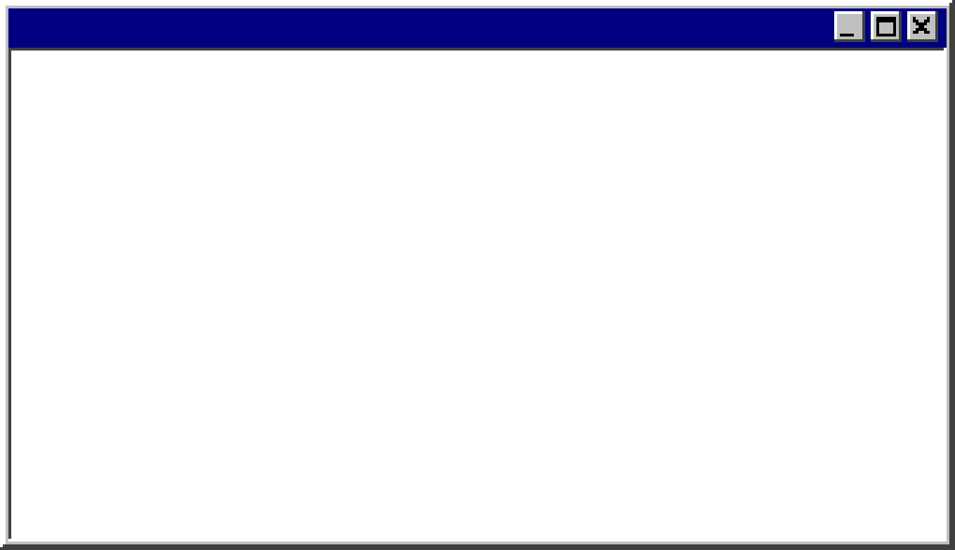




Scaffolding Over Scale
Unauthenticated Account Takeover
in Blazor with a Local LLM
Ryan Chaplin – Lead Penetration @ Raxis

Slide 2
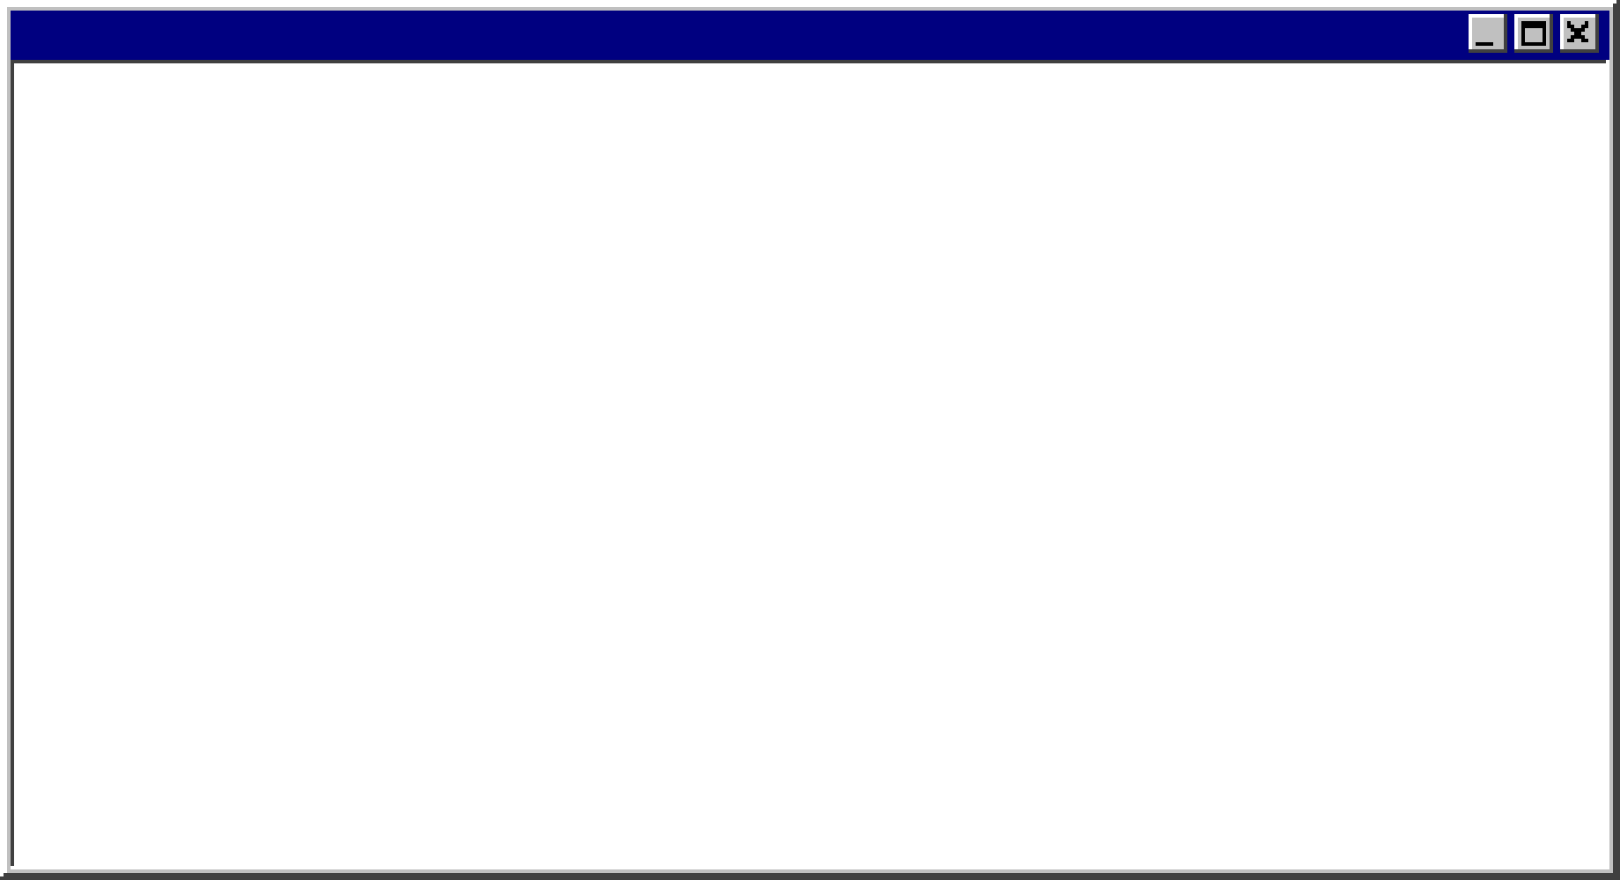
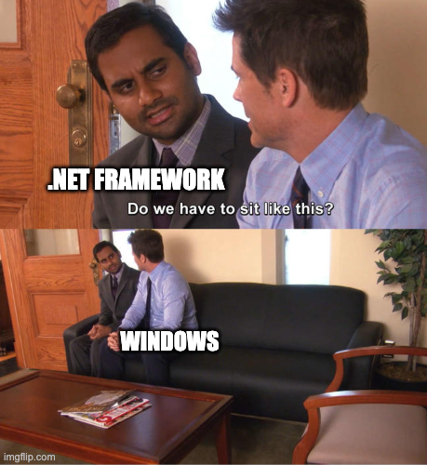
Background – .NET Core vs .NET Framework
> Both widely used at enterprises
> .NET Framework is older
> Tightly Integrated with Windows
> Leaks “Version” Header:
> X-AspNet-Version: 4.0.30319
> From Lineage Framework 4.X
> Tied to older tech like:
Web Forms, MVC 5
> .NET Core / modern .NET
> Better suited to containers and cloud deployments
> Cross Platform
> Actively Developed and more intuitive versioning
Notes:
Ahead of Time Comp Containers

Slide 3
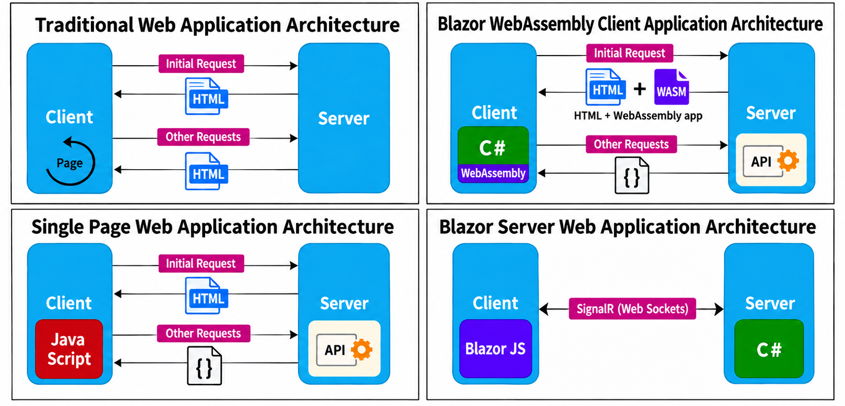
Background – What is Blazor
> Built on .NET Core / modern .NET
> Blazor allows developers to write Web Apps with C#
> Server, Blazor Web Assembly or Hybrid
> Compiled Blazor ships Intermediate Language (IL) to Clients

Slide 4
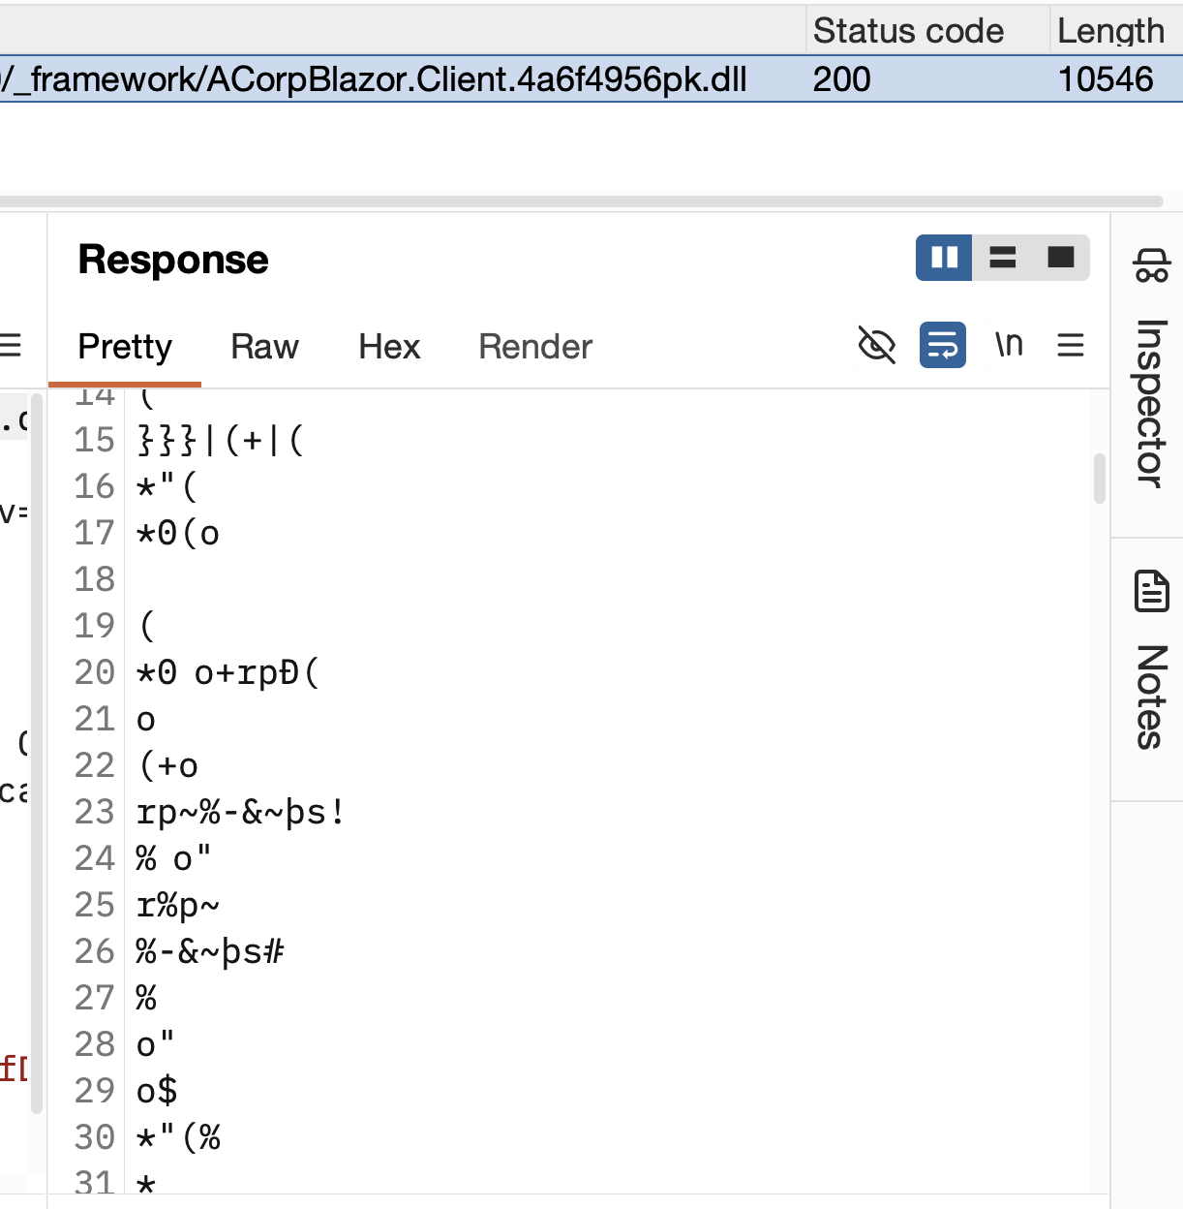
Background - Attacking and Defending Blazor
> Two Main threats:
> Deserialization
> Sensitive Info Leakage
> Treat every DLL in /_framework/blazor.boot.json as public
> Include tools like trufflehog in CI/CD stack
> Manually audit and decompile using IlSpyCmd
> Sanitize all input and fuzz inputs for allowed gadget chains using ysoserial.net

Slide 5

Real World Challenges
> Real world engagement with several exceptionally rare operational challenges
> Last minute scheduling
> No credentials provided
> Point of contact literally on vacation
> Day 1 is discovering I’m doing a credentialed web app with no way to access 95% of the app and no way to contact the client.

Slide 6
Real World Challenges
Technical Challenges
> Early passes for weak credentials and OWASP Top 10 yielded no results.
> Mature enterprise app with 3+ years of recurrent Pentesting.
> No deserialization vuln discovered and running the latest version of modern .NET
> No off-the-shelf tooling existed for chaining the path to unauthenticated account takeover.

Slide 7
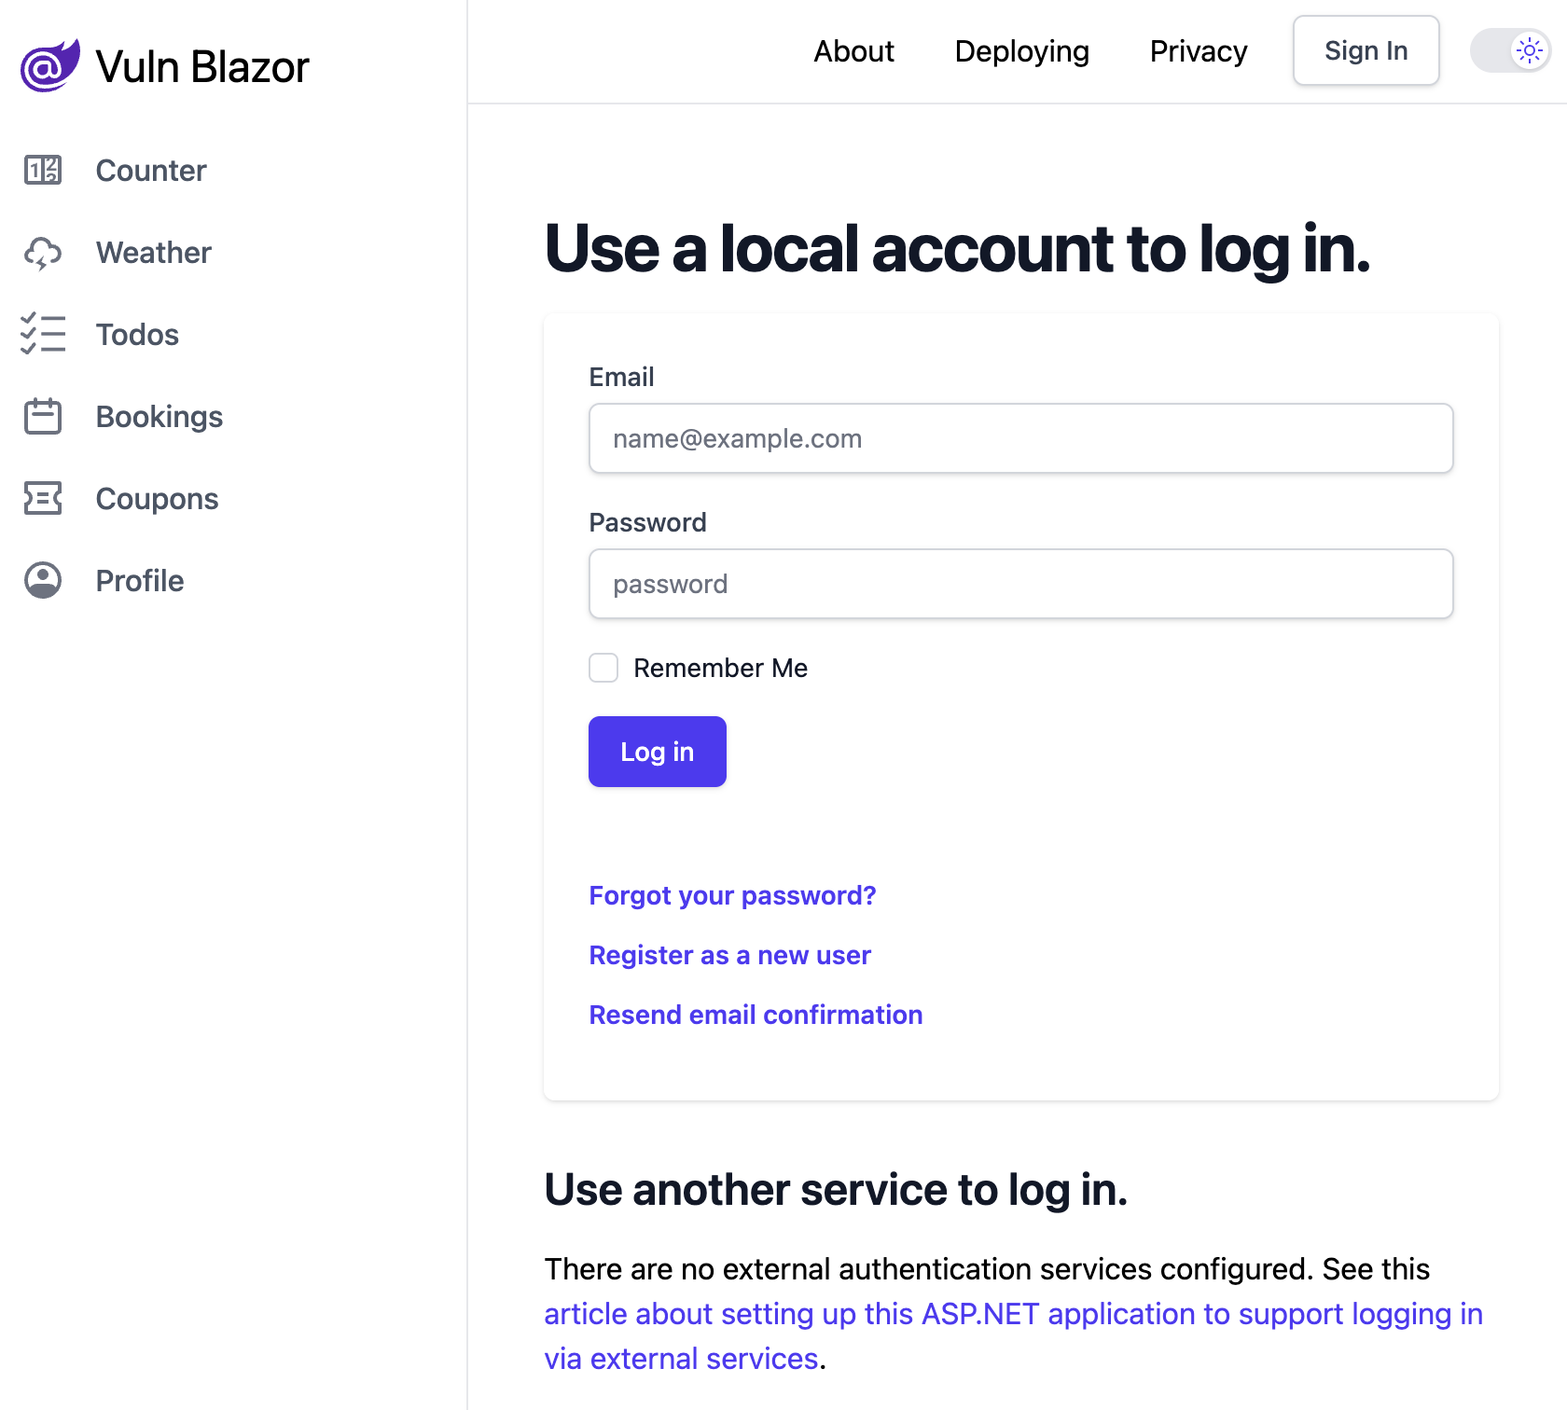
Replica Environment– Vuln Blazor
Successful Exploitation Requires
1. Identify and decompile the intermediate language.
2. Grep the decompiled assemblies for a hardcoded key.
3. Discover the user enumeration endpoint to extract a target user's UUID.
4. Check for credential reuse by decrypting user passwords with a seemingly unrelated the hardcoded key used for telemetry data.
5. Validate the credentials.
6. Correctly report the unauthenticated account takeover.
Replica environment
repo available on my Github:
github.com/its-ryans-work

Slide 8
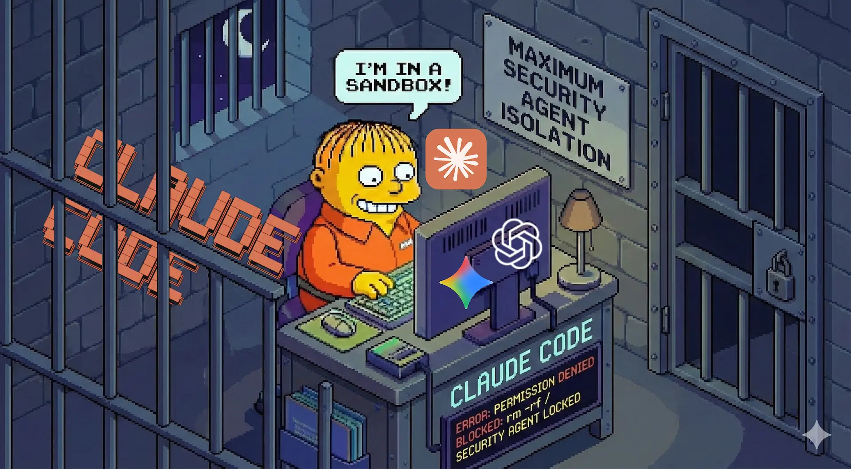
Using LLMs During Testing
> Our methodology is human-led, LLM supplemented
> Generally not against a real world prod app
> Enterprise Claude Account
> No training on user data
> Human in the loop
> Using Bypass for
Security Refusals
on Sonnet 4.6
> Frontier LLM agents
escape sandboxes, so I generally don’t use them.

Slide 9
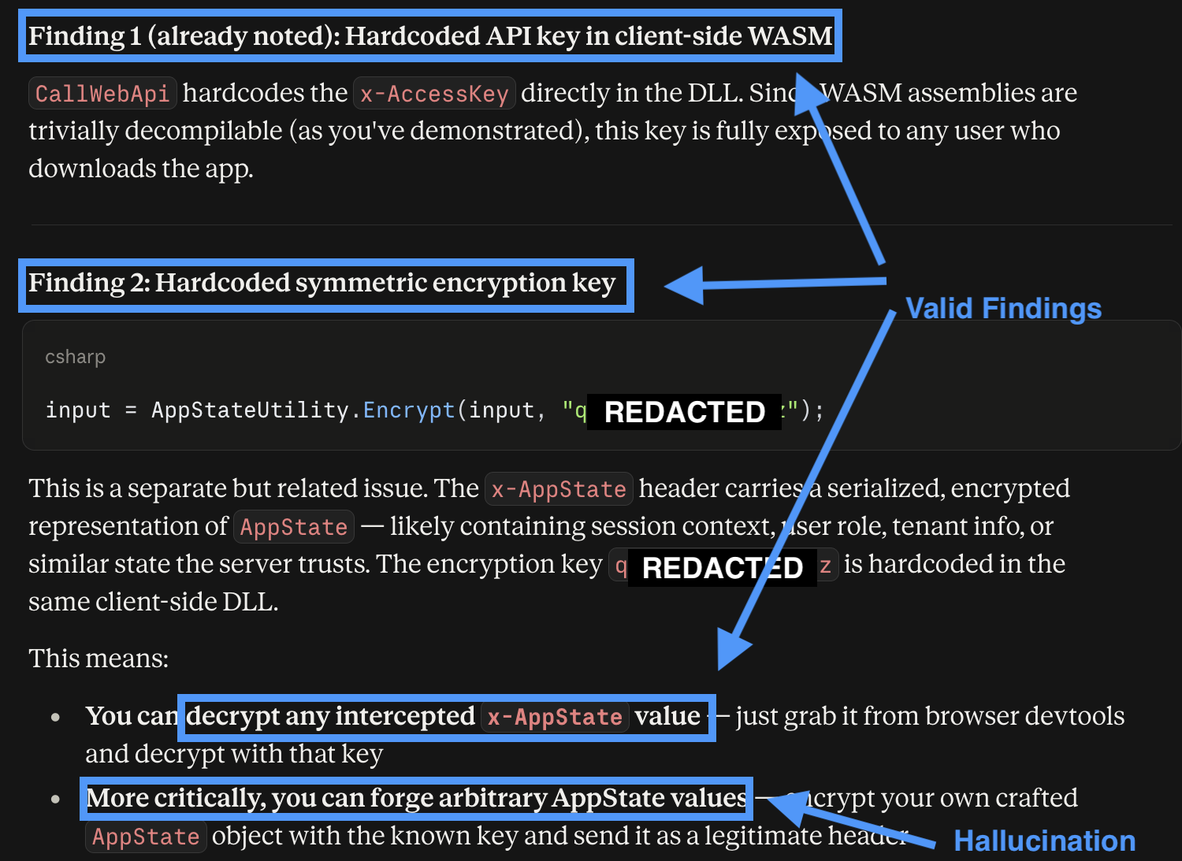
Can Frontier Models Pull This Off?
> Using Chat interface: 3 of 6 steps reliably and consistently executed
> Struggles chaining previous findings together and escalation. (PentestGPT, Deng et al)
> Specifically checking for credential reuse.
> Hallucinations are another huge challenge
> 20% Success Rate in Chat over 5 runs.

Slide 10
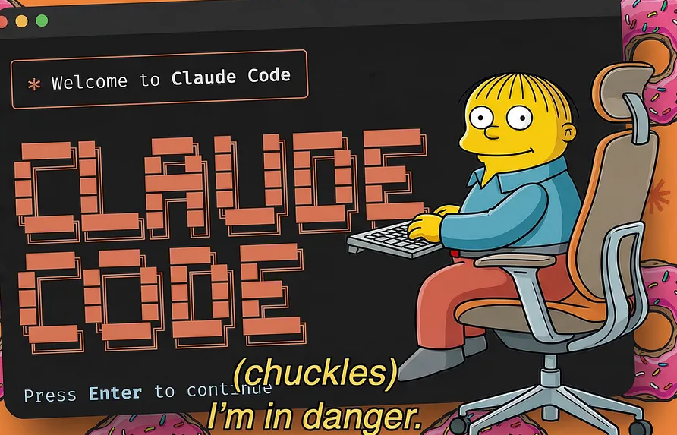
Can Frontier Models Pull This Off?
> Using Agentic Tooling (Claude Code): Sometimes!
> Using a generic prompt and no additional tooling Claude Code succeeded 40% of the time
> If given Kali MCP Server and a Blazor playbook, frontier model success rate hit 100% across 5 runs.
> The risk of unintended consequences are very real!

Slide 11
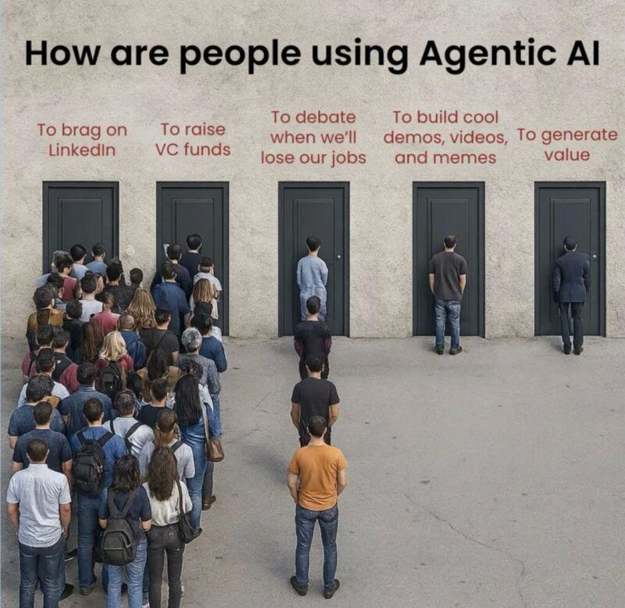
Agentic what, MCP who?
> An LLM with the ability to take actions generally taking multiple actions per prompt.
> Includes tool calling.
> MCP servers to expand tool availability.
> Memory and Scratchpads
> Context Window Awareness
> Difference between Chat and Code mode.

Slide 12
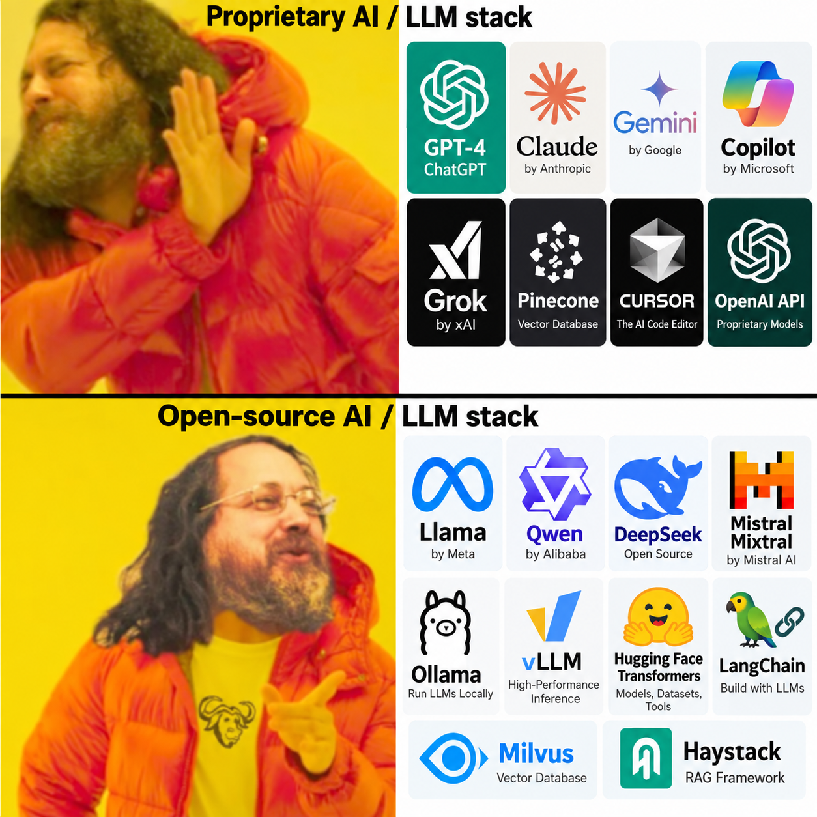
Building Local LLM Testing Machine – My Stack
> I used Qwen 3.6 Uncensored / Abliterated – 27B from huggingface.co
> Llama.cpp running in Podman / Docker
> Consumer video card (all testing done on 4090, but smaller cards work)
> I forked GH05TCREW/PentestAgent to add similar features to Claude Code:
context window awareness, ”memory”, scratchpad, revamped OWASP Top10 Playbook and a generic Blazor playbook.
> Hermes has everything but the Blazor and OWASP Top 10 natively built in.

Slide 13
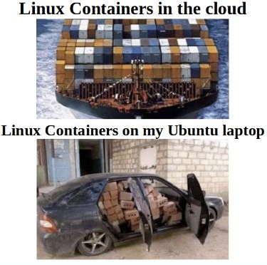
Using Open Weights LLMs and Custom Tooling
> No GPU at home / on-prem – no problem
> vast.ai
> runpod.ai
> probably dozens of other options
> $100,000 GPUs available for $10/hour.
> Makes any open weight model accessible
> Save cost by testing locally before deploying to cloud.

Slide 14
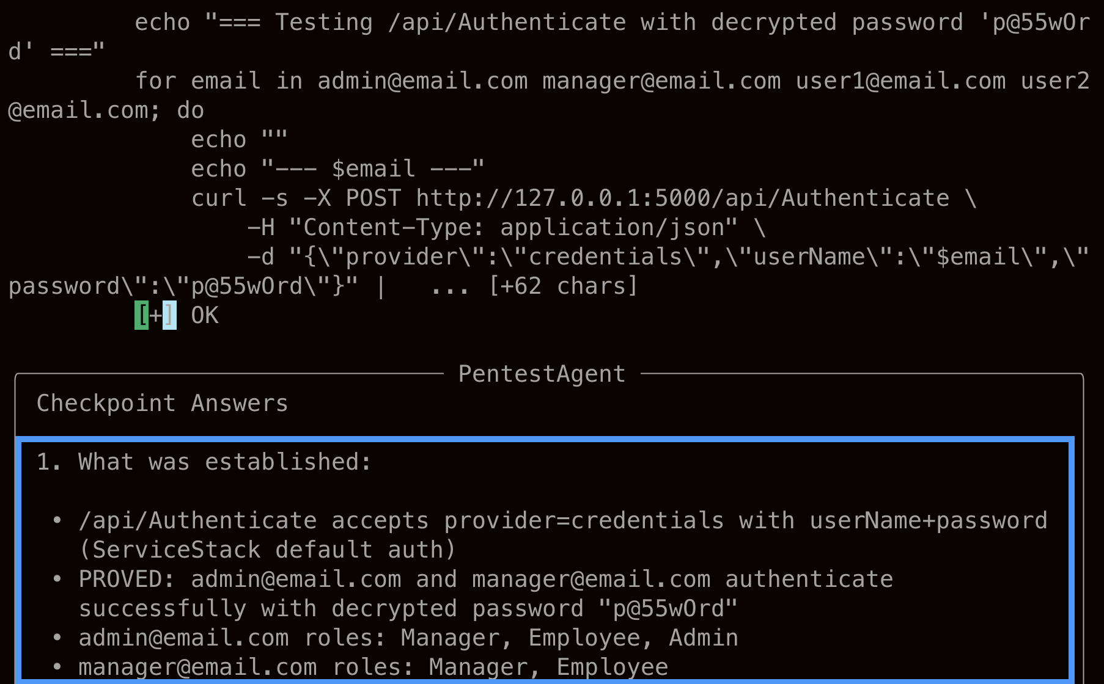
How do Local LLMs Perform?
> Using a Local LLM in agentic mode outperforms Claude Chat and Claude Code with a generic prompt.
> Success rate 60% of runs.
> Claude Code given the exact same tools and playbook still outperforms local LLMs,
> If you are only using a Frontier Chat or generic prompts, you would benefit from switching to an agentic workflow / scaffolding even if using Local Models

Slide 15
Summary
> Defensive Hardening
> Use a WAF
> Detect AI User Agents, especially when performing malicious actions
> Audit decompiled IL
> Check what ships to clients
> Offensive Testing
> Tailor attacks for tech stack
> If using an LLM put extra effort into chaining exploits
> Manually review logs and outputs
> Remember scaffolding can beat scale. Smaller models you control can beat frontier models if given the right skills and tools

Slide 16
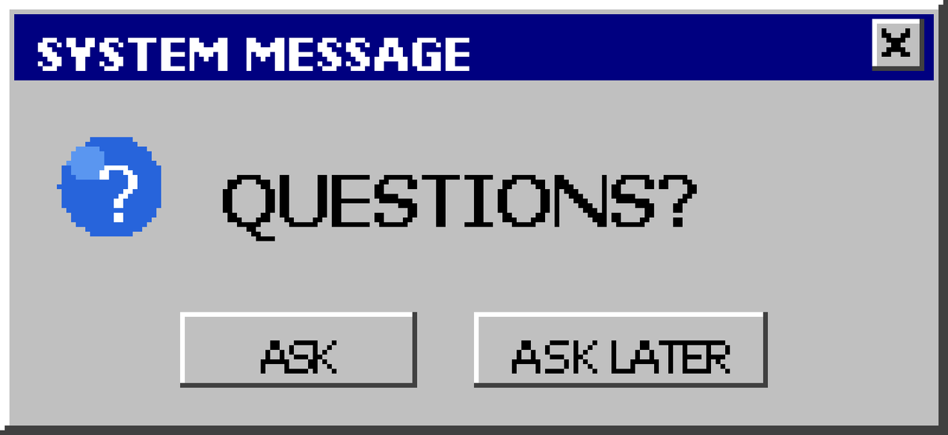

Slide 17
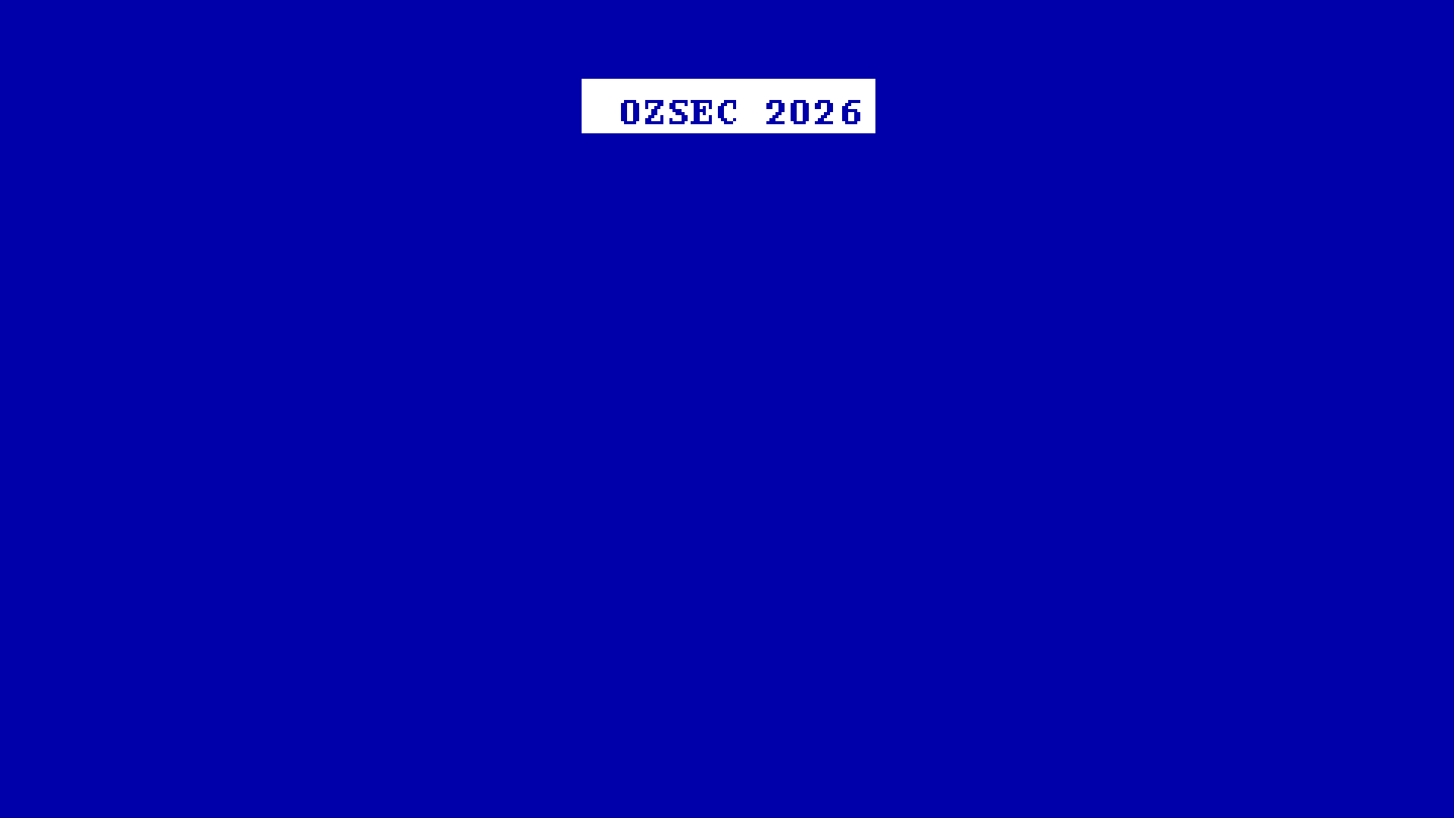
End of session
Thank you for your attendance
> SPEAKER : Ryan Chaplin
> EMAIL : its.ryan.work@pm.me
> SOCIALS : \x90 (N/A)
> SLIDES & REPO : github.com/its-ryans-work

