Slide 1


April
2022
Corporate Institute of Science and
Technology Bhopal
Department of Computer science & Engineering
A presentation on
Traffic Monitoring System
Presented by :
MD SERAJ KHAN
0502CS181029
UNDER THE GUIDANCE OF :
PROF. AJAY WADEKAR
Computer Science Department

Slide 2
INTRODUCTION :
Traffic Monitoring is special and unique software, which used in police station, traffic signals who want to have lot of issue related to the schedule of the staff as well as generating the customs reports.
This software can be implemented in various places for manage the schedule. With the help of this generator the different type of customs reports and also current location of the staff. We also have different login available for different task preformation.
In this we able to manage the different staff details and there profiles so that we will able to get those data in centralized place. also get the monthly report for the so the details.
Thus we are presenting an traffic monitoring system that can reduce time consumption by replacing the conventional method schedule. it also needs lesser man power & has provision to access the different records .​

Slide 3
Abstract
The “Traffic monitoring system” is a web application which allows us to access the total information about the Police station and there staff. In this application we can get the latest information & current location of staff members. This application will maintain the challan, attendance & fine report etc.
The application will be maintained by the administrator. It can also use in the multiple state as well​.

Slide 4
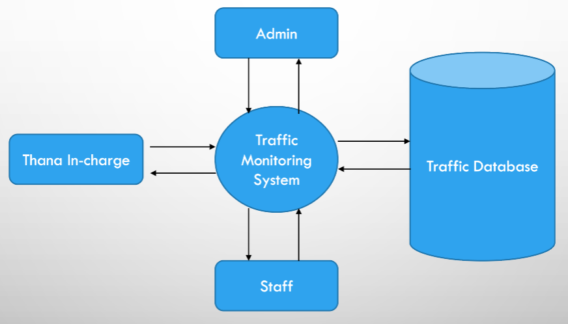
Data Flow Diagram (DFD)

Slide 5
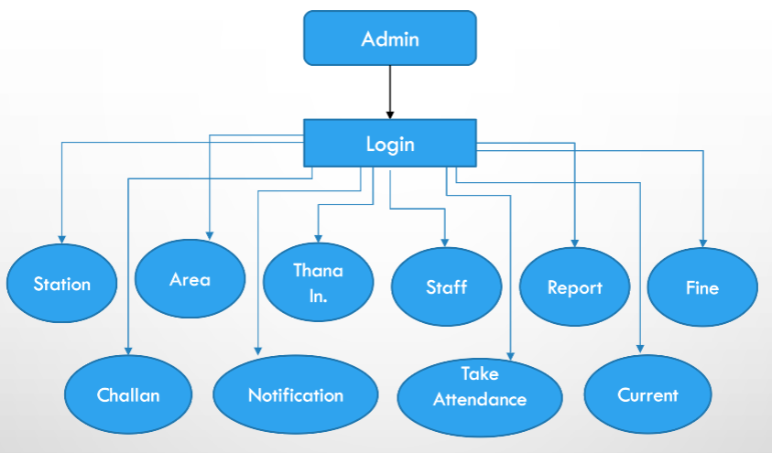
Admin Level DFD

Slide 6
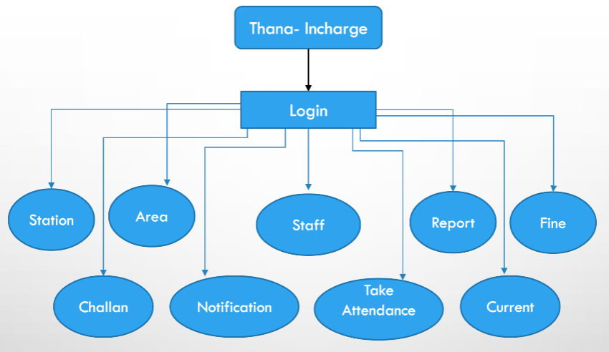
Thana-Incharge Level DFD

Slide 7
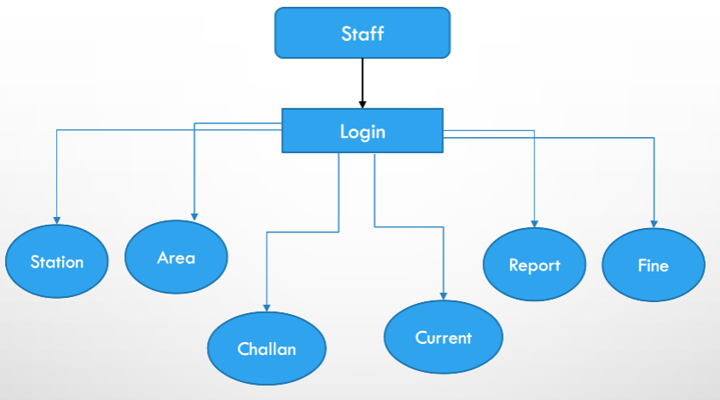
Staff Level DFD

Slide 8
Software & Hardware Requirements
Software
Text Editor ( VS code )
Any PHP Server ( WAMPP / XAMP )
Web Browser
OS : Windows / Linux / IOS
Hardware
Processor : minimum 1GHz, recommended 2GHz
Hard Drive : minimum 32GB, recommended 64GB
RAM : minimum 1GB, recommended 4GB

Slide 9
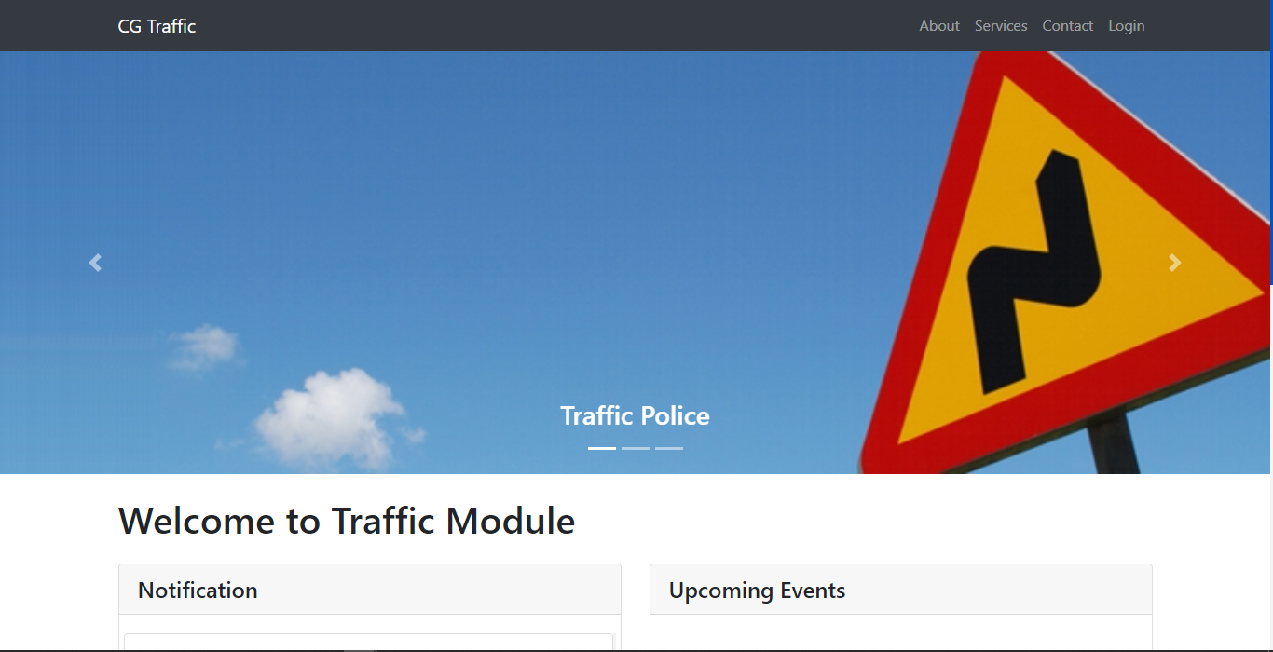
Homepage

Slide 10
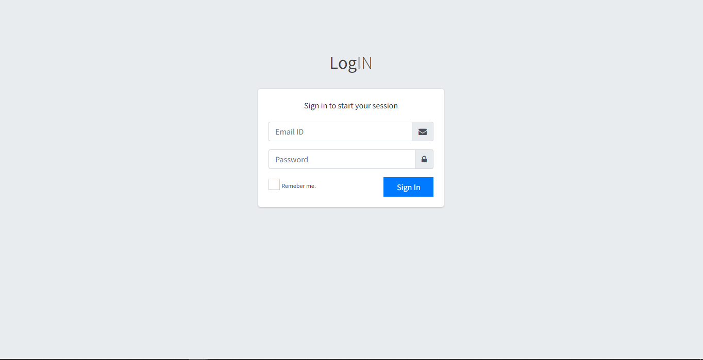
Login

Slide 11
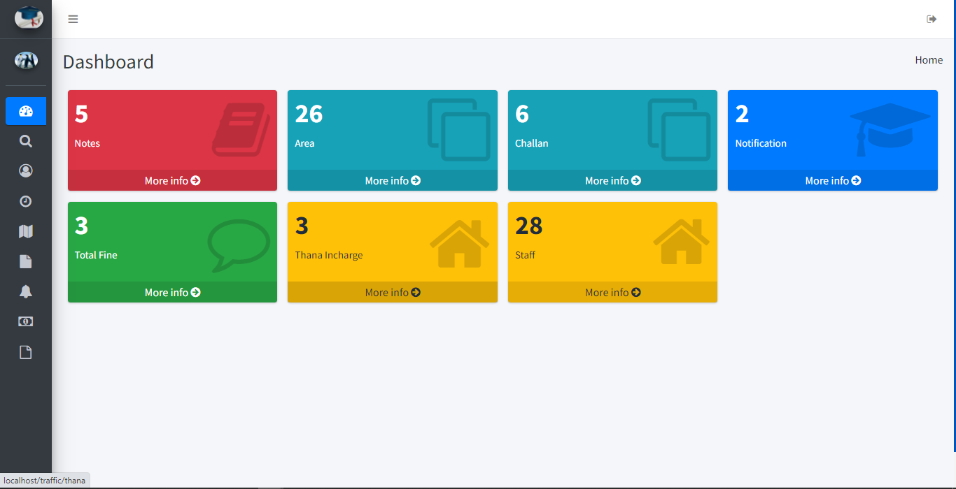
Admin Dashboard

Slide 12
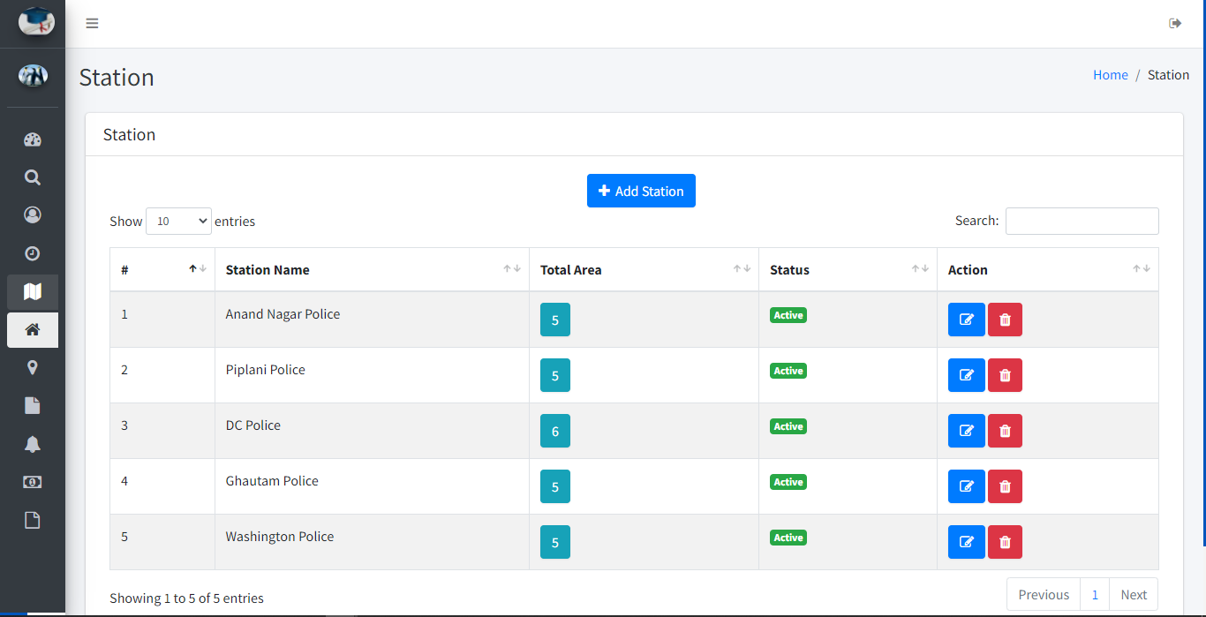
Station

Slide 13
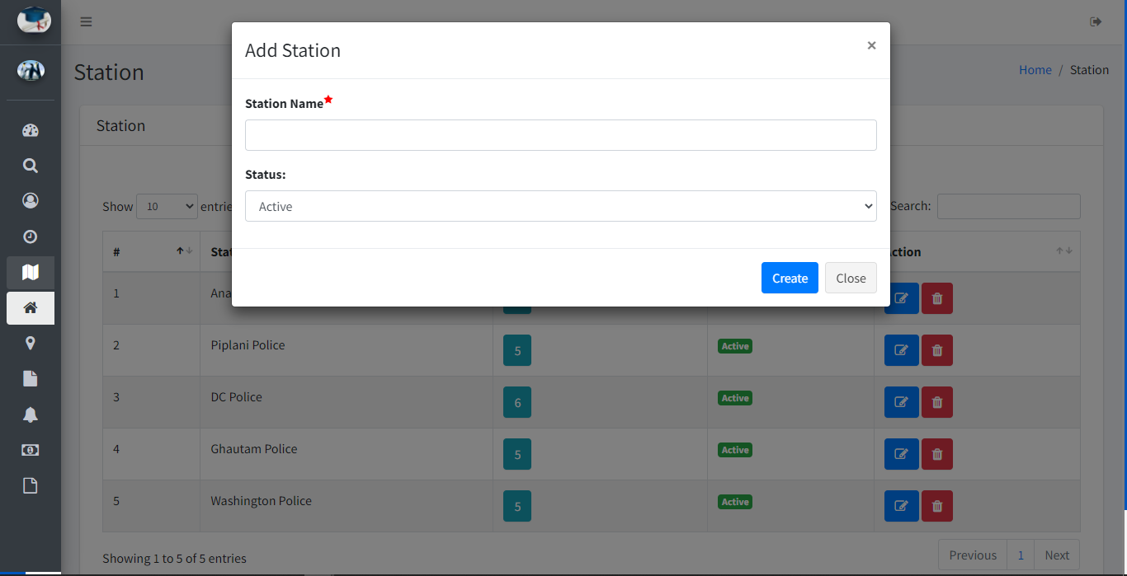
New Station add

Slide 14
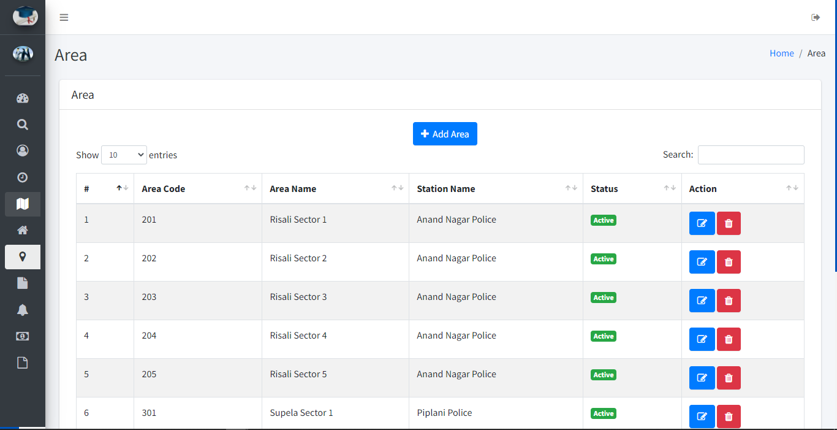
Area

Slide 15
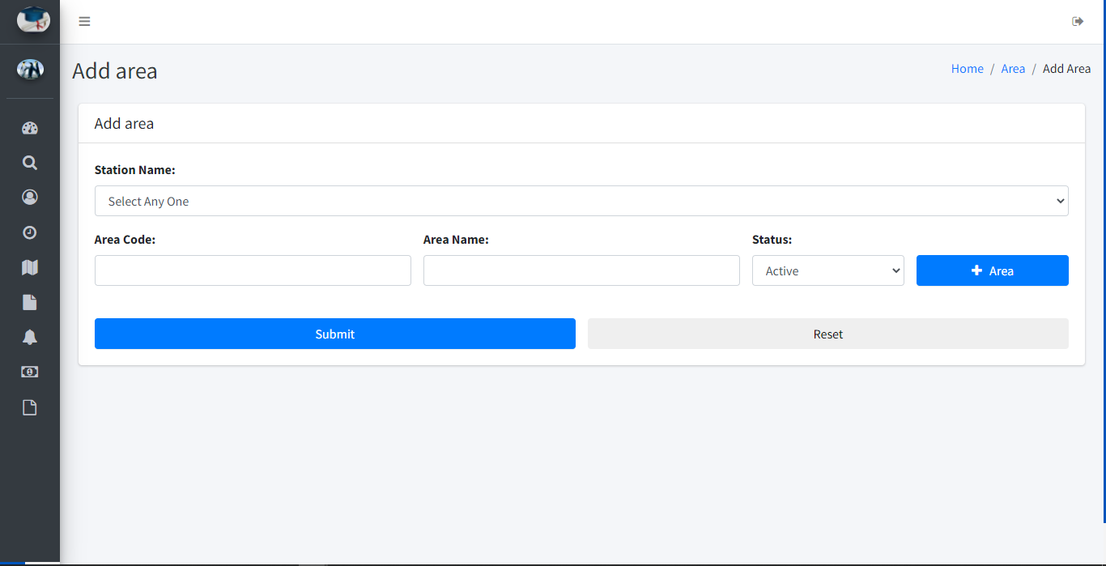
Add Area

Slide 16
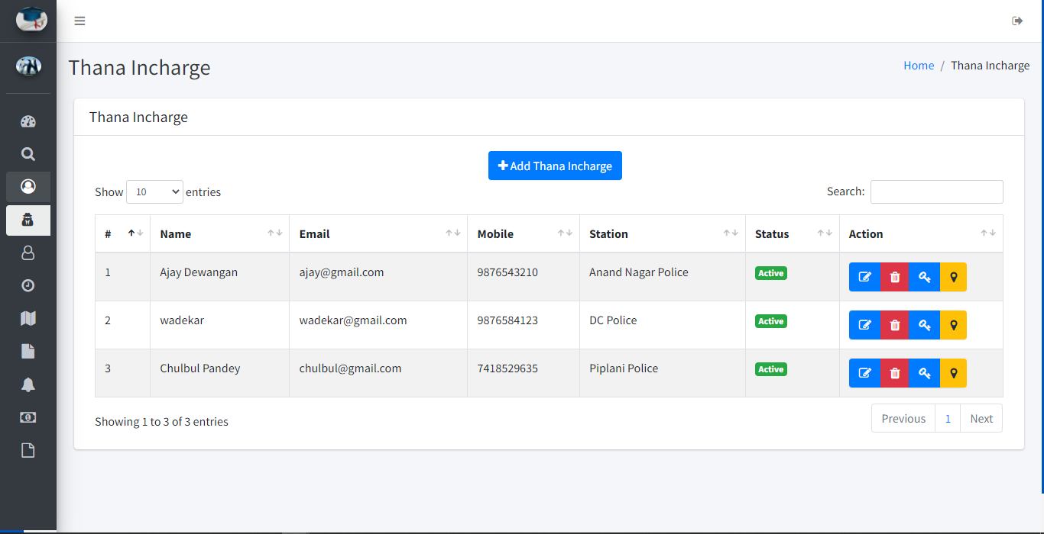
Thana Incharge

Slide 17
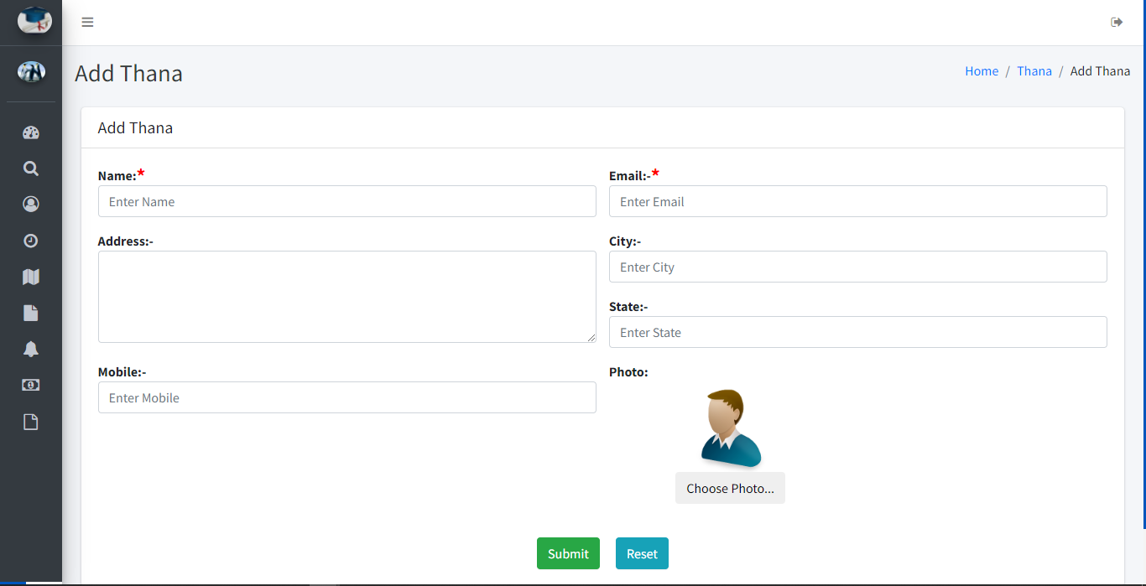
Add Thana Incharge

Slide 18
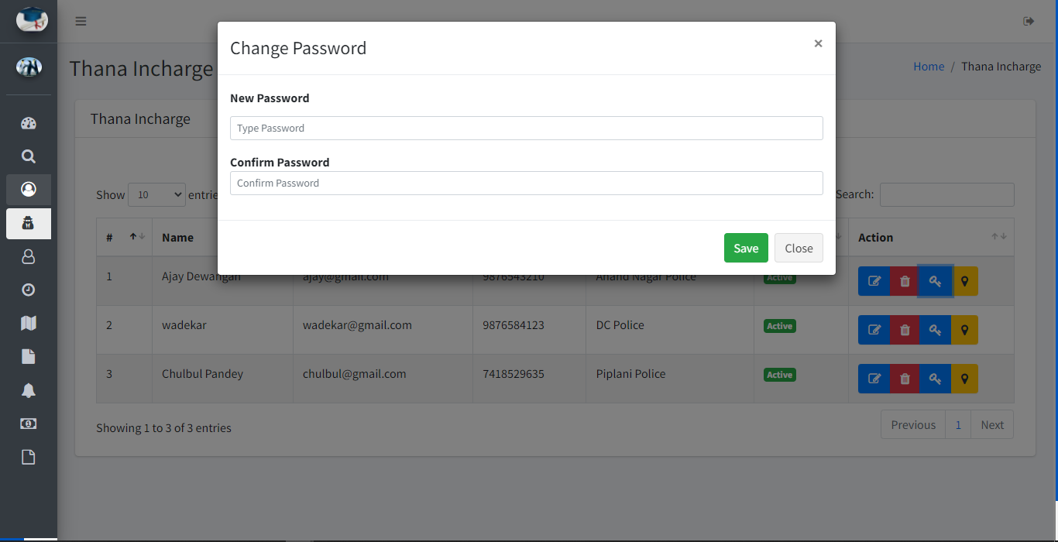
Password Change

Slide 19
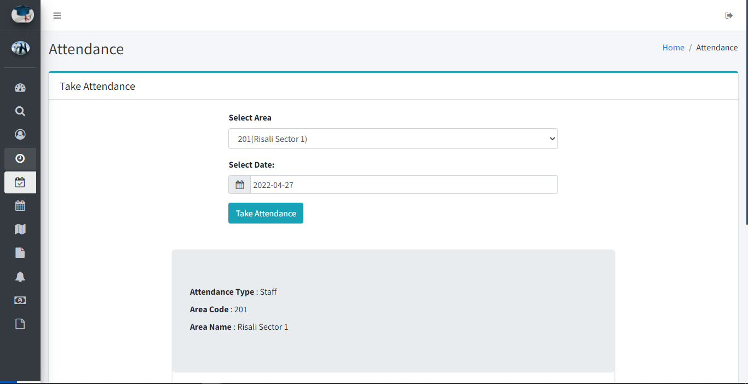
Take Attendance

Slide 20
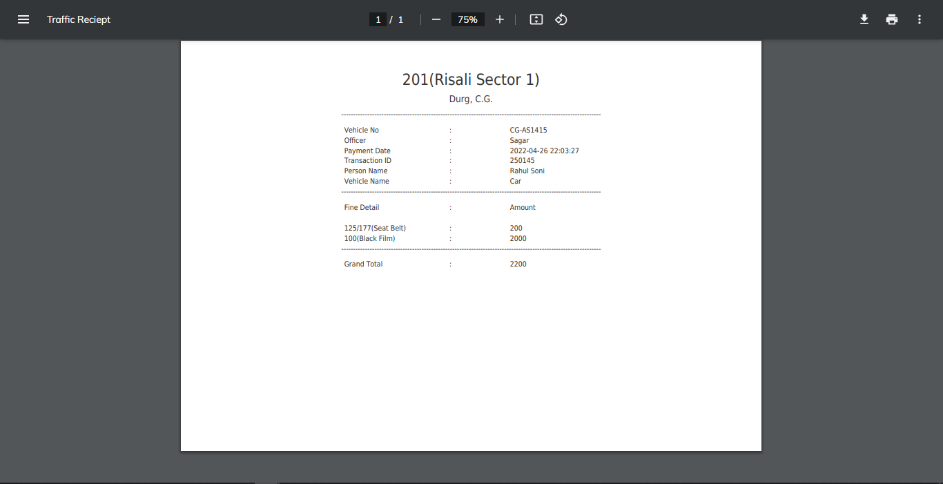
Fine Receipt

