Slide 1
GUEST HOUSE MANAGEMENT SYSTEM
PREPARED BY: GROUP 37
UTKARSH KHURANA 20UCS215
HRISHIT JHAVERI 20UCS081
YASH PALIWAL 20UCS238
MIHIR BAGADIA 20UCS116

Slide 2
Minutes of Meeting(MOM)
Date:16 Sept 2022 Time: 3:00 PM Location: LNMIIT Guest House
Participants Present: Mr. Virendra Kumar, Utkarsh Khurana, Hrishit Jhaveri, Yash Paliwal, Mihir Bagadia
Below is the Record of discussions Between our Group and Guest House manager Regarding the SWE Project:-
Summary of Discussion:-
Guest House is intended for use only by Lnmiit student and its faculty members.
There are total of 14 rooms which are present out of which only 12 can be booked by student/faculty while the other two(VIP rooms) are reserved for administrative purposes and can be booked only on the director’s approval.
All Rooms are fully equipped with AC & Kettle, double-bed and all other required facility.
To book the room, fill the form of guest house and submit it to Mr. Virendra Kumar or Mr. Samar Singh. On the Student Dean(Mr. Anupam)’s approval, rooms are booked for the given person.
A Room can be booked only for maximum 3-4 days.
The confirmation of whether the room is booked or not, will be given only 7 days before by the guest house administration.
Payment will be done at checkout. Cost for student for booking the room is Rs.500 only & for faculty members is Rs 250 only (upto 10 bookings annually).
The room will be cancelled if the student didn’t show on the assigned date.

Slide 3
References
[1] IEEE. IEEE Std 830-1998 IEEE Recommended Practice for Software Requirements Specifications. IEEE Computer Society, 1998.
[2] Software Engineering, Ian Sommerville, Pearson, 2017, 8th edition.
[3] Software Engineering: A Practitioner's Approach by Roger Pressman, TMH, 6th / 7th Editions.
[4] IEEE template for Software Requirements Specification.

Slide 4
INTRODUCTION
PURPOSE
The primary objective of this Guest House Management System Software Requirement Specification (SRS) is to provide a detailed overview of the GHMS, its parameters, constraints and goals.
This SRS document will be used in the future stages of the project which will help for the development of correct software for the end user.
PRODUCT SCOPE
The scope of the to be developed “Guest House Management System” package is:
to provide a system for a guest house to automate its major operations.
The software automatically reserves 80% of the total rooms on first come first serve basis and rest of the 20% rooms are allotted on priority basis, which is decided manually by the Admin. Our GHMS will have two end users: USER(Students/faculty) and Admin.
GHMS consists of Booking Management System, DBMS Server, and Report Generator. End users can check the room’s availability and select and book the rooms. `The Admin will have access to approve, update or modify booking details.

Slide 5
Overall Description
Product Functions
Functions For User(s)
Login/ Registration
Search for Rooms
Request Room Booking
Payment
Check Booking Status
Cancel Booking
Functions For Admin
Confirm/Cancel Booking
Add/Delete Rooms
Add/Delete User
DFD LEVEL 0

Slide 6
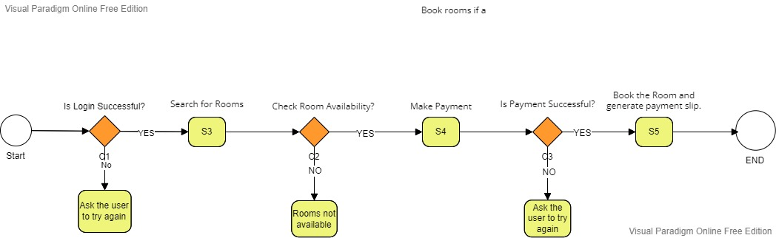
Product Perspective
Buisness Process Modeling:

Slide 7
User Classes and Characteristics
Following are the User that will be using this Product –
A Student who will be using Booking Portal for booking a room in LNMIIT Guest House.
A Faculty member who will be using Booking Portal for booking a room in LNMIIT Guest House.
The administration will use the administration portal for confirming and managing the bookings
User Interface
Login Interface:
There will be two options to either register using the rollNo for students or register using the EmployeeID for faculty login and registration.
After login, the user shall see the dashboard which will have 3 options – search for rooms, cancel booking and check booking status.

Slide 8
Administration Interface:
The user shall verify themselves through an authentication process before making any changes(add/edit) to the Admission Portal.
Administrator will be provided with GUI’s which can be used to add/edit important details regarding Guest House, like add room, delete room, add user, delete user, check pending request.
In the check pending request option, a new window will open which will show all the pending room booking requests and the details of the check-in, check-out dates, no of person, names of guests.
The admin can review and either accept or reject the booking.
Room booking interface:
There will be an option to enter the check in and check out dates for which the user wants a room.
On the next page, the user can see the rooms which are available on the requested dates and their prices.
The user can proceed to book the room by clicking the send booking request button where he will be given a form in which he has to enter the names of the guest, number of guest, no of days, contact number and the price will be displayed.
Then the request would be sent to the admin.
Check booking status:
The user can see the status of the booking request on this page.
If the admin has confirmed the booking, there will be an option to pay the booking amount.
After payment, the user will be able to download the booking receipt.

Slide 9
EXTERNAL INTERFACE REQUIREMENTS
SR.NO | USER ACTION | SYSTEM RESPONSE
1 | The Applicant accesses the Portal through the Internet | Software will display the following options: a) User Id b) Password
2 | The Applicant logs in using the assigned Application Id and Password | Software will validate the details and show the Applicant Portal's Initial Screen
3 | Search for rooms | Checks if rooms are available
4 | On user request GHMS creates a new booking | A new booking object is created
5 | User makes payment to complete his booking | User completes booking
6 | Check booking status | GHMS provides booking status
7 | Person Initiates cancellation process | Refund process is initiated
8 | Person uses his credentials to access GHMS | Person is granted access to GHMS
9 | Admin confirms the booking from waiting list | Booking status confirmed

Slide 10
10 | Admin adds a room to the database | Room is added
11 | Admin deletes a room from the database | Room deleted from the database
12 | Admin adds a user to the database | User is added
13 | Admin deletes a user from the database | User deleted from the database

Slide 11
Other Non-Functional Requirements
Performance Requirements:
Some of the identified Performance requirements are:
1. The database shall be able to store records for a minimum of 5000 users.
2. The software shall support concurrent users.
3. The user data shall be easy to recover in case of a data loss.
Software Quality Attributes :
Adaptability: The software shall be able to adapt itself to the constant updating environment such as web browsers, operating systems etc.
Flexibility: The software shall provide a GUI for updating details like deadlines and counselling rounds that have to be frequently edited during the admission process.
Availability: The software shall be available for the users 99% of the time.

Slide 12
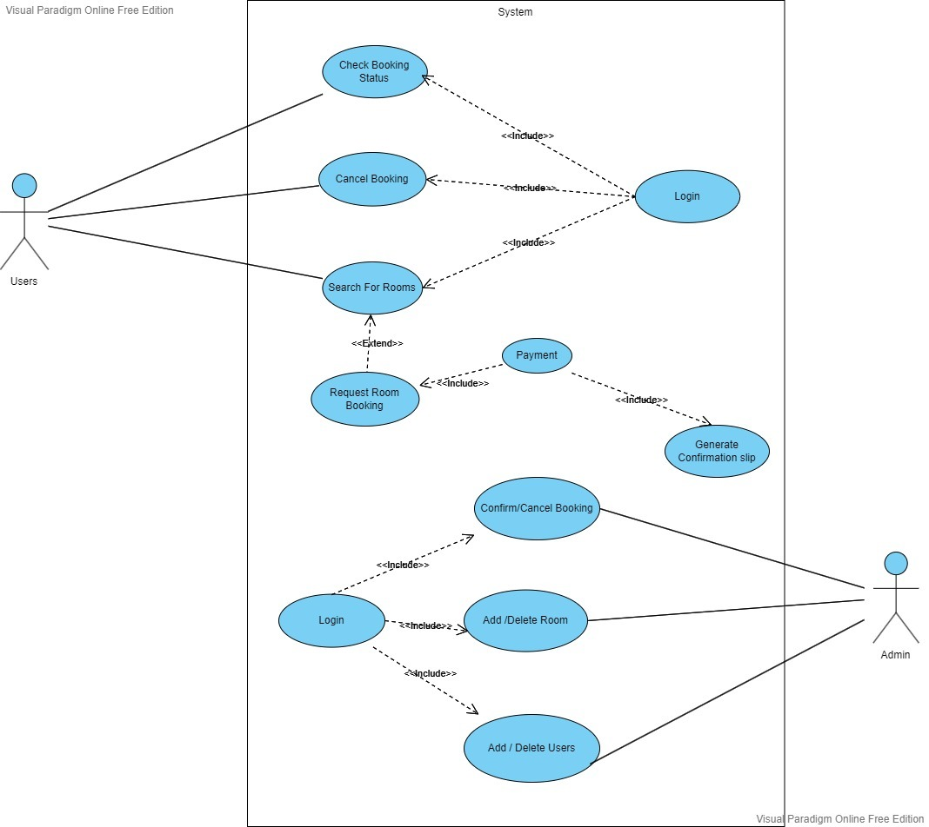
Use-Case Diagram:

Slide 13
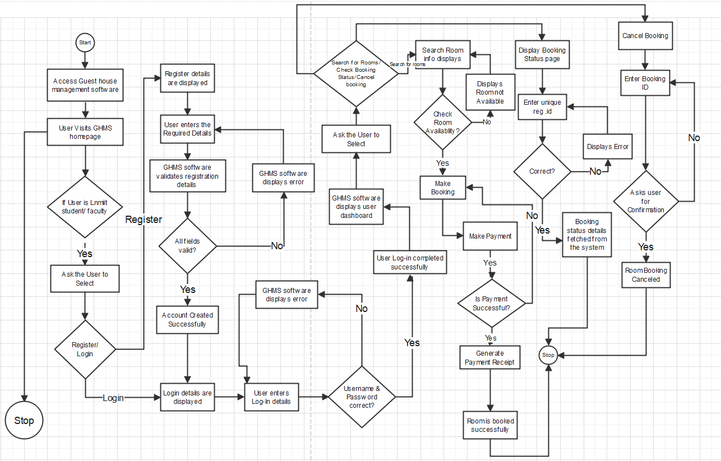
Expanding Use-Case as Use-Case Activity

Slide 14
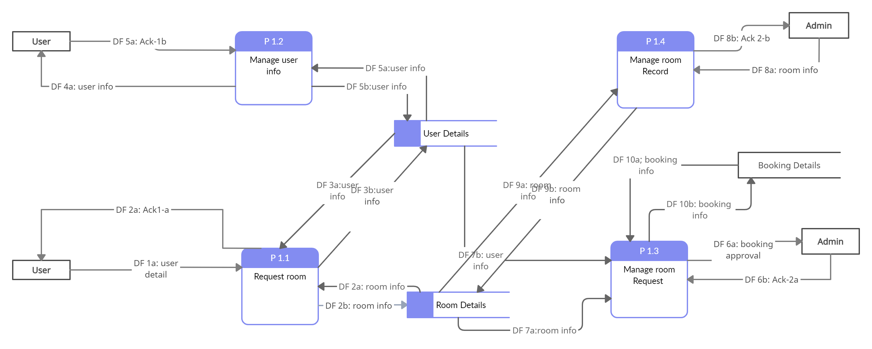
DFD LEVEL 1

Slide 15
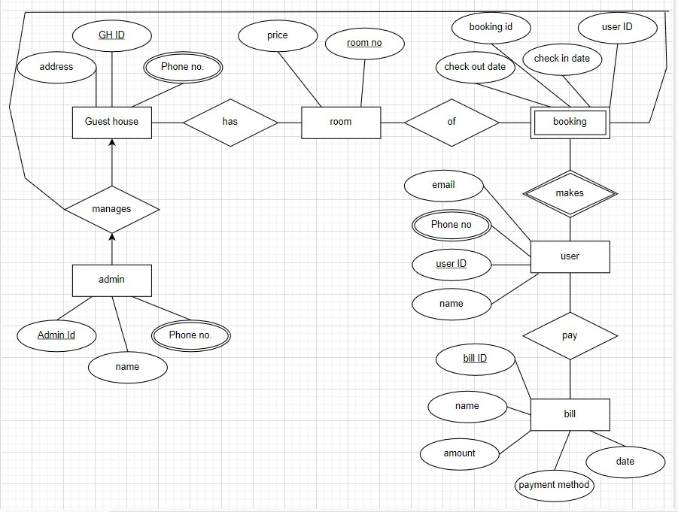
E-R Diagram

Slide 16
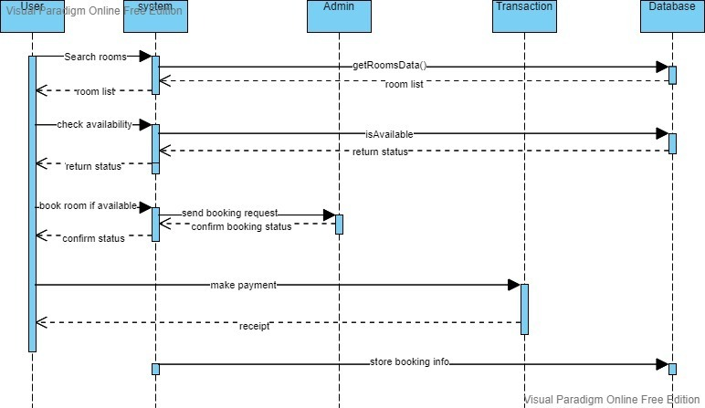
SEQUENCE DIAGRAM
Book Rooms-

Slide 17
Check Booking Status:

Slide 18
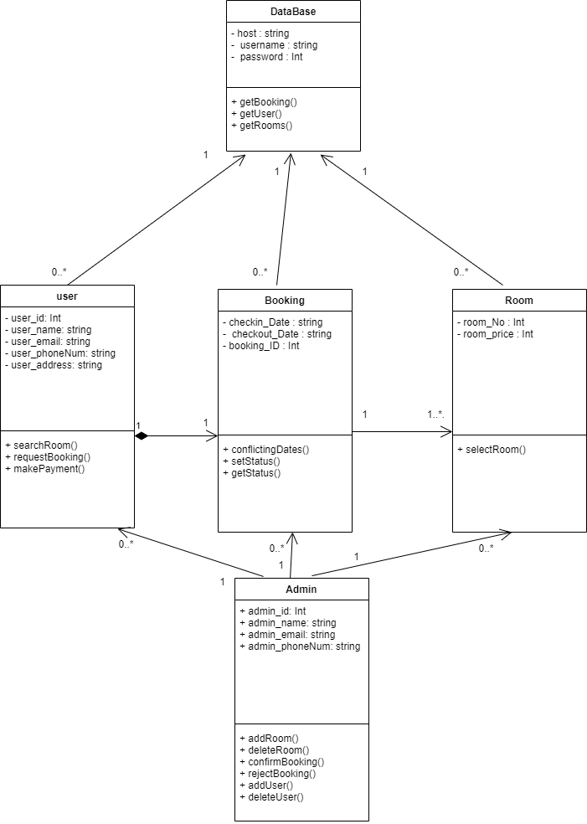
UML Class Diagram:

Slide 19
THANK YOU

