Slide 1

Similarity SMC
أنس عبدالله الذارعي

Slide 2
Distance Measures in Machine Learning
Find the distance between two objects represented by attribute values X = (1, 0, 0, 0, 0, 0, 0, 0, 0, 0)
and Y = (0, 0, 0, 0, 0, 0, 1, 0, 0, 1)

Slide 3
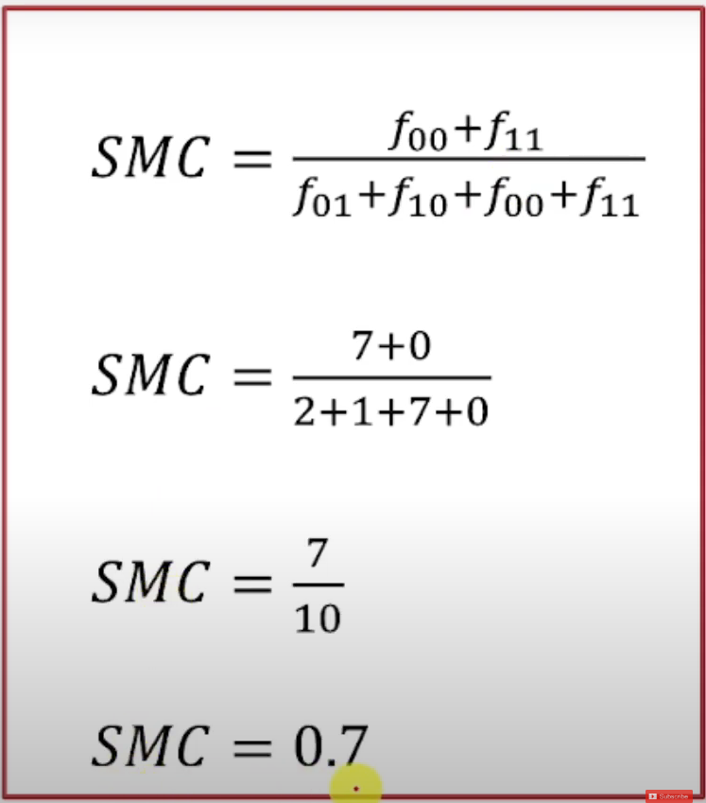
Simple Matching Coefficient (SMC)
X = (1, 0, 0, 0, 0, 0, 0, 0, 0, 0) and
Y = (0, 0, 0, 0, 0, 0, 1, 0, 0, 1)
F01 → Value of x is 0 and y is 1 = 2
F10 → Value of x is 1 and y is 0 = 1
F00 → Value of x is 0 and y is 0 = 7
F11 → Value of x is 1 and y is 1 = 0

Slide 4
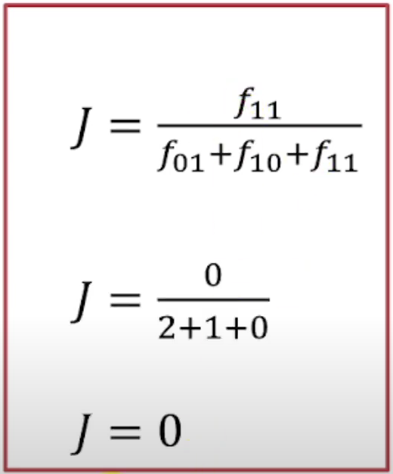
Jaccard Coefficient
X = (1, 0, 0, 0, 0, 0, 0, 0, 0, 0) and
Y = (0, 0, 0, 0, 0, 0, 1, 0, 0, 1)
F01 → Value of x is 0 and y is 1 = 2
F10 → Value of x is 1 and y is 0 = 1
F00 → Value of x is 0 and y is 0 = 7
F11 → Value of x is 1 and y is 1 = 0

Slide 5
Interpretation
The SMC counts both mutual presences (when an attribute is present in both sets) and mutual absences (when an attribute is absent in both sets) as matches.
It compares this to the total number of attributes in the universe.
Unlike the Jaccard index, which only counts mutual presence as matches, the SMC considers both scenarios.

Slide 6
Comparison with Jaccard Index
The main difference between SMC and the Jaccard index lies in their numerator and denominator terms:
SMC: Includes both mutual presences and mutual absences.
Jaccard index: Considers only mutual presences.
In market basket analysis, where baskets may contain only a fraction of available products, the Jaccard index is often more appropriate.
However, when 0 and 1 carry equivalent information (symmetry), SMC is a better measure of similarity.

