Slide 1
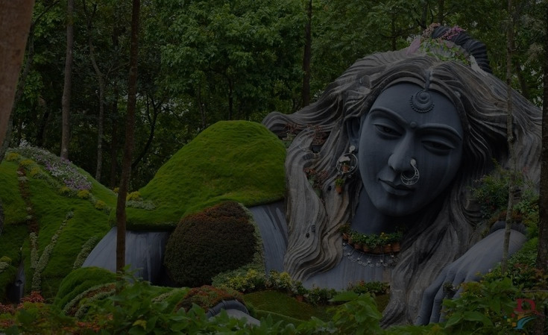
C
coffee Land
ikkamagaluru
Presented By:
Nikhil S G
GAPP at BAE Nalanda
Bharat Electronics

Slide 2
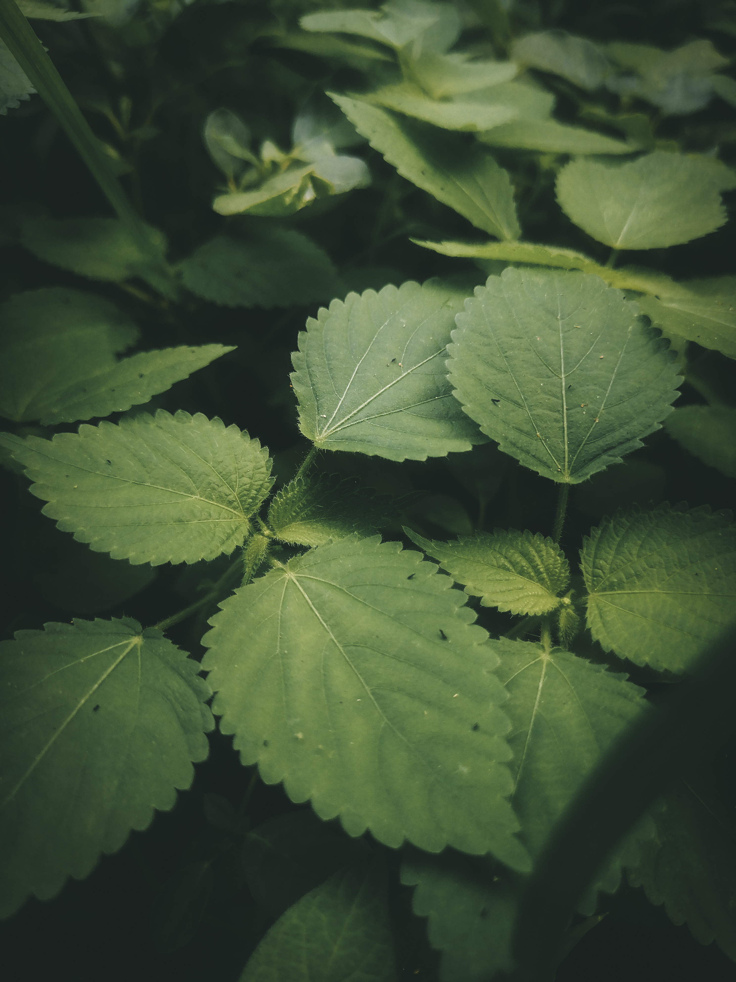
Origin of the Name “Chikkamagaluru”
The name Chikkamagaluru comes from the Kannada words “Chikka” (ಚಿಕ್ಕ) meaning “younger/smaller” and “Magalu” (ಮಗಳು) meaning “daughter

Slide 3
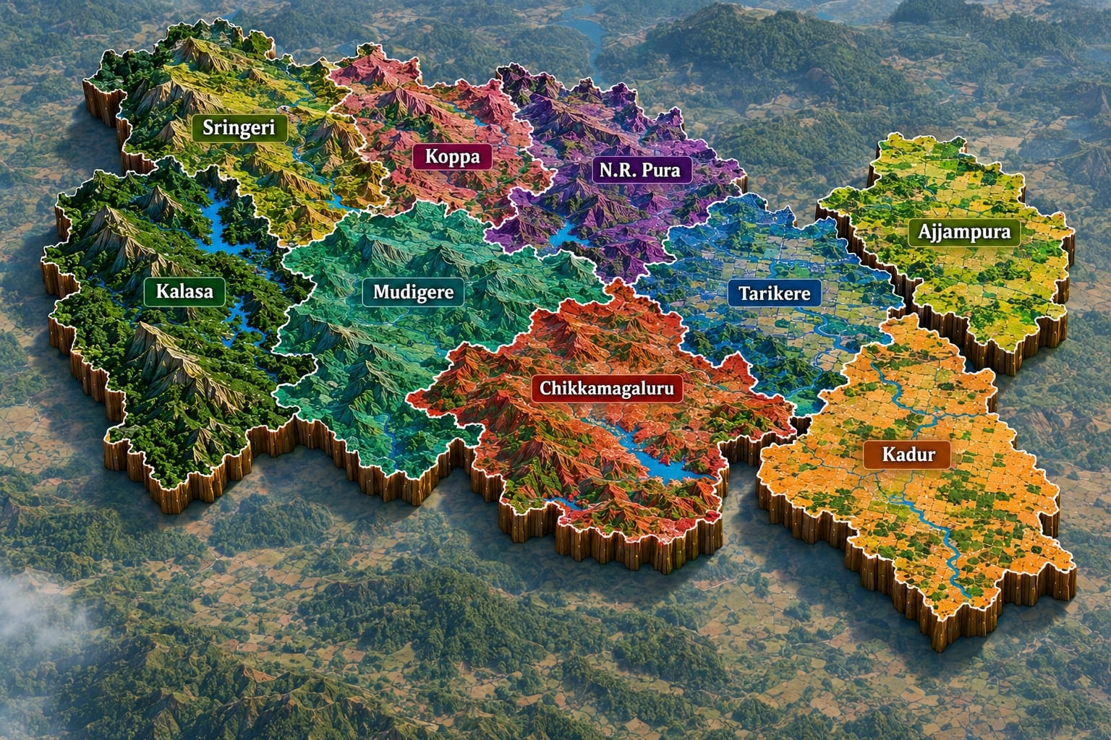

Slide 4
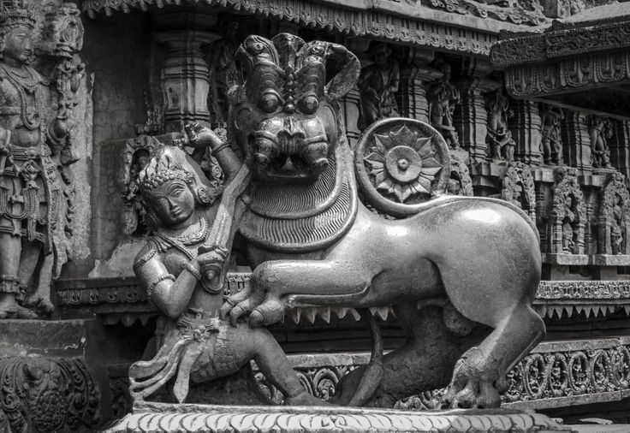
Hoysala Empire
The Hoysala dynasty started in the Malenadu region of Karnataka. It is traditionally linked to Angadi in Chikkamagaluru district. The Hoysalas were famous for building beautiful temples with detailed stone carvings. Their history and culture can be seen in the famous temples of Belur and Halebidu

Slide 5
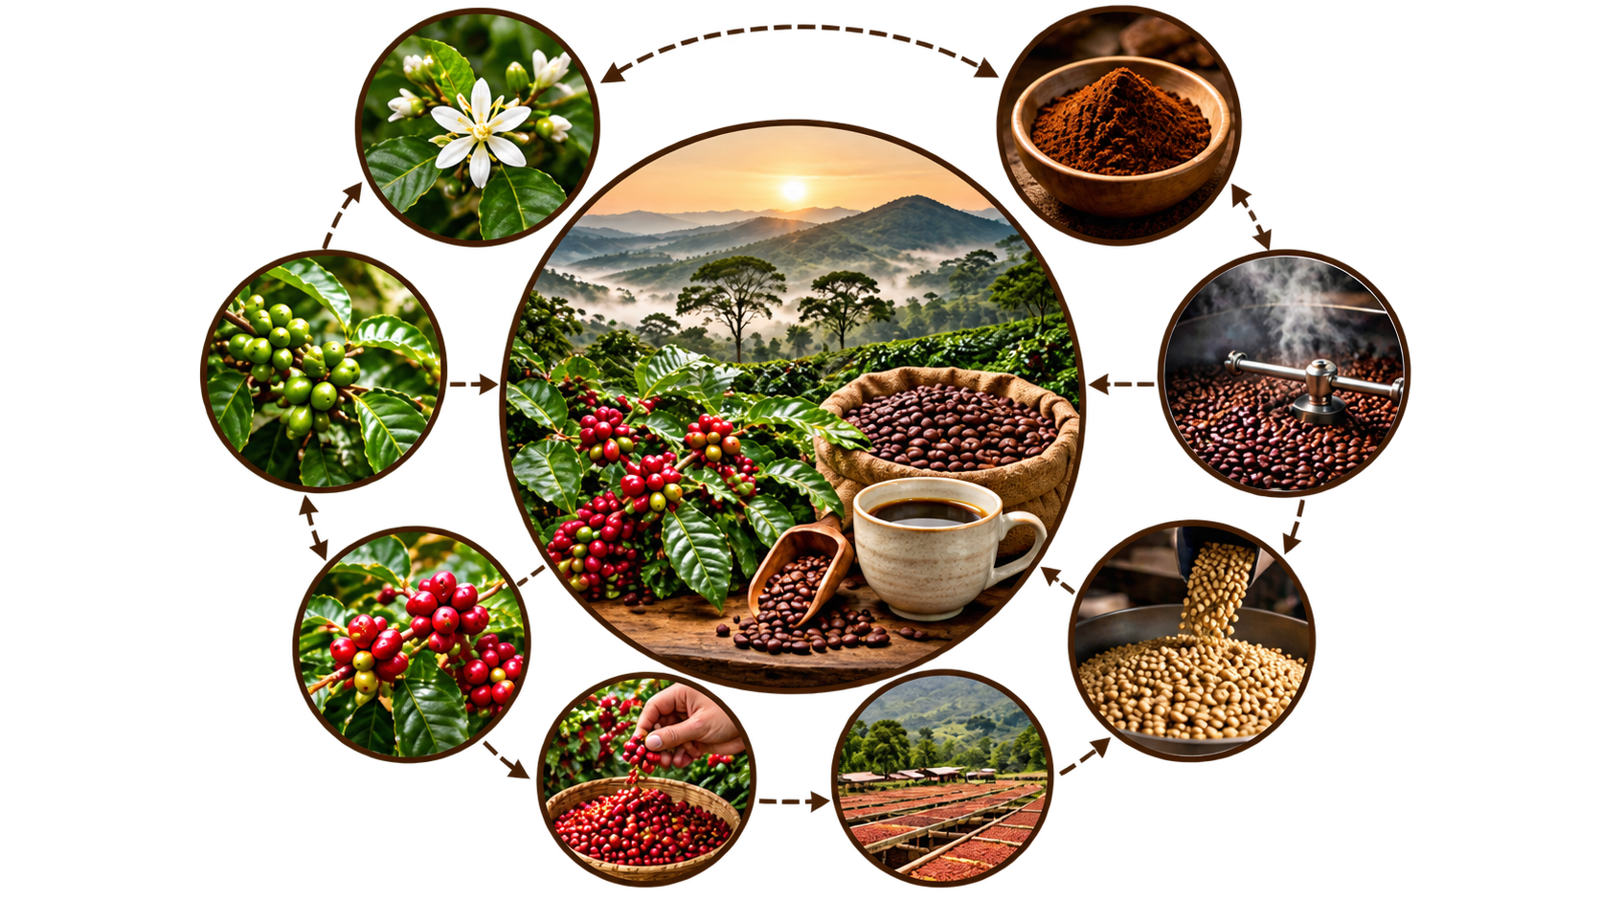
COFFEE
→ Chikkamagaluru is known as the Coffee Land of Karnataka and has a special place in the history of Indian coffee.
→ Baba Budan brought seven coffee beans from Yemen and planted them in the Baba Budan Giri hills around 1670.
→ Today, Chikkamagaluru is an important coffee-producing region, growing both Arabica and Robusta varieties

Slide 6
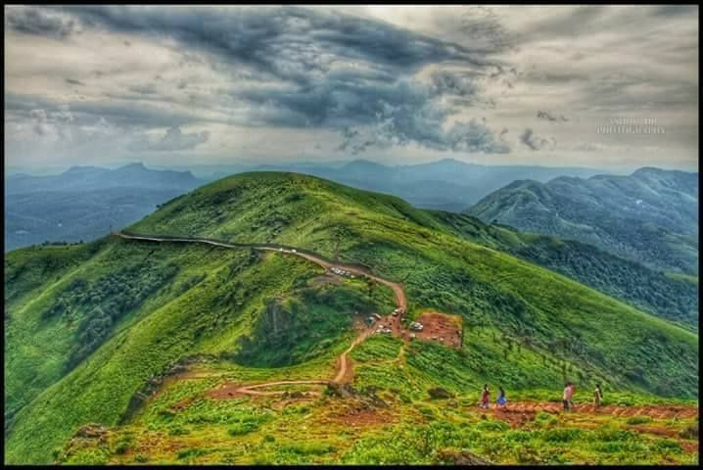
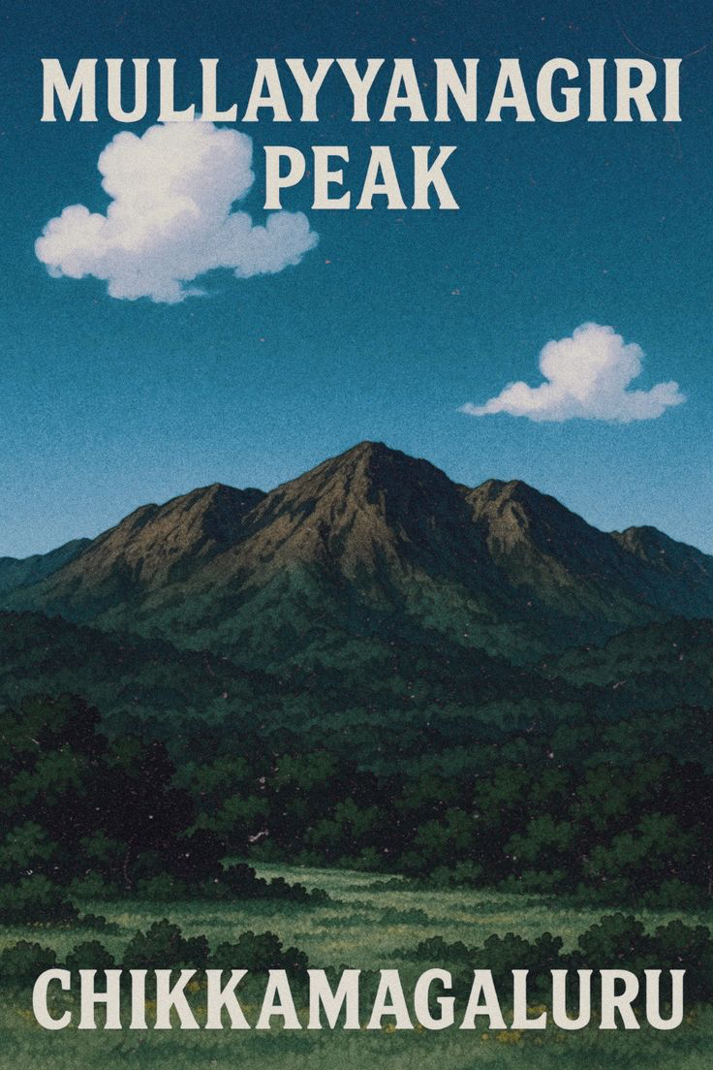
Mullayanagiri
Karnataka's highest peak;
popular for trekking,
mountain views and sunrise/sunset
With a height of 1,925 metres, it is the highest peak in Karnataka

Slide 7
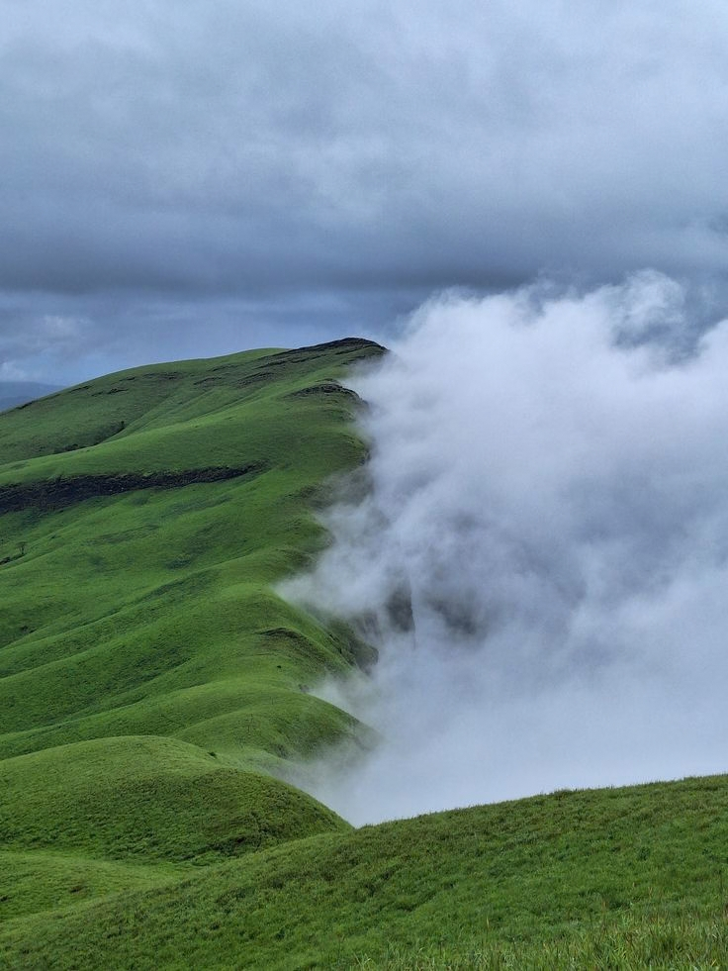
Nethravathi Peak
Nethravathi Peak is a popular trekking destination in the Kudremukh region of Chikkamagaluru district, Karnataka.

Slide 8
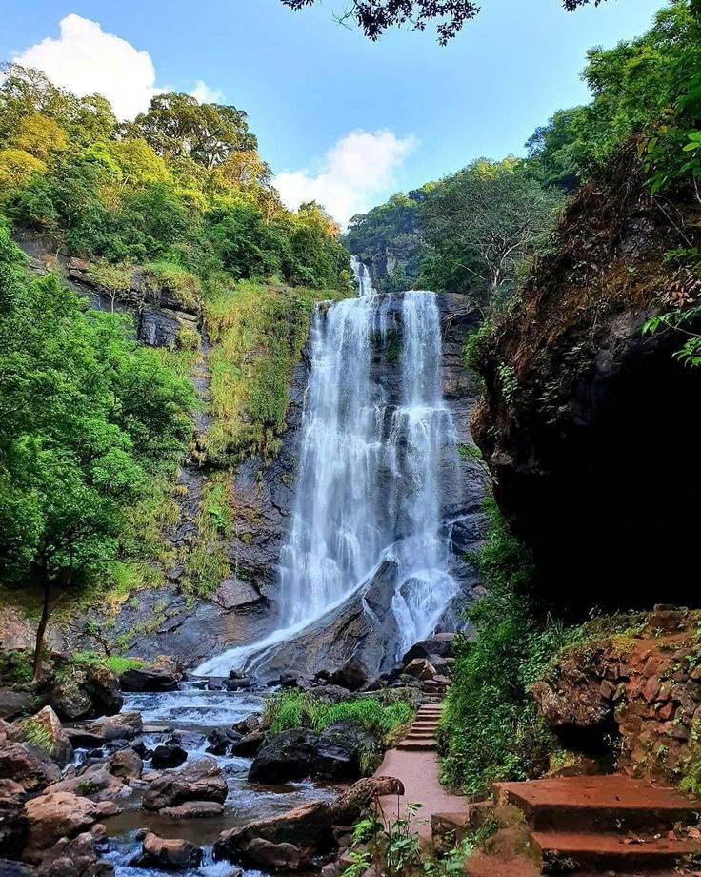
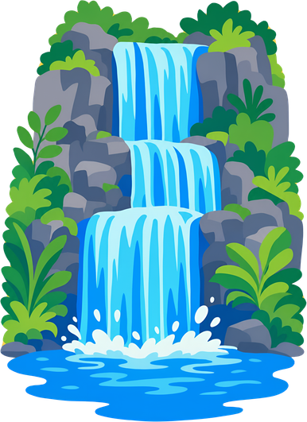
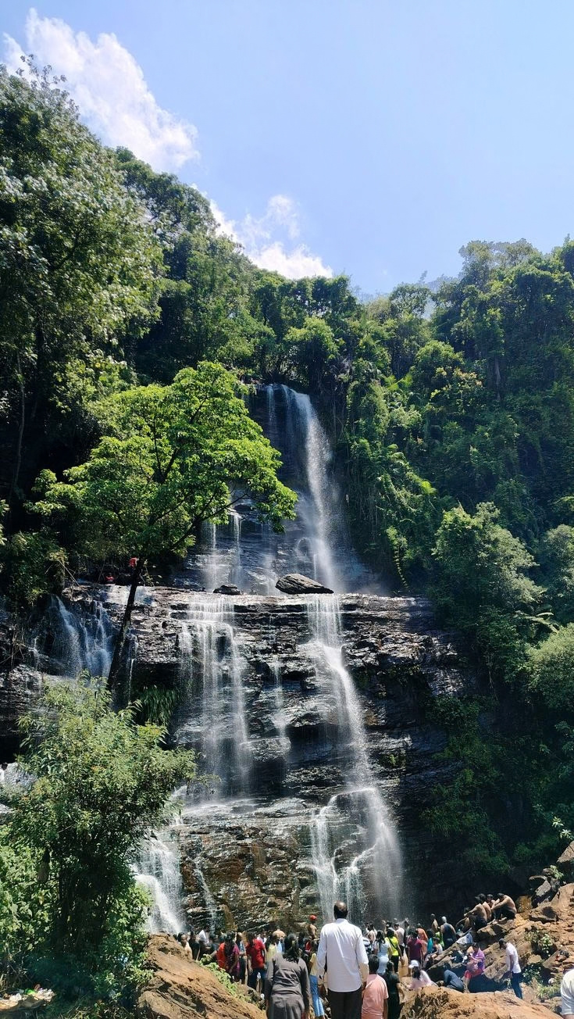
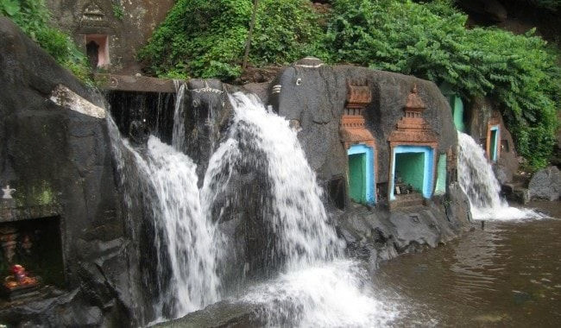
Waterfalls of Chikkamagaluru
Hebbe Falls – a two-stage waterfall near Kemmangundi.
Jhari Falls – a popular waterfall Dattathreya Peeta.

Slide 9
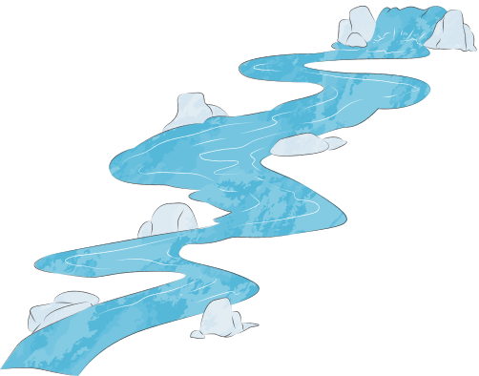
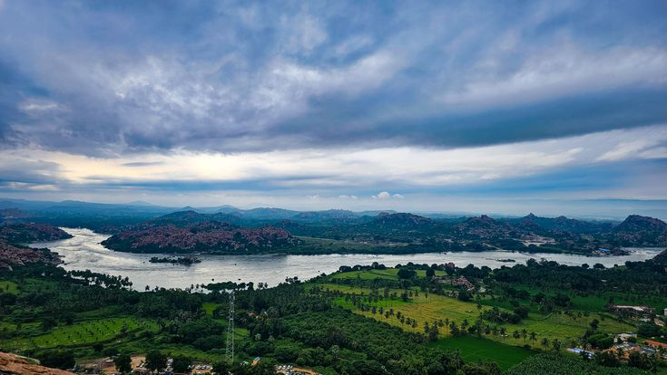
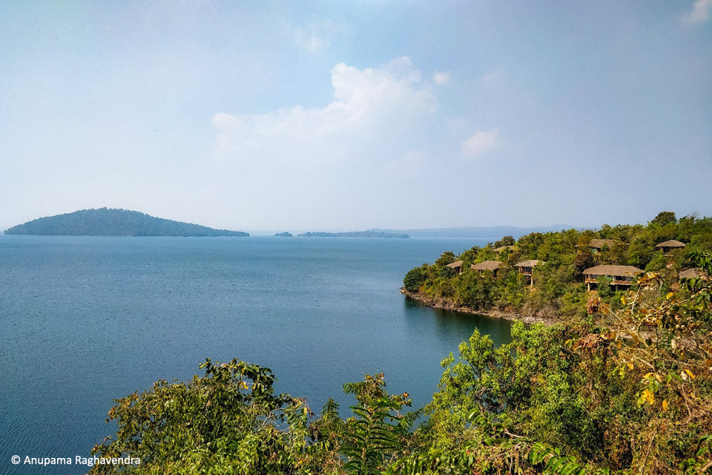
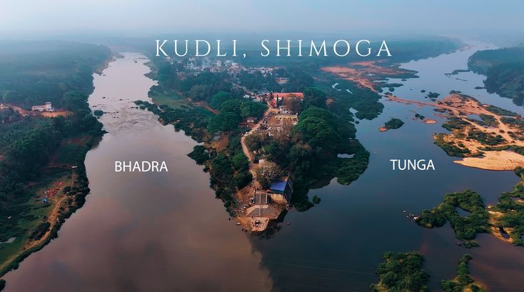
Rivers
Tunga
Bhadra

Slide 10
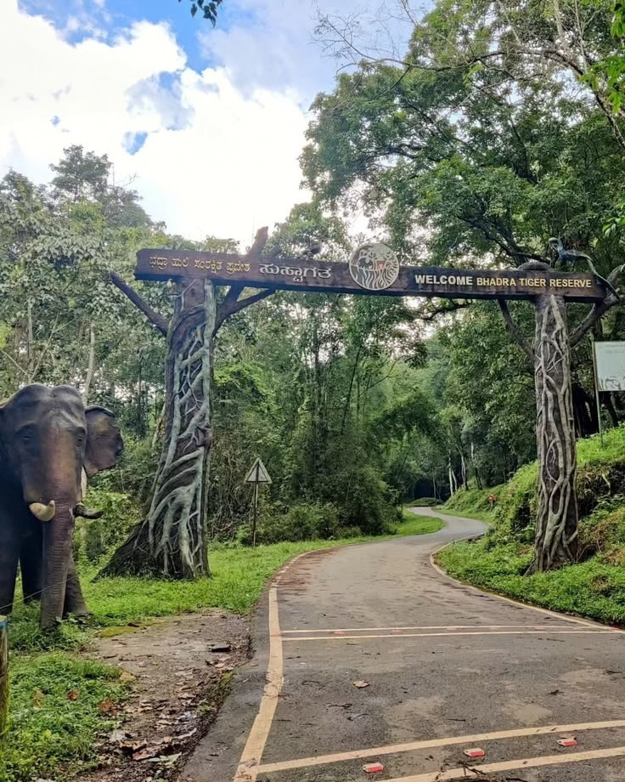
Bhadra Wildlife Sanctuary / Tiger Reserve
Bhadra Wildlife Sanctuary a protected area and a Project Tiger tiger reserve located 38 km .

Slide 11
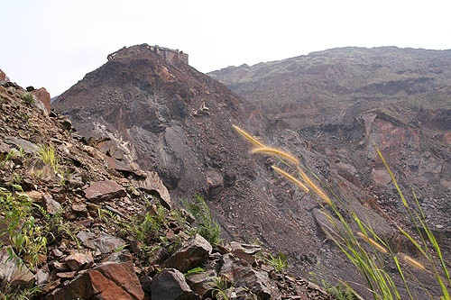
Kudremukh
Kudremukh was once a major iron-ore mining region operated by KIOCL. Mining began in the 1970s but was stopped in 2005 due to environmental concerns. Today, the region is primarily known for its forests, biodiversity, trekking and ecotourism.

Slide 12
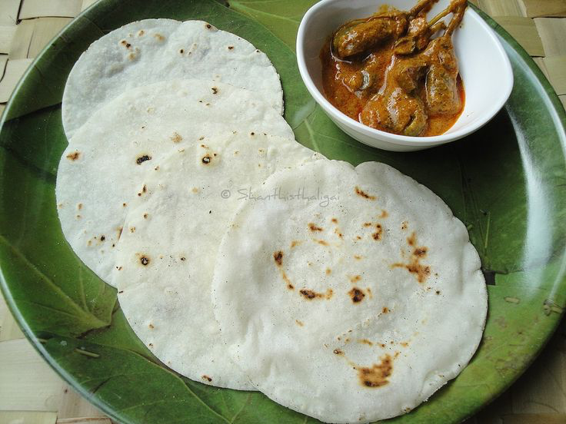
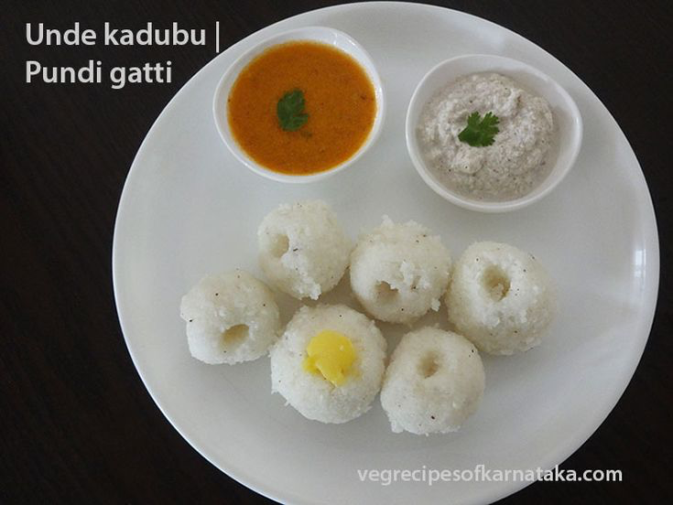
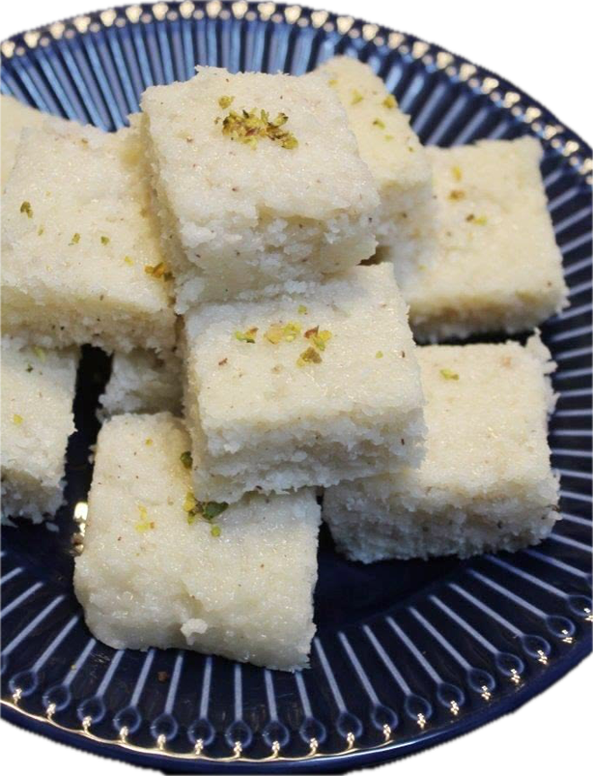
malnad dish
Akki Rotti
Unde Kadubu
coconut burfi

Slide 13
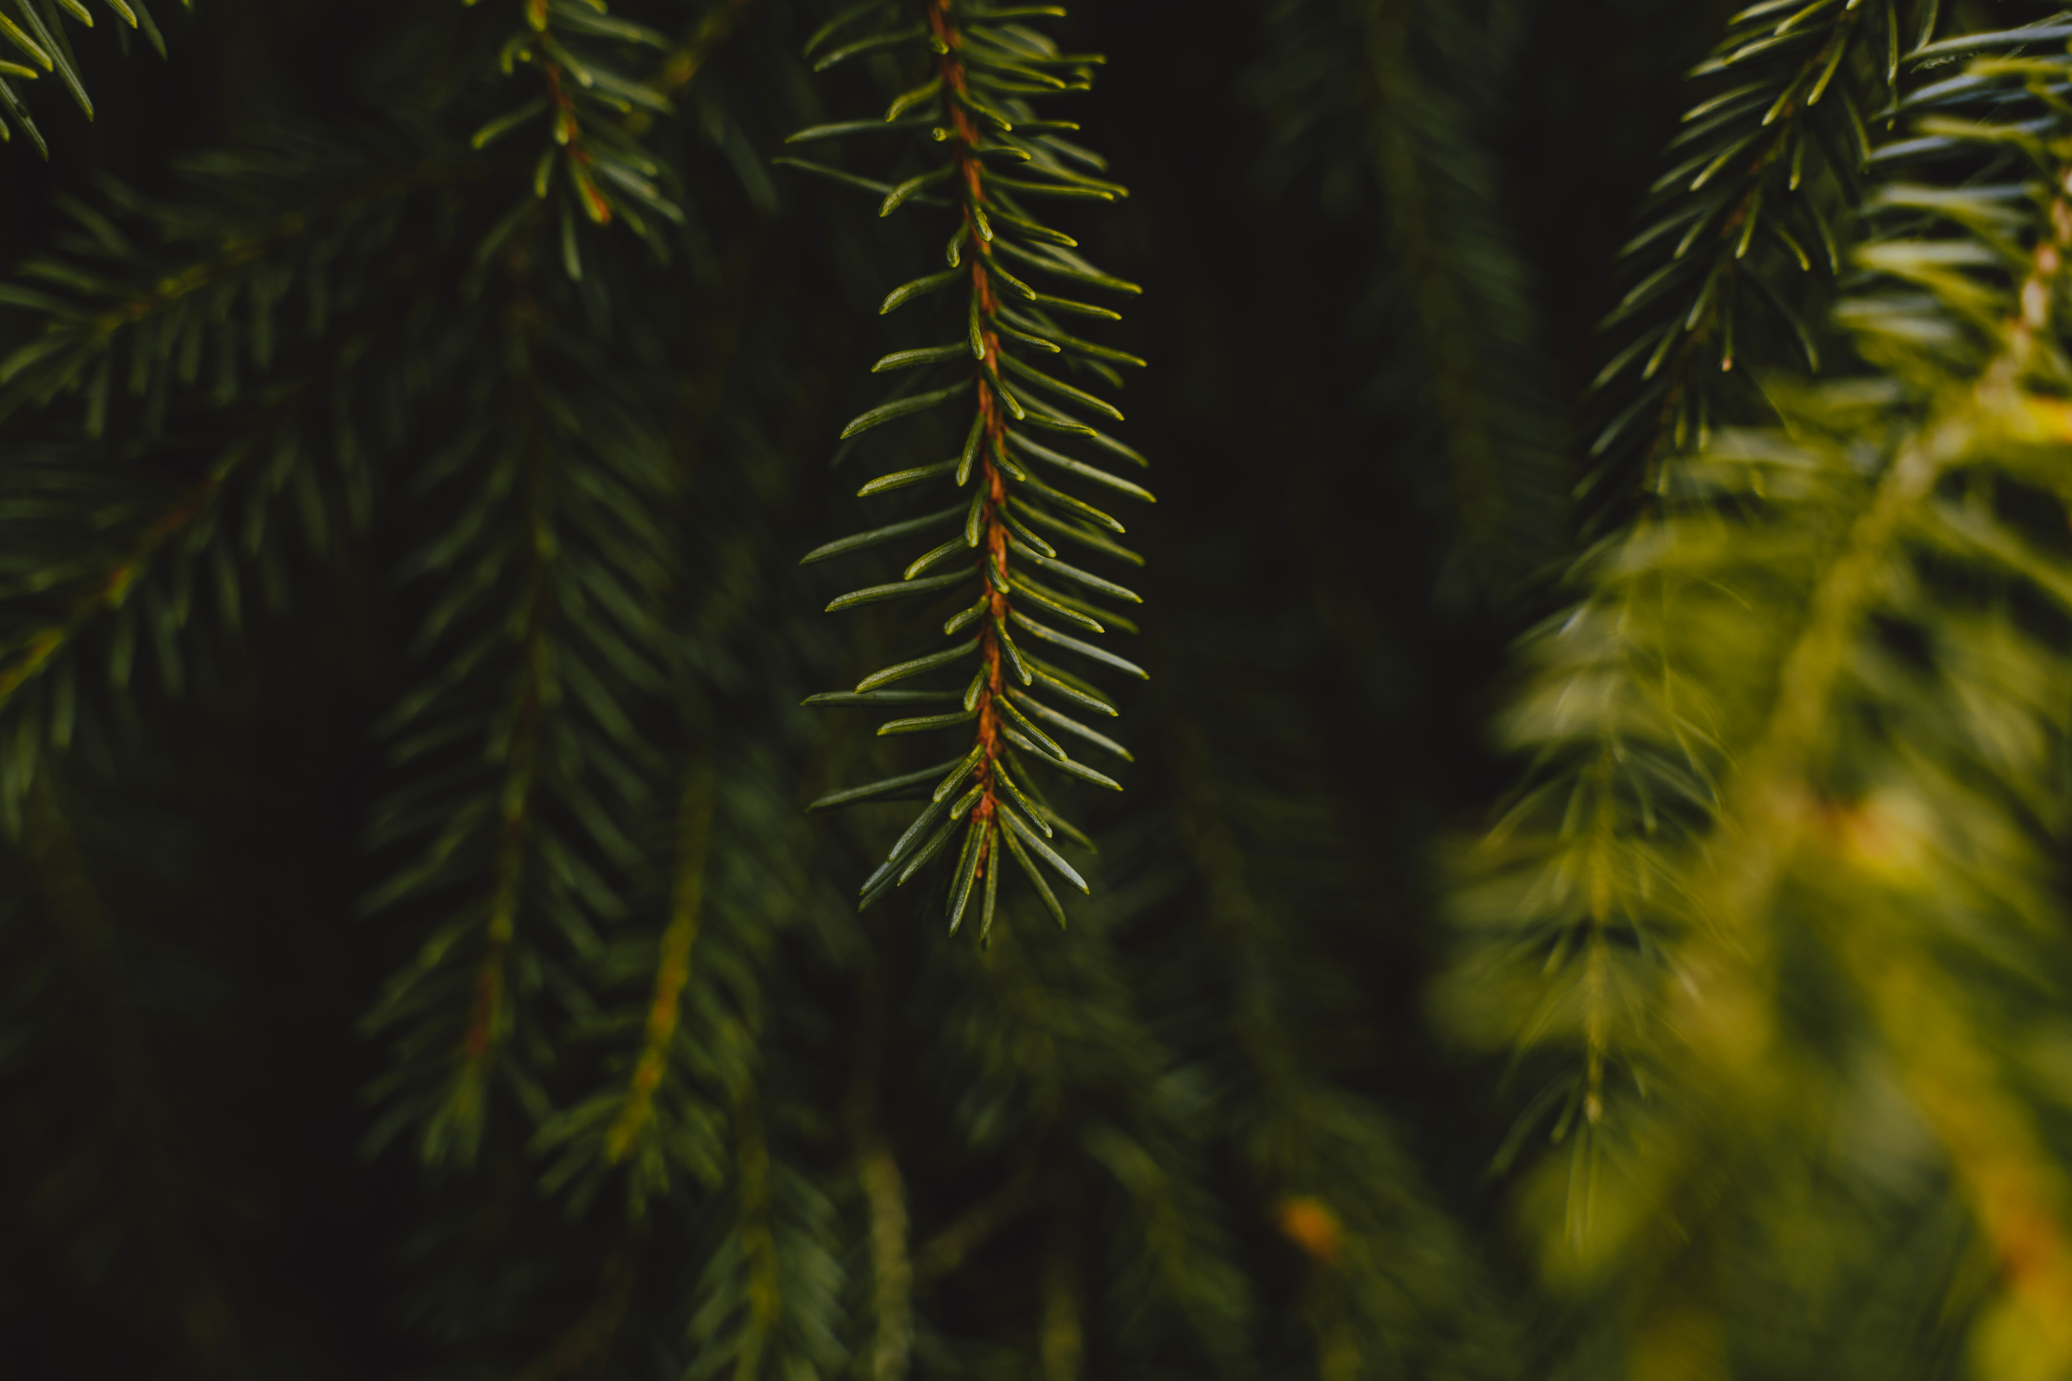
T
hanks

