Slide 1
IMPLEMENTATION

Slide 2
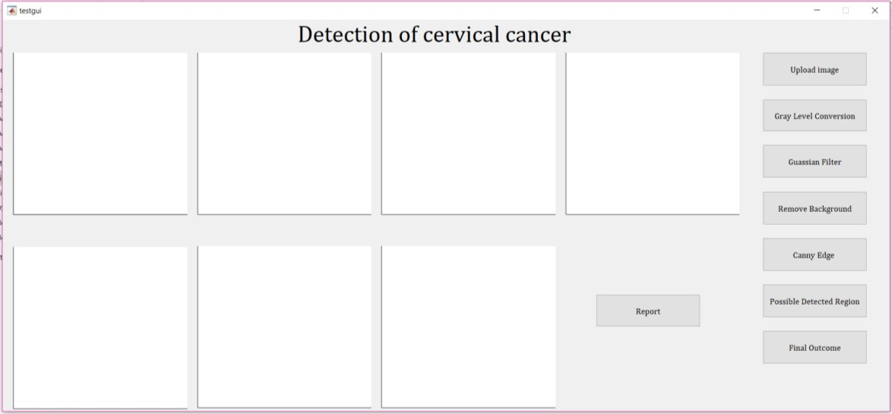
USER INTERFACE

Slide 3
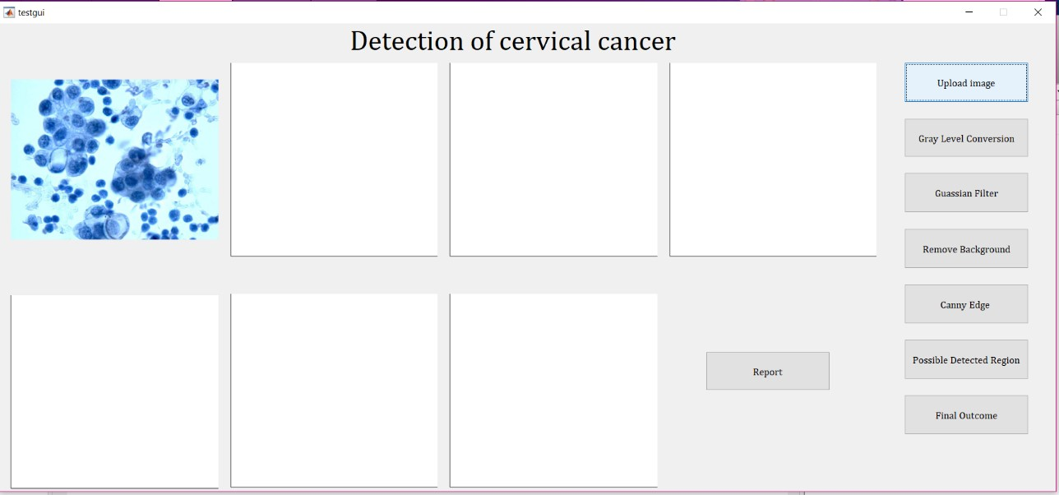
UPLOADING AN IMAGE

Slide 4
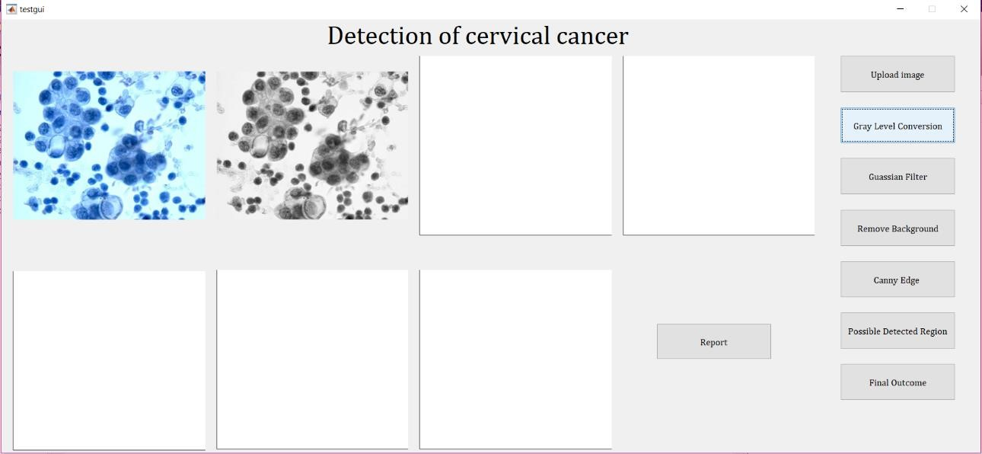
GREYSCALE CONVERSION

Slide 5
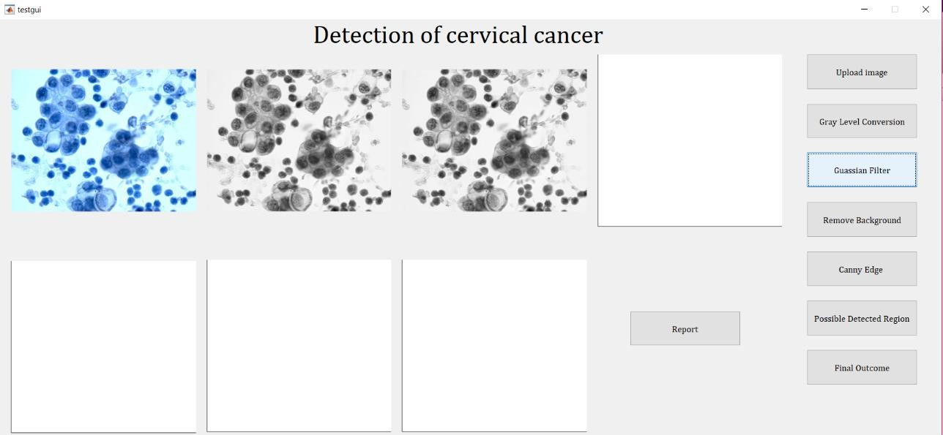
GAUSSAIN FILTER

Slide 6
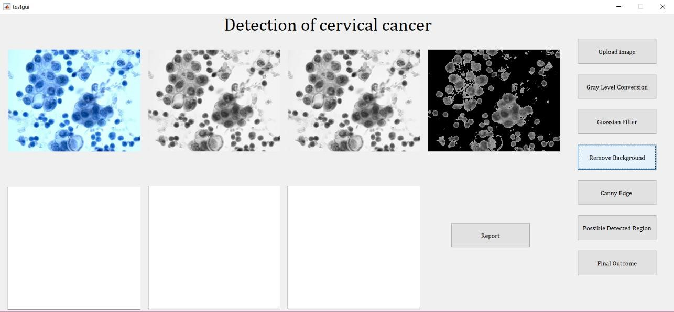
GROUPING AFFECTED CELLS

Slide 7
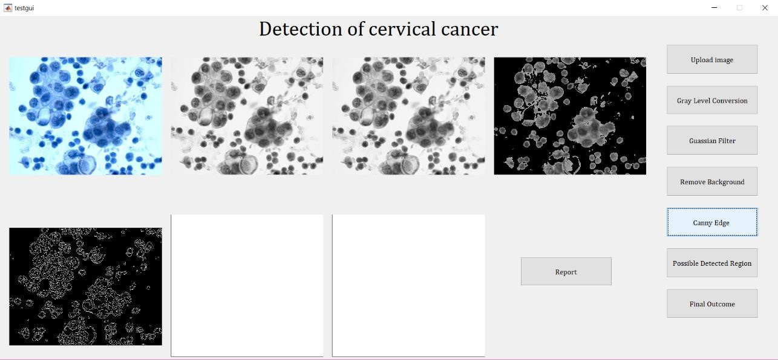
CANNY EDGE TECHNIQUE

