Slide 1
METHODOLOGY

Slide 2
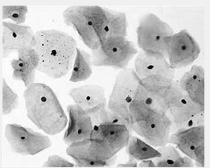
GREY-SCALE CONVESRION
The biological RGB cell image (bitmap image) is converted into grey-scale image.
In this step 3D image is converted into 2D image.
A pre-processing technique is applied to grey-scale image to improve the quality of image.

Slide 3
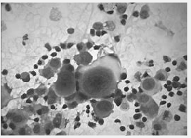
GAUSSIAN FILTER
In image processing, a Gaussian Filter is the result of blurring an image by a Gaussian Function.
Gaussian filters are generally isotropic.
Gaussian Filter basically applied to reduce image noise and to eliminate the useless information in image.
An image can be filtered by an isotropic Gaussian filter by specifying a scalar value for sigma.

Slide 4
GROUPING AFFECTED CELLS
Adaptive thresholding is an image segmentation algorithm that appears quite resistant to varying lighting conditions.
The most basic thresholding method is to choose a fixed threshold value and compare each pixel to that value
The maximum intensity values of smoothen image is considered as background.

Slide 5
CANNY EDGE DETECTION
Canny Edge function is used find edges in intensity image.
This function looks for places in the image where the intensity changes rapidly
The Canny edge technique is used to extract the abrupt changes of affected cells and non- affected cells.
This technique helps us to make the difference between affected and non affected cells.

