Slide 1
CODAEMONS Presents you SAHAYAK -An AI Assistant
Brought to you by :-
Abhay Raj Yadav(E22CSEU1276)
Mohd Adnan Hasan(E22CSEU1269) Vanipally Rahul Reddy(E22CSEU1274)
Shubh Sonakiya(E22CSEU1290)
Adhyay Bansal (E22CSEU1272)
Aryan Jain(E22CSEU1285)

Slide 2
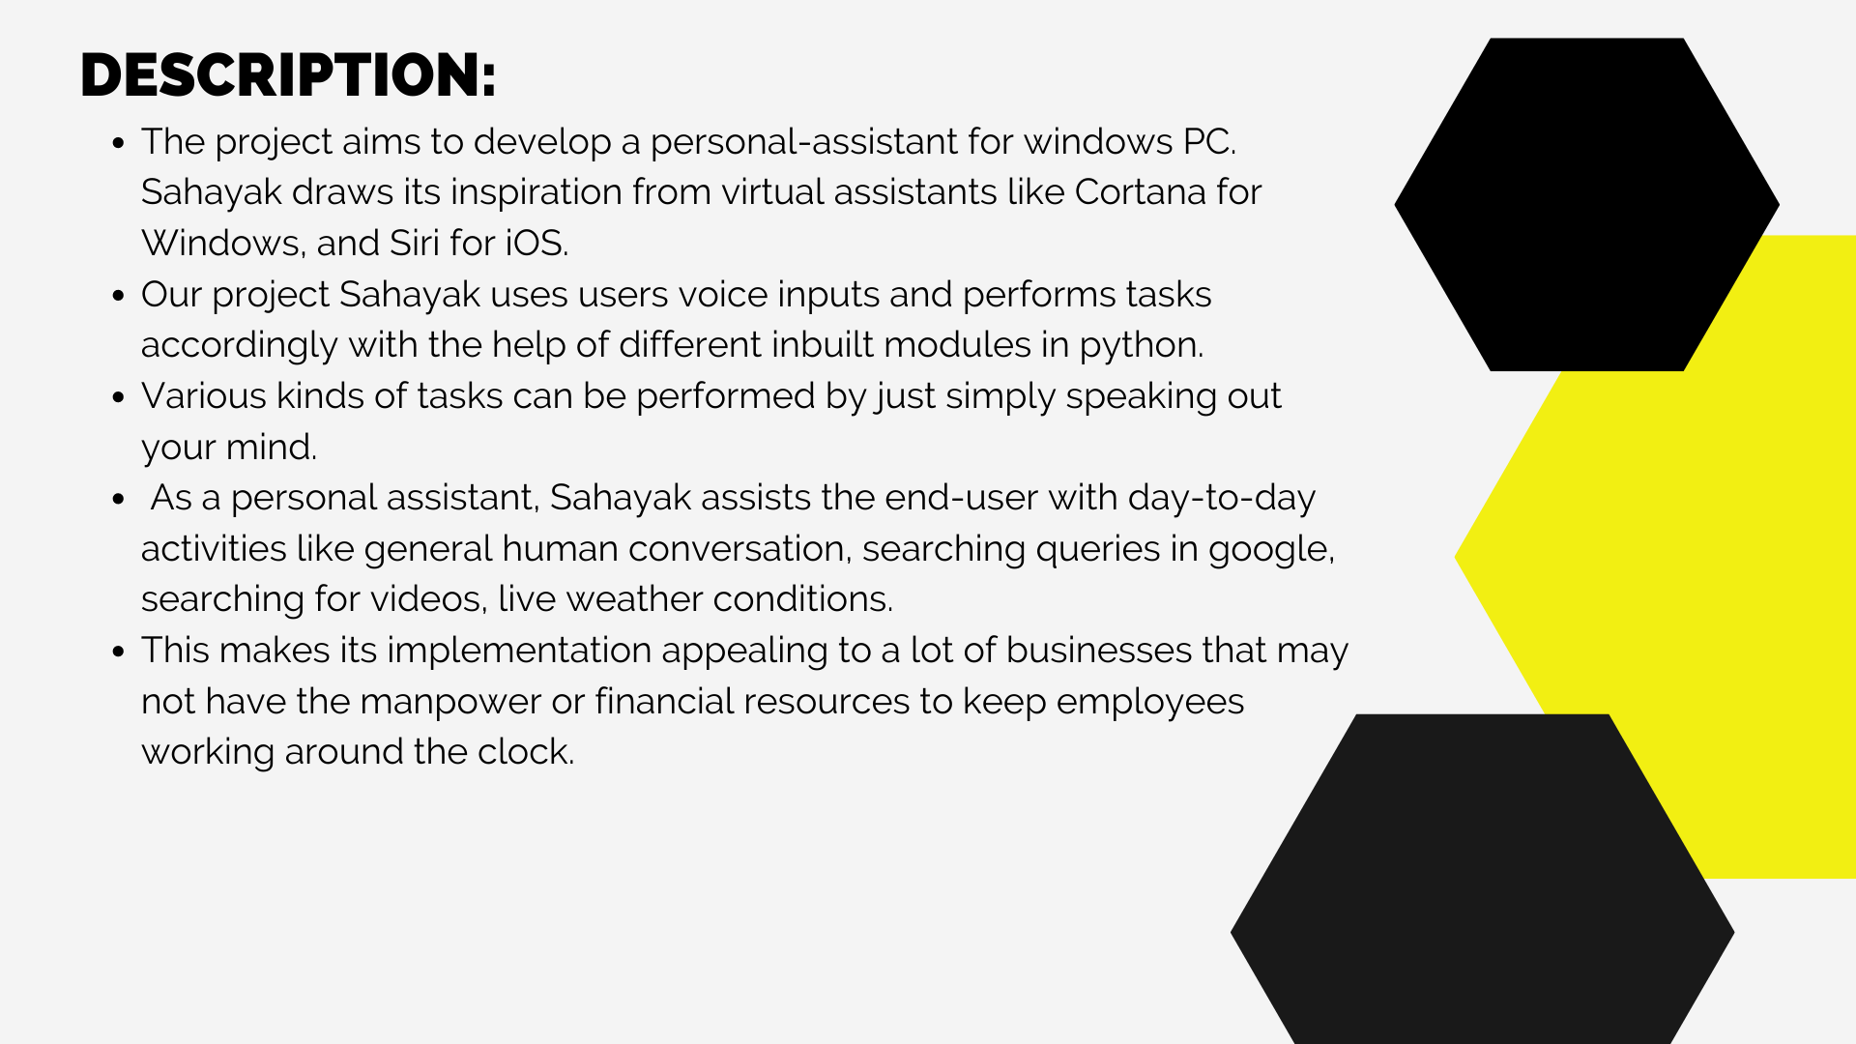

Slide 3

SOLUTION APPROACH:
The libraries and modules that we have used in our program are:
- pyttsx3-> text to speech conversion library
- speech_recognition-> converts voice input to string
- datetime
- Wikipedia
- webbrowser
- email.message-> base class for email object model
- ssl-> provides security to email content
- googletrans-> works as a translator
- random-> generates random number between two defined numbers
- os-> provides functions for interacting with the operating system

Slide 4
- smtplib-> used to send mail
- wolframalpha-> computes answers using wolfram’s algorithms and AI technology
- tkinter-> standard graphical user interface library for python
- PIL-> adds image processing to python
- playsound -> plays the sound
Voice assistant stood as a difficulty in pc and laptop, which we have tried to compensate through sahayak.
Everything that required manual typing has simply been converted to speech.

Slide 5
INDIVIDUAL CONTRIBUTION:
Abhay raj Yadav:- worked on Tkinter module(front-end)
Mohd Adnan hasan:- developed voice assistant and few general queries(back-end)
V Rahul Reddy:- integrated weather and email function.
Shubh Sonakiya:- integrated general queries of sahayak
Adhyay Bansal:- developed music function of sahayak.
Aryan Jain:- worked on Google trans library

Slide 6
APPLICATIONS:
Automating the tasks of PC desktop
Saving time by opening the target application by voice command
Visually impaired can have access to daily desktop tasks using SAHAYAK.
Reduced typing requirements for process like sending emails and writing notepad files.
User friendly interface.
It has potential to automate the household gadgets.
It can be trained for various other activities which can then act as ‘JARVIS’ a fictional supersmart AI.

Slide 7
REFERENCES:
Codemy.com
GeeksforGeeks.com
Wolframalpha.com

Slide 8


