Slide 1
Vulnerability Assessment and Risk Calculation

Slide 2
PROJECT OVERVIEW
The project aims to identify vulnerabilities and calculate risks in a system or network.
Key components:
Data Collection: Gathers data from system processes, network, registry, and files.
Vulnerability Assessment: Analyzes collected data to identify security weaknesses.
Risk Calculation: Quantifies risks based on identified vulnerabilities.
Automation: Automates data collection, analysis, and reporting.
Web Interface: Provides a user-friendly dashboard for monitoring and reporting.

Slide 3
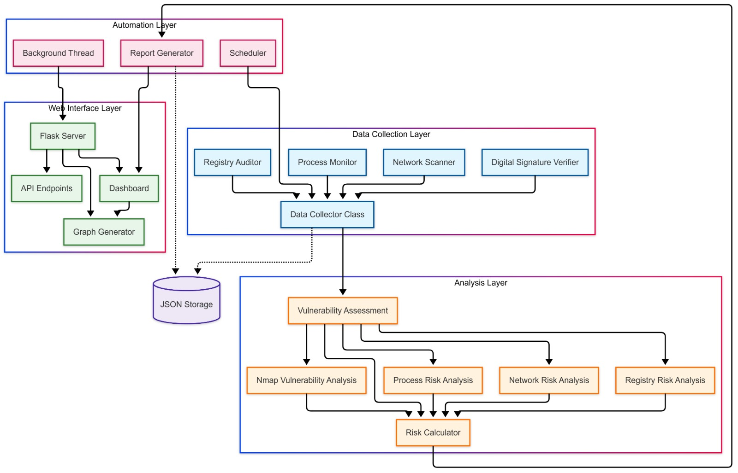
SYSTEM ARCHITECTURE

Slide 4
KEY COMPONENTS
Data Collection:
Registry Auditor, Process Monitor, Network Scanner, Digital Signature Verifier.
Vulnerability Assessment:
Nmap Vulnerability Analysis, Process Risk Analysis, Network Risk Analysis, Registry Risk Analysis.
Risk Calculation:
Computes an overall risk score based on the analysis.
Web Interface:
Flask Server, API Endpoints, Dashboard, Graph Generator.

Slide 5
CYBER FORENSICS FEATURES
Digital Signature Verification:
Uses Windows Signtool to verify file signatures.
Detects tampered or malicious files in the "test" folder.
Registry Auditing:
Scans the Windows registry for suspicious startup items.
Helps identify malware persistence mechanisms.
Process Monitoring:
Tracks running processes and identifies suspicious activity (e.g., unknown processes, high CPU usage).
Forensic Reporting:
Generates comprehensive reports with evidence, analysis results, and conclusions.
Reports include details on suspicious processes, registry entries, and file integrity.

Slide 6
Conclusion
The Cyber Forensics project provides a comprehensive solution for digital investigations.
It automates data collection, analysis, and reporting, offering actionable insights for forensic investigators.
Future enhancements could include:
File carving for recovering deleted files.
Memory forensics for analyzing running processes.
Timeline analysis for identifying suspicious activity.

