Slide 1
hearing aid
Presented by :-
Arnav Gupta
Vivek Goyal
Prakhar Saxena
Nikhil Srivastava

Slide 2
contents
Introduction
Motivation
Requirements
Gesture types
Input devices
Challenges
Uses
References
User interface

Slide 3
Requirements
Python3
Tensorflow
Tflearn
Opencv (cv2) for python3
Numpy
Pillow
Imutils

Slide 4
introduction
What are gestures ?
A form of non-verbal communication.
Movement of hands , face or other parts of the body.
What is gesture Recongnition ?
Interpreting human gesture via mathematical al

Slide 5
Motivation
Since childhood we see many dumb people who are unable to express their feeling to other normal person. Once I saw a person who was dumb and he was trying to say something to the shop vender to know about a product but he was unable to ask and vender was unable to understand the sign language. From there only I got the motivation to develop this type of neural network which change sign language to text language using a camera and computer.

Slide 6
Gestures type
Offline gestures
Processed after the user’s interaction with the object.
ex:- gesture to activate a menu.
INPUT DEVICES
Single camera

Slide 7
Challenges
Lack of Gesture Language
Different users make gestures differently causing difficulty and identifying motions
Robustness
Many gesture recognition systems do not read motions accurately or optimally due to factors like insufficient background light , high background noise etc

Slide 8
Uses
Sign language recognition :
just as speech recognition speech to text , certain types of gesture recognition software can transcribe the symbol represented through sign language into text.
The main advantage of hearing aid is to make dumb person feel like normal person.

Slide 9
References
Udemy : It is an online learning platform. It is aimed at professional adults.
https://gogul09.github.io/software/hand-gesture-recognition-p1
https://github.com/gogul09

Slide 10
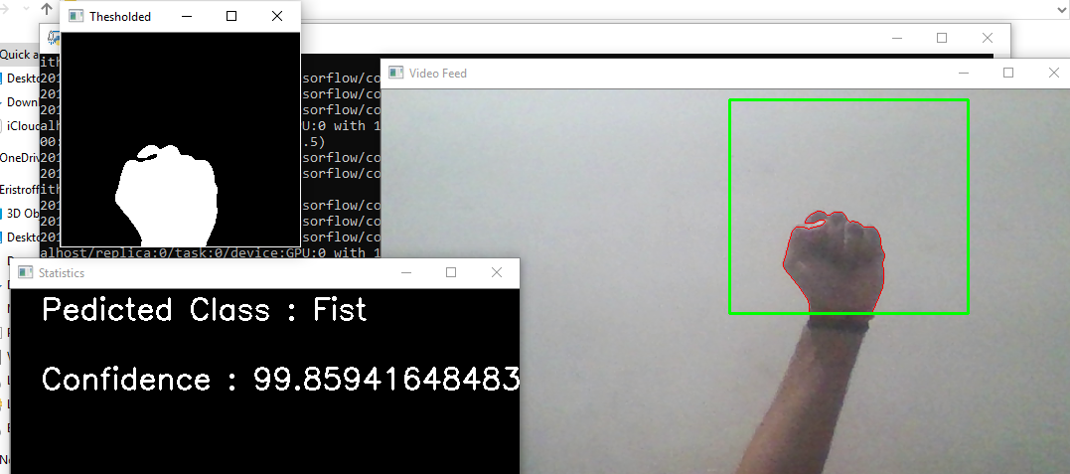
user interface

Slide 11
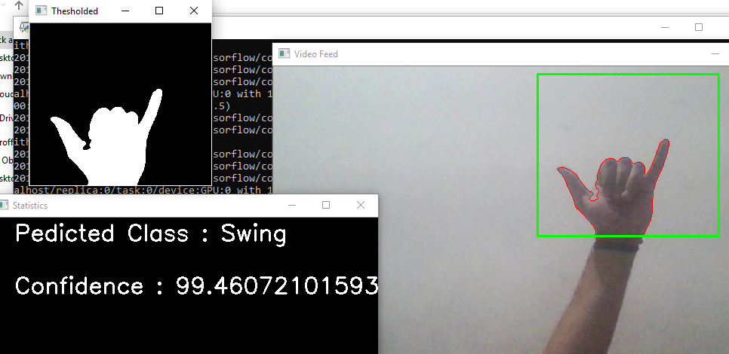

Slide 12
