Slide 1

SAMSUNG PRISM
Generative AI
Hackathon
3rd Edition
2026 – 27
PARLEY
A voice agent that listens through self-corrections before it acts.
Theme ID -
05 (Interruptible Real-Time Agents)
Team Name -
The_T_Guys
College Name -
Thapar Institute of Engineering & Technology, Patiala
Member Name & Email 1 -
Gobinda Podder, gpodder_be24@thapar.edu
Member Name & Email 2 -
Kumar Ashish, kashish_be24@thapar.edu
Member Name & Email 3 -
Devaansh Gupta, dgupta_be24@thapar.edu
Member Name & Email 4 -
Aryan Chourasia, achourasia_be24@thapar.edu
Submission Github link -
https://github.com/itsAryan-devop/parley

Slide 2
Theme
People don't speak in finished commands.
USER SAYS
"Switch my mortgage autopay to
checking…
wait, no…
make it savings."
Typical agent
call 1 · checking
call 2 · savings
2 calls, the first one wrong
wrong value committed
PARLEY
listening… turn held open through the correction
1 call · savings
1 call, the right one
THEME 05
SCORED ON FULL-DUPLEX-BENCH V3
HARDEST CATEGORY
Interruptible Real-Time Agents: voice agents must handle users who pause, hesitate and correct themselves mid-sentence.
100 real human recordings, 4 domains, 12 tools (flights, cards, apartments, orders…).
Self-correction: even GPT-Realtime fails over 40% of them.
Notes:
Parley (n.) is a conversation under truce, in which either side may speak at any moment. The benchmark's authors name the cause: agents "commit intermediate parameters before the correction arrives."

Slide 3
Existing Solutions & Gaps
FDB-v3 Pass@1
Benchmark paper · 100 clips · gpt-4o judge
1
Barge-in = flush everything
Pipecat and LiveKit cancel the whole pipeline when the user speaks: they conflate stop talking with stop working.
GPT-Realtime
0.600
Gemini Live 3.1
0.540
Gemini Live 2.5
0.490
Stock cascaded (Whisper → GPT-4o → TTS)
0.450
2
Tools fire on the first plausible value
▲ slowest: 10.12 s mean latency · the template PARLEY forks
No framework holds a tool call until the user has actually finished, so corrections become a second, extra call.
Grok
0.430
Ultravox
0.410
3
Duplicate calls are a known framework bug
LiveKit issue #3702: interrupted tool calls get re-issued. The later fix dedupes by tool name only, so it can't tell "track order A" from "track order B".
Source: Lin et al., Full-Duplex-Bench v3, arXiv 2604.04847.
Notes:
Fixed quiet-period gates (for example waiting 600 ms after every turn) help, but add that delay to every single call.

Slide 4
Our Solutions & Architecture Diagram
PARLEY addition
Off-the-shelf
still mid-thought → keep listening
turn done
User audio
Silero VAD
Whisper large-v3-turbo
Turn Detector
gpt-oss-120b
ID canonicaliser
LiveKit room
voice activity
learned endpointer
LLM, tool calling
"P-5-2" → "P52"
STT
reply
talking
result
Piper TTS
Run tool
silent
ToolGuard
Agent audio
local, CPU
FDB-v3 mock APIs
commit window + dedupe
VAD also feeds ToolGuard: speaking / silent
Learned turn detector
ToolGuard: cancel before effect
Fork, don't fork the benchmark
EXTENSION · SEPARATE AGENT
Keeps the turn open on a dangling word, a repair ("no", "I mean") or a trailing "…". 89.4% accuracy, 3% false-early vs a silence timeout's 72% and 25%. About 10 µs per decision.
Camera frame → diagnose_device_frame() → colour classifier + OCR + abstention → diagnosed / ask / retake
Every call waits a 0.3 s commit window and runs only if the user is silent and nothing they said is still being transcribed. An identical (tool, arguments) pair runs at most once per conversation.
Same 12 tools, schemas and logs as FDB-v3's stock cascaded agent, so the benchmark scores it exactly like the original.
Not part of the benchmark score
Notes:
Violet nodes are PARLEY additions; teal-outlined nodes are off-the-shelf. When ToolGuard defers, the LLM receives "not executed, wait" instead of a result. The camera extension is a separate agent and is not part of the benchmark score.

Slide 5
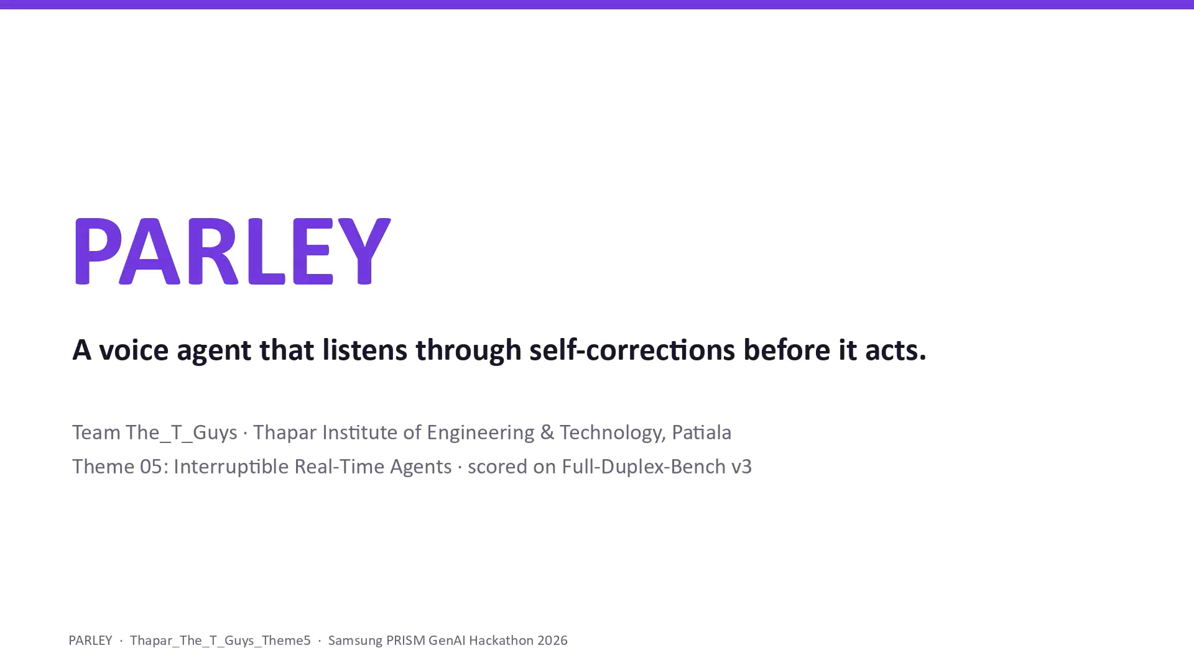


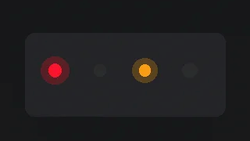

Demo & Product Walkthrough
1
Benchmark clip. A real recording with a self-correction ("checking… wait, no… savings"). PARLEY waits, then makes one call on "savings".
2
Guard log. The premature call is visibly deferred ("not executed: user still speaking").
3
Extension, camera away. The user asks "what's wrong?" and the agent asks to see the device. It doesn't guess.
4
Extension, real TV. The phone camera shows a TV reading "No Signal"; the agent diagnoses it from the screen text and reads the fix steps.
Demo video (max 5 min)
5
Graceful degradation. Groq's free voice quota runs out mid-call; the offline Piper voice takes over, with no dropped session.
youtu.be/-l4Yk7sETZQ
EXTENSION ANSWERS
Asks: WAN light or power light?
It asks rather than guesses.
Diagnosed + steps
Asks for a better shot
Notes:
Demo video: https://youtu.be/-l4Yk7sETZQ?si=6066k-7NFxGb2okl. Walk through the five storyboard beats in order; the three tiles at the bottom show the extension's possible answers.

Slide 6
Tools and tech stack used
LAYER
COMPONENT
LICENCE
RUNS
Benchmark
Full-Duplex-Bench v3 @ 3e799c45, NeMo parakeet ASR scorer
per FDB-v3
local
Vision (extension)
PARLEY colour classifier + RapidOCR
ours / Apache-2.0
local CPU
Text-to-speech
Piper 1.2.0 (en_US-ljspeech-medium , public-domain voice); Groq Orpheus in the extension, with Piper fallback
MIT
local CPU
Tool safety
PARLEY ToolGuard + ID canonicaliser
ours
local
Reasoning & tool calls
gpt-oss-120b (reasoning_effort=low)
Apache-2.0
Groq API (free tier)
Turn detection
PARLEY endpointer (logistic regression, our own synthetic corpus)
ours
local CPU
Speech-to-text
Whisper large-v3-turbo
MIT
Groq API (free tier)
Voice activity
Silero VAD
MIT
local CPU
Real-time transport
LiveKit Agents 1.3.12 + LiveKit Cloud
Apache-2.0
local agent / cloud rooms
$0 to run
Free tiers plus local models; no paid APIs, no servers of our own at evaluation time. One command reproduces everything:
bash reproduce.sh
Notes:
Stack reads bottom to top: transport at the base, benchmark harness on top. Violet layers are ours. Everything runs on free tiers plus local models.

Slide 7
Impact & Use case
In voice commerce, an extra tool call isn't a typo. It's a double charge.
BANKING
E-COMMERCE
TRAVEL
"autopay from checking… no, savings"
"add the… um… the blue one"
"flights to Paris… actually Berlin"
Naive
Changes autopay twice; the first change was wrong
Naive
Adds the wrong item, then the right one
Naive
Searches Paris and Berlin
PARLEY
Searches Berlin once
PARLEY
One change, on savings
PARLEY
Waits for the finished request
EXTENSION · SAMSUNG DEVICES
"Point your phone at the TV and ask what's wrong."
The agent reads the screen ("No Signal"), names the fault and reads the fix. When unsure, for example two router LEDs lit, it asks instead of guessing : the difference between a support call avoided and a wrong fix.
Notes:
The guide explicitly names device troubleshooting with a camera frame as the extension use case. Remedies come from bundled manual pages, not from the LLM's memory.

Slide 8
Innovation highlights, results and limitations
INNOVATION
RESULTS
LIMITATIONS
A learned turn detector running as LiveKit's turn-detection plug-in: 3% false-early .
Turn detector vs baselines (held-out)
Mean response latency (s)
No full 100-clip run yet: Groq's free tier allows about 200K LLM tokens/day, and a clip costs about 4K.
Accuracy
False-early ↓
First 5 benchmark clips
Silence timeout (700 ms)
Stock cascaded (paper, 100 clips)
"Cancel before effect" ToolGuard: defers while the user speaks or while their words are still in transcription.
72%
10.12
On 5 easy clips, turning our additions off scored the same (5/5 vs 4/5, within replay noise). Those clips contain no self-corrections.
25%
PARLEY, hosted TTS
Lexical completeness rule
10.1
63%
PARLEY, local Piper TTS
Deduplication by tool and normalised arguments , returning the first result instead of refusing.
44%
5.7
PARLEY endpointer
The vision model was trained on synthetic frames only; retraining with camera-style augmentation was tried and rejected (it began guessing on two-LED frames). Routers and washers on camera are unproven.
89.4%
3% ← lower is better
Extension that reads the screen and abstains: 0 wrong diagnoses on real camera frames.
FDB-v3 strict pass, our runs
Clips
Config
Strict
Tool sel.
First 5
submitted agent
4/5
93.3%
10 spread, all 4 domains
submitted agent + fixes
4/10
81.1%
10 spread
gpt-oss-20b A/B baseline
6/10
100%
2 calls → 1 call
5/9 · 4 · 0
Self-correction clip
Real phone frames: diagnosed · abstained · wrong
Caveat: exact-match scoring (no gpt-4o judge), 5–10 clips per run; one clip is within noise. Not comparable to the paper's judged Pass@1.
Notes:
Self-correction clip quote: "…from the checking, wait, no… make it savings." No full 100-clip run yet: Groq's free tier allows about 200K LLM tokens/day and a clip costs about 4K. Scoring is exact-match with no gpt-4o judge, so these numbers are not comparable to the paper's judged Pass@1.

Slide 9
What’s next
01
02
03
04
Full 100-clip run
Judged scoring
Audio-aware turn-taking
Extension on real devices
Serve the LLM on the evaluation GPU (e.g. gpt-oss-20b under vLLM, already supported via PARLEY_LLM_BASE_URL ) to remove the daily token cap.
One run with FDB-v3's gpt-4o judge for a like-for-like comparison with the paper.
Add prosody cues (pitch and energy at the pause) to the text-based endpointer.
Collect real router and washer frames with the built-in debug capture, and add readable-panel rules like the one that fixed real TVs.
Notes:
gpt-oss-20b under vLLM is already supported via PARLEY_LLM_BASE_URL.

Slide 10
Brownie points slide( differentiation)
3%
2 → 1
5.7 s
false-early turn endings (vs 25% for a silence timeout)
mean latency, down from 10.1 s, by moving TTS on-device
tool calls on a real self-correction clip
0
$0
414
wrong diagnoses on real phone-camera frames: it asks instead
to run: free tiers plus local models, one-command reproduction
automated tests passing
Why trust our numbers
We publish the ablation that didn't flatter us, the retraining we rejected, and every run's logs in runs/fdb/ . Judges can re-run it all with bash reproduce.sh.
Notes:
All run logs are in runs/fdb/. We publish the ablation that didn't flatter us and the retraining we rejected.

Slide 11
Checklist- Updated on Public GitHub
Working prototype code — public or shared GitHub repo (Y/N)
✓ Y
github.com/itsAryan-devop/parley
README with reproducible setup instructions (Y/N)
✓ Y
One command: bash reproduce.sh
Demo video, max 5 minutes (YouTube or Drive link)
✓ Y
youtu.be/-l4Yk7sETZQ
Presentation file (PPT or PDF) (Y/N)
✓ Y

Slide 12
Thank you
PARLEY
·
github.com/itsAryan-devop/parley
Organised by the Language AI Team and the PRISM Team, Samsung R&D Institute India

