Slide 1

Internship Assessment
(Summer Internship)
Presentation
On
Energy Data Analysis & Visualization
Submitted To
Mr. Basudeo Singh Roohani
Mr. Gaurav Gulati
(Internship Coordinators)
Submitted By Supervised By
Atharv Singh Dr. Sonali Mathur
2201430100066 HoD & Prof.
7th Sem, CSE-1 Department: CSE
Department of Computer Science & Engineering
IMS Engineering College, Ghaziabad, India
(2025-26)
1
Notes:
1

Slide 2
Introduction
Company Profile :
NTPC Limited is India’s largest power generation company with 70+ GW installed capacity.
NTPC Tanda is a coal-based thermal plant in Uttar Pradesh with 1760 MW capacity.
Focuses on reliable energy supply and operational efficiency.
Domain of work :
AI-powered analytics and visualization tools for energy sector.
Using Python to enhance decision-making.
Objective of the internship :
To gain industrial experience.
Analyze NTPC data for better monitoring of generation, demand, coal usage and waste.
2
Notes:
2

Slide 3
Problem Statement
Background:
Power plants generate large datasets from operations, fuel consumption and energy demand.
Manual reporting is slow and lacks real-time insights.
Why Relevant:
Efficient planning is critical to avoid energy shortages.
Monitoring coal usage and waste helps reduce cost and environmental impact.
Forecasting demand ensures better energy distribution.
Issues in Existing Methods:
Static reports with limited interactivity.
No centralized system for all plant data.
Lack of forecasting and trend analysis capabilities.
3
Notes:
3

Slide 4
Requirement Analysis
Software Requirements :
Operating System : Windows 7 & Higher
User Interface : Streamlit
Development Tools : Jupyter Notebook & PyCharm
Programming Language : Python
Libraries : Pandas, Plotly, Statsmodels
Version Control : Git & GitHub
Browser Support : Chrome, Firefox & Edge
Hardware Requirements :
Processor: i3 & Higher
Hard Disk: 40GB (For Dataset Uploads)
RAM: 8GB
Internet connection for data processing and visualization
4
Notes:
4

Slide 5
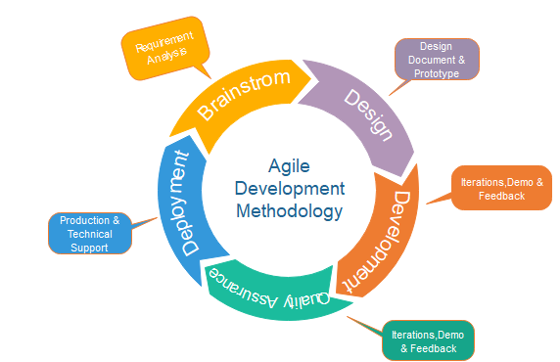
Methodology
Model Used :
Agile with Prototype Focus
5
Notes:
5

Slide 6
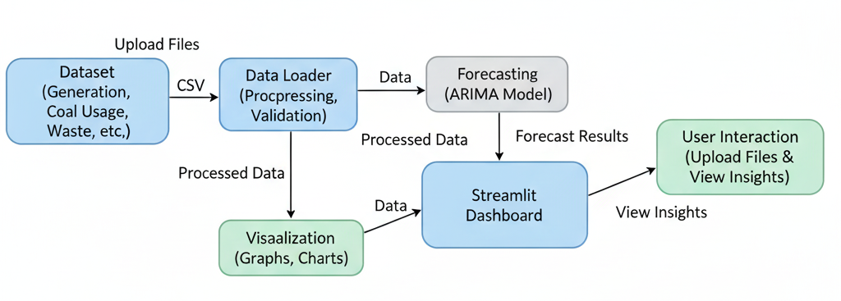
Methodology
Data Flow Diagram
6
Notes:
6

Slide 7
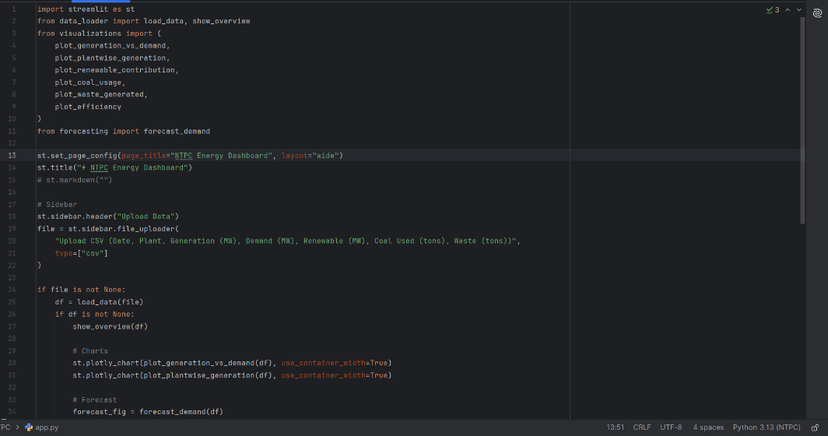
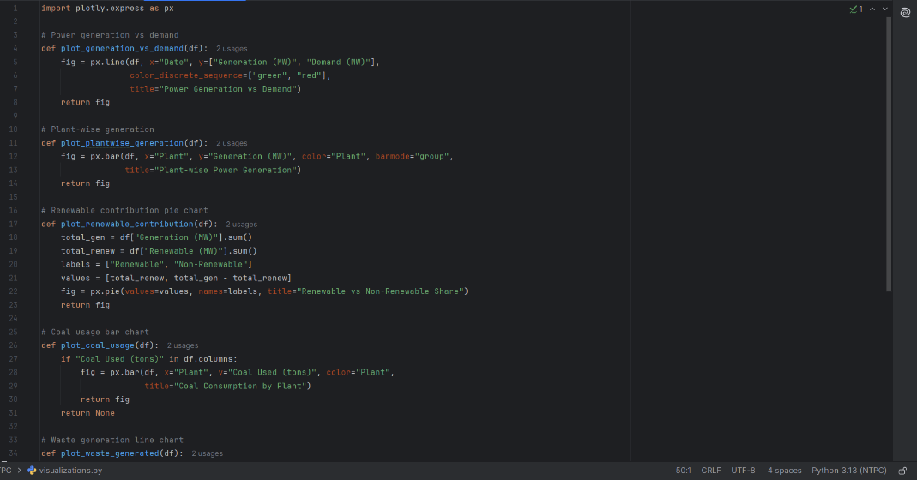
Implementation
app.py
visualizations.py
7
Notes:
7

Slide 8
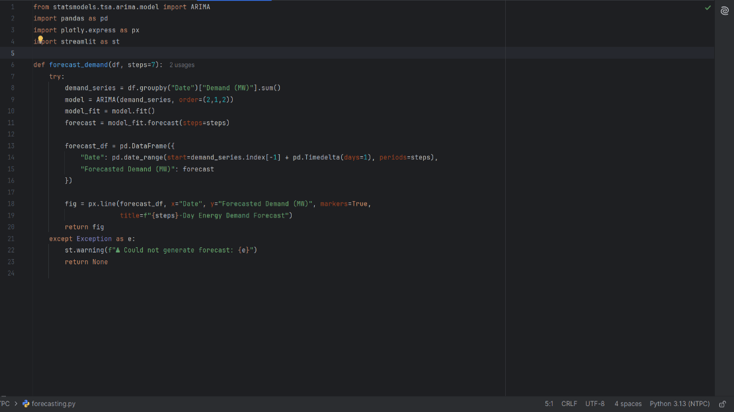
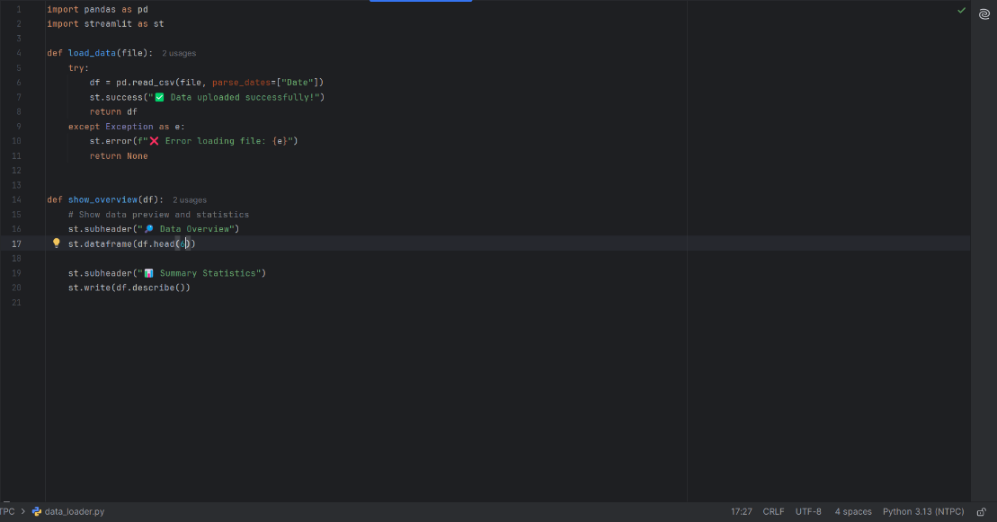
Implementation
forecasting.py
data_loader.py
8
Notes:
8

Slide 9
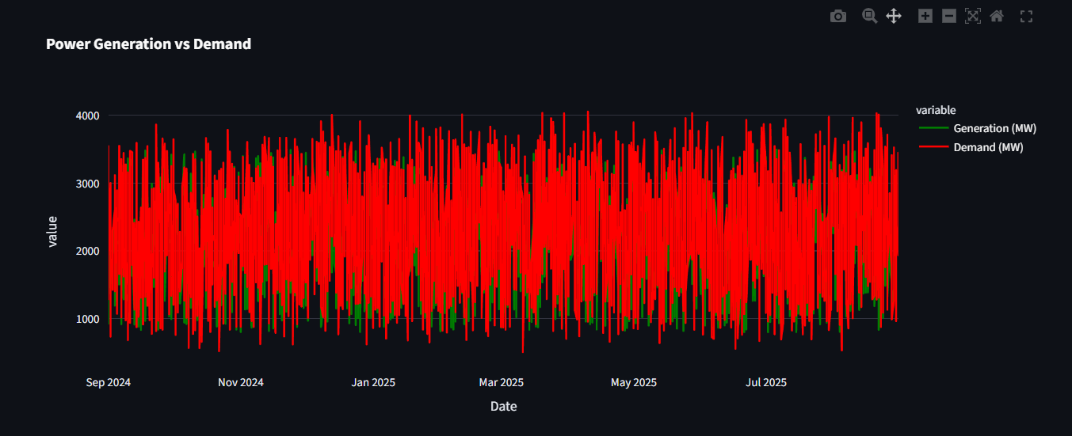
Results & Analysis
Power Generation vs Demand

Slide 10
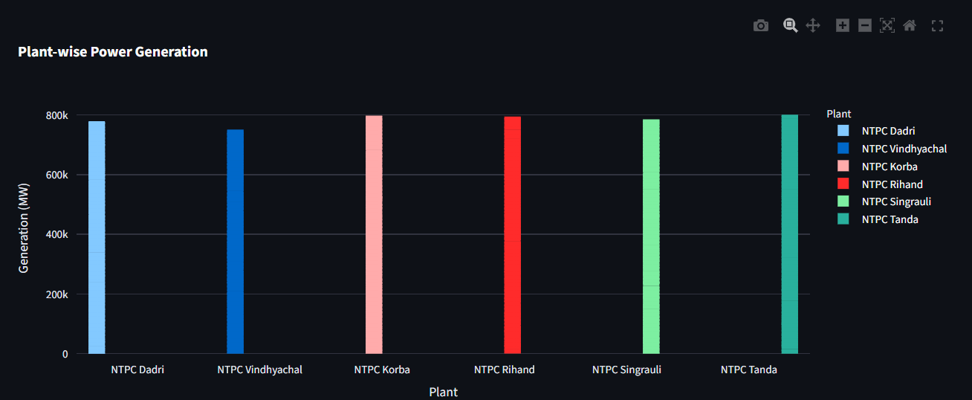
Results & Analysis
Plant-wise Power Generation

Slide 11
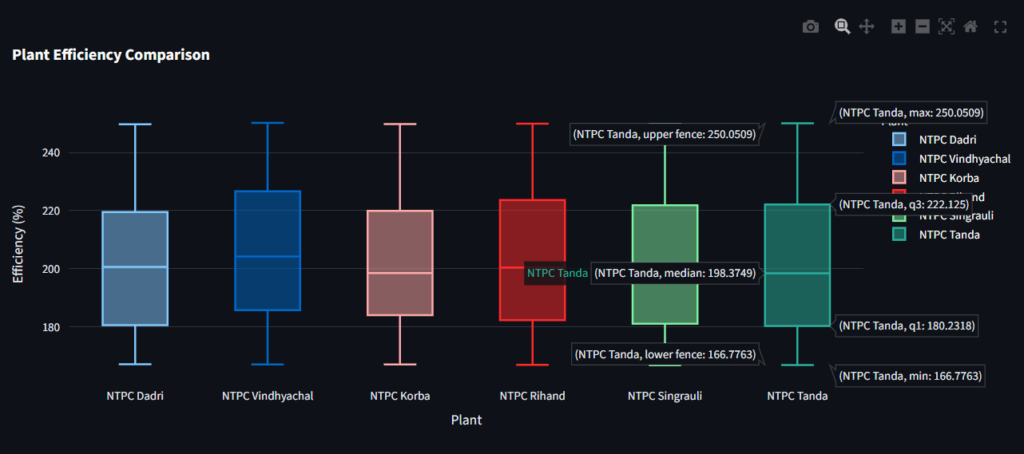
Results & Analysis
Plant Efficiency Comparison

Slide 12
Conclusion & Future Work
Summary:
Built a data-driven dashboard for energy analysis at NTPC Tanda.
Enabled interactive visualization and demand forecasting.
Supported planning through actionable insights.
Recommendations:
Extend to real-time monitoring with IoT data.
Use advanced models like LSTM or Prophet.
Integrate dashboards into operational workflows.

Slide 13
References
NTPC Official Website: https://www.ntpc.co.in
Streamlit Documentation: https://docs.streamlit.io
Plotly Express: https://plotly.com/python/plotly-express/
Statsmodels ARIMA: https://www.statsmodels.org

Slide 14
Acknowledgement
I would like to express my sincere gratitude to NTPC Tanda, for giving me the opportunity to pursue my internship with their organization. I am especially thankful to the Training and Operations Teams for their guidance and support during the initial days of my internship, which helped me understand the working of a thermal power plant.
I would also like to thank my mentors at NTPC Tanda for their constant guidance, support, and encouragement, which helped me grow both professionally and personally.
I also extend my sincere thanks to Respected Director, Prof. (Dr.) Manas Kumar Mishra, HoD, Prof. (Dr.) Sonali Mathur, Internship Coordinators, Mr. Basudeo Singh Roohani and Mr. Gaurav Gulati, and all the faculty members of the CSE Department for their invaluable support and guidance.

Slide 15
Thank You

