Slide 1
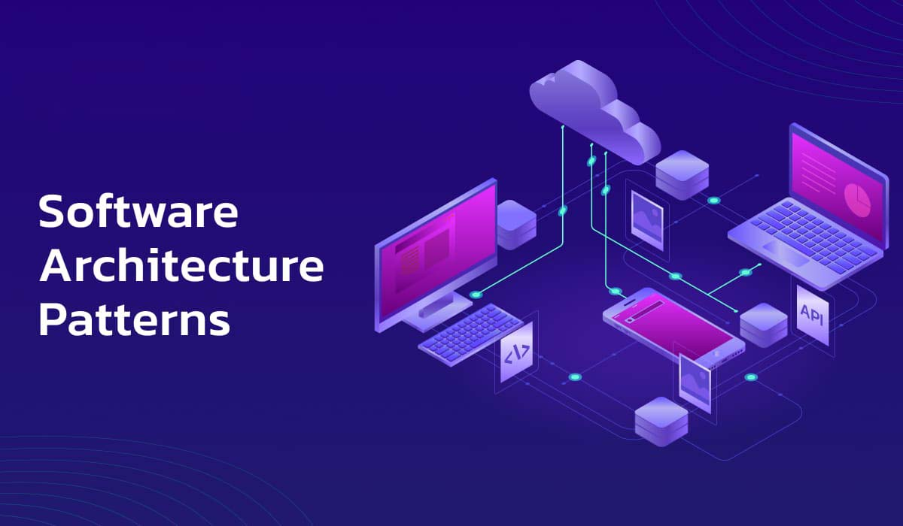
A Deep Dive into Modern Architectural Patterns

Slide 2
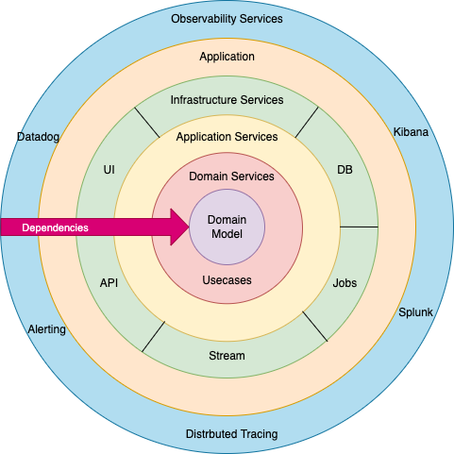
Advantages & disadvantages
✅ Separation of concerns
✅ Scalability
Clean Architecture (Onion Architecture)
✅ Easier to test
❌ Tight coupling between layers
❌ Performance overhead
❌ Code duplication in certain cases

Slide 3
Clean Architecture (Onion Architecture)
Core Layers:
Entities (Domain Layer) - Business models & rules
Use Cases (Application Layer) - Business logic & workflows
Adapters (Infrastructure Layer) - Communication with DB, APIs, UI
Frameworks & Drivers (Outer Layer) - UI frameworks, database engines
Notes:
Onion Architecture is a domain-centric design pattern that emphasizes dependency inversion, keeping business logic independent of frameworks, UI, and databases.
Core Layers:
Entities (Domain Layer) - Business models & rules
Use Cases (Application Layer) - Business logic & workflows
Adapters (Infrastructure Layer) - Communication with DB, APIs, UI
Frameworks & Drivers (Outer Layer) - UI frameworks, database engines

Slide 4
Advantages & disadvantages
Core Layers:
Entities (Domain Layer) - Business models & rules
Use Cases (Application Layer) - Business logic & workflows
Adapters (Infrastructure Layer) - Communication with DB, APIs, UI
Frameworks & Drivers (Outer Layer) - UI frameworks, database engines
Notes:
Onion Architecture is a domain-centric design pattern that emphasizes dependency inversion, keeping business logic independent of frameworks, UI, and databases.
Core Layers:
Entities (Domain Layer) - Business models & rules
Use Cases (Application Layer) - Business logic & workflows
Adapters (Infrastructure Layer) - Communication with DB, APIs, UI
Frameworks & Drivers (Outer Layer) - UI frameworks, database engines

Slide 5
Core Layers:
Entities (Domain Layer) - Business models & rules
Use Cases (Application Layer) - Business logic & workflows
Adapters (Infrastructure Layer) - Communication with DB, APIs, UI
Frameworks & Drivers (Outer Layer) - UI frameworks, database engines
Advantages & disadvantages
✅ Highly maintainable
Notes:
Tier : ردیف

Slide 6
Advantages & disadvantages
✅ Highly maintainable
✅ independence of frameworks
Notes:
Highly maintainable – The architecture keeps business logic separate from frameworks, making changes and updates easier.

Slide 7
Advantages & disadvantages
✅ Highly maintainable
✅ independence of frameworks
✅ Easy to test
Notes:
independence of frameworks – The system does not rely on specific technologies, allowing flexibility in choosing tools.

Slide 8
Advantages & disadvantages
✅ Highly maintainable
✅ independence of frameworks
✅ Easy to test
❌ Higher complexity
Notes:
Easy to test – Business logic can be tested independently without dependencies on external components.

Slide 9
Advantages & disadvantages
✅ Highly maintainable
✅ independence of frameworks
✅ Easy to test
❌ Higher complexity
❌ Requires more initial setup
Notes:
Higher complexity – Requires more layers and abstractions (تجرد), making it harder to learn and implement.

Slide 10
Domain - Driven Design (DDD)
Advantages & disadvantages
✅ Highly maintainable
✅ independence of frameworks
✅ Easy to test
❌ Higher complexity
❌ Requires more initial setup
Notes:
Requires more initial setup – Takes more effort to design and structure compared to simpler architectures.

