Slide 1
Domain-Driven Design (DDD) is an approach to software development that focuses on modeling real-world business concepts, ensuring that software reflects the business domain accurately.
Advantages & disadvantages
Domain - Driven Design (DDD)
✅ Highly maintainable
✅ independence of frameworks
✅ Easy to test
❌ Higher complexity
❌ Requires more initial setup

Slide 2
Advantages & disadvantages
Domain - Driven Design (DDD)
Domain-Driven Design (DDD) is an approach to software development that focuses on modeling real-world business concepts, ensuring that software reflects the business domain accurately.
✅ Highly maintainable
✅ independence of frameworks
Core Concepts
Bounded Contexts – Divide large systems into smaller, manageable parts.
Entities – Objects with a unique identity that evolve over time.
Value Objects – Objects without identity that represent concepts (e.g., Money, Address).
Aggregates – Groups of related entities that must be consistent.
Repositories – Abstraction for data access, managing aggregates.
Domain Events – Capture important business events for decoupling.
✅ Easy to test
❌ Higher complexity
❌ Requires more initial setup

Slide 3
Domain-Driven Design (DDD) is an approach to software development that focuses on modeling real-world business concepts, ensuring that software reflects the business domain accurately.
Domain - Driven Design (DDD)
Advantages & disadvantages
Core Concepts
Bounded Contexts – Divide large systems into smaller, manageable parts.
Entities – Objects with a unique identity that evolve over time.
Value Objects – Objects without identity that represent concepts (e.g., Money, Address).
Aggregates – Groups of related entities that must be consistent.
Repositories – Abstraction for data access, managing aggregates.
Domain Events – Capture important business events for decoupling.

Slide 4
Advantages & disadvantages
✅ Aligns software with business needs
Core Concepts
Bounded Contexts – Divide large systems into smaller, manageable parts.
Entities – Objects with a unique identity that evolve over time.
Value Objects – Objects without identity that represent concepts (e.g., Money, Address).
Aggregates – Groups of related entities that must be consistent.
Repositories – Abstraction for data access, managing aggregates.
Domain Events – Capture important business events for decoupling.

Slide 5
Advantages & disadvantages
✅ Aligns software with business needs
✅ Encapsulation of business rules
Notes:
This leads to Better domain understanding

Slide 6
Advantages & disadvantages
✅ Aligns software with business needs
✅ Encapsulation of business rules
✅ Works well with microservices
Notes:
Leads to a clear separation of concerns.

Slide 7
Advantages & disadvantages
✅ Aligns software with business needs
✅ Encapsulation of business rules
✅ Works well with microservices
❌ Requires deep domain knowledge and technical expertise.
Notes:
Works well with microservices and event-driven architectures.

Slide 8
Advantages & disadvantages
✅ Aligns software with business needs
✅ Encapsulation of business rules
✅ Works well with microservices
❌ Requires deep domain knowledge and technical expertise.
❌ Increased complexity

Slide 9
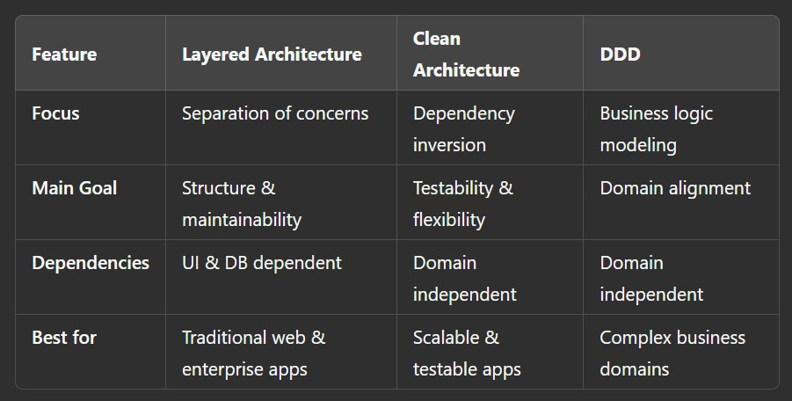
Comparison
Advantages & disadvantages
✅ Aligns software with business needs
✅ Encapsulation of business rules
✅ Works well with microservices
❌ Requires deep domain knowledge and technical expertise.
❌ Increased complexity
Notes:
More layers and concepts can slow development.

