Slide 1
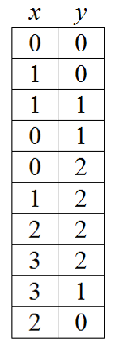
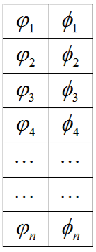
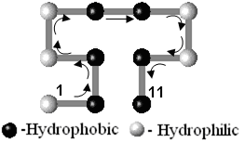

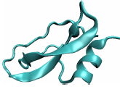
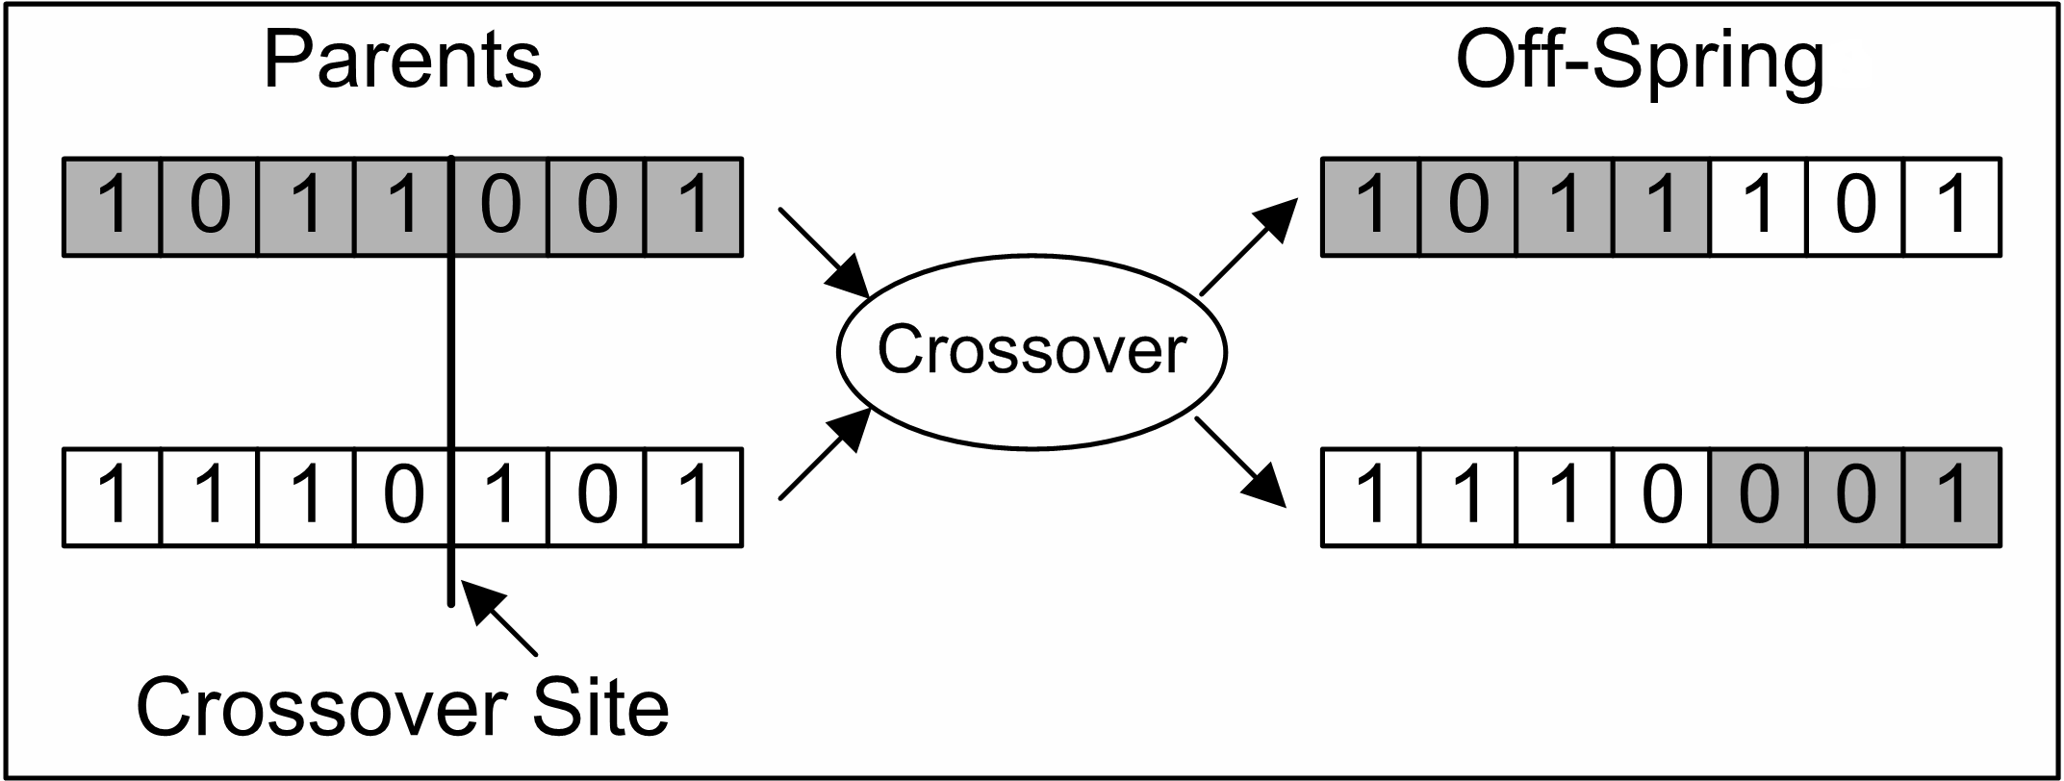
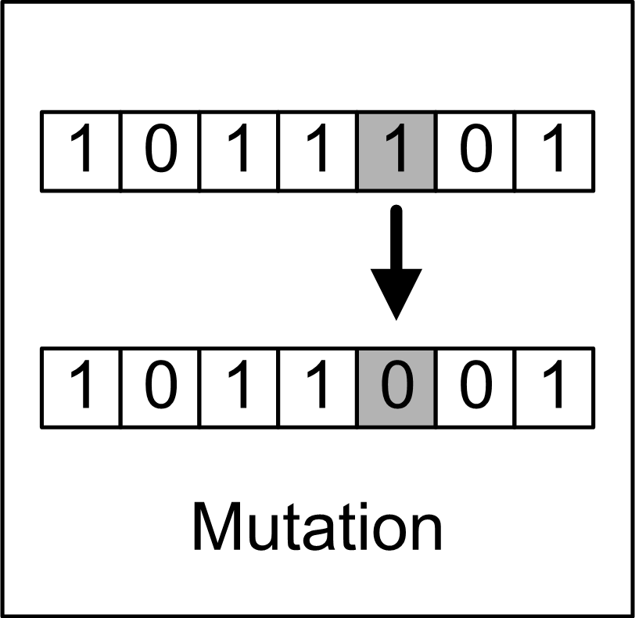
Genetic Algorithm (Basic)
Major Components: Chromosomes, Population, Crossover, Mutation, …
Coding:
Or,
Three different arrows are indicating Left (0), Right (1) and Forward (2). Encoded Chromosome can be:
Crossover
Mutation

Slide 2
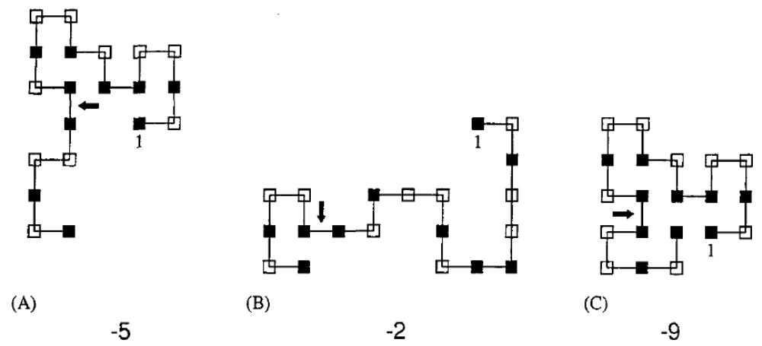
Example of Crossover operation:
Figure: By crossing over conformation (A) and (B) with fitness -5 and -4 respectively, we get a better one (C) with fitness value -9.

Slide 3
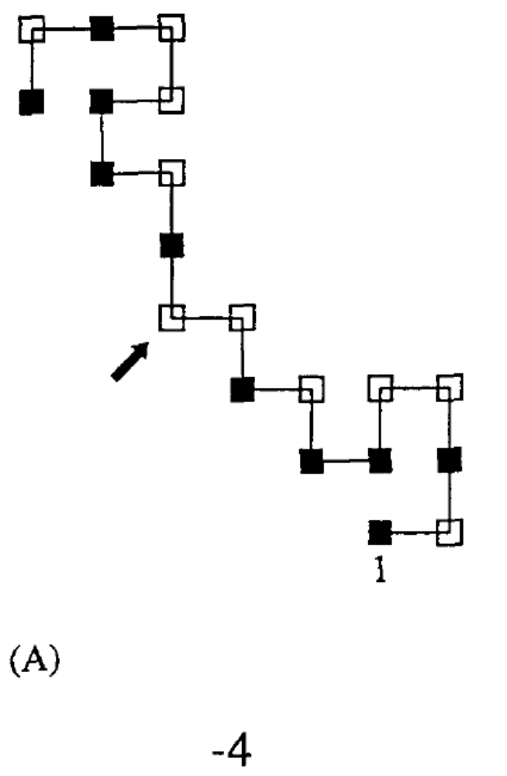
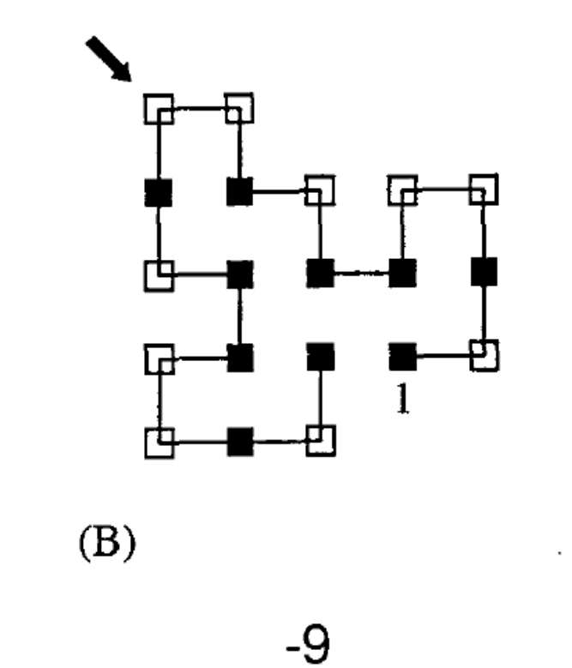
Mutation by pivot rotation
Figure: Mutation by pivot rotation is in increasing the fitness from -4 to -9.

Slide 4
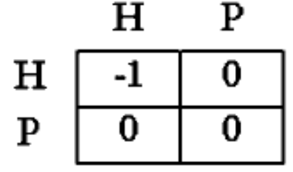
Fitness Function
For the given HP-model we will follow a fitness function to find the best fold
on a 2D HP model, which can be expressed by the following simplified energy
matrix:
Protein structure prediction (PSP) using hydrophobic (H) and hydrophilic (P or Polar) or HP lattice model was introduced by Dill.
It uses a simplified version of amino acid sequence having only two types of monomers, namely ‘H’ and ‘P’, and the chain is placed as a self-avoiding-walk (SAW) on this lattice path.
Search using this model looks for the valid conformation (i.e. SAW) which has the maximum number of topological neighboring (TN) (Figure 1 next) of H-H contacts, where the Hs are not already covalent bonded (or sequential) in the amino acid chain sequence.

Slide 5
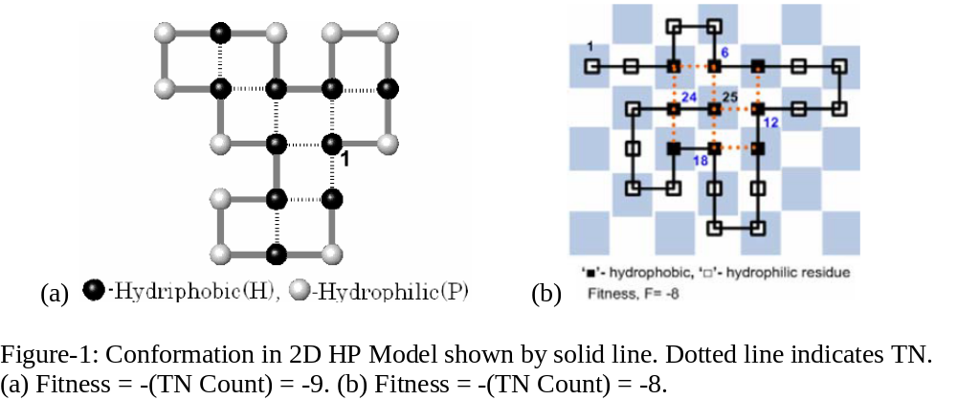
Fitness Function
For the given HP-model we will follow a fitness function to find the best fold
on a 2D HP model, which can be expressed by the following simplified energy
matrix:

Slide 6
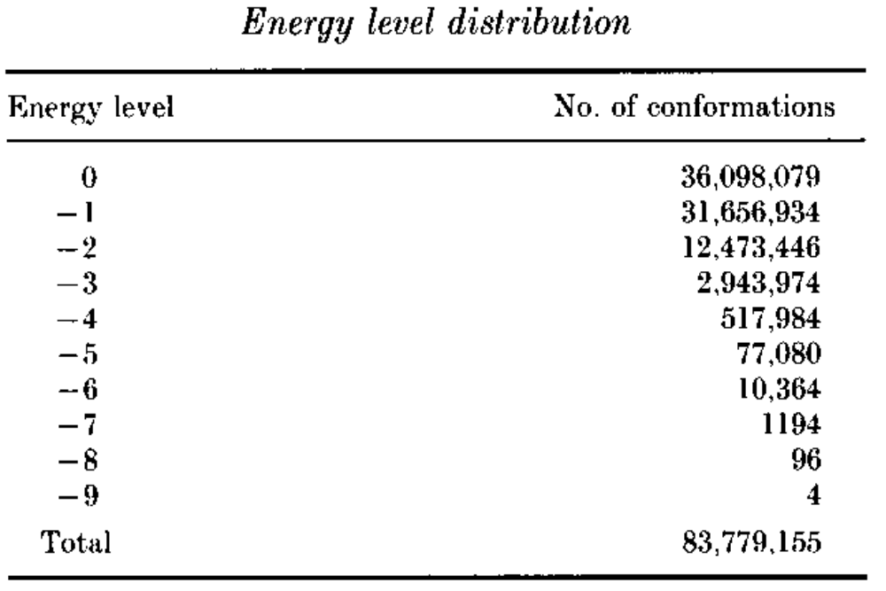
Solving the “Sequence-to-Fold” problem by Exhaustive search
For an hp sequence, say, hphpphhphpphphhpphph, where h=hydrophobic and p=polar or hydrophilic residues we can have many possible conformation as computed below by exhaustive search:

Slide 7





Approximating, How many Conformations from a Sequence?
Valid Sequence: Self avoiding walk (SAW)
-- How many? Ans:
where,
= 4.68401 for Simple lattice
e.g. in 2D, if n = 40
2 860 274 487 506 831 970 500 921 533, possible.
Earth Surface = 510, 072, 000, 000, 000 m² → 5,607,589,688, 332 earths to hold one conformation in 1 m² of earth surface.

Slide 8
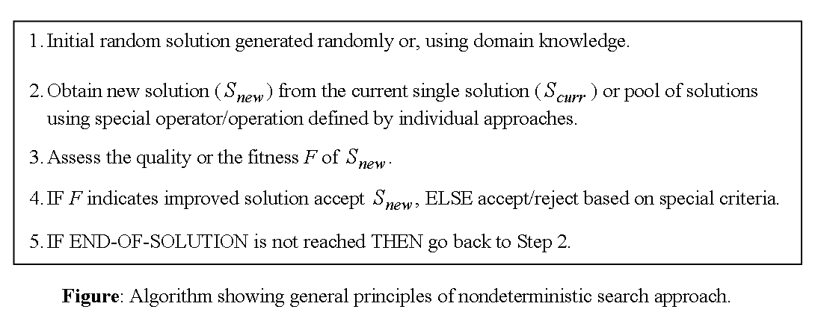
Using Nondeterministic Approaches instead of the Exhaustive Search
Working Principles of The Nondeterministic Algorithms

Slide 9
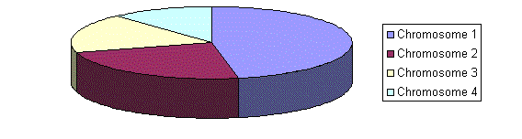
Selection Procedures
Roulette Wheel Selection
Figure: A marble is thrown and selects the chromosome. Chromosome with bigger fitness will be selected more times.
2. Rank Selection
Rank selection first ranks the population and then every chromosome receives fitness from the ranking.
Other option: Steady State Selection (which is close to elitism)
Recommended GA parameters
Crossover rate = 80 to 90%, at least 60% required
Mutation rate = 0.5 to 5 %
Elite rate = 5 to 10%
Notes:
RWS: Parents are selected according to their fitness. The better the chromosomes are, the more chances to be selected they have. Imagine a roulette wheel where are placed all chromosomes in the population, every has its place big accordingly to its fitness function, like on the following picture.

Slide 10
GA Steps for Programming
1. Initialization (Pop1)
2. Compute Fitness (Pop1, for all chromosome Ci)
3. Sort (Pop1)
4. Examine: C1/Progress or Max_gen, Exit()?
5. Elite(5 to 10%); Pop2← Pop1
6. Crossover (~80%); Pop2(remaining) ← Pop1
7. Fillup Pop2 randomly (remaining, if any)
8. Mutation (Pop2(Non_Elite)); 5% to 50%
9. Pop1 ← Pop2; gen = gen+1
10. Go to Step #2.

