Slide 1
Final project of an Introduction to Databases course
Mohammed Nasser Abdu
120191177
Abdulrahman Mohammed Al-Majayda
120190071

Slide 2
UCAS Charitable Society
The project is a charity named UCAS.-
-It contains six tables and when breaking a many-to-many relationship results in the seventh table.
-Tables are Departments,Locations, Employees,Warehouses, Needy Peoples,Grants AND Distribution.

Slide 3
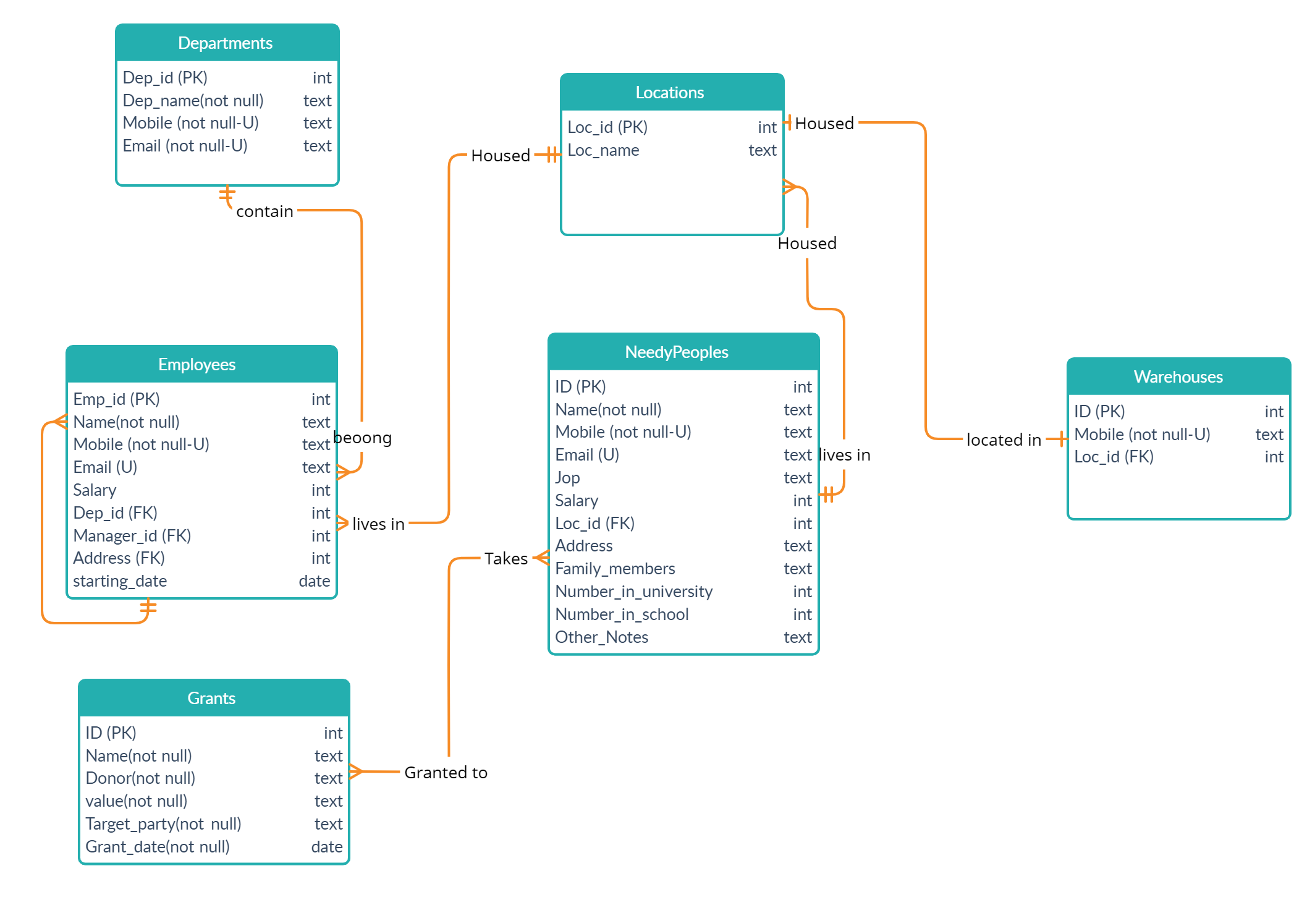

Slide 4
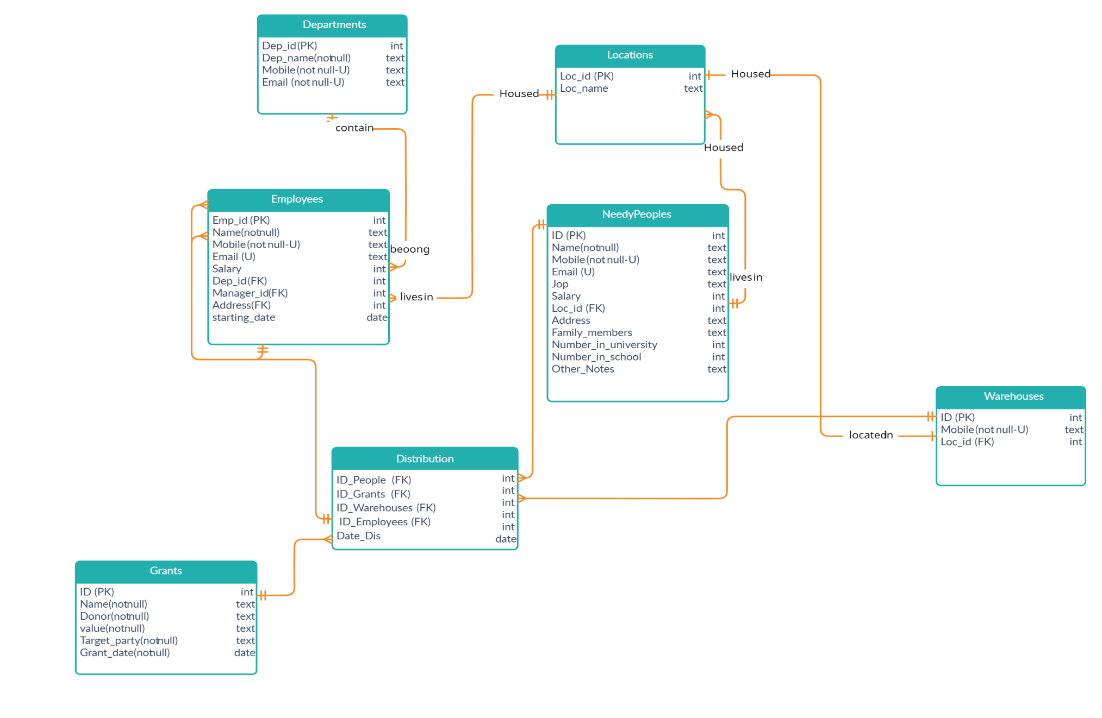
ERD After broken many-to-many relationship

Slide 5
UCAS Charitable Society
* The Departments table includes the sections that make up the association.
* Employees table includes employees and their data.
* The needy table includes the needy, their data, and their socio-economic status.
* The scholarship table includes grants and their value that the association provides to the needy.

Slide 6
UCAS Charitable Society
* Table of sites includes the governorates of the Gaza Strip.
* The warehouse schedule is a special warehouse
. for the association in each governorate
* When breaking the many-to-many relationship between the grants and needy table, a distribution table is produced that includes all the grant and the needy who have benefited from it.

Slide 7
UCAS Charitable Society
sequence
* Sequence for Grants table
create sequence gr_id_seq
INCREMENT BY 1
start with 30001
maxvalue 39999;
* Sequence for Grants table
create sequence emp_id_seq
INCREMENT BY 1
start with 10000
maxvalue 19999;

Slide 8
UCAS Charitable Society
sequence
* Sequence for WAREHOUSES table
create sequence WH_ID_SEQ
increment by 10
start with 10
maxvalue 100;

Slide 9
UCAS Charitable Society
View
* Sequence for Grants table
create sequence gr_id_seq
INCREMENT BY 1
start with 30001
maxvalue 39999;
* Sequence for Grants table
create sequence emp_id_seq
INCREMENT BY 1
start with 10000
maxvalue 19999;

