Slide 1

Delta - How To ?
2024 Ashby Hackathon in Computational Science
Center for Artificial Intelligence, NCSA
Minu Mathew
Research Software Engineer, NCSA

Slide 2

Agenda
Overview
Login
Data management
Installing packages and softwares
Dev workflow
Job scheduling (Slurm)
Running jobs - example slurm scripts
Job monitoring

Slide 3
DELTA
HPC resource maintained by NCSA
CPU, GPU and storage resources available
124 CPU nodes, 100 quad A100 GPU, 100 quad A40 GPU nodes, Five eight-way A100 GPU nodes, One MI100 GPU node
200 Gb/s HPE SlingShot network fabric,
7 PB of disk-based Lustre storage, 3 PB of flash-based storage for data-intensive workloads
Allocations through ACCESS https://allocations.access-ci.org/
Login and you should be able to see an allocation
Hackathon has a shared LDAP group - bbug
This group will have access to GPU, CPU and storage resources

Slide 4

DELTA : Login
Prerequisites
ACCESS allocation
Username
2FA setup - Duo
Three modes of login :
CLI - Direct Access Login Nodes
GUI - Using Open OnDemand
IDE with tunneling - VSCode
User documentation

Slide 5

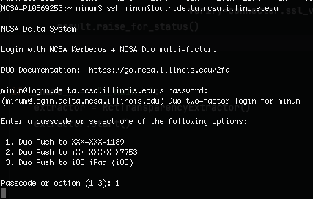
DELTA : CLI Login
Direct Access Login Nodes
CLI
Use ssh to connect to any login node
ssh username@login.delta.ncsa.illinois.edu

Slide 6
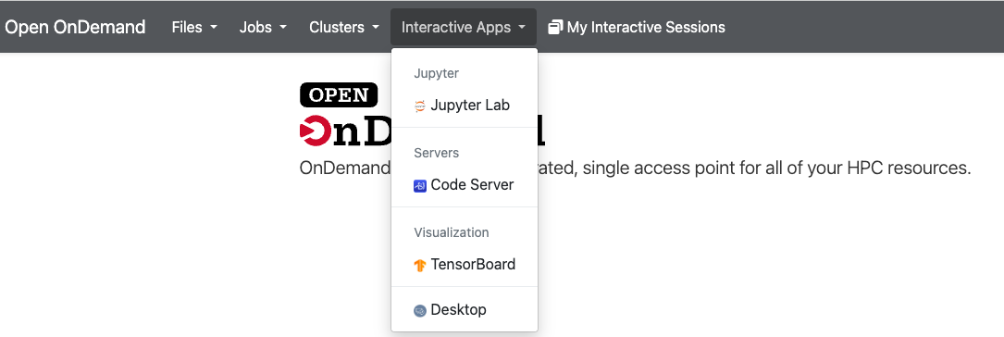
DELTA : Interactive Login
Open OnDemand
https://openondemand.delta.ncsa.illinois.edu/
Auth - select Identity provider (NCSA / UofI)
Easy access to your files and folders
Launch jupyter notebooks, submit jobs via GUI
Shell access on browser

Slide 7
DELTA : VSCode Login
VSCode with remote SSH
Install Remote-SH extension in VSCode
Add Delta to $HOME/.ssh/config as known host
Work with Delta as though in local
Can also work with Jupyter extension for VSCode.
More details in documentation
User might encounter higher latency because of ssh tunneling
Difficult to collaborate when working on different git branches
Good if you are constantly iterating

Slide 8

DELTA : Accounts
Login to Delta.
`accounts` command will list all the accounts you are part of
You should see bbug account

Slide 9
DELTA : Data Management
Hackathon participants have a shared LDAP group - bbug
Use `quota` to see your filesystems.
Each user has a home directory $HOME located at /u/$user
/projects & /scratch directory is shared across the LDAP user group
Each user will have directories under /projects/bbug and /scratch/bbug
Use `projects` for shared code, datasets etc
Use `scratch` for IO
Documentation on file systems

Slide 10
DELTA : Transferring Data
SCP and Rsync for small data transfers
`scp -rp file1.py file2.py file3.txt username@login.delta.ncsa.illinois.edu:/projects/accounttag/username`
Globus for large data transfers
Read detailed instructions - Documentation on data transfer

Slide 11
DELTA : Installing software / packages
Delta comes with some pre-installed packages
See `module list` to see currently loaded packages (documentation)
You might want to load gcc, anaconda, and cuda `module load gcc anaconda3_gpu cuda`
Python packages
Create a virtual environment - conda is recommended
Install any packages
`conda create –name venv –file requirements.txt` ` conda activate venv`
Location defaults to $HOME/.conda - which makes it visible to running jobs.
Containers
Run as Apptainer sif files (documentation)

Slide 12
DELTA : Dev workflow (recommended)
Use interactive Open OnDemand for quick tests
Setup a git repo for your project
Clone git repo in Delta `projects` folder
Test and develop on your local git repo.
Use multiple branches to work on different features and collaborate
Use .env file track data path and other environment variables/api keys
Push to remote git when done
Pull the git branch on Delta and run
interactive job - using Open OnDemand
OR using SLURM script

Slide 13
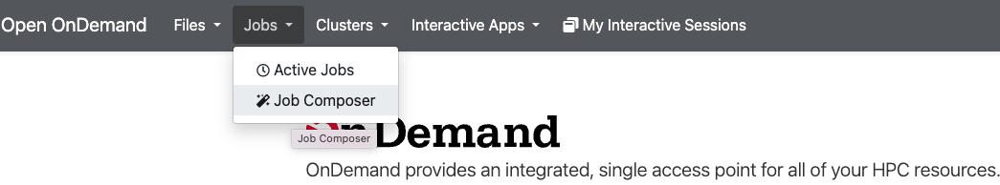
DELTA : Submitting jobs
Delta uses SLURM workload manager
Prerequisites to submitting a job
Account name - bbug
Partition information
Virtual environment created and packages installed, if necessary.
Executable script in `/projects` directory
Submit jobs via
Interactive Open OnDemand Job composer
CLI slurm commands

Slide 14
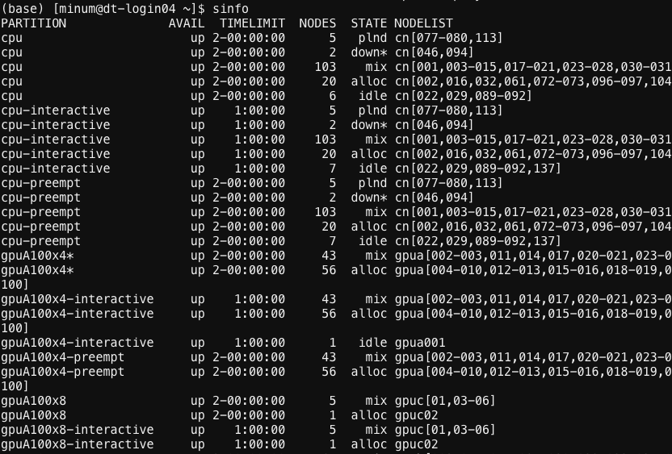
DELTA : Slurm Partition info
Delta system architecture information is required to choose the nodes to run a job (documentation)
Slurm command `sinfo` gives partition information
If executing interactive jobs (running jupyter notebooks) - choose “interactive” partition
Check the availability, time limit, state and number of nodes and make sure you choose the right partition required for your job.

Slide 15
DELTA : Running jobs
Batch scripts (sbatch) OR Interactive runs (srun) . Documentation
`sbatch` - Uses batch scripts to submit a non-interactive job. Results are written to a `.out` file once completed.
Sample batch scripts here and in slides 15,16.
Run as `sbatch file.slurm`
`srun` - Runs a single command on a compute node. More interactive use
Eg: `srun python test.py`
On successful submission, you will get a jobID
Example slurm scripts

Slide 16
DELTA : Running batch jobs
#!/bin/bash
#SBATCH --job-name=llmslurm
#SBATCH --partition=gpuA100x8
#SBATCH --account=bbug-delta-gpu
#SBATCH --time=00:30:00
#SBATCH --output=llmout.log
#SBATCH --error=llmerr.log
#SBATCH --nodes=1
#SBATCH --gpus-per-node=4
#SBATCH --mem=100g
#SBATCH --cpus-per-task=32
conda activate venv
echo "python path `which python3`"
echo "job is starting on `hostname`"
srun python3 llm.py
# (optionaly) keep node alive for full amount of $TIME
sleep infinity
Single node run
Set a job name
Set the correct partition - use `sinfo`
Set the account
Set time to run the script / time till when the node will be reserved.
Optionally set files for stdout and stderr. If not set, the output will be in `jobid.out`
If running `sbatch` where a conda env is set, you could omit the `conda activate`
Setting `mem=0` will the job access to all memory on each node.

Slide 17
DELTA : Running batch jobs
Multi node run
#!/bin/bash
#SBATCH --job-name=llmslurm
#SBATCH --partition=gpuA40x4
#SBATCH --account=bbug-delta-gpu
#SBATCH --time=02:00:00
#SBATCH --nodes=8
#SBATCH --ntasks=8
#SBATCH --gpus-per-node=2
#SBATCH --mem=0
module load anaconda
export PROJECT_BASE_DIR=$HOME/LLM
export DATA=${PROJECT_BASE_DIR}/datasets/test-data
conda activate venv
python llm.py
# (optionaly) keep node alive for full amount of $TIME
sleep infinity
#!/bin/bash
#SBATCH --job-name=llmslurm
#SBATCH --partition=gpuA40x4
#SBATCH --account=bbug-delta-gpu
#SBATCH --time=02:00:00
#SBATCH --nodes=8
#SBATCH --ntasks=8
#SBATCH --gpus-per-node=2
#SBATCH --mem=0
# export local environment variables to the job
#SBATCH --export=ALL
python llm.py

Slide 18
DELTA : Running batch jobs
#!/bin/bash
#SBATCH --job-name=llmslurm
#SBATCH --partition=gpuA40x4
#SBATCH --account=bbug-delta-gpu
#SBATCH --time=02:00:00
#SBATCH --nodes=8
#SBATCH --ntasks=8
#SBATCH --gpus-per-node=2
#SBATCH --mem=0
export NUM_GPUS_PER_NODE=1
nodes=$(scontrol show hostnames "$SLURM_JOB_NODELIST")
nodes_array=($nodes)
export MAIN_HOST=${nodes_array[0]}
export WORLD_SIZE=$(($NUM_GPUS_PER_NODE * $SLURM_JOB_NUM_NODES))
conda activate coin
echo "Starting on hostname: $(hostname | cut -c 1-7)"
echo " JobID:= " $SLURM_JOB_ID
echo " Nodelist:= " $SLURM_JOB_NODELIST
echo " Number of nodes:= " $SLURM_JOB_NUM_NODES
echo " GPUs per node:= " $SLURM_GPUS_ON_NODE
echo " CPUs per node:= " $SLURM_CPUS_ON_NODE
echo " NTasks per node:= " $SLURM_NTASKS_PER_NODE
# SLURM_NPROCS is my "world size", meaning total # of (GPU) devices.
echo " Slurm NPROCS:= " $SLURM_NPROCS
echo "World size: $WORLD_SIZE"
localrank=0
for ((node_i = 0; node_i < $SLURM_JOB_NUM_NODES; node_i++)); do
local_node_hostname=${nodes_array[$node_i]}
for ((gpu_i = 0; gpu_i < $NUM_GPUS_PER_NODE; gpu_i++)); do
echo "Starting GPU worker rank $localrank at $local_node_hostname"
ssh "$local_node_hostname"\
"conda activate venv"\
"python llm.py" &
((localrank=localrank+1))
sleep 0.1
done
done
echo "Job completed"

Slide 19
DELTA : Monitoring jobs
squeue to display job queue information
squeue -u $USER
squeue -j jobid
scontrol to see job information
scancel jobID - to cancel / terminate a job
To monitor nodes
top -u $USER
nvtop Documentation

Slide 20
Participants : To-do list
Check access to Delta
Account - bbug
Submit and run jobs
Hackathon information documents (gdrive link)
Checkout NCSA-hackathon-starter-kit (work in progress)
https://github.com/rohan-uiuc/ncsa-hackathon-workflows

Slide 21
Happy Hacking!
Tech team
Rohan Marwaha - rohan13@illinois.edu
Minu Mathew - minum@illinois.edu
Kastan Day - kvday2@illinois.edu
Contact us via email or Slack

