Slide 1

Linear Regression Project for Medical Insurance Forecast
By Group A
Ishwor Upreti
Ganne Nanda Kishore
Sanjog Kafle
Tang Xiaofan

Slide 2

Introduction:
To earn a profit, insurance firms must calculate premiums based on demographic trends, despite knowing little about the insured population
Our Goal is to predict the price that insured must pay.
Using Different Linear Regression and Methods available in R.

Slide 3
Introduction To Dataset:
Dataset we have collected from Kaggle have following headers: Age, sex, bmi, children, smoker, region, charges.
Where Age is age of insured , sex is sex of insured, children is numbers of children with insured.
Smoker is the smoking habit of the insured and region is the places where the insured belong.
Charges is the total amount have to pay by insured.
Here Charge is dependent variables whereas all the other variables is independent.
Also, the dataset contains some categorical variable like sex, children(number of children, and region).
And The Dataset has 1338 rows.

Slide 4
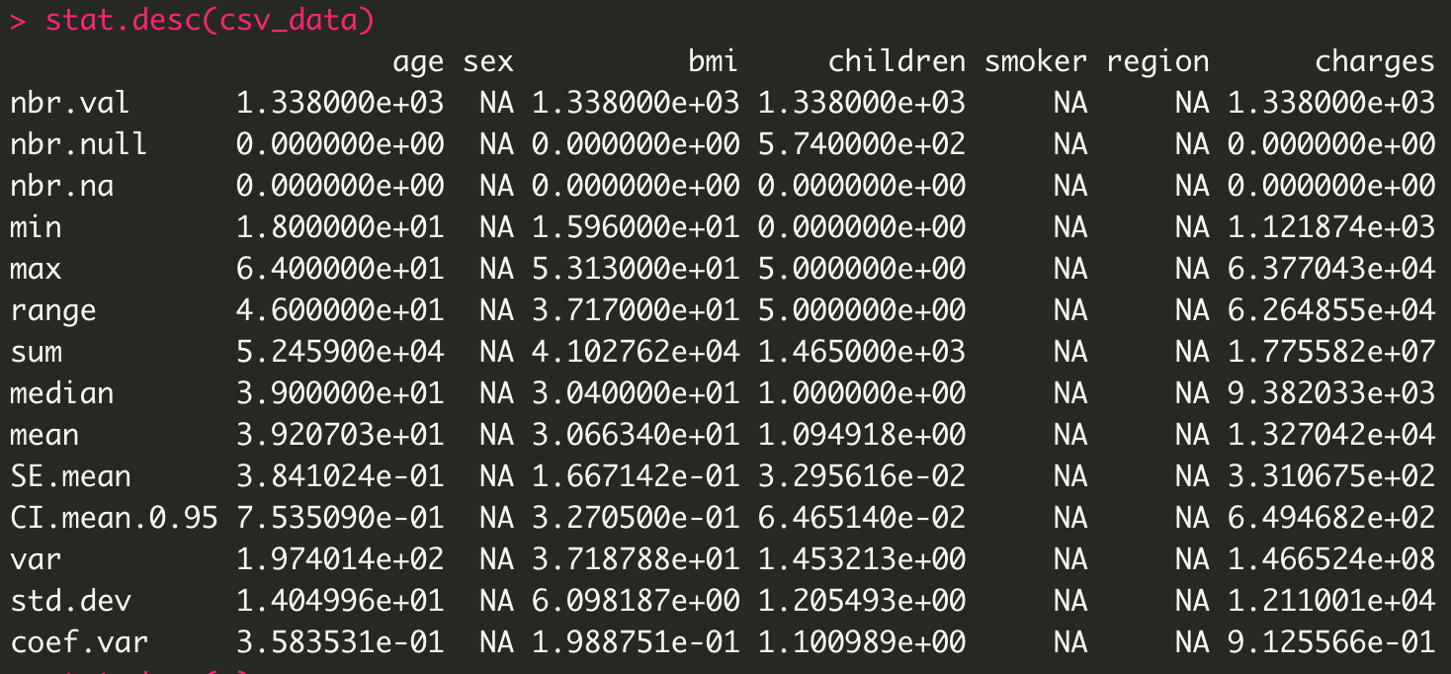
Highlights of EDA:
While inspecting data with pastecs, library for Exploratory data analysis, we see the following stats.
Here sex, smoker, region have no any stats since they are categorical variable.

Slide 5
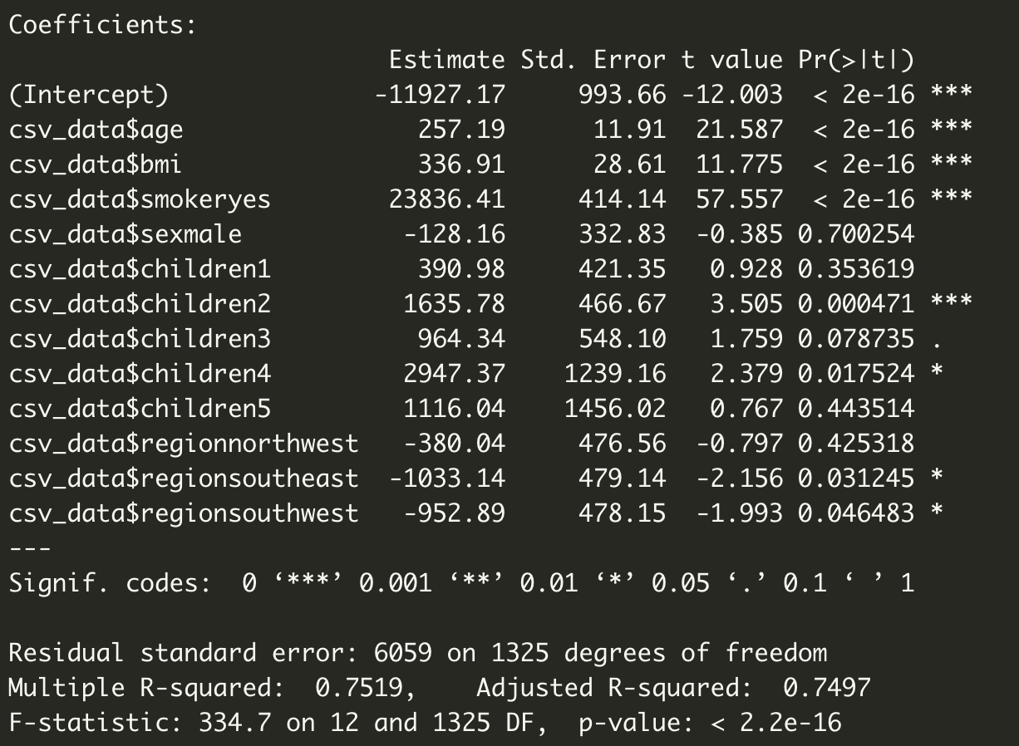
Model:
The Initial model looks like: charges= -11927.17 + 257.19(age) + 336.91(bmi) + 23836(smoker-yes) +1635.78(children2)
Since There is Heterscedasticity present in the given data, we’ve removed it using logarithmic method after that diagnostics the model looks like: log(charges)= 6.9692685+0.0348147*age+0.0104155*bmi+(1.5437176)smoker+children1*0.1423780+children2*0.2792741+children3*0.2494404+ (children4*0.5197718)+children5*0.3979236
The initial and final model has R-Squared value of 0.7516 and and 0.7644.
Which means there is significant relationship between variables though there is some homoscedasticity.

Slide 6
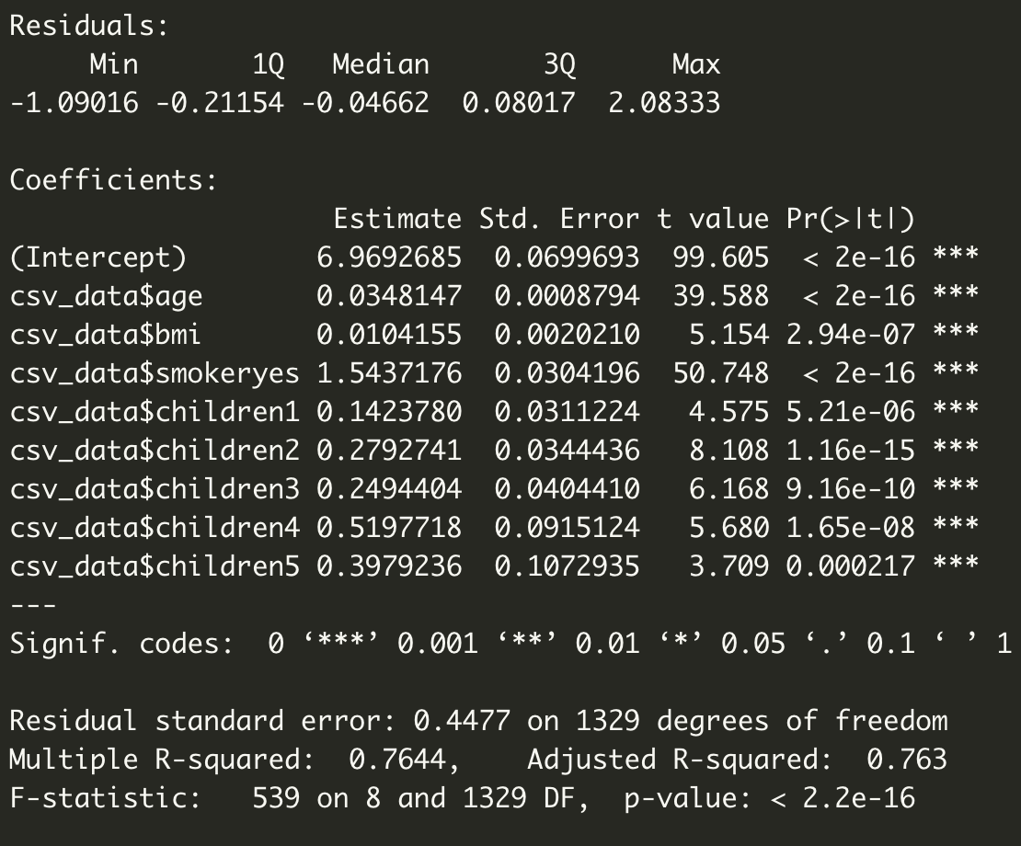
Findings:
There is no multicollinearity detected in the model. However, there are outliers and leverages and influential points in the model.
To to heteroscedasticity some of the categorical variable have no significant contribution to the model which is corrected using logarithmic diagnostic. Afterwards, all the variable has equal contribution on determining the dependent variables.

Slide 7


Conclusions:
We have fitted a linear regression model to the dataset using R and predicted the values for different conditions using the model.
The model has a precision of 76.44 %, which can be improved by adding additional datasets or by removing a few categorical variables from the dataset.

