Slide 1
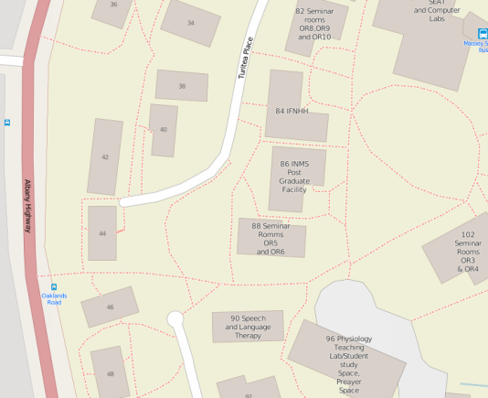
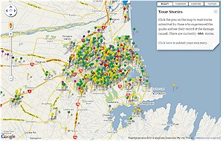
Geospatial Natural Language
Where am I? (e.g. for emergency services)…
On motorway bridge over a small river. In a rural area. There is farmland on both sides of the road. To the right there is a group of tall trees on the side of the river.
Where was this specimen collected (with Landcare Research)?
2.4 kilometers south-west Waitaki-Steward Road, 46 meters south of high terrace on east side of road.
What was the impact of the disaster (e.g. social media)?
A power line is down near the library, opposite the supermarket.

Slide 2
Geospatial Data Integration
Especially at a semantic level:
Integrating data that uses different categorisations
Dynamic integration
Spatial data infrastructures
Our Land and Water National Science Challenge

