Slide 1
CCNA 2 V3.1
Access Control Lists (ACLs)
http://www.ciscoacad.ucad.sn

Slide 2
Objectives
Access control list fundamentals
Access control lists (ACLs)

Slide 3
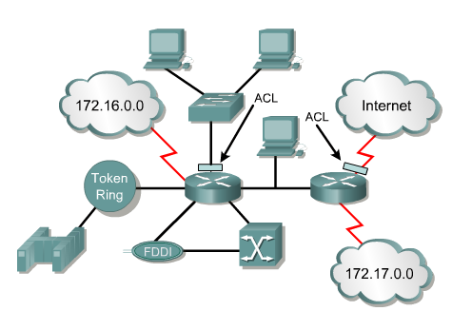
What are ACLs?
ACLs are lists of instructions you apply to a router's interface to tell the router what kinds of packets to accept and what kinds to deny.

Slide 4
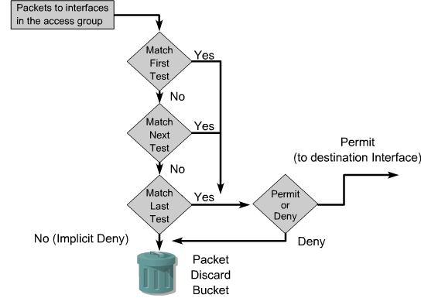
How ACLs Work

Slide 5
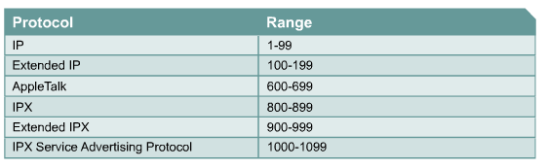
Protocols with ACLs Specified by Numbers

Slide 6
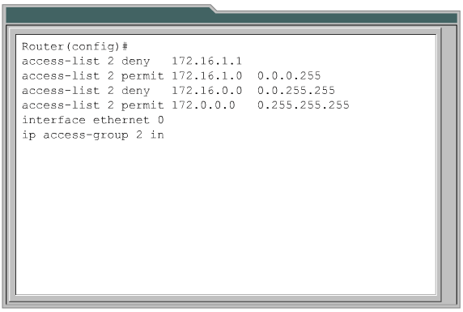
Creating ACLs

Slide 7
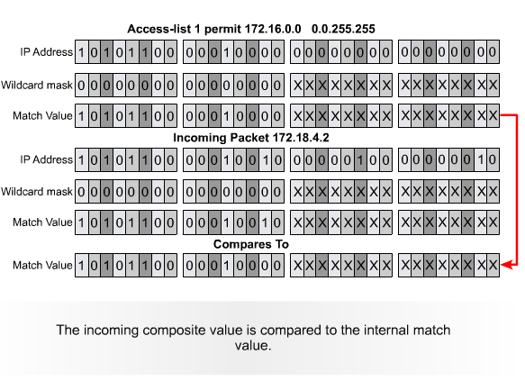
The Function of a Wildcard Mask

Slide 8
Verifying ACLs
There are many show commands that will verify the content and placement of ACLs on the router.
  show ip interface
  show access-lists
  Show running-config

Slide 9
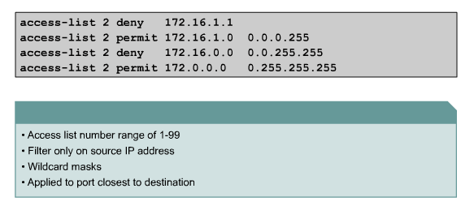
Standard ACLs

Slide 10
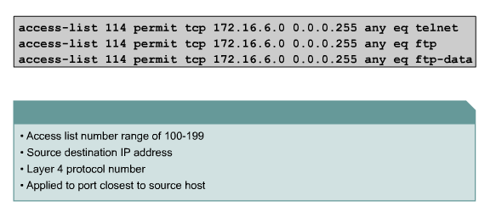
Extended ACLs

Slide 11
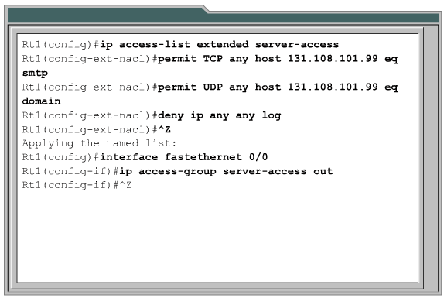
Named ACLs

Slide 12
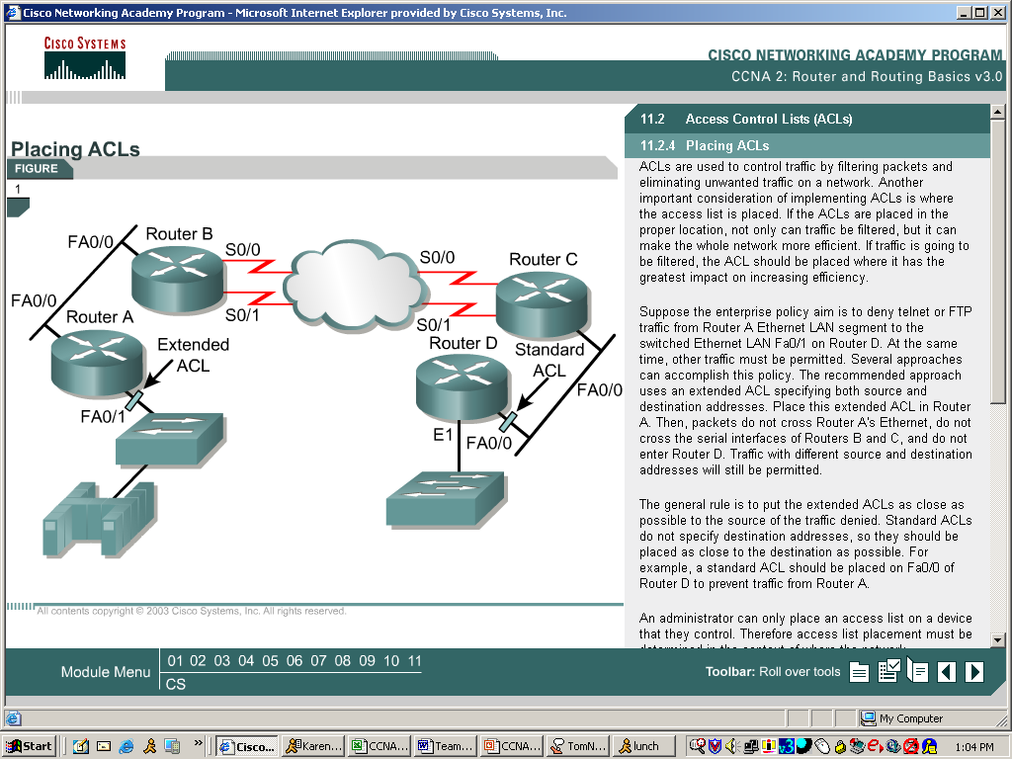
Placing ACLs
Standard ACLs should be placed close to the destination.
Extended ACLs should be placed close to the source.

Slide 13
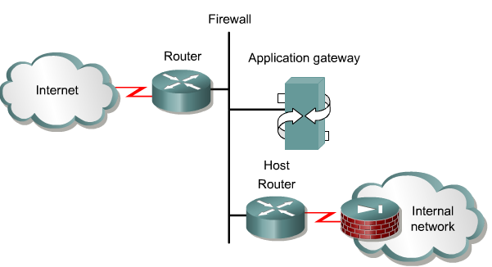
Firewalls
A firewall is an architectural structure that exists between the user and the outside world to protect the internal network from intruders.

Slide 14
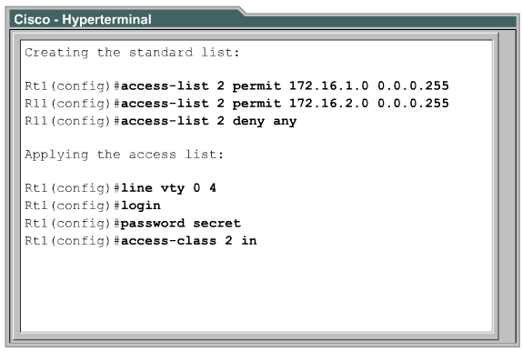
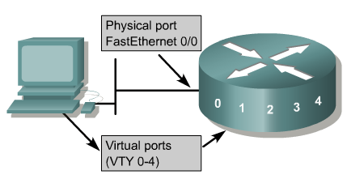
Restricting Virtual Terminal Access

Slide 15
Questions?
http://www.ciscoacad.ucad.sn

