Slide 1
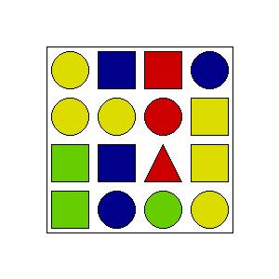
Title Game
Level: X
Picture: y/Y
Some Instructions
Describe the Picture:
Enter

Slide 2
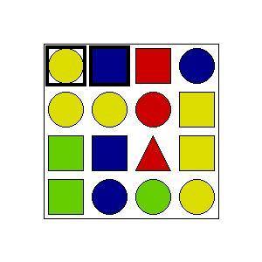
Title Game
Level: X
Picture: y/Y
Some Instructions
You describe these two blocks, correct?
Yes
No

Slide 3
Title Game
Level: X
Picture: y/Y
Some Instructions
You describe these two blocks, correct?
Yes
No

Slide 4
Title Game
Level: X
Picture: y/Y
Python Script
Creating GUI
Def _send_input_to_parser
Take the list, loop over elements and mark the corresponding
Parser
Get list of logical forms ordered by likelihood
Some Instructions
Describe the Picture:
Enter
Title Game
Level: X
Picture: y/Y
Some Instructions
You describe these two blocks, correct?
Yes
No

