Slide 1

EmoSense: Multimodal Emotional Intelligence for Everyday Mental Wellbeing
Understand voice, adapt conversation, guide support. A conversational AI that listens to how you feel, not just what you say.
Notes:
1

Slide 2




The Challenge in Current Mental Health Support
Text-Only Limitation
Masked Emotions
Most chat assistants read words but miss the emotional tone carried in voice—affecting how users actually feel versus what they type.
People in distress often mask their true feelings with neutral or positive wording, making their emotional state invisible to text-based systems.
Reactive, Not Proactive
Missing Local Context
Support typically responds after crisis escalation rather than detecting early warning signs in context and providing actionable guidance.
Crisis situations lack immediate, localized resource recommendations tailored to the user's emotional state and geographic location.
Notes:
2

Slide 3

Our Solution: Multimodal Emotional Intelligence
How EmoSense Works
EmoSense combines multiple AI technologies to create emotionally aware conversational support:
Voice emotion detection from speech using Wav2Vec2 with 8 emotional classes
Text sentiment and intent classification through RoBERTa models
Emotion-aware conversational responses powered by Qwen2.5-7B-Instruct
Resource recommendations tailored to emotional state and user intent
Deterministic crisis-first safety interception before LLM generation
Notes:
3

Slide 4






Product Experience Flow
Audio Input
User uploads or records voice message sharing how they feel
Emotion Detection
System predicts emotion classification with confidence scoring
Conversational Mode
User continues via text, voice, or file upload in natural flow
Context Fusion
Voice emotion, text sentiment, and intent combine into unified understanding
Smart Response
Assistant replies in emotional context with relevant resources
Session Report
Export conversation transcript and emotion analytics summary
Notes:
4

Slide 5
Core Features
1
2
3
Multimodal Context Understanding
Six Intent Categories
Crisis Safety Path
Detects venting, seeking advice, resource requests, gratitude, casual chat, and crisis situations to adapt responses appropriately.
Fixed deterministic response for high-risk language with immediate helpline connections before any generative AI processing.
Simultaneously processes voice affect and text meaning to capture the full emotional picture behind user expressions.
4
5
Resource Engine
Session Analytics
Provides breathing exercises, grounding techniques, reading recommendations, affirmations, music mood matching, and support line access.
Tracks emotion drift over time, identifies dominant intents, and detects contradictions between voice and text signals.
Notes:
5

Slide 6
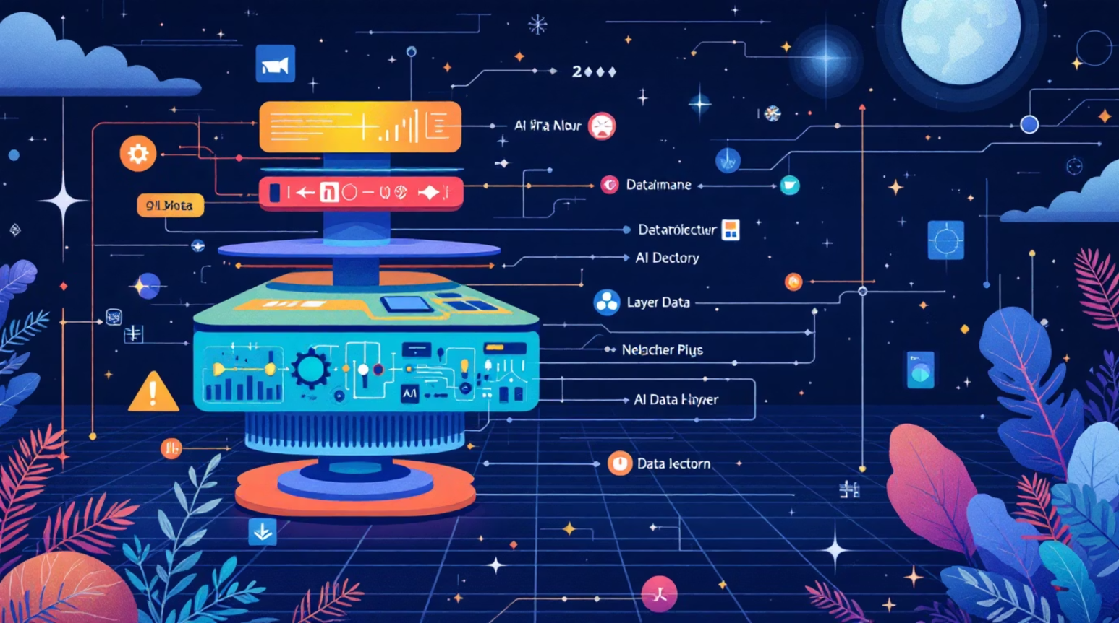
Technical Architecture
Layered Design
EmoSense implements a robust multi-layer architecture ensuring safety, accuracy, and responsiveness:
Frontend: Streamlit production-ready UI
SER: Fine-tuned Wav2Vec2 on RAVDESS dataset
NLP: RoBERTa sentiment + rule-based intent
Fusion: Contradiction-aware signal combiner
Conversation: Qwen2.5 via Hugging Face API
Output: Recommendations + report export
Notes:
6

Slide 7




What Makes EmoSense Different
It Listens to Voice Affect
Not just another chatbot reading text—it detects emotional tone through speech analysis, capturing what words alone cannot express.
It Interprets Intent and Contradictions
Going beyond simple sentiment, EmoSense understands user purpose and flags when voice emotion contradicts text content for deeper insight.
It Provides Practical Tools
Category-based support resources deliver actionable self-regulation strategies rather than generic conversational responses.
It Includes Safety Logic
Deterministic crisis detection runs before any LLM call, ensuring immediate helpline-first guidance for high-risk situations.
Notes:
7

Slide 8
Safety and Responsible Design
Crisis Keyword Detection
Runs before any LLM call to catch high-risk language immediately
Non-Generative Emergency Response
Immediate fixed response with helpline numbers, no AI generation during crisis
Local Resource Matching
Geographic-aware helpline connections tailored to user location
Secrets Management
Environment variables and secrets files prevent key exposure in production
Minimal Backend Exposure
Production UI hides internal implementation details from end users
Notes:
8

Slide 9
Market Opportunity and User Value
Who Benefits
Market Entry Points
EmoSense delivers meaningful value to users who need emotional support:
Digital mental wellbeing tools are growing rapidly across consumer, education, and workplace sectors:
Feels emotionally aligned, not like another generic chatbot
Reduces friction to start self-regulation actions quickly
Helps users who cannot easily articulate emotions in words
Encourages help-seeking through visible support pathways
B2C: Wellbeing companion app for everyday mental health
B2B: Wellness integration for HR and edtech platforms
API/SDK: Health-tech product integrations and white-label solutions
Notes:
9

Slide 10
Roadmap and Next Steps
Short Term
Long Term
Multilingual support expansion
Personalized recommendation ranking
Improved contradiction calibration
Mobile app development
Real-time edge inference
Lightweight on-device models
1
2
3
Mid Term
Longitudinal trends analysis
Weekly emotional summaries
Clinician handoff pathways
What We Need Now
Pilot Partners
Clinical Mentorship
Funding Support
Real-world validation with mental health organizations, universities, or workplace wellness programs
Expert guidance on clinical safety design, crisis protocols, and therapeutic best practices
Product hardening, deployment infrastructure, and scaling to production-ready standards
EmoSense turns emotional signals into timely, practical, and safer support—helping people feel heard when they need it most.
Notes:
10

