Slide 1

Earning analysis of San Francisco
Presentator,
Milan Prajapati
Master of Professional Studies in Analytics
ALY 6010 Capstone Report

Slide 2
DataSet Overview
The dataset is taken from the open-source government websites of San Francisco to make the analysis more reliable and it’s contains important information about the job market of San Francisco in between year 2011 to 2014.
The Data set contain 13 columns and 1,48,654 rows and each column has a different data type and structure .
The dataset contains information such as Id, Employee Name, Job Title, Base Pay, Overtime Pay, Other Pay, Benefits, Total Pay, Benefits, Year, Notes, Agency, and Status.
Data set also contain many null and empty value, to eliminate that ,data cleaning and modeling is also required in the chosen dataset .

Slide 3
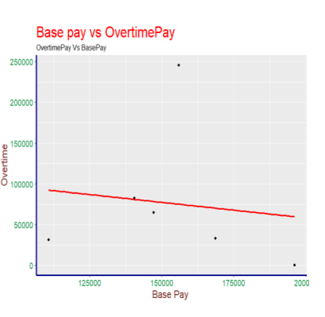
Average earning of people working in the city of San Francisco
one sided t-test and hypothesis test performed to find the average salary.
Here the regression line shows negative linear relation and which contradicts our.
hypothesize test the reason behind this is that the overtime pay is dependent upon the base pay but the employees with high salaries do less overtime work.
Here the regression line shows negative linear relation and which contradicts our hypothesize test the reason behind this is that the overtime pay is dependent upon the base pay but the employees with high salaries do less overtime work.

Slide 4
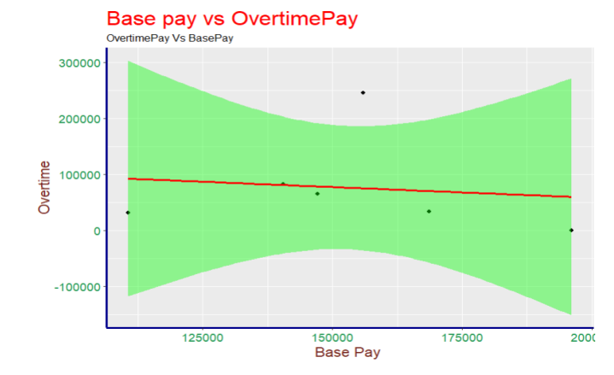
Result of our hypothesis t provides that the average base salary of people working in san Francisco is in range of 66107.61$ to 66543.29 $
per years.
That overtime earnings are 0.26
percent positively dependent upon the base pay .

Slide 5
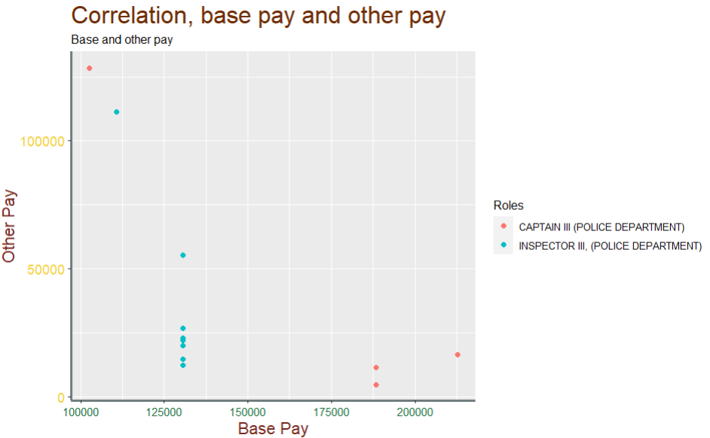
2. The average earning and fund allocation for police of department
Comparatively, other pay is more dependent on the role inside of base pay.
A police officer working as an inspector earns more from the other pay as compared to officers working as Captain.

Slide 6
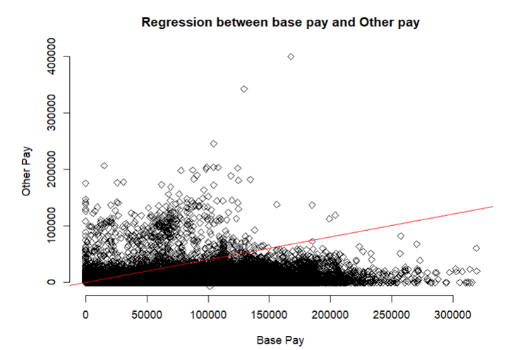
Average cost to the government for providing salary to individual police officers is around 1,03,534 $ per year while the average other costs spent on individual police officers are around 1,82.685 $ per year.
Funds provided to the individual officer are 0.28 percent positively dependent on their yearly income, which shows that police officer which has high base salary received comparatively

Slide 7
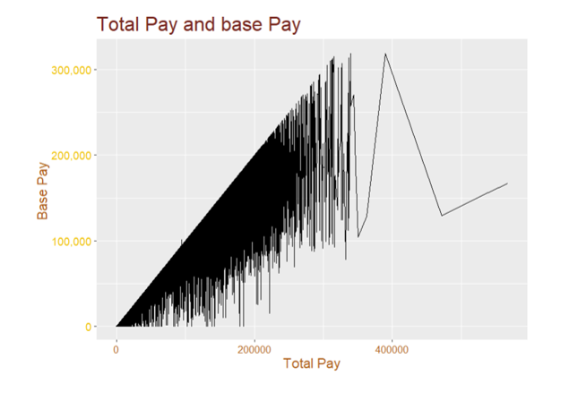
3. Relation between base pay and total pay for employees
Total pay is highly dependent on base pay for every profession as the base pay increases total pay also increases linearly.
The majority of employees have base pay and total pay between 100,00 to 200,000 $ per year, while comparatively very fewer populations have base pay and total pay above 200,000 $ a year.

Slide 8
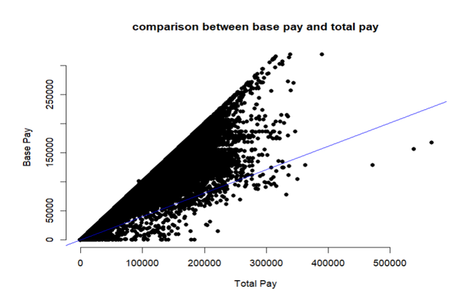
The average earnings of people in San Francisco in between 74,511 $ to 75,025 $ per years.
The total earnings of the individual are 0.95 percent dependent on their base salary.
The visualization besides shows Positive linear regression between total pay and base pay, with the increment the base pay of employee total pay is increased.

Slide 9
4. conclusion
Earning from overtime is dependent upon the base salary but people with higher base pay earn less income by doing extra work .
For the police department base salary and other income is very less dependent and the government spends more funds in providing other services to police individuals as compared to spending on their base salary .
Base pay and total pay are positively dependent for every job filed, and any change in base pay linearly impact the total pay.

Slide 10
5. References
What Is a Regression Model? (2021, June 16). IMSL by Perforce. https://www.imsl.com/blog/what-is-regression-model
Author Removed At Request Of Original Publisher. (2016, December 1). Nonlinear Relationships and Graphs without Numbers – Principles of Macroeconomics. Pressbooks. https://open.lib.umn.edu/macroeconomics/chapter/nonlinear-relationships-and-graphs-without-numbers/
taylor.curley@gatech.edu. (n.d.). T-Tests: One and Two-sample. https://rstudio-pubs-static.s3.amazonaws.com/326285_978dc80a48de439f86cb0ac56925ddf6.html

Slide 11
Thank You!
Special Thanks to
Professor Mohsen Soltanifar, PhD, AStat
For the guidance and Instruction

