Slide 1

Real-Time Traffic Analytics and Dynamic Signaling : A Next-Gen Approach to Traffic Management
Group Members:
Muhammad Talha (20P-0015)
Irsa Khan (20P-0016)
Project Supervisor
Mr. Usama Musharraf

Slide 2
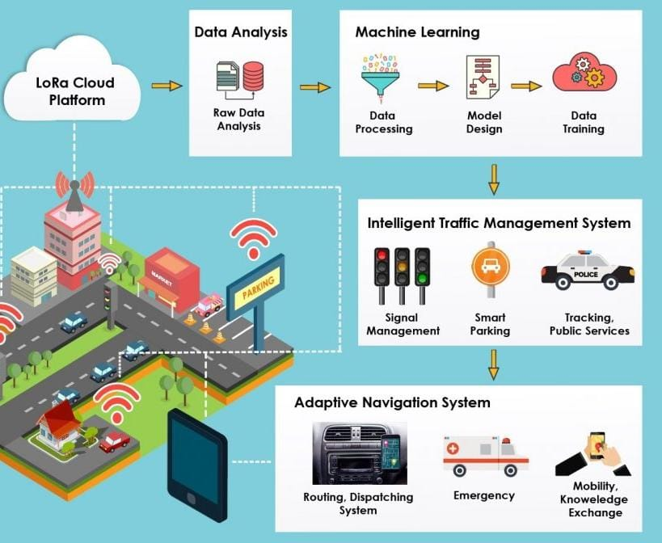
Introduction
Urban areas globally suffer from severe traffic congestion, leading to increased travel times, fuel consumption, and pollution.
Traditional traffic signals struggle with dynamic traffic patterns, leading to congestion issues.
Integrating AI into traffic signal control presents promising solutions, optimizing flow, reducing congestion, and enhancing management.
2

Slide 3
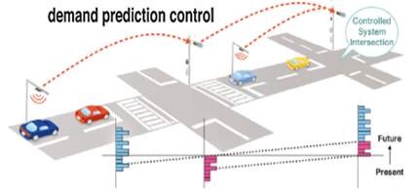
Importance of Traffic Analytics and Dynamic Signaling
Traffic analytics offer crucial insights into traffic behavior and trends, aiding in informed decision-making.
By analyzing data on traffic volume, congestion hotspots, and peak hours, analytics enable proactive traffic management strategies.
3

Slide 4
Motivation
Traditional traffic management systems often struggle to keep pace with dynamically changing traffic patterns, leading to inefficiencies, longer travel times, increased fuel consumption, and heightened environmental pollution.
The motivation behind this topic lies in the potential of analytics-driven insights and real-time adjustments to revolutionize traffic management strategies
By harnessing the power of data analytics, cities can gain a deeper understanding of traffic behavior, identify bottlenecks, and implement targeted interventions to mitigate congestion and enhance urban mobility.
4

Slide 5

Problem Statement
Traditional traffic signal systems struggle to adapt to changing traffic conditions, leading to congestion, delays and inefficiencies in traffic flow.
5

Slide 6
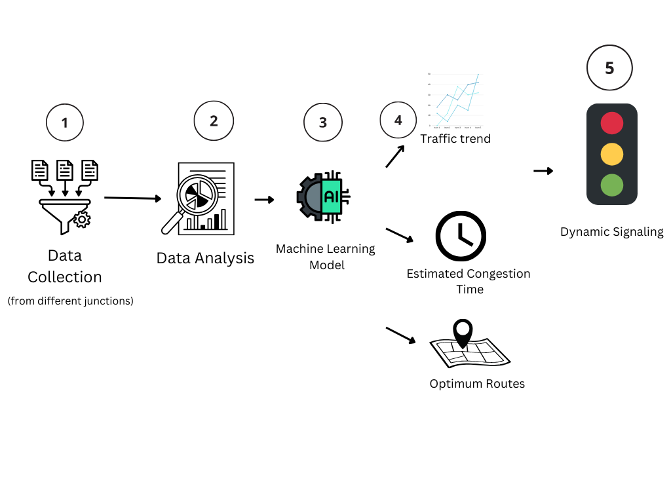
Solution
Utilize real-time traffic data analyze traffic patterns, derive actionable insights, dynamically adjust signal timings and predict future conditions to optimize traffic flow
6

Slide 7

Scope of the project
Utilize analytics to monitor and analyze traffic patterns for effective congestion control.
Implement dynamic signaling system to adapt signal timings based on traffic trends.
Develop algorithms to optimize signal timings and prioritize congestion alleviation strategies.
7

Slide 8
Goals
Designing an AI-based model that can analyze and interpret traffic data to make informed decisions regarding signal timing.
Evaluating the effectiveness of the dynamic traffic signal control.
Comparing the performance of the proposed AI-based system with traditional fixed-time signal control approaches.
Improve overall transportation system performance by effectively managing congestion and optimizing signal timings.
8

Slide 9
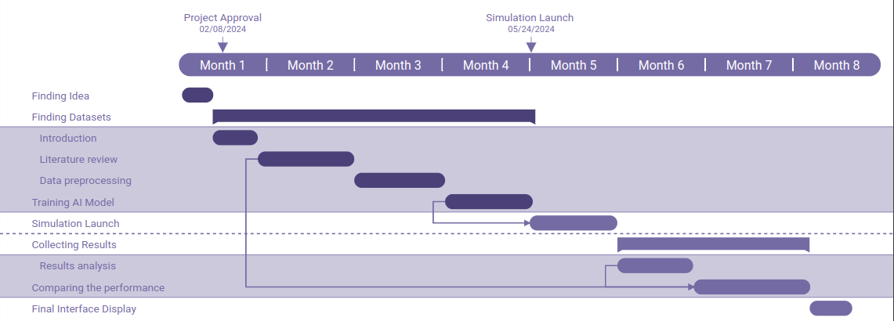
Timeline
9

Slide 10
Expected Results
A traffic system with:
Minimized wait times at intersections through congestion control.
Predictive analytics.
Increased throughput of vehicles at intersections.
10

Slide 11
Team Work
Muhammad Talha Irsa Khan
Responsible for building the backend infrastructure of the system.
Develops and trains Machine Learning models.
Shares insights from data analysis with Member 2 for UI design optimization.
Designs and implements the user interface.
Sources and preprocesses the datasets for training Machine Learning models.
Collaborates with Member 1 to ensure seamless integration of the backend with the UI.
Conduct joint code reviews and pair programming sessions to ensure code quality and Performance testing
11

Slide 12
Thank You
12

